Slide 1

SMART COOLER INSTALLATION
iOS Installation Guide
September 2025
© 2025 Vision Group

Slide 2

APPLICATION FEATURES
Association – Associate the Smart Device and remove any existing association with the Cooler.
Device Scanning and Configuration – Check the device advertisement and configure settings as needed.
DFU (Direct Firmware Update) – Perform a direct firmware update for Smart Devices.
Data Download and Upload – Download data from and upload data to the Smart Devices.
Debug Logs – Enable application logging, collect data, and send the logs.
Fix Faulty Devices – Repair any faulty devices.
Test and Verify – Verify the functionality of the device after repairs.
© 2025 Vision Group

Slide 3
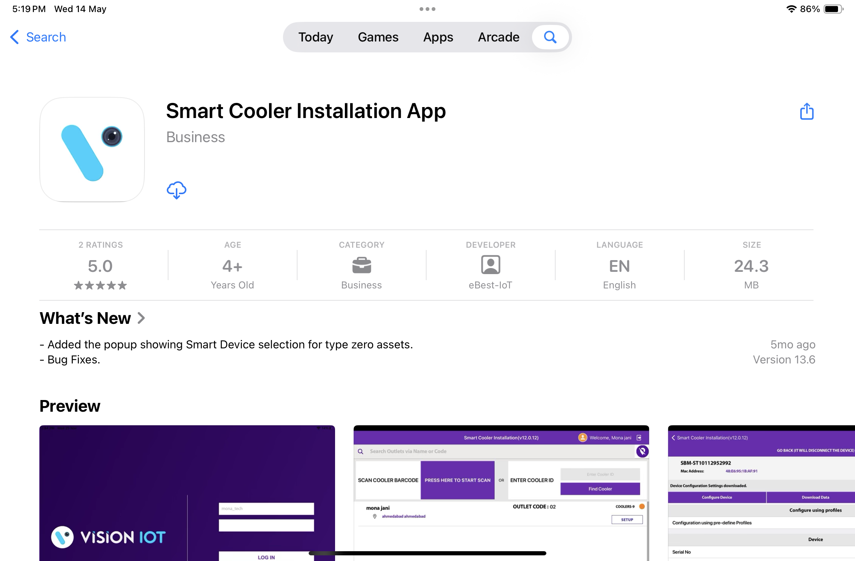
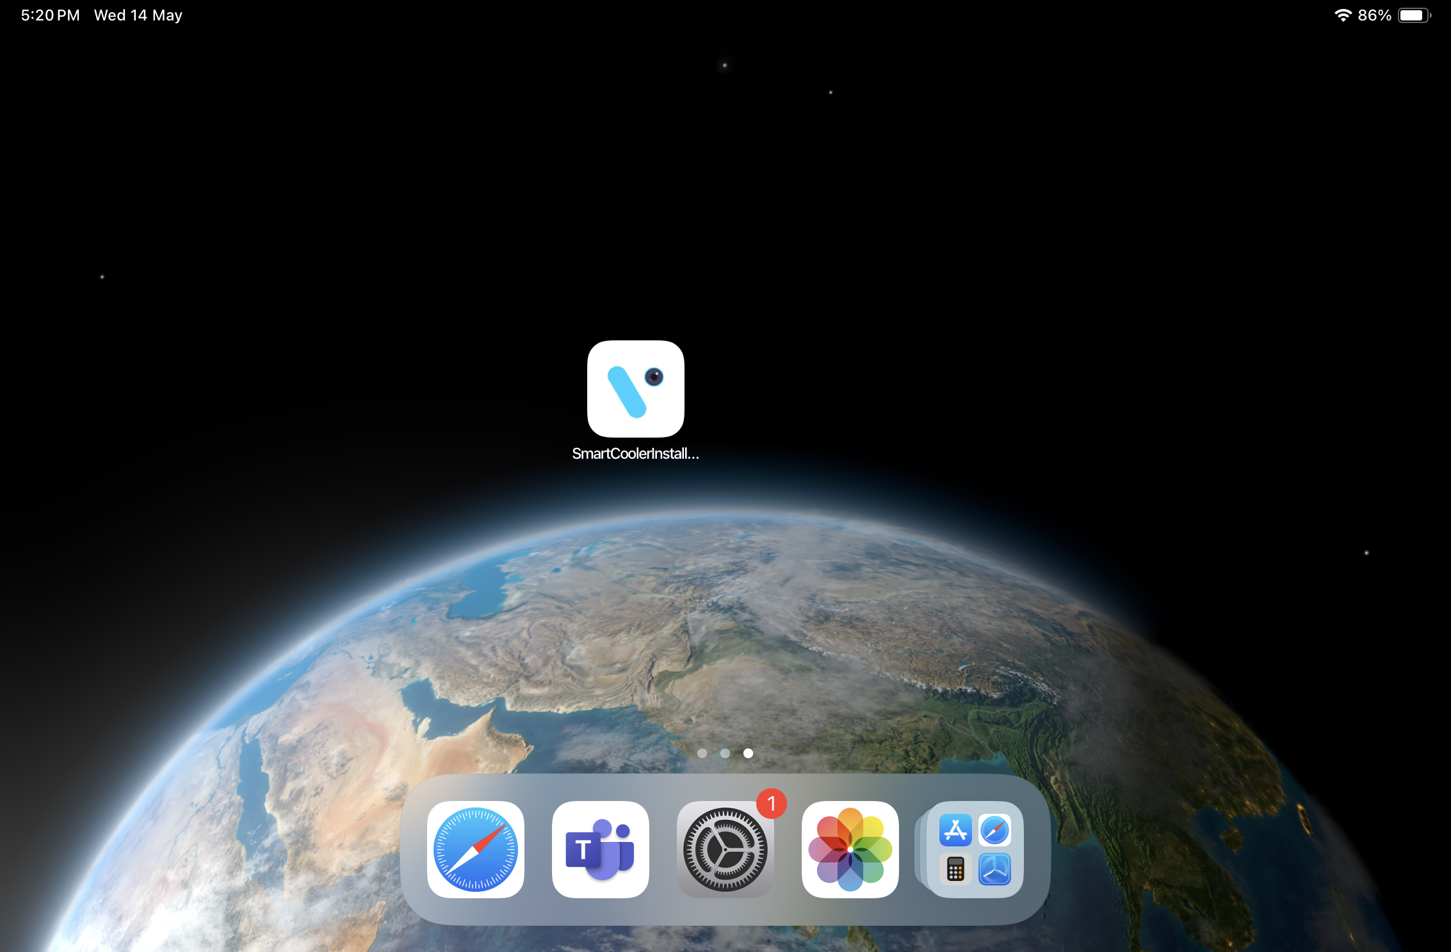
APPLICATION INSTALLATION
Please follow these instructions: Open the App Store on an iOS device. Search for the “SMART COOLER INSTALLATION” application and install it.
Removing the previous version of the application before installing the new one is preferable.
© 2025 Vision Group

Slide 4
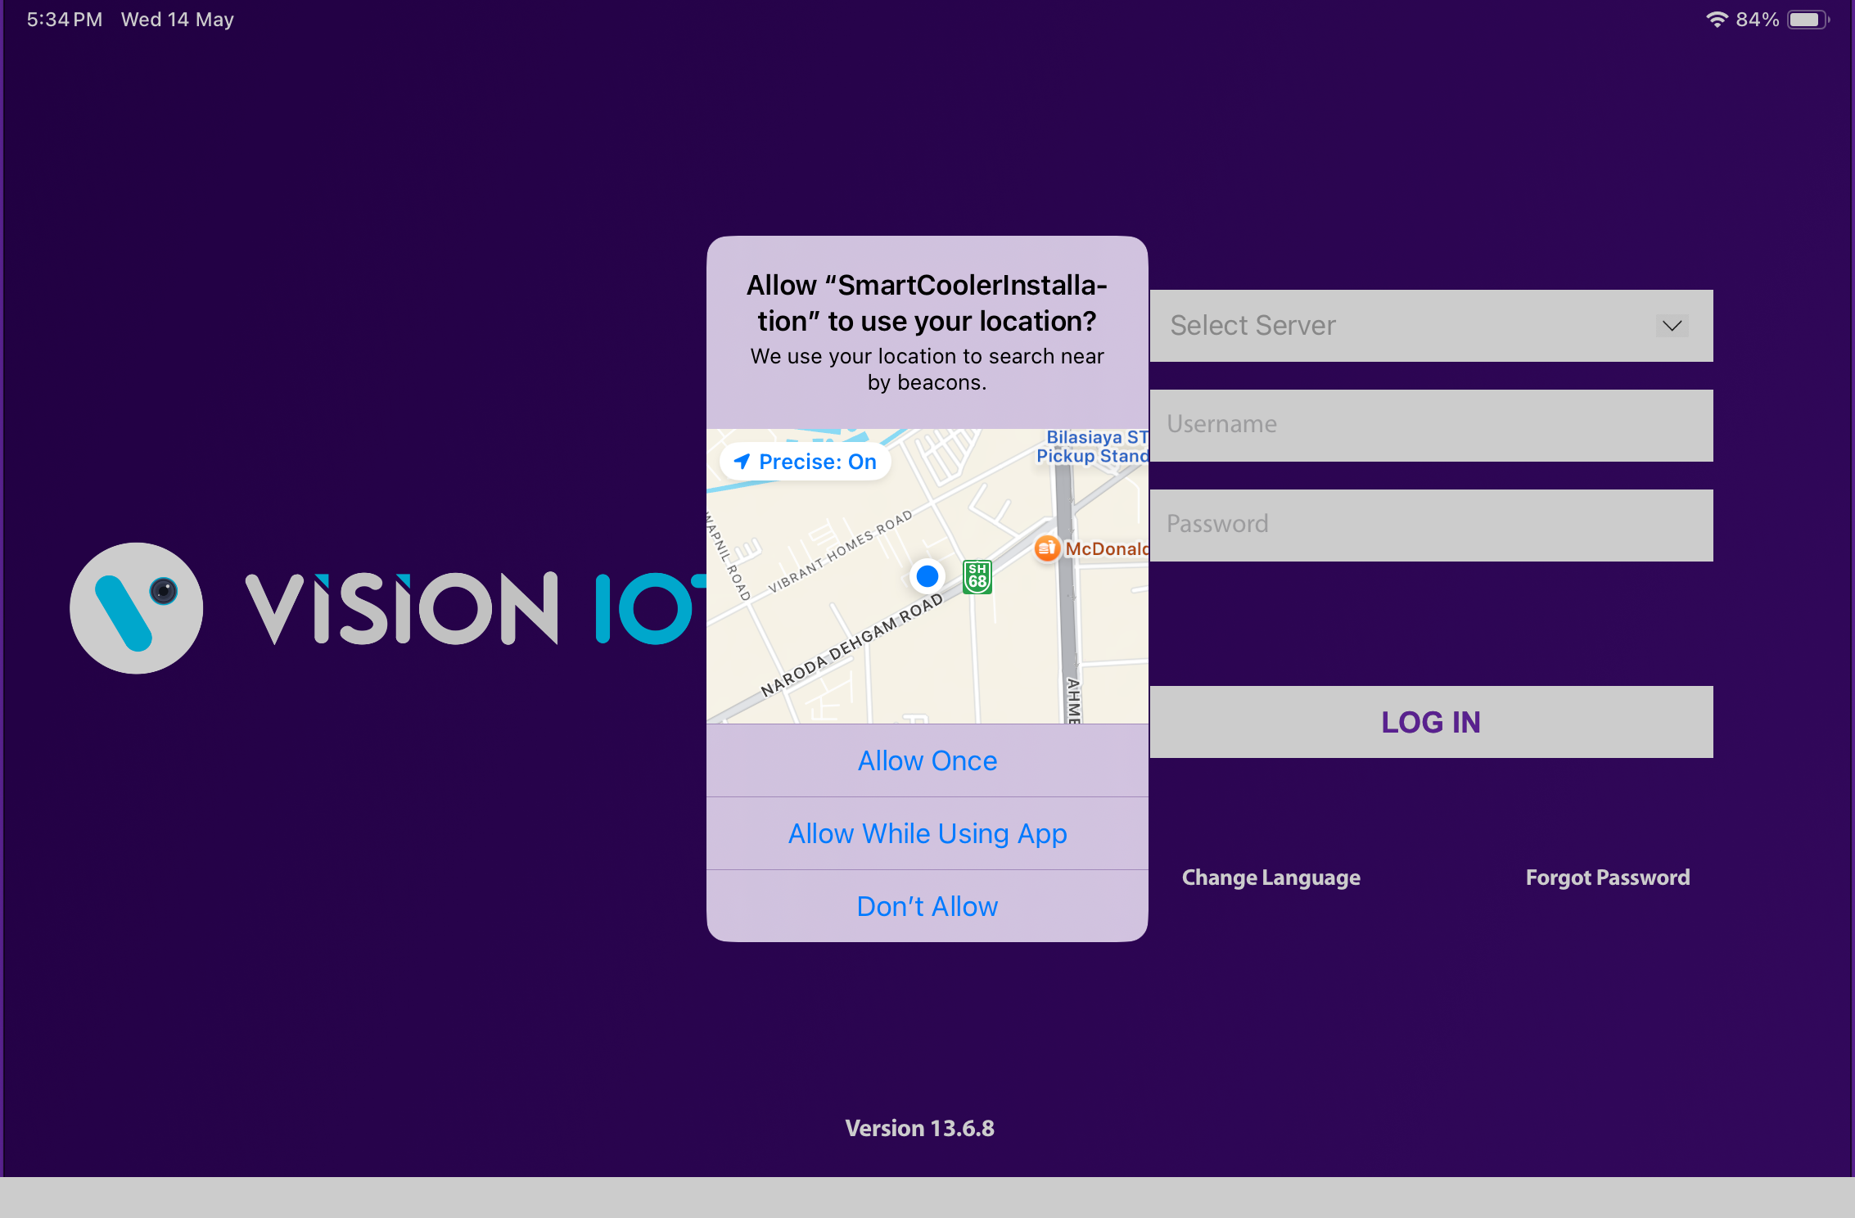
APPLICATION PERMISSION
After initial installation and launch, the application will request permissions to access the camera, files and media, location, and nearby devices. These permissions need to be allowed.
Choose Server: The server designated for ATOS Codex should be used for CCH. A different server must be selected to serve other customers and for QA purposes.
LOCATION PERMISSION
For Location (so beacons can be found) - Choose Allow While Using for iOS OS 15 and Above.
© 2025 Vision Group

Slide 5
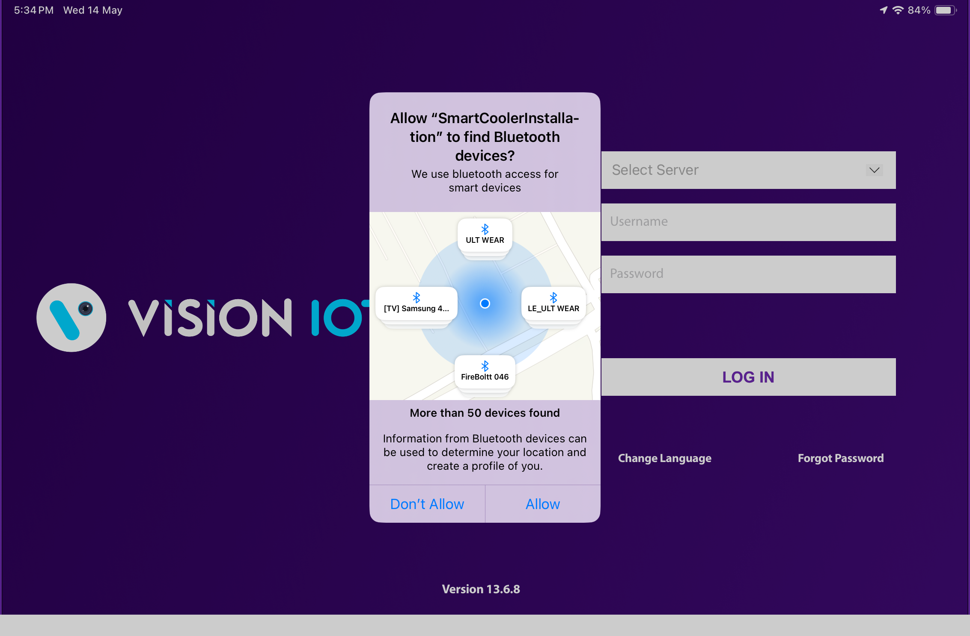
BLUETOOTH PERMISSION
Access the Bluetooth (to scan barcodes) – the first prompt on the Outlet screen -> Choose “Allow”.
© 2025 Vision Group

Slide 6
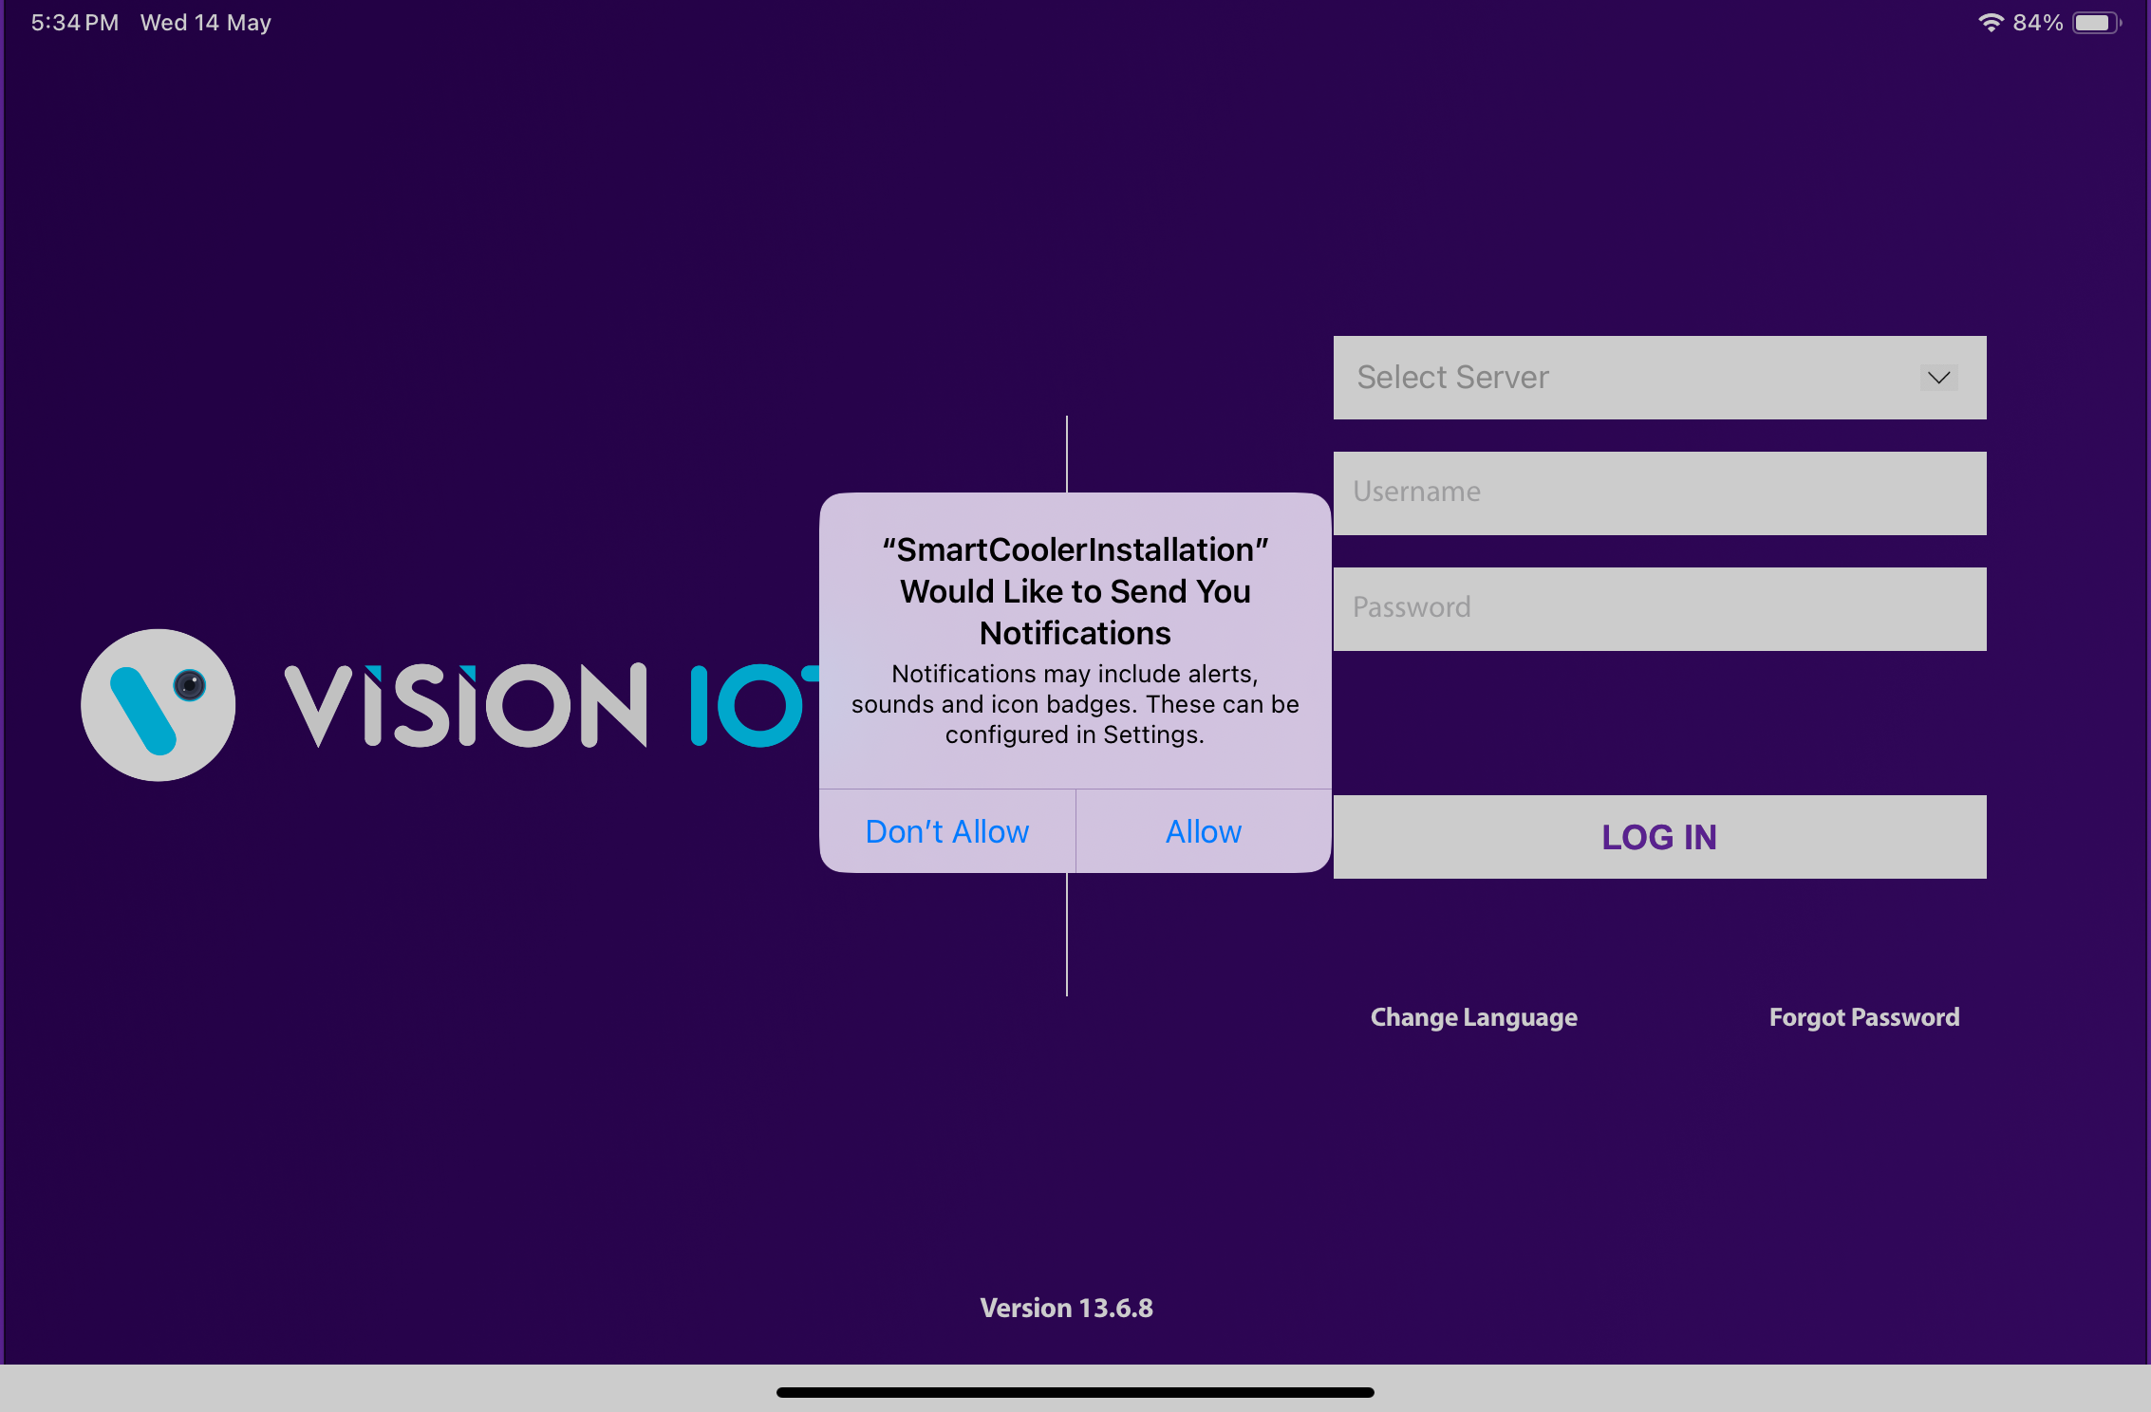
NOTIFICATION PERMISSION
Send notifications (to inform of data download) -> Choose “Allow”
© 2025 Vision Group

Slide 7
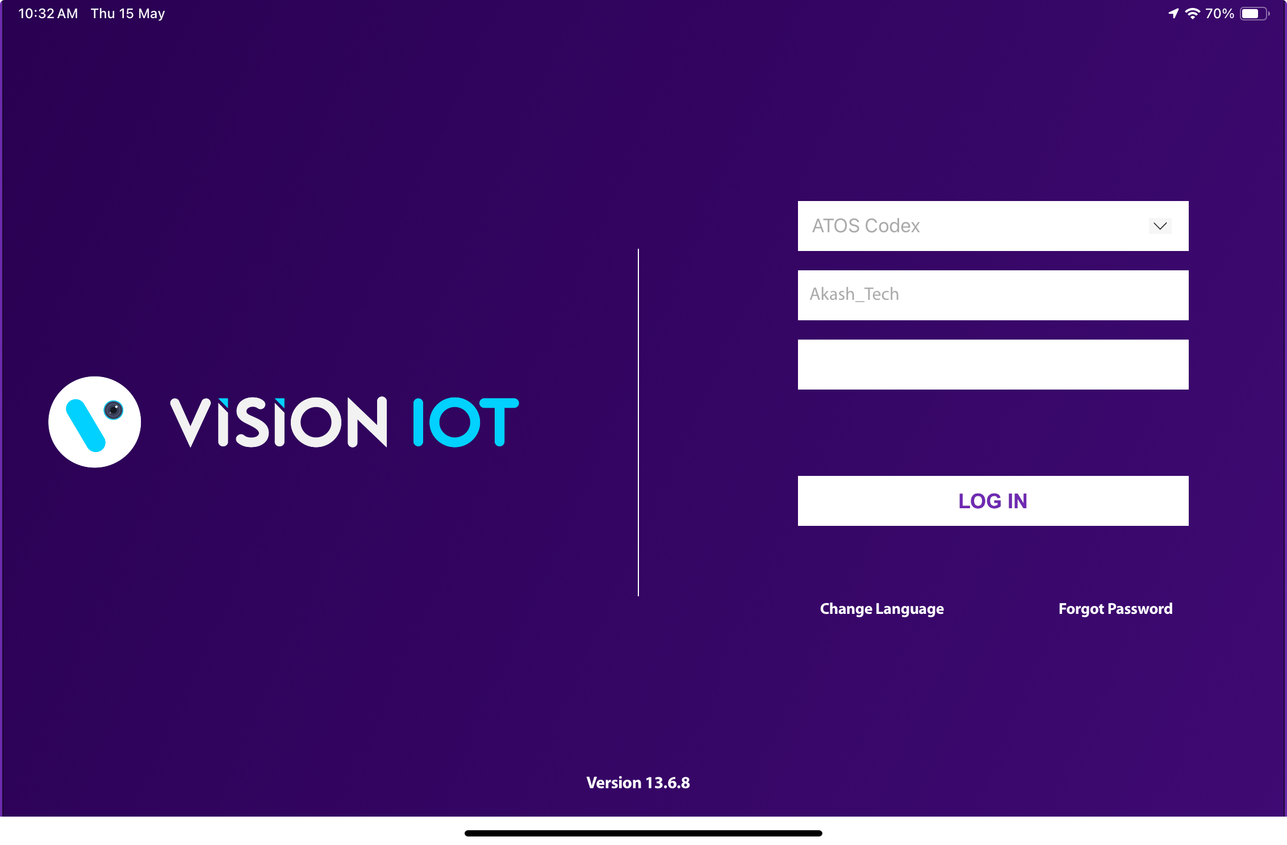
LOGIN
After successfully installing the Smart Cooler Installation Application, open it, and it will redirect you to the Login Page. Select the server from the server list and Login in to the application using the credentials provided by your administrator after successful login.
Remember to ensure Bluetooth & Mobile Wi-Fi or Mobile Data are ON in the device.
Bluetooth and location services should also be enabled.
The application requires an internet connection for initial login. After the initial login, the application can operate in Offline mode, provided that the same username & password used for the online login are used.
All versions after and including 1.7 do not download device data by default. If you wish to enable this option, you should toggle the switch at the VH screen, which is titled “Only Remote Command”
Minimum device requirements – iPad 8th Gen and Above Models.
The Minimum iOS version is 15 and Above.
© 2025 Vision Group

Slide 8
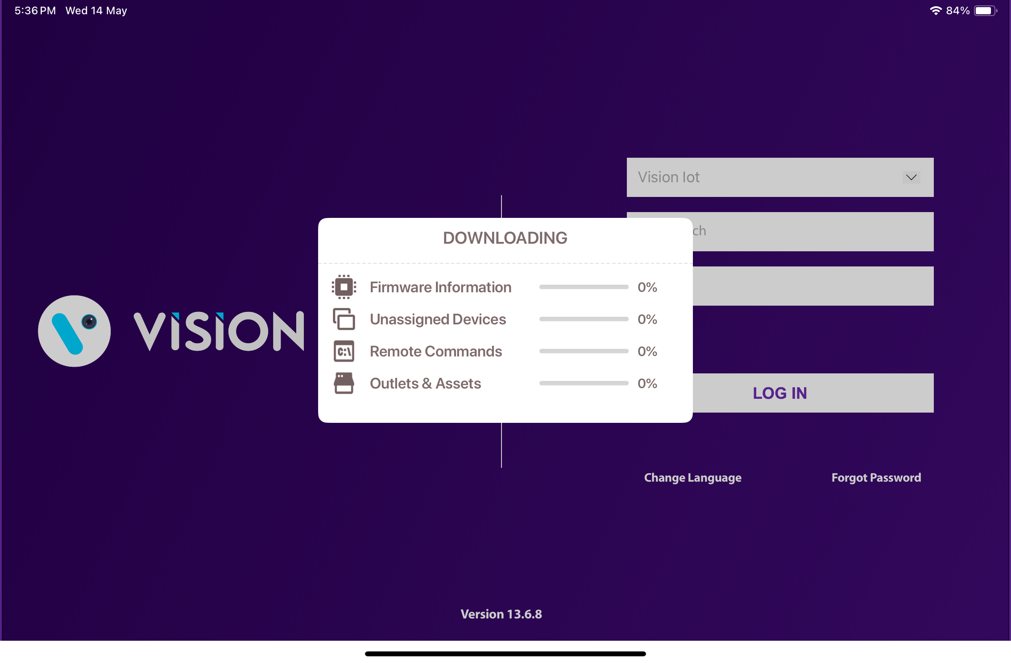

Provide valid credentials and tap on the Login button. Please be advised that the application will need some time to download data from the cloud.
Note – Internet connectivity is required for login; otherwise, the login will fail, and the application will display network errors.
© 2025 Vision Group

Slide 9
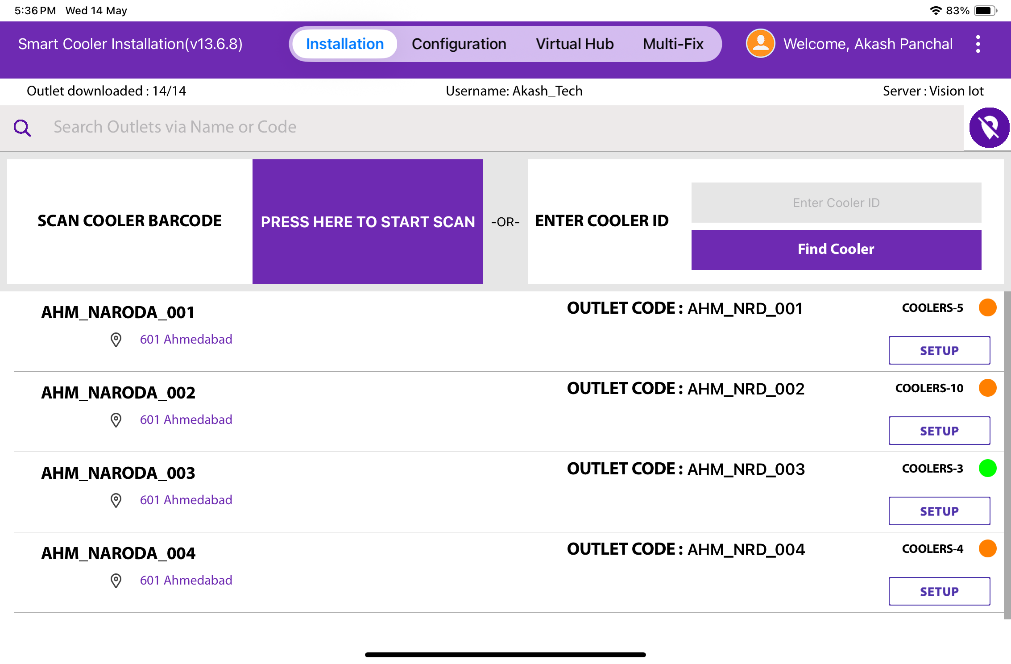
APPLICATION FUNCTIONS
1
2
3
4
1. Association Screen - Use for the Association and Remove Association.
2. Configuration Screen - Use to check the Device Advertisement and configure it.
3. VH Screen - Use for the Data Download and Upload to the Server.
4. Multi-Fix Screen - To Fix the Faulty Devices.
5. Test and Verify – Verify the functionality of the device after repairs.
6. Debug Logs – Enable application logging, collect data, and send the logs.
© 2025 Vision Group

Slide 10
ASSOCIATION SCREEN
Click on the Association Icon to move to the Association Screen.
Total # of outlets in BD territory and how many have been loaded. Outlets are loaded at startup.
Tap on this icon to show all outlets, not only the nearest ones
If a cooler can’t be found via the barcode scanner, then enter the Technical ID or Serial Number here to find it.
Use this box to search for the Outlet Code or Outlet Name quickly. If an Outlet is found the result of the Outlet will be shown.
Coolers – 10
Shows the number of coolers in the outlet.
Red – No cooler in the Outlet is associated with Smart Device
Orange – some coolers in the outlet have been associated with smart devices, but not all
Green – all coolers in this outlet have been associated with smart devices
Tap to start the camera and scan the Cooler Barcode. If a cooler is found, the association menu for this cooler will be shown.
A list of outlets will be shown on successful login.
Only Assigned User outlets will be shown, for each one, the Outlet name, address & code will be displayed.
Tap on Setup to enter the Outlet and view assigned and unassigned Coolers.
© 2025 Vision Group

Slide 11
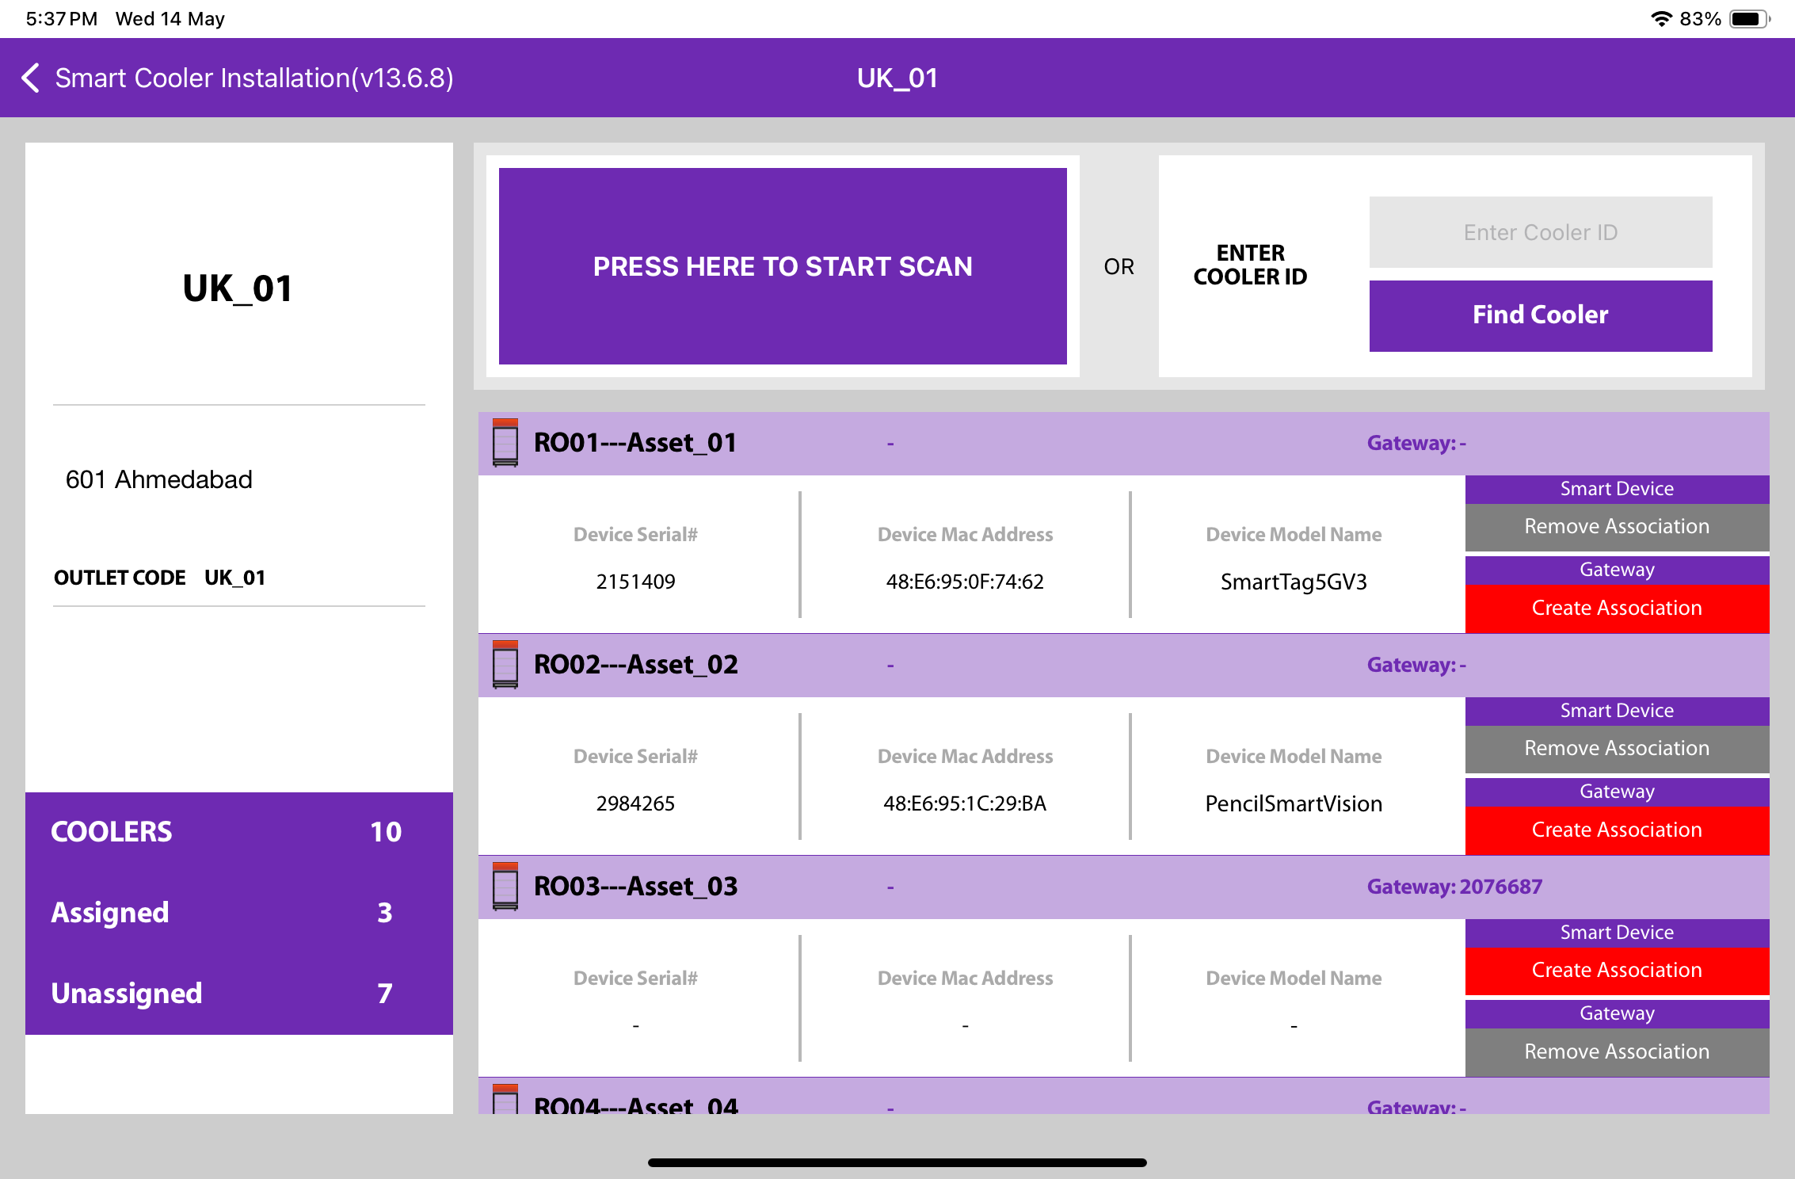
Serial Number, Equipment Number, & Cooler Model
Outlet
Name
Address
Outlet Code
If a Smart Device is already associated with this cooler, the information will be shown in this box.
Tap to start Smart Device association or scan the barcode of the Cooler via the scanner.
If a smart device is already associated with this cooler, the button will grey with the label Remove Association
© 2025 Vision Group

Slide 12
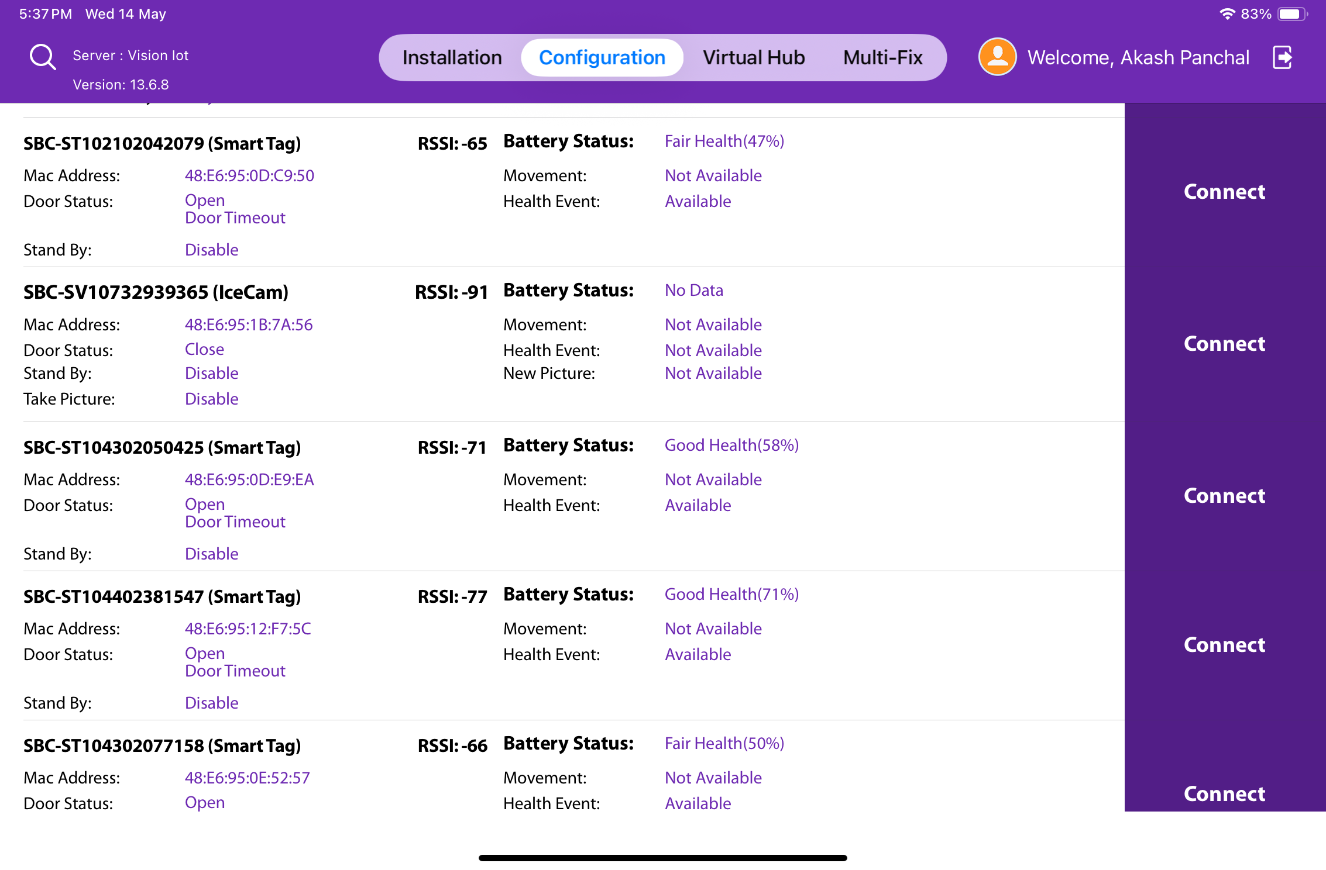
CONFIGURATION SCREEN
Click on the Configuration Icon to move to the Configuration Screen.
Smart Device # – Smart Device Serial Number
Smart Device Type – Type of Smart Device
Outlet Name – Name of the Outlet of the Smart Device
Cooler ID – Name of Cooler SN of Smart Device
MAC Address – Smart Device’s MAC Address
Door Status – The Flag of Door Status is Open /Closed
Standby – Flag Showing if Device is in Standby Mode
UUID Frame – Smart Devices iBeacon UUID Namespace and Instance Value(Showing if Enabled)
Battery Status – Smart Device Battery Status
RSSI – Range of Smart Devices in dB
Health Event – Health available/Not available for Smart devices
Movement Status – Movement available/Not available for Smart devices
Standby – Stand by Mode Enable/ Disable of Device

Slide 13
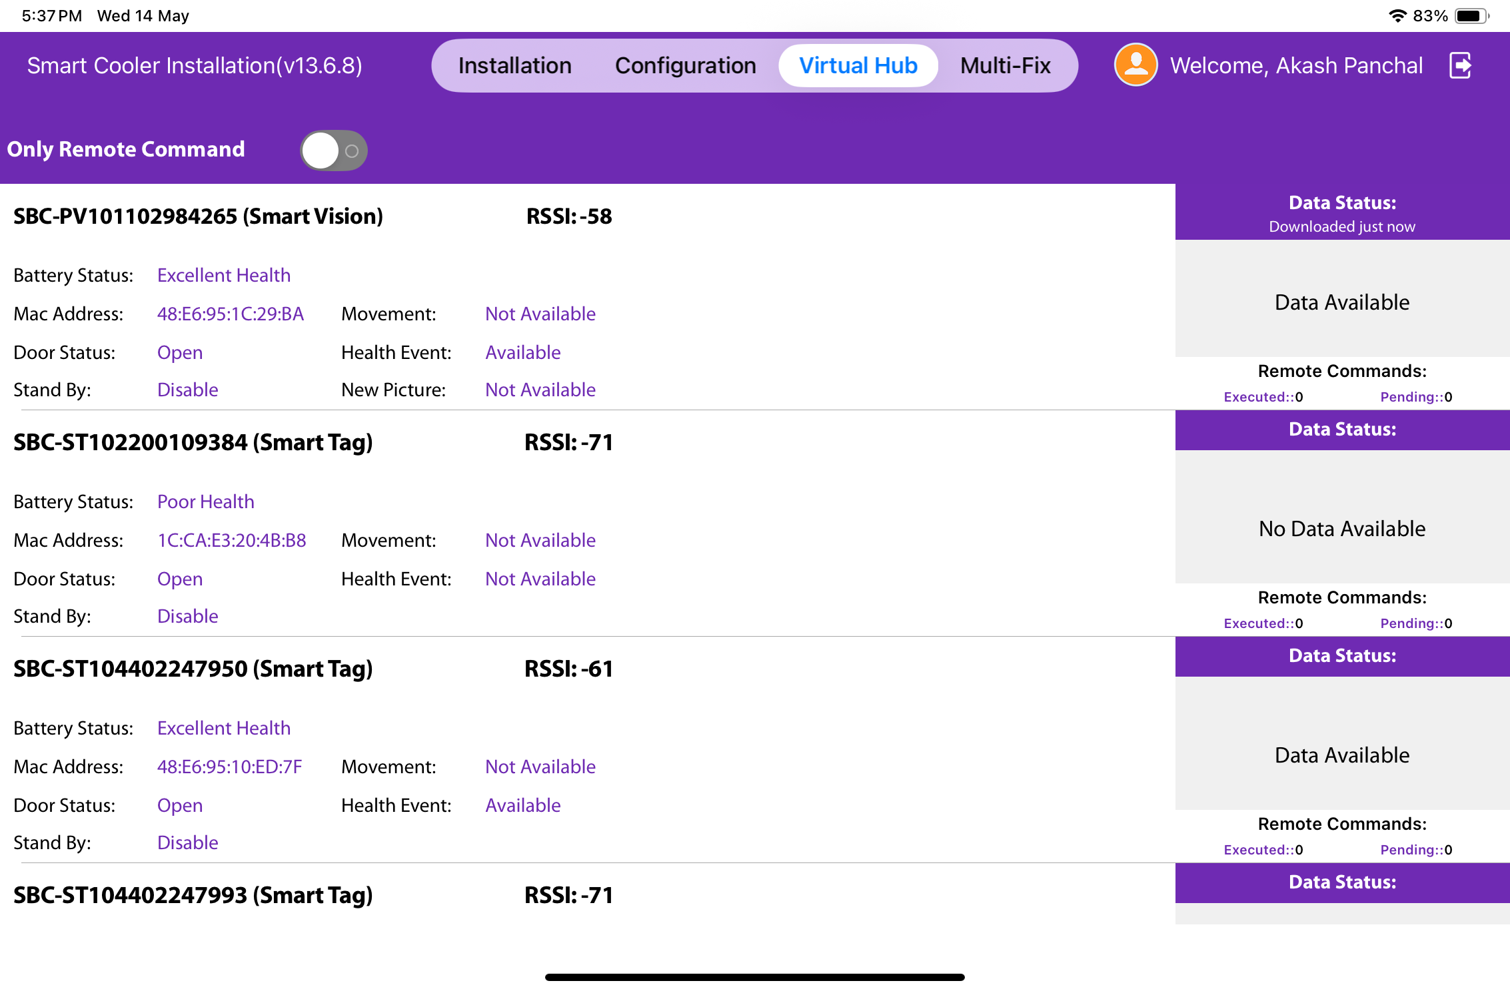
VH SCREEN
Click on the VH icon to navigate to the VH screen.
This section displays the nearest whitelisted devices from which the application can download smart device data and upload it to the server.
For each type of smart device, information such as sensor data flags, MAC address, and smart device serial number is provided.
The operational status of each smart device is managed by the application, with indicators for connection status, data download, and data upload.

Slide 14
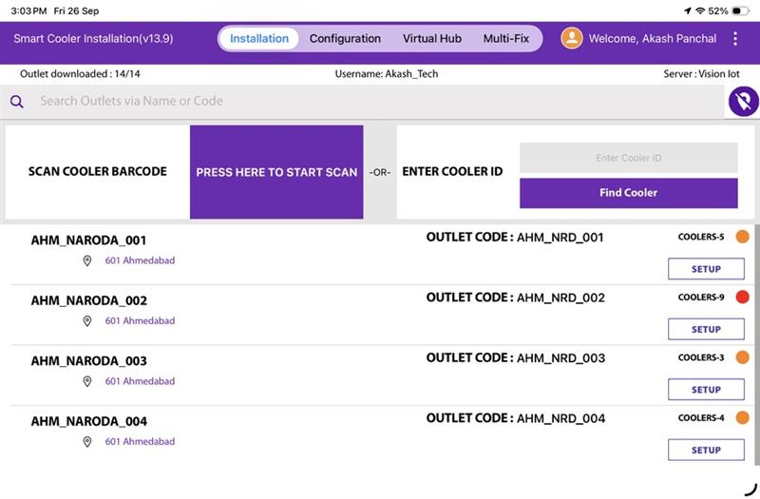
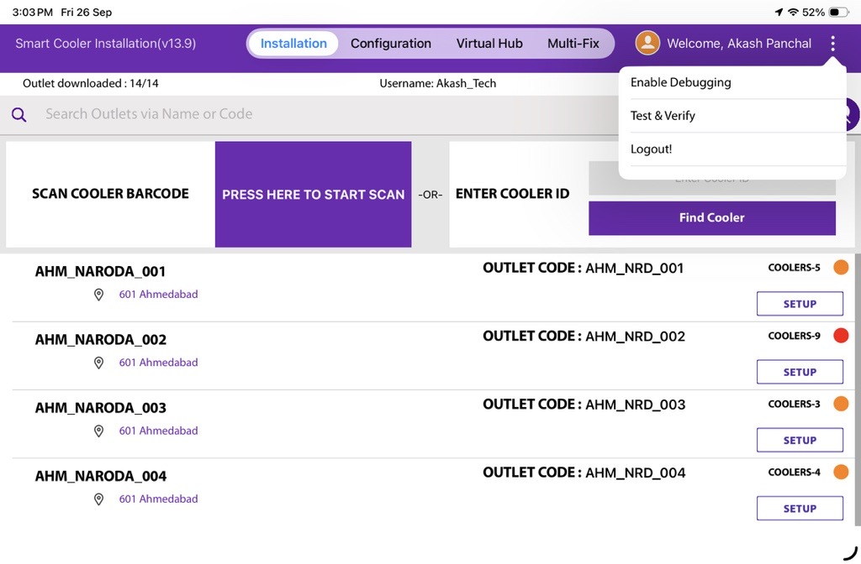
DEBUG LOGGING
A new “Enable Debugging” option in the app to help capture user activity for troubleshooting. Users can enable debugging from the 3-dots menu. A clear prompt informs users that all actions will be recorded until debugging is disabled.

Slide 15

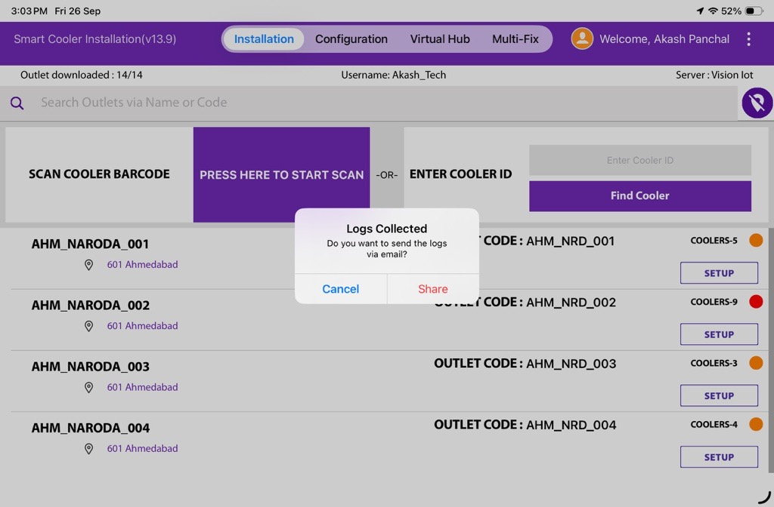
Logs are securely stored in a “.txt” file. When debugging is turned off, the app automatically prepares an email with the log file and sends it to our IoT Support Team.

Slide 16
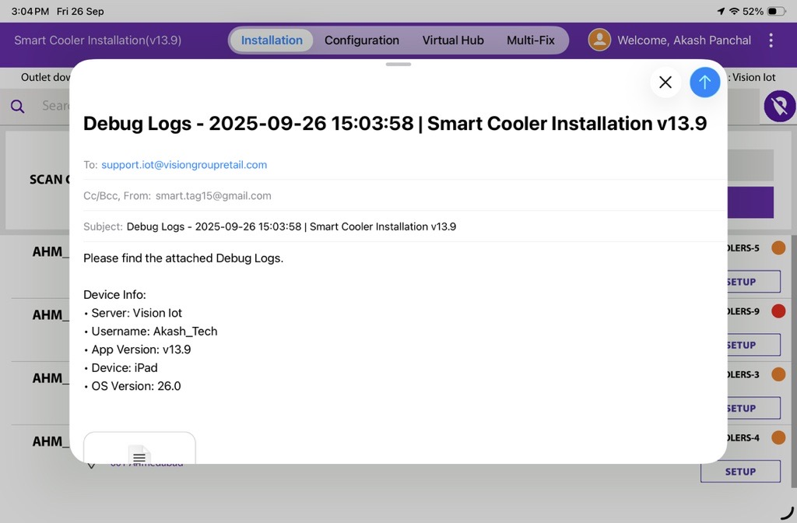
If users forget to disable debugging, logging will stop after 30 minutes, and a reminder pop-up will be shown. If the app is force-closed, the reminder pop-up will reappear when the app is launched again.

Slide 17
ASSOCIATION PROCESS
Selecting Asset – Using Barcode Scanning:
Click on the Barcode icon, Barcode scanning window will open.
Scan the cooler barcode using the barcode scanner – Position the camera of the mobile device in such a way that the barcode of the Cooler (Technical ID) is in the box.
Outlet will automatically be selected, and a menu will be shown for choosing the device that will be installed.
B. Alternative – Selecting Outlet by entering Outlet Code or Name:
If Scanning of the Cooler serial is not possible, enter either the Outlet Name or Outlet Code and Tap on “Find”.
C. Alternative – Selecting Outlet – Manual selection of the cooler
If Scanning of the Cooler serial is not possible and the outlet code/name is not known, the User can manually select the outlet.
B
A
C
The application will allow one smart device and one smart gateway device to associate with an asset.
© 2025 Vision Group

Slide 18
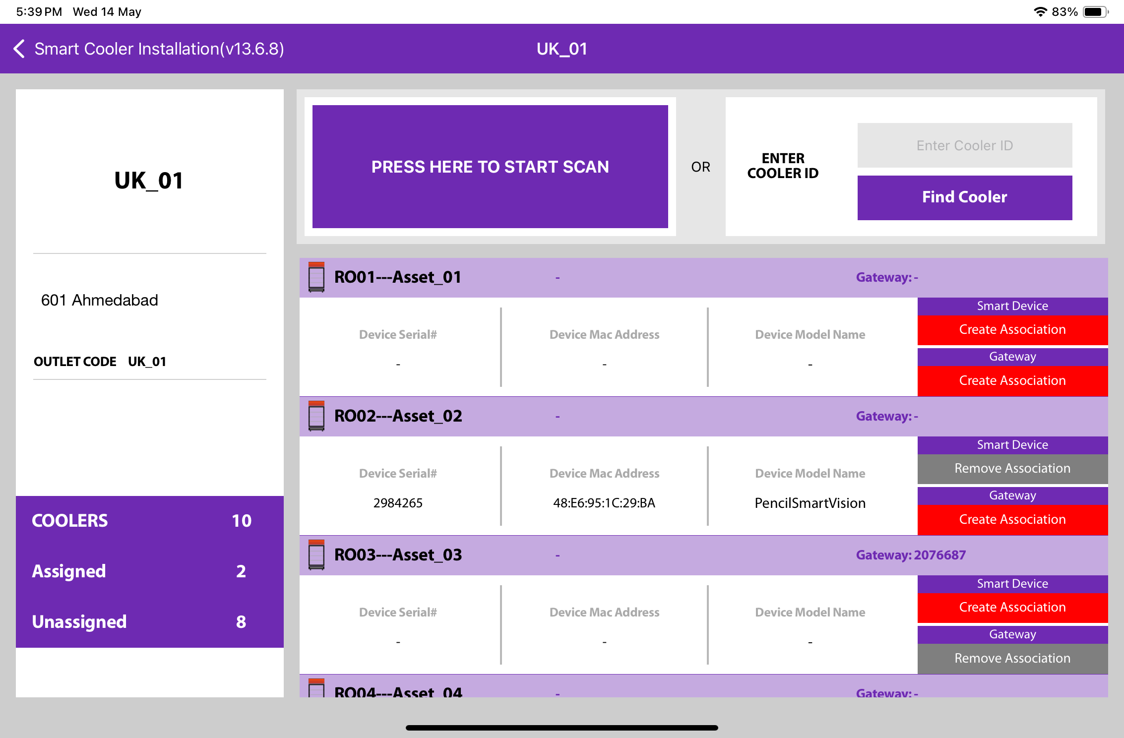
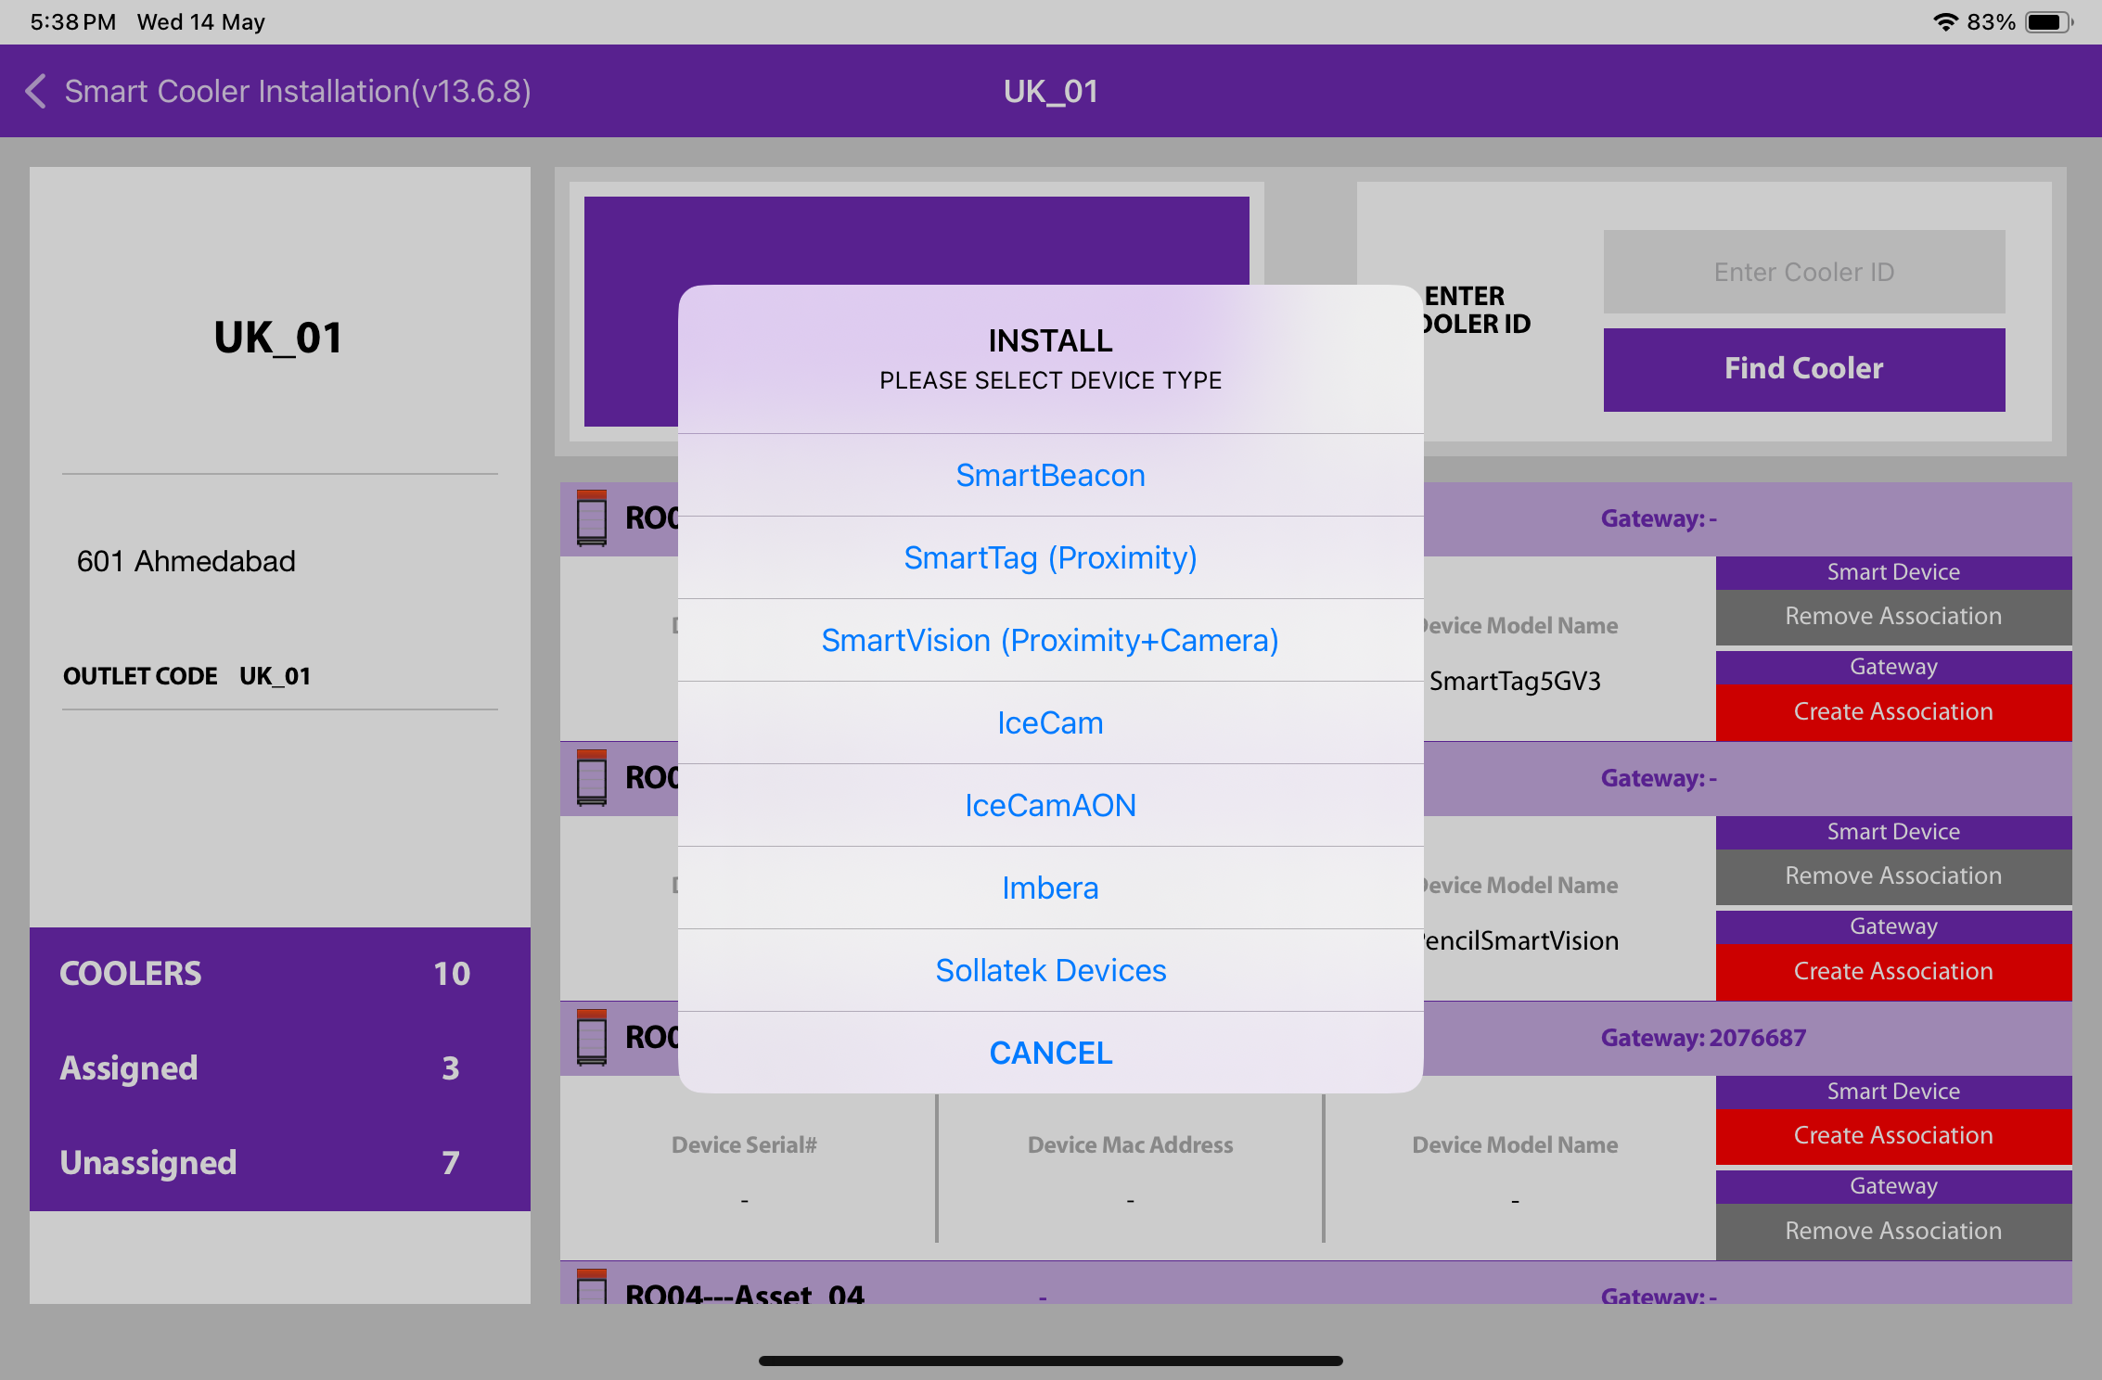
ASSOCIATION – SMART TAG (SMART DEVICE)
1. Selecting a Cooler - A new window will open, allowing the user to select the cooler for the chosen outlet manually. Click on “Association” to choose the asset for installation.
2. Selecting Smart Device type - A new window will open, prompting the user to select the types of devices to associate. Click on “SMART TAG” to link the SmartTag device..
The user will see a list of unassociated devices, and they can use the door status to identify the installed device.
© 2025 Vision Group

Slide 19
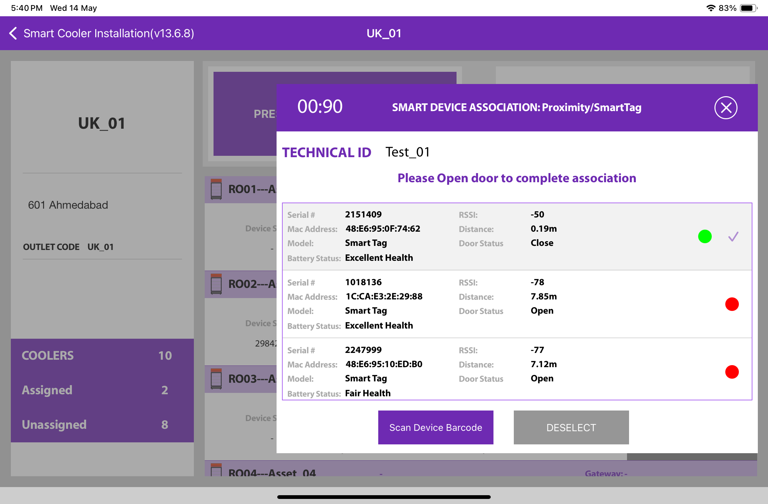
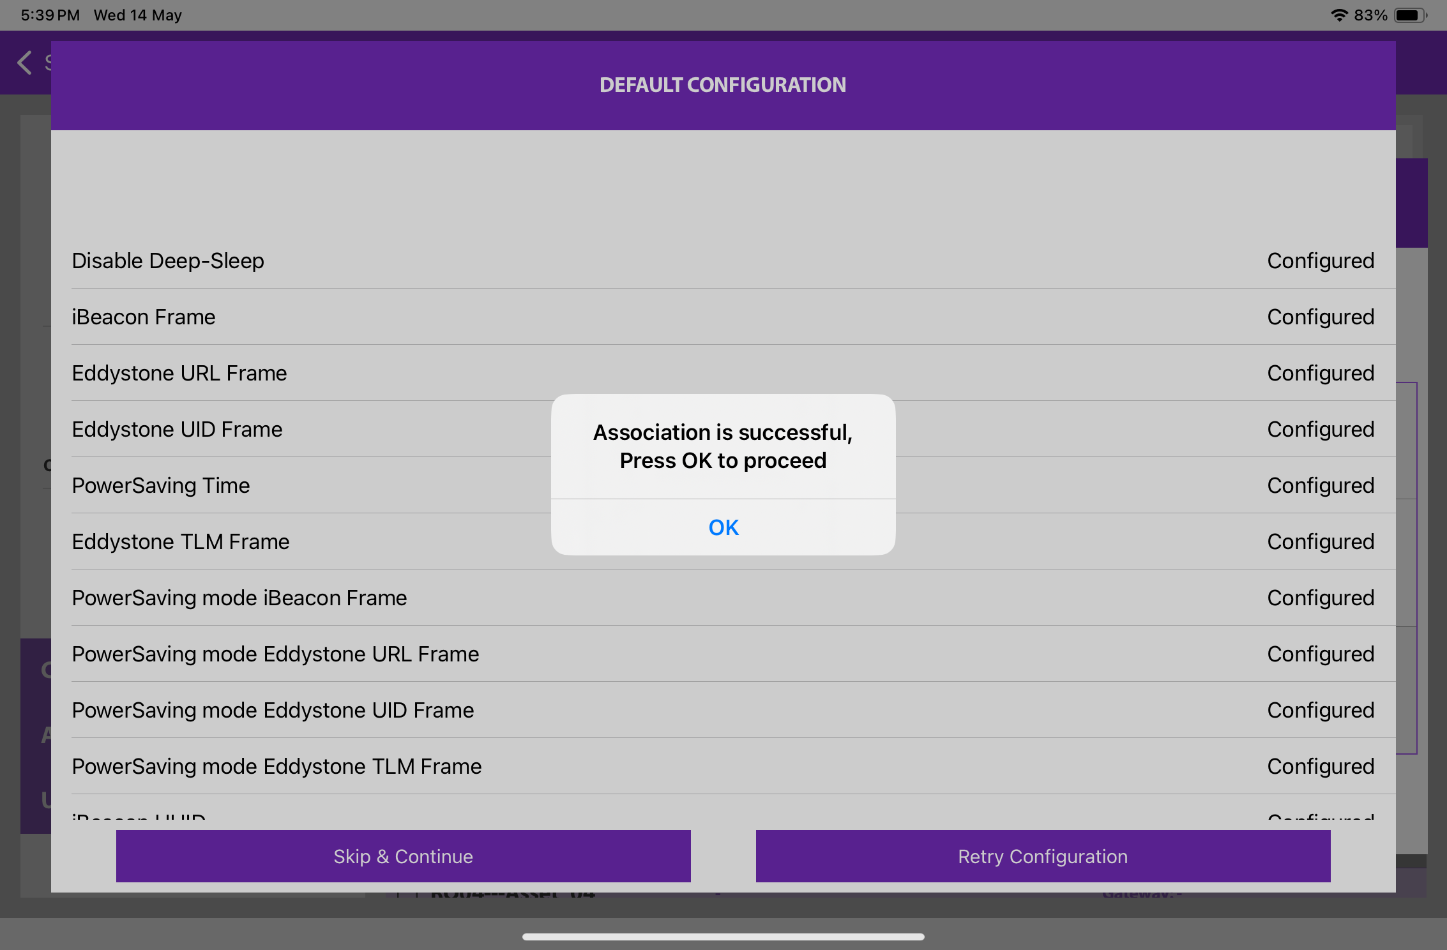
3. Selecting the Device for Association- The user will see a list of unassociated devices and can use the door status to identify the installed device. After identifying the device, select it to start the installation process. The app will display a pop-up to confirm the association; click "OK" to confirm. Once the process is complete, the user will return to the Outlet Screen, where they will see that the Proximity/Smart Tag is now associated with the Cooler.
To select the device, close the cooler door. After the green checkmark appears, open the door again to complete the association.
© 2025 Vision Group

Slide 20
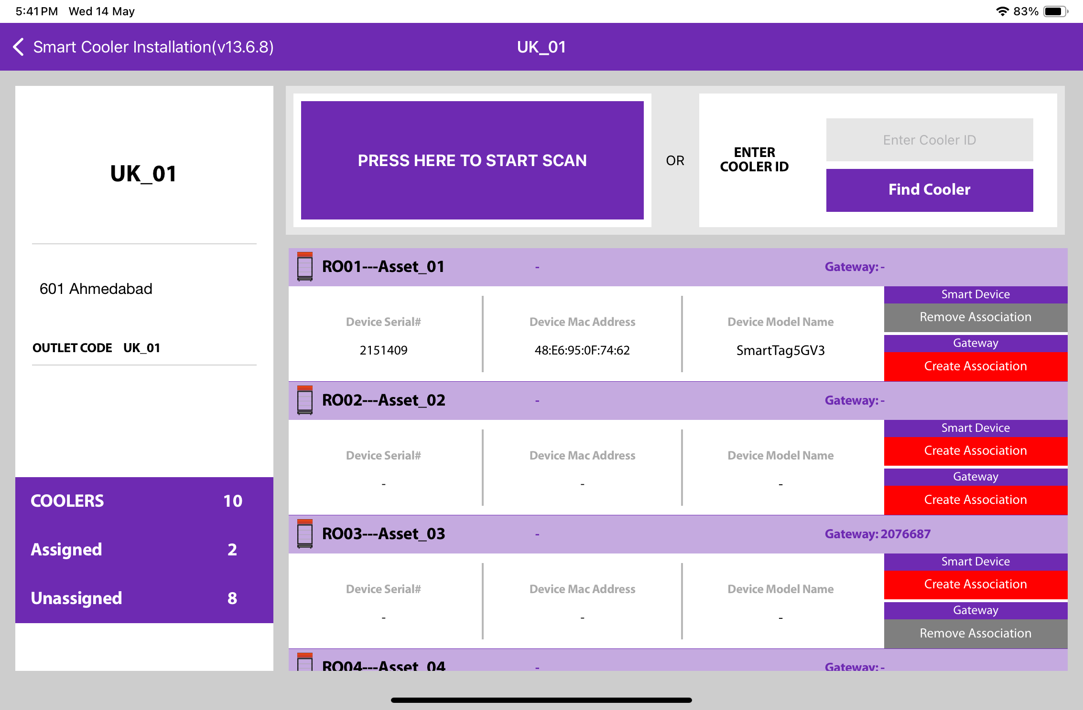
4. Smart Device Configuration Setting - When a device is selected, the application will connect to it, apply all necessary configuration changes, and display a status message. A success message will appear once the device is successfully connected. Press "OK" to close the pop-up window. When this message is visible, the device has been provisioned, and the user can press "Close" to return to the main outlet screen.
Note: The device only activates when the cooler door is opened and closed.
© 2025 Vision Group

Slide 21
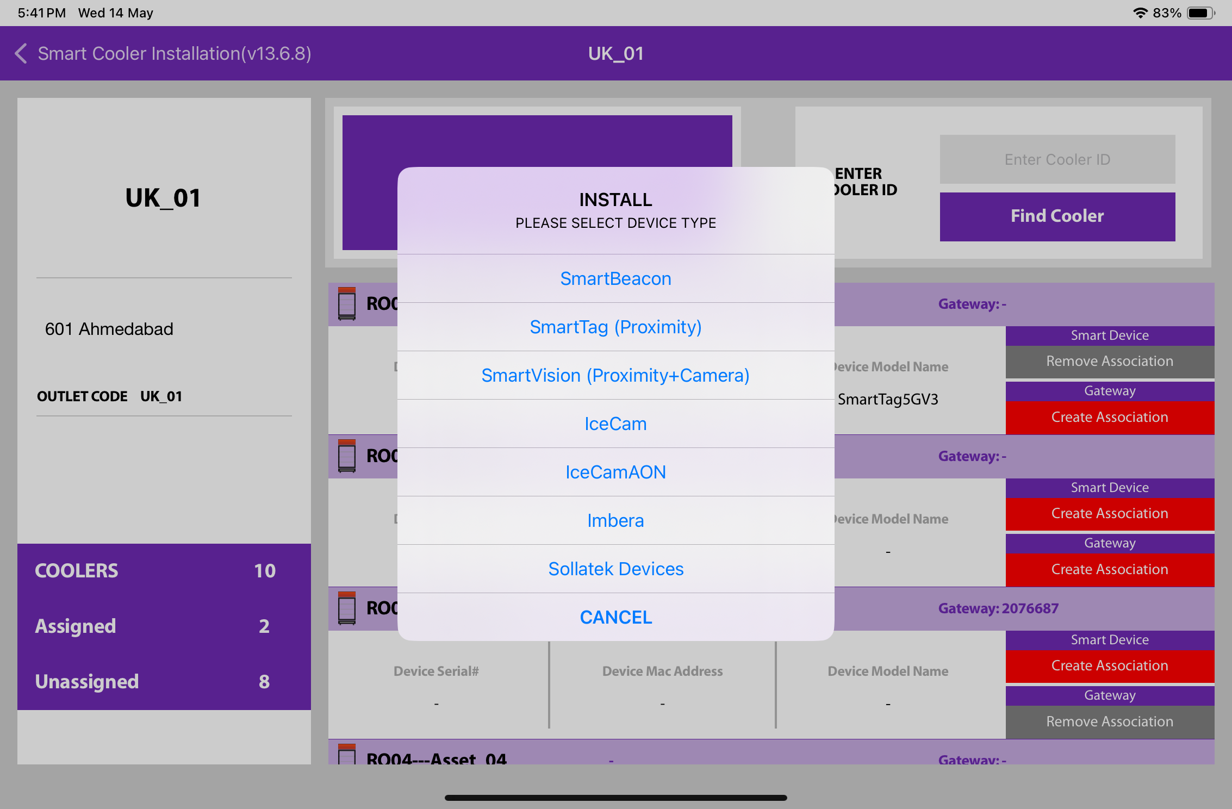
ASSOCIATION – SMART VISION (SMART DEVICE)
1. Selecting a Cooler - A new window will open, allowing the user to manually select a cooler for the chosen outlet. Click on “Association” to choose the asset for installation.
2. Selecting Smart Device type - A new window will appear, prompting the user to choose from the available device types to associate. Click on “SMART VISION” to link the SmartVision device.
The user will see a list of unassociated devices, which can be identified using the door status of the installed device.
© 2025 Vision Group

Slide 22
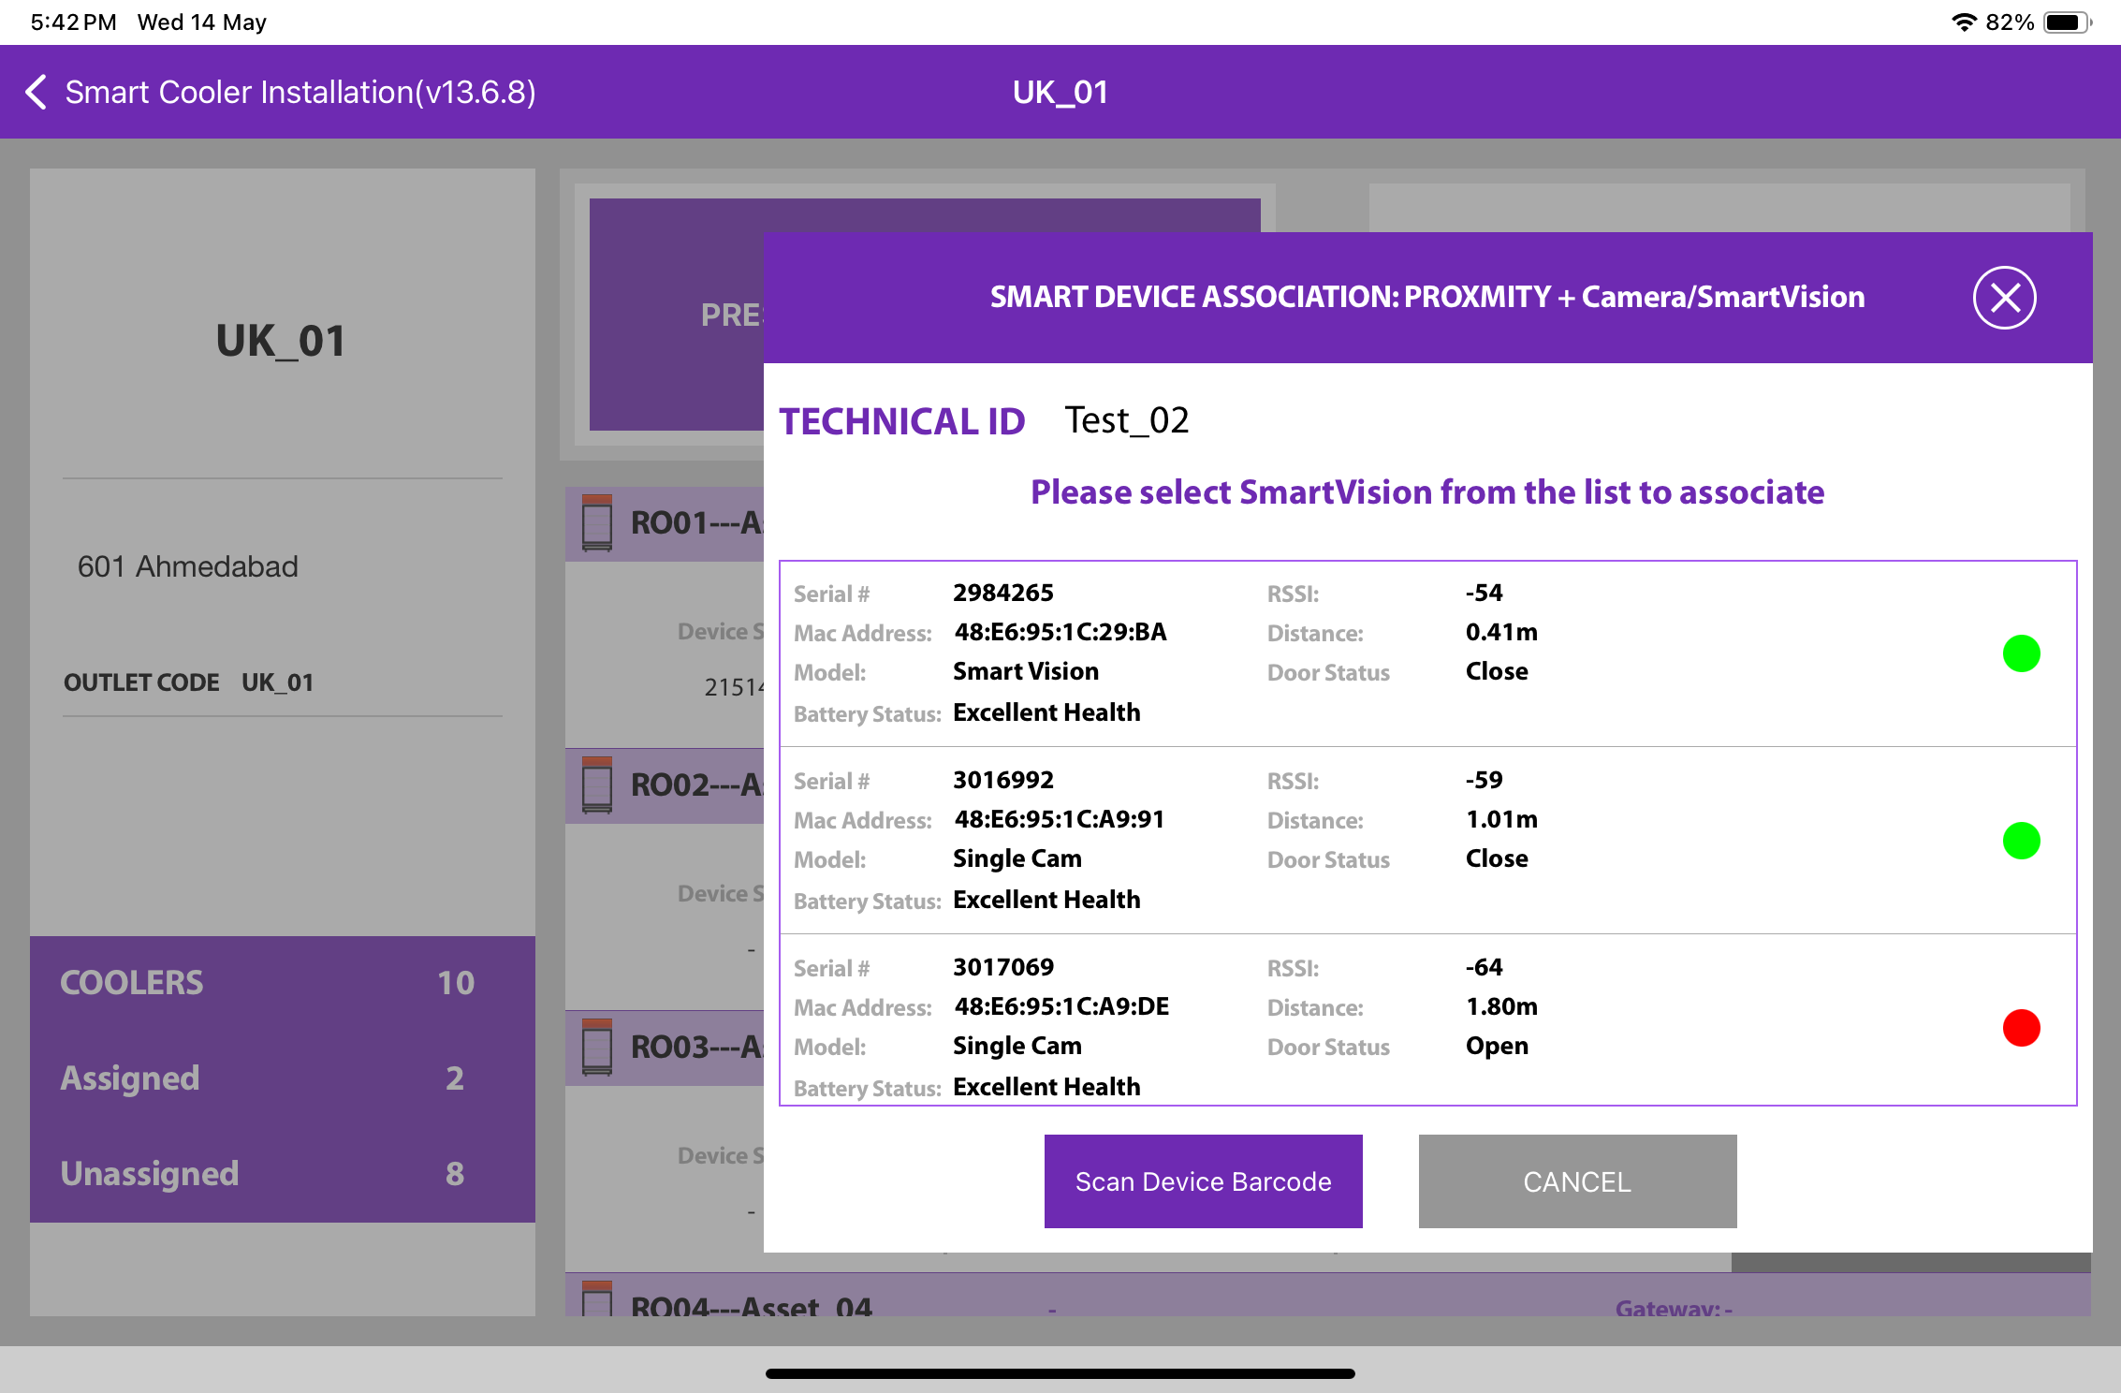
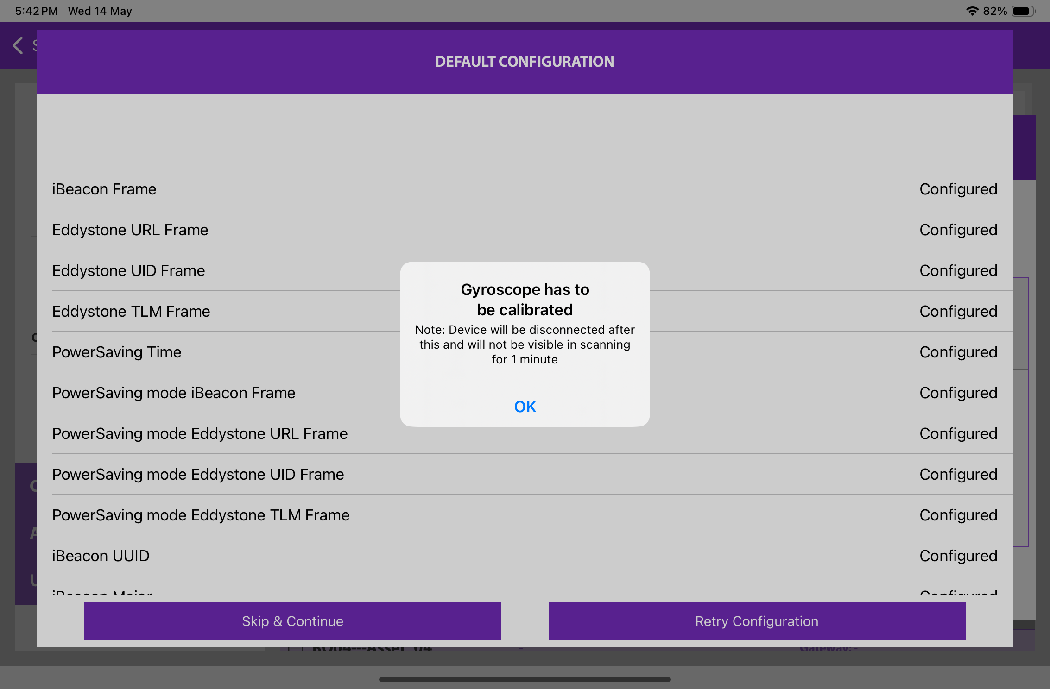
3. Selecting the Device for Association - The user will see a list of unassociated devices. They can identify the installed device by checking the door status. Once the device has been identified, select it to begin the installation process. The app will prompt a confirmation pop-up for the association. Click "OK" to confirm. When the process is complete, the user will be returned to the Outlet Screen, where they will see that the Smart Vision is now associated with the Cooler. At this point, the device will be gyroscopically calibrated, and the user can press "OK" to return.
When the door closes, a pop-up screen will appear; click "OK" to proceed.
© 2025 Vision Group

Slide 23

4. Smart Device Configuration Settings - Once you select the device, the application will establish a connection, apply all necessary configuration changes, and display the status. A success message will appear after the device has been successfully associated. Click "OK" to close the pop-up. When this message appears, the device has been provisioned, and you can click "Close" to return to the outlet screen.
Note: Please remember that the device will only wake up when the cooler door has been closed for 15 seconds.
© 2025 Vision Group

Slide 24
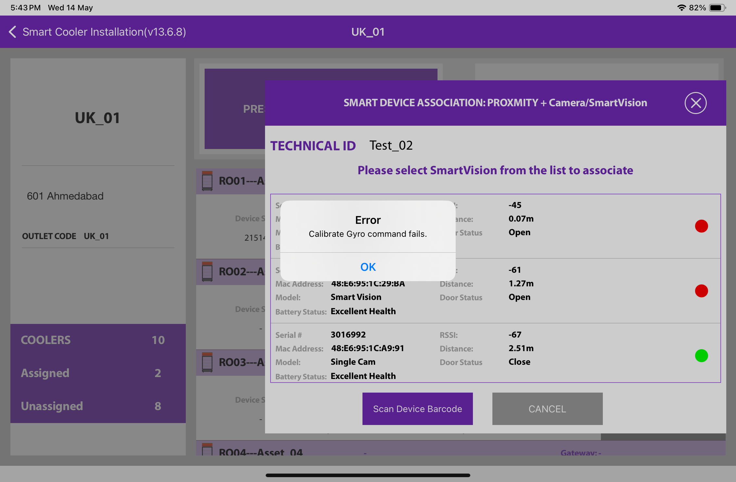
If the gyro command does not receive a successful response and indicates waiting or failed status.
Users should wait for 1 minute, and if the pop-up does not appear, they can try again.
Failed - Check the door status. If it’s “Open”, close the door and tap “Retry”.
© 2025 Vision Group

Slide 25
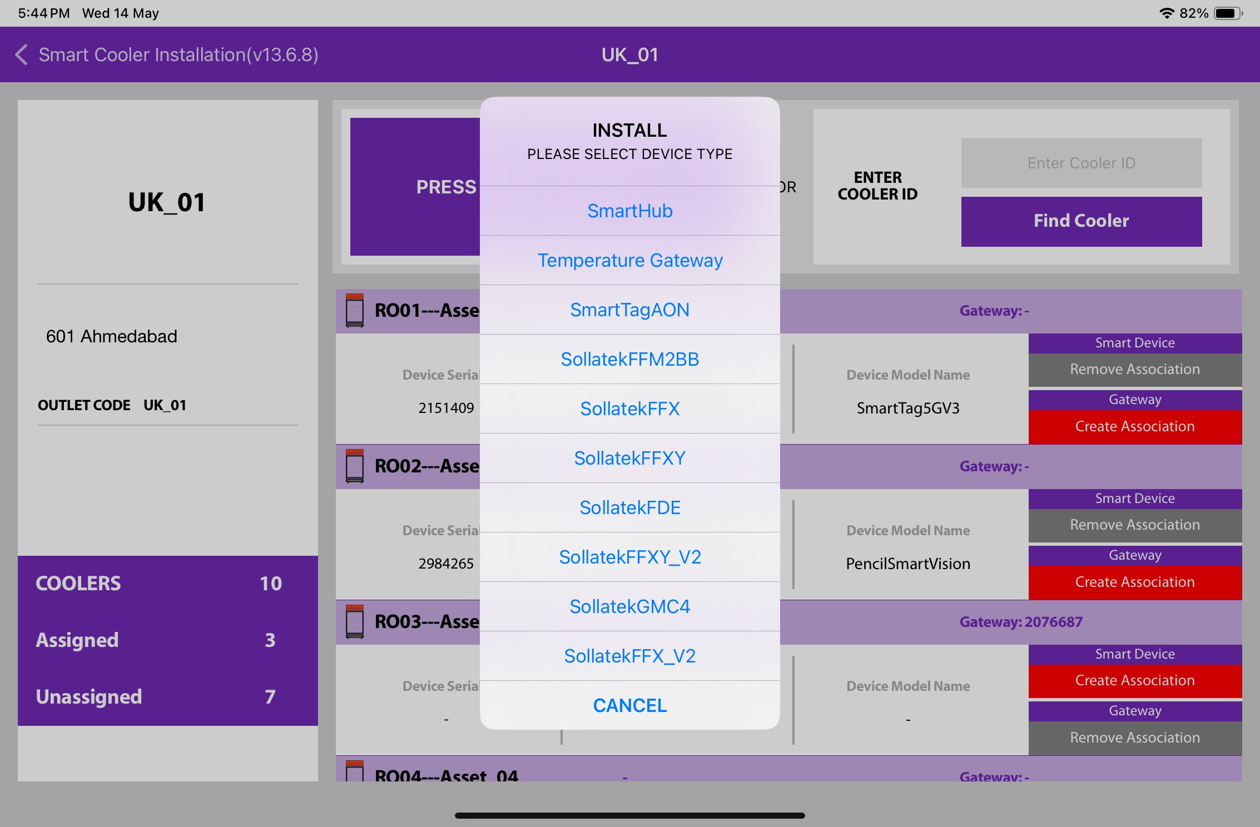
ASSOCIATION – SMART HUB (SMART GATEWAY)
1. Selecting a Cooler - A new window will open, allowing the user to manually select the cooler for the chosen outlet. Click on “Association” to choose the asset for installation.
2. Selecting Smart Device type – A new window will open, prompting the user to select the types of devices to associate with. Click on “SMART HUB” to associate the SmartHUB device. Make sure to power on the Smart HUB device.
Note: Ensure that the gateway device is powered on at the time of association.
© 2025 Vision Group

Slide 26
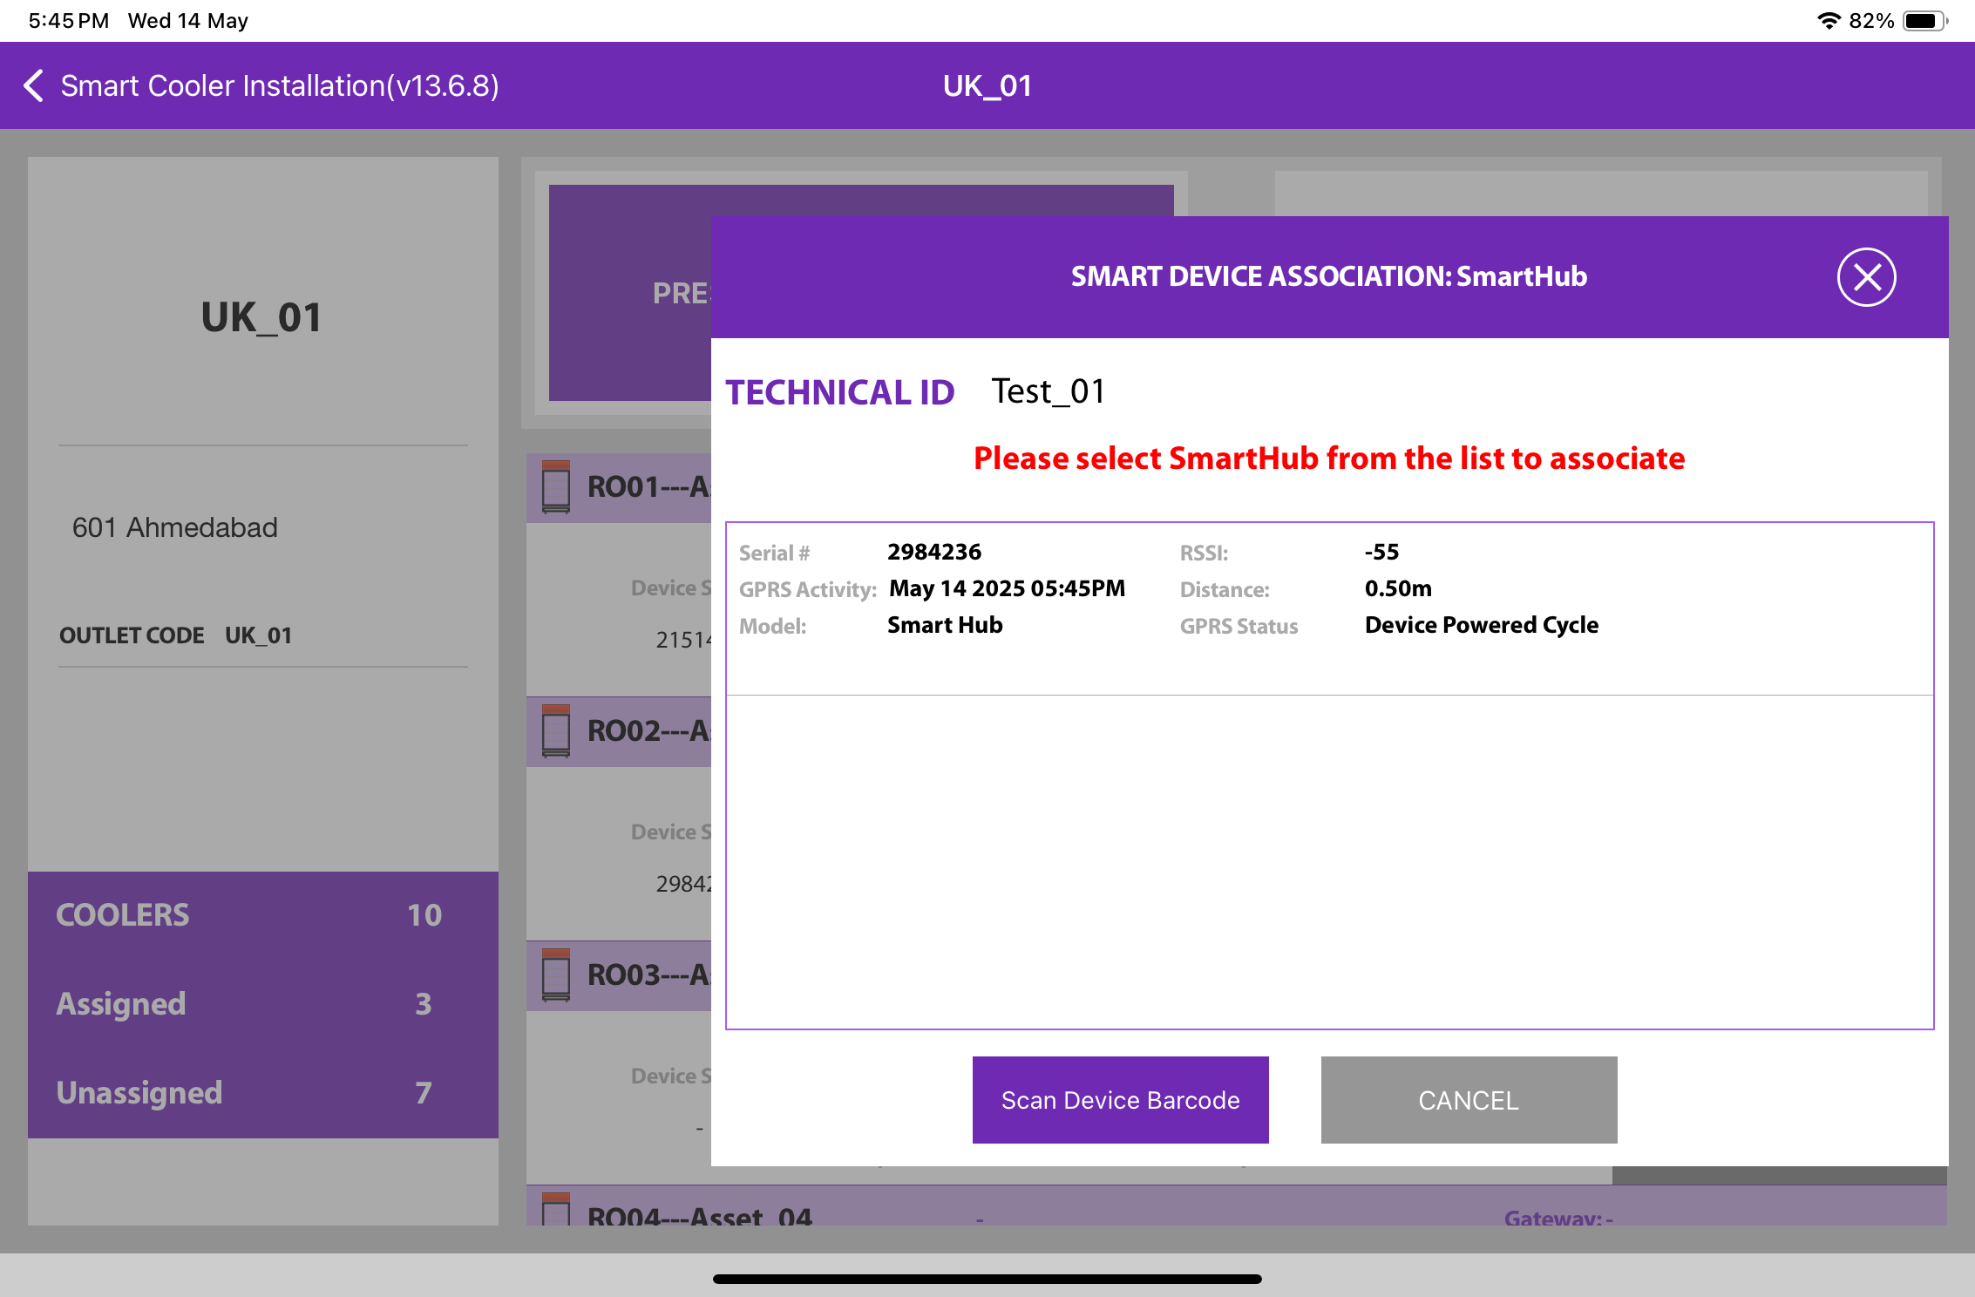
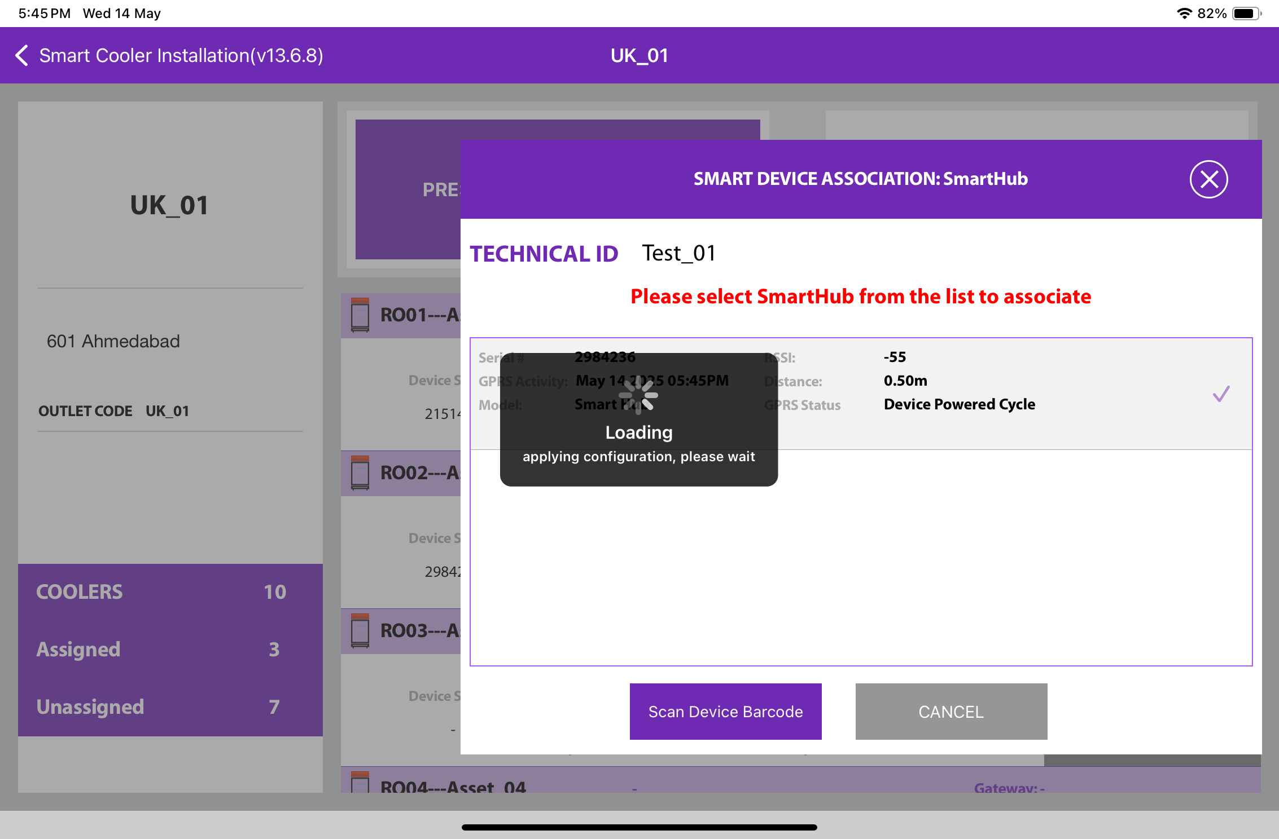
3. Selecting the Device for Association - The user will be presented with a list of unassociated devices. To identify the installed device, the user can refer to the door status. After identifying the device, select it to initiate the installation process. The app will display a pop-up to confirm the association; click "OK" to proceed. Once the process is complete, the user will return to the Outlet Screen, where they will see that the Proximity/Smart Tag is now associated with the cooler.
To select the device, close the cooler door. Once a green checkmark appears, the user needs to open the door to finalise the association.
© 2025 Vision Group

Slide 27
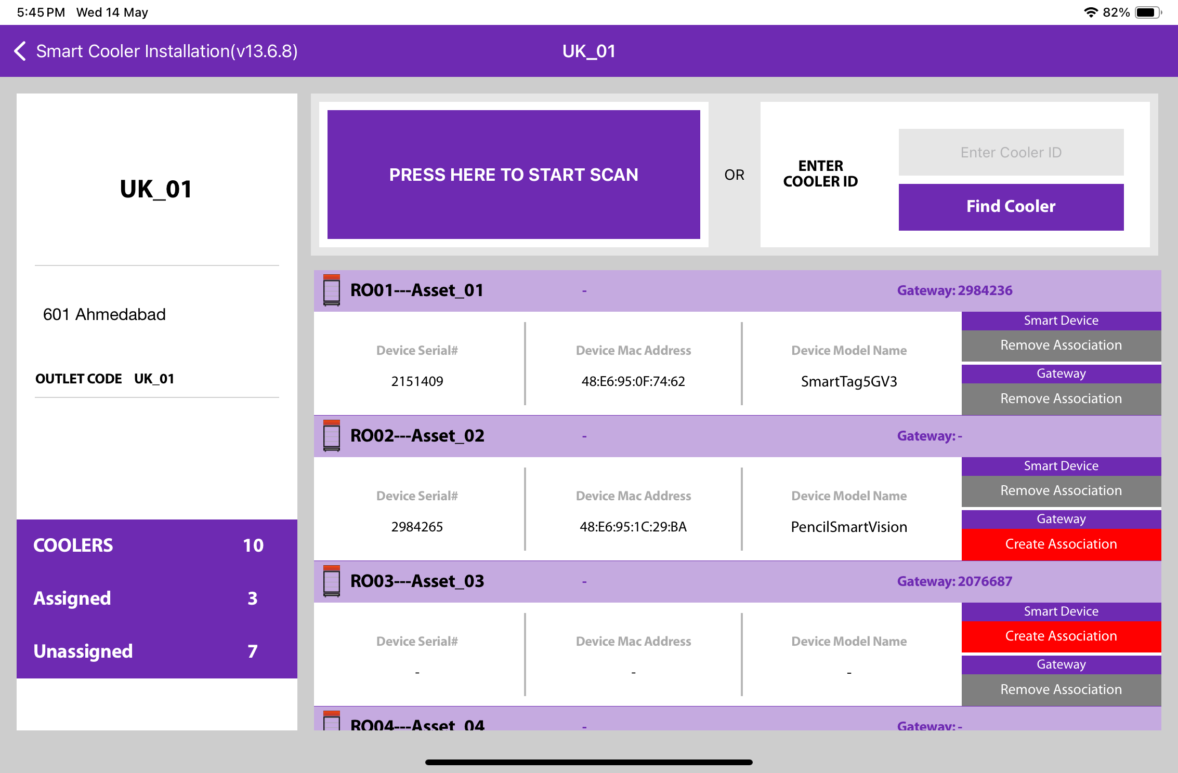
4. Selecting the Device for Association - After identifying the device, select it to begin the installation. The app will display a pop-up to confirm the association; click "OK" to confirm. Once the process is complete, you will be returned to the Outlet Screen, where you will see that the Smart Hub is now associated with the Cooler.
© 2025 Vision Group

Slide 28
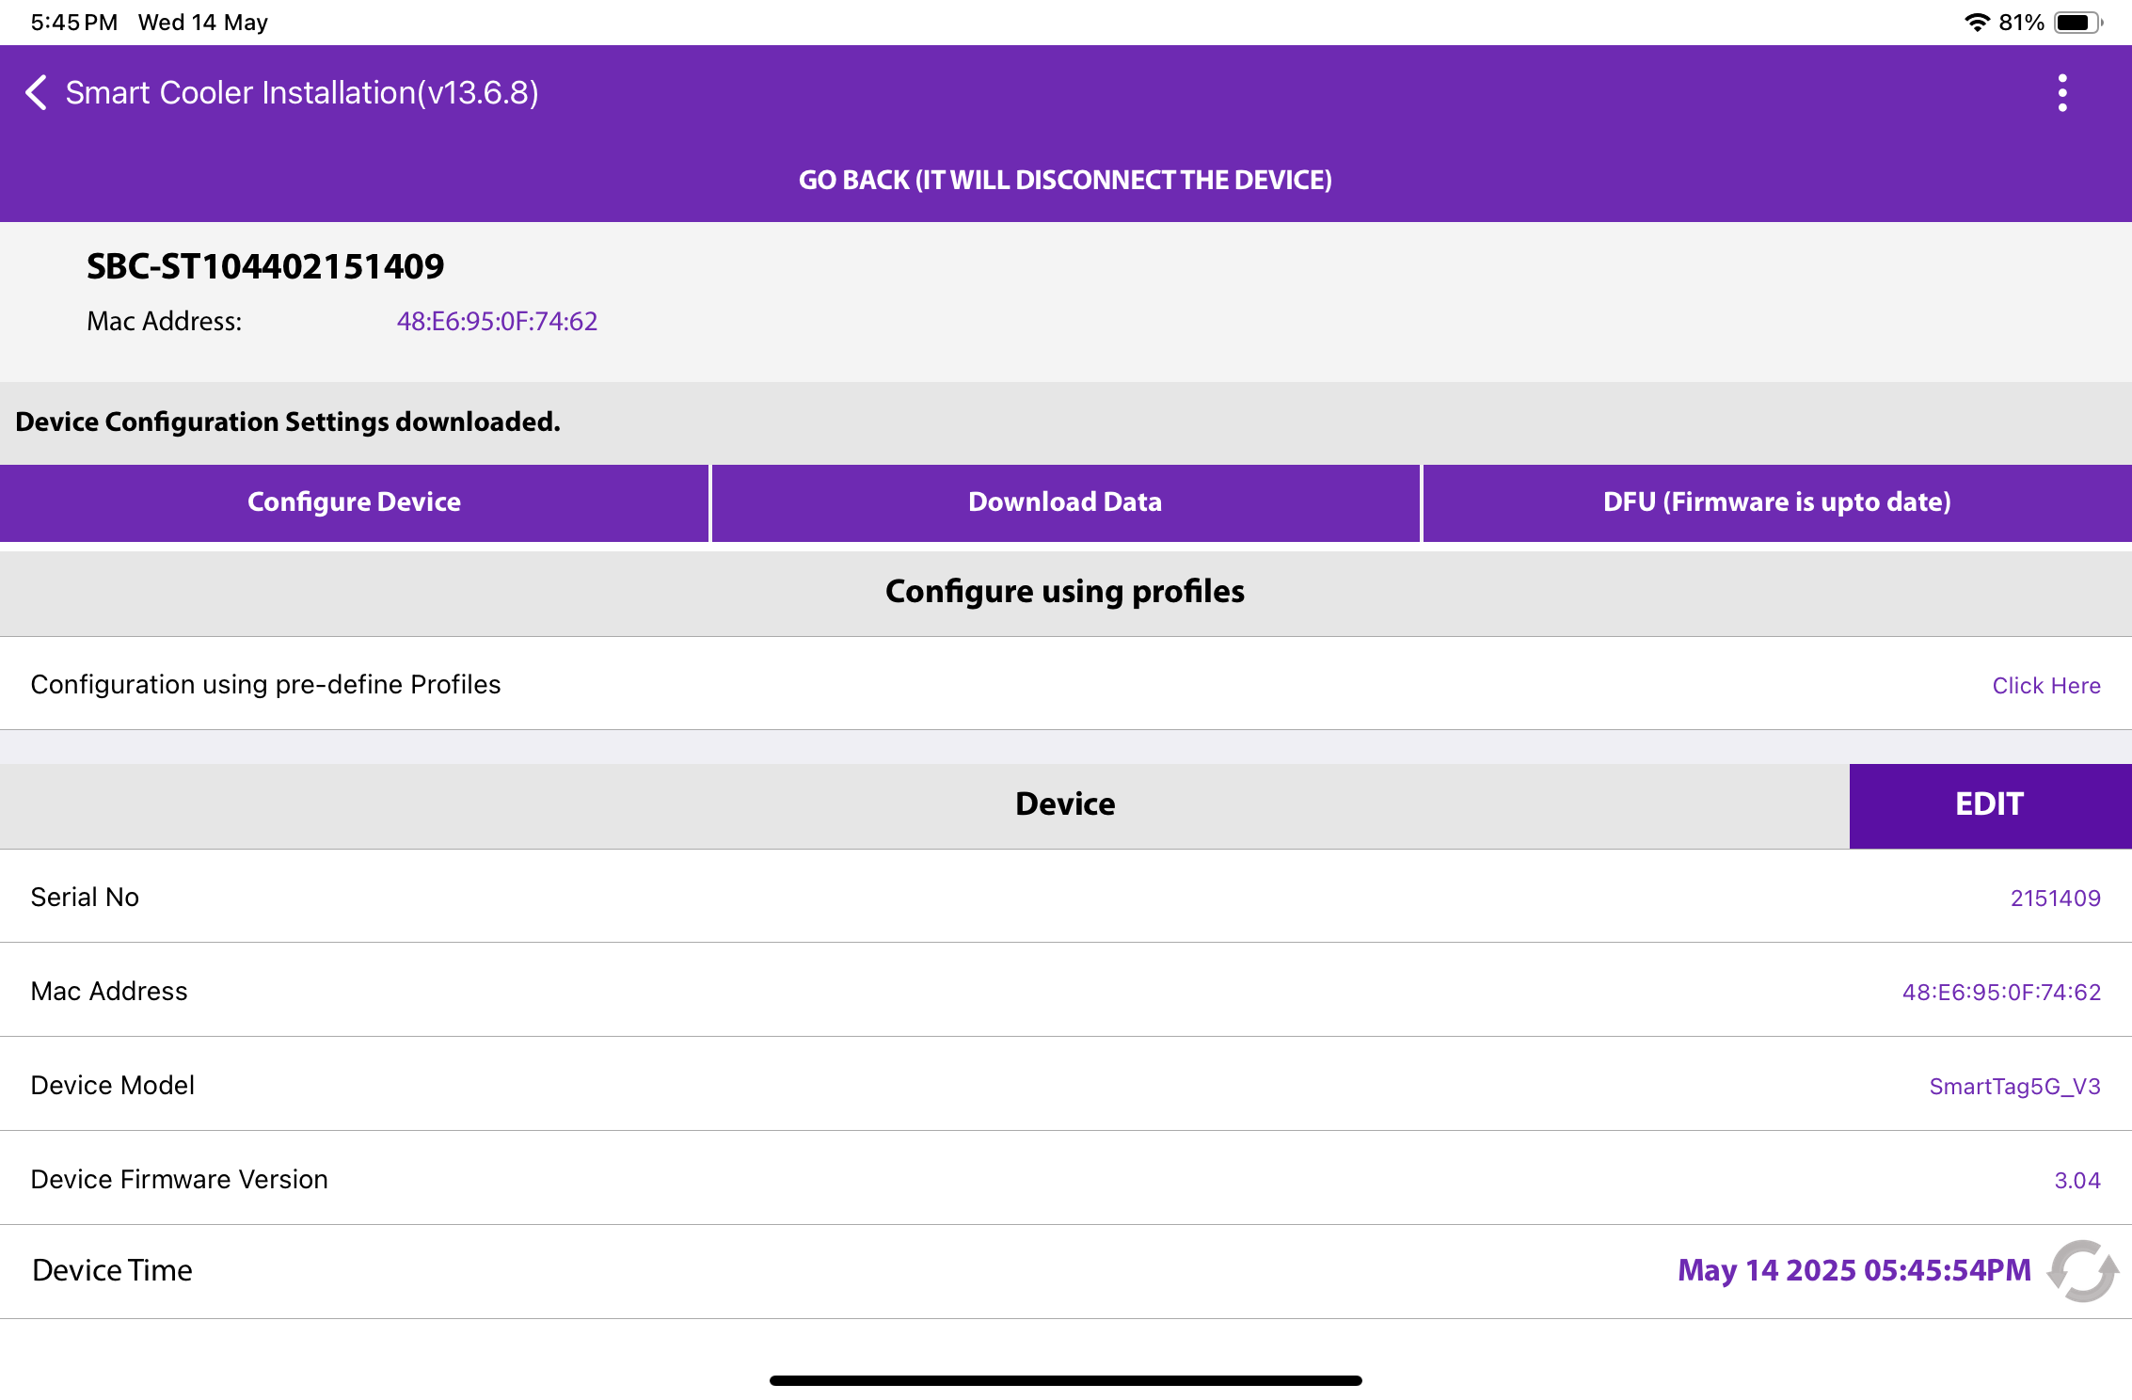
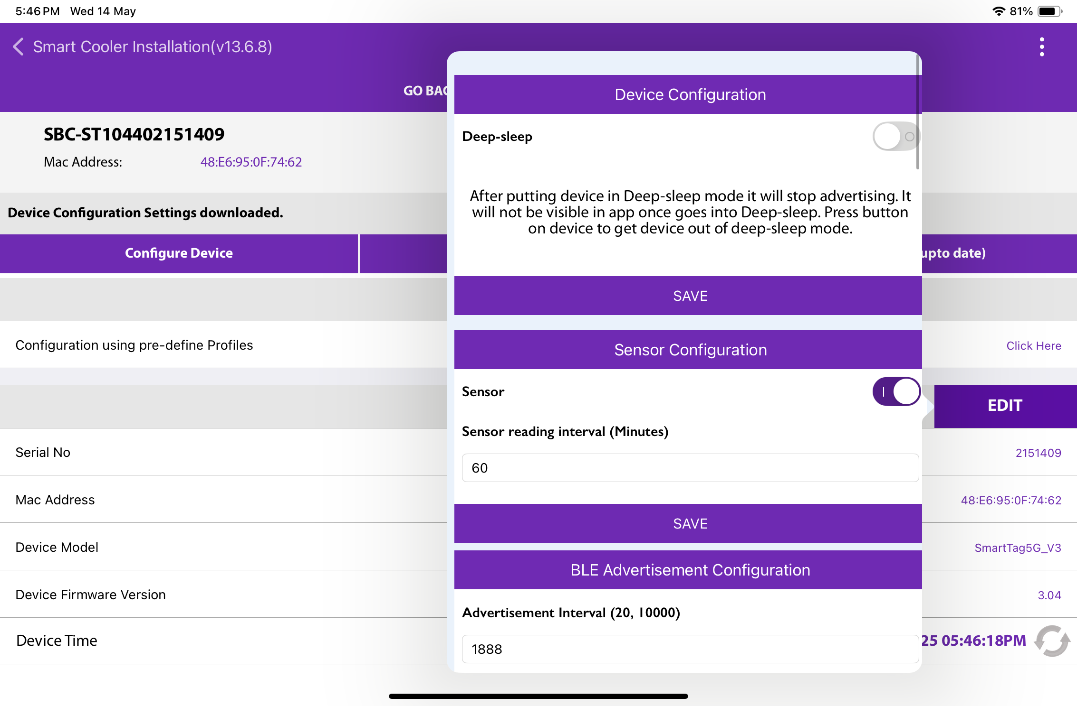
CONFIGURATION - SET HEALTH INTERVAL
Once connected to the device, the user can configure the following parameters. In the STATUS Parameters section, tap on "Heartbeat Interval (in Minutes)”.
A. Enter the desired interval value and press the "Set" button.
B. After making the changes, press the "SAVE" button at the bottom to save the new settings to the device.
A
B
© 2025 Vision Group

Slide 29
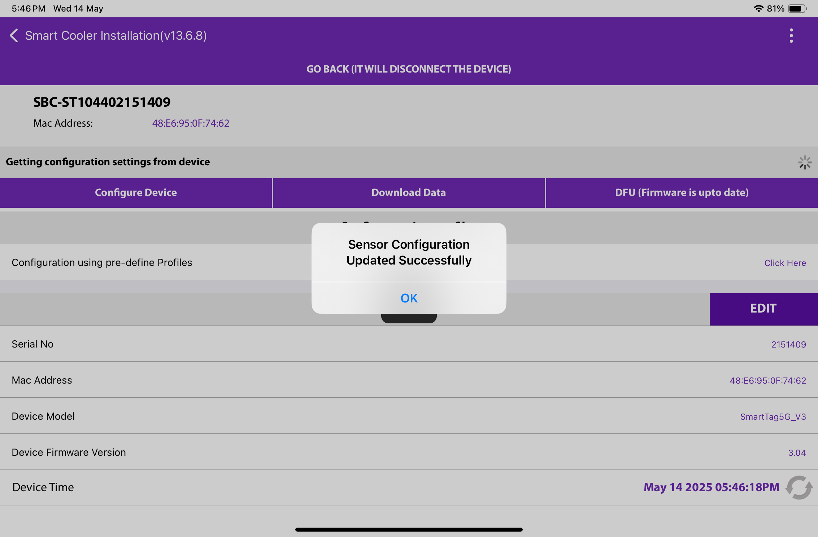
Once the sensor configuration is complete, a success message will appear as shown in the image below.
© 2025 Vision Group

Slide 30

CONFIGURATION - SET CURRENT DATE TIME
After connecting to smart devices, tap the Refresh button in the STATUS section under the "Current Time" row to update the device's time.
© 2025 Vision Group

Slide 31
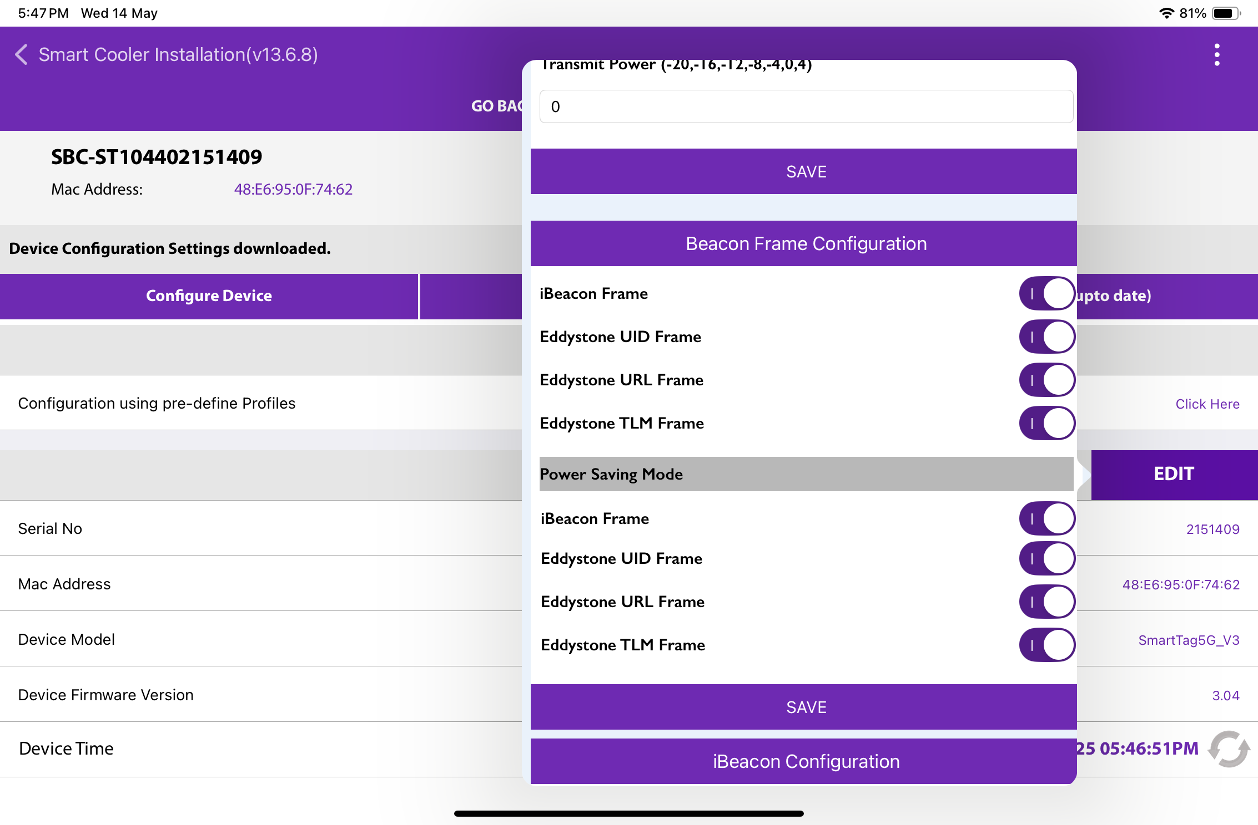
CONFIGURATION - SET IBEACON PARAMETERS
Enable or Disable iBeacon Frame - Use the toggle button to activate or deactivate the iBeacon frame in the iBeacon Raw section. After changing the settings, click the SAVE button at the bottom to apply the changes to the device.
© 2025 Vision Group

Slide 32
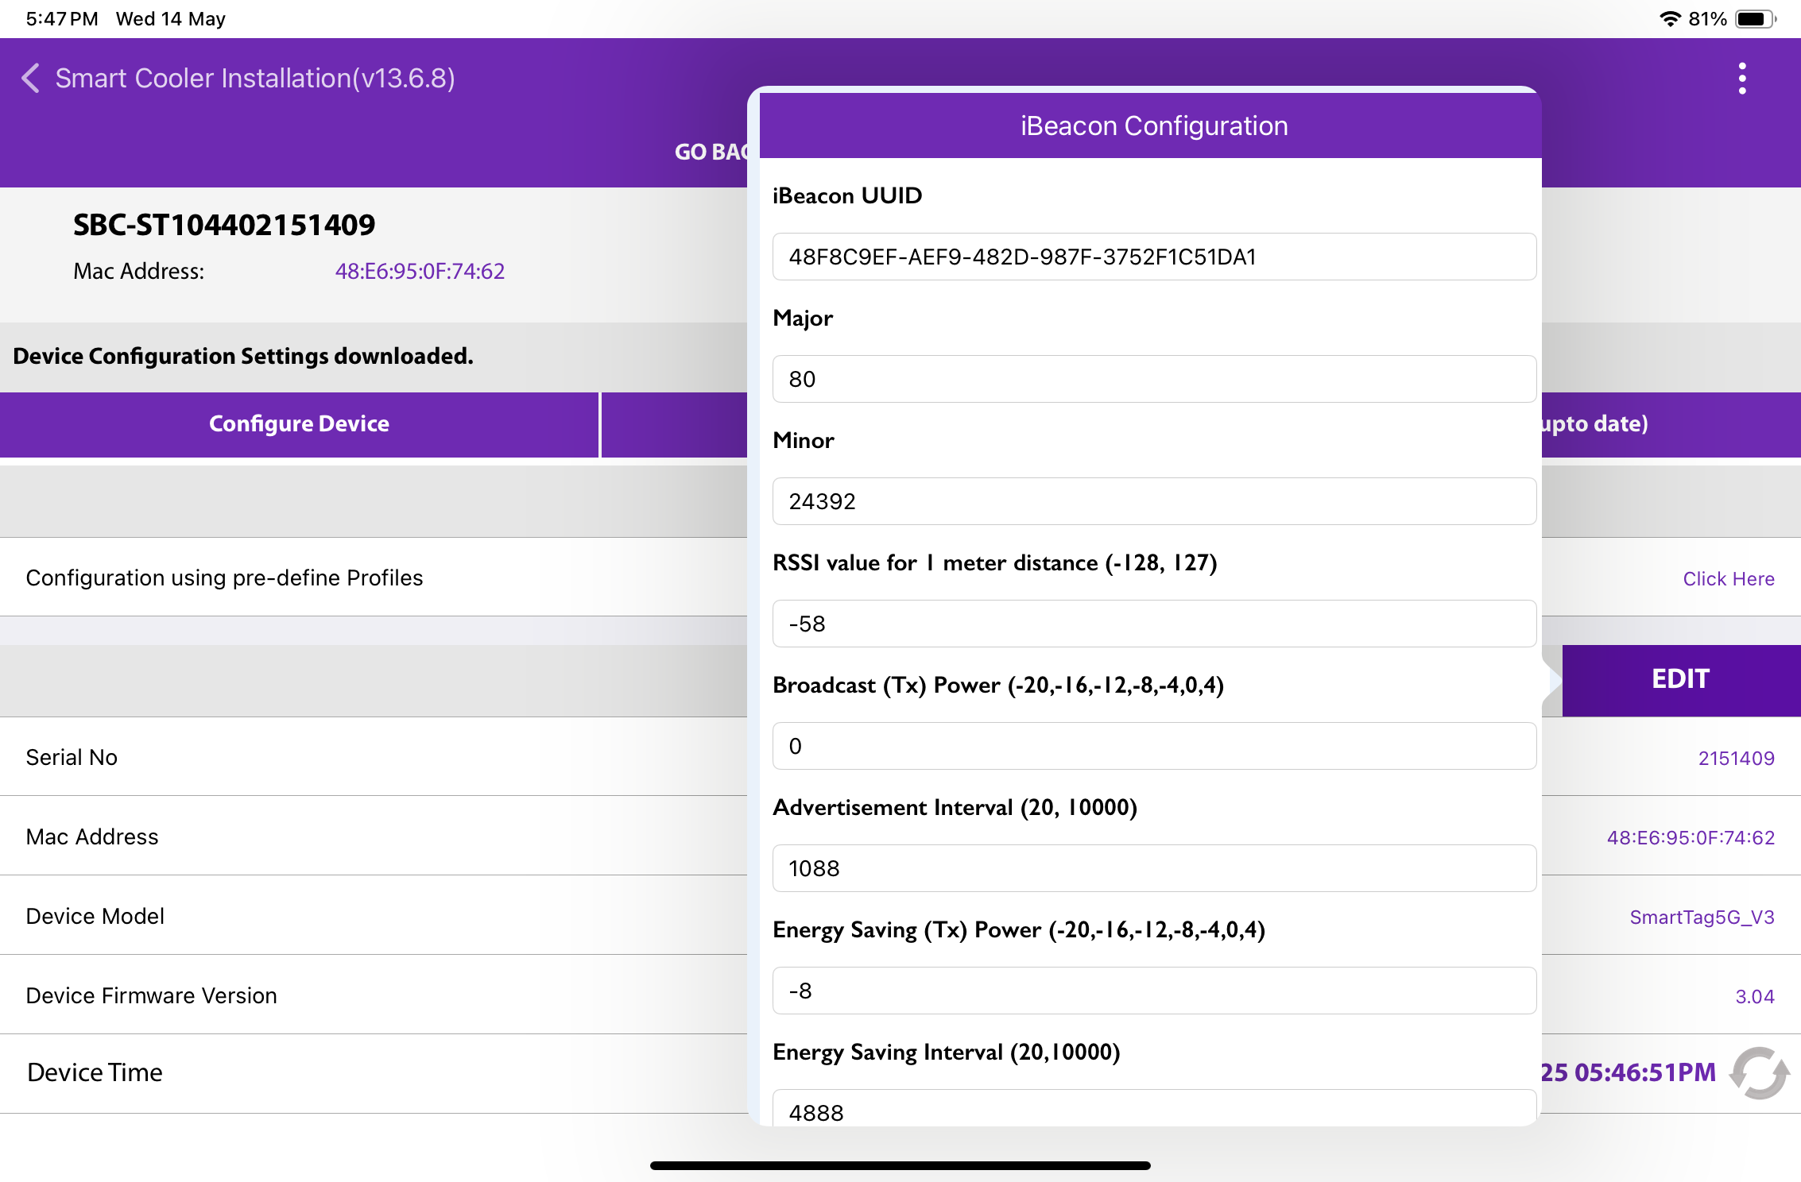

Set UUID – After establishing a connection, as illustrated in the figure, tap on the UUID row located below the iBeacon bar. Enter a 16-byte UUID. Once you have entered the new values, click the SAVE button at the bottom to store them on the device.
© 2025 Vision Group

Slide 33
Set Major - After establishing a connection, you will see a row labelled "Major" beneath the iBeacon bar, as illustrated in the figure below. Click on any row and enter the desired value as shown. Once you have adjusted the values, make sure to press the "SAVE" button at the bottom to save your changes to the device.
© 2025 Vision Group

Slide 34
Set Minor - After establishing a connection, as depicted in the figure, you will see a row labelled "Minor" below the iBeacon bar. Click on any row in that section and enter the desired value as indicated below. Once you have changed the values, be sure to press the "SAVE" button at the bottom to save the changes to the device.
© 2025 Vision Group

Slide 35
Set RSSI - After establishing a connection, you will see a row for RSSI below the iBeacon bar, as shown in the figure. Click on any row and enter the desired value. Once you have updated the values, be sure to press the "SAVE" button at the bottom to save the changes on the device.
© 2025 Vision Group

Slide 36
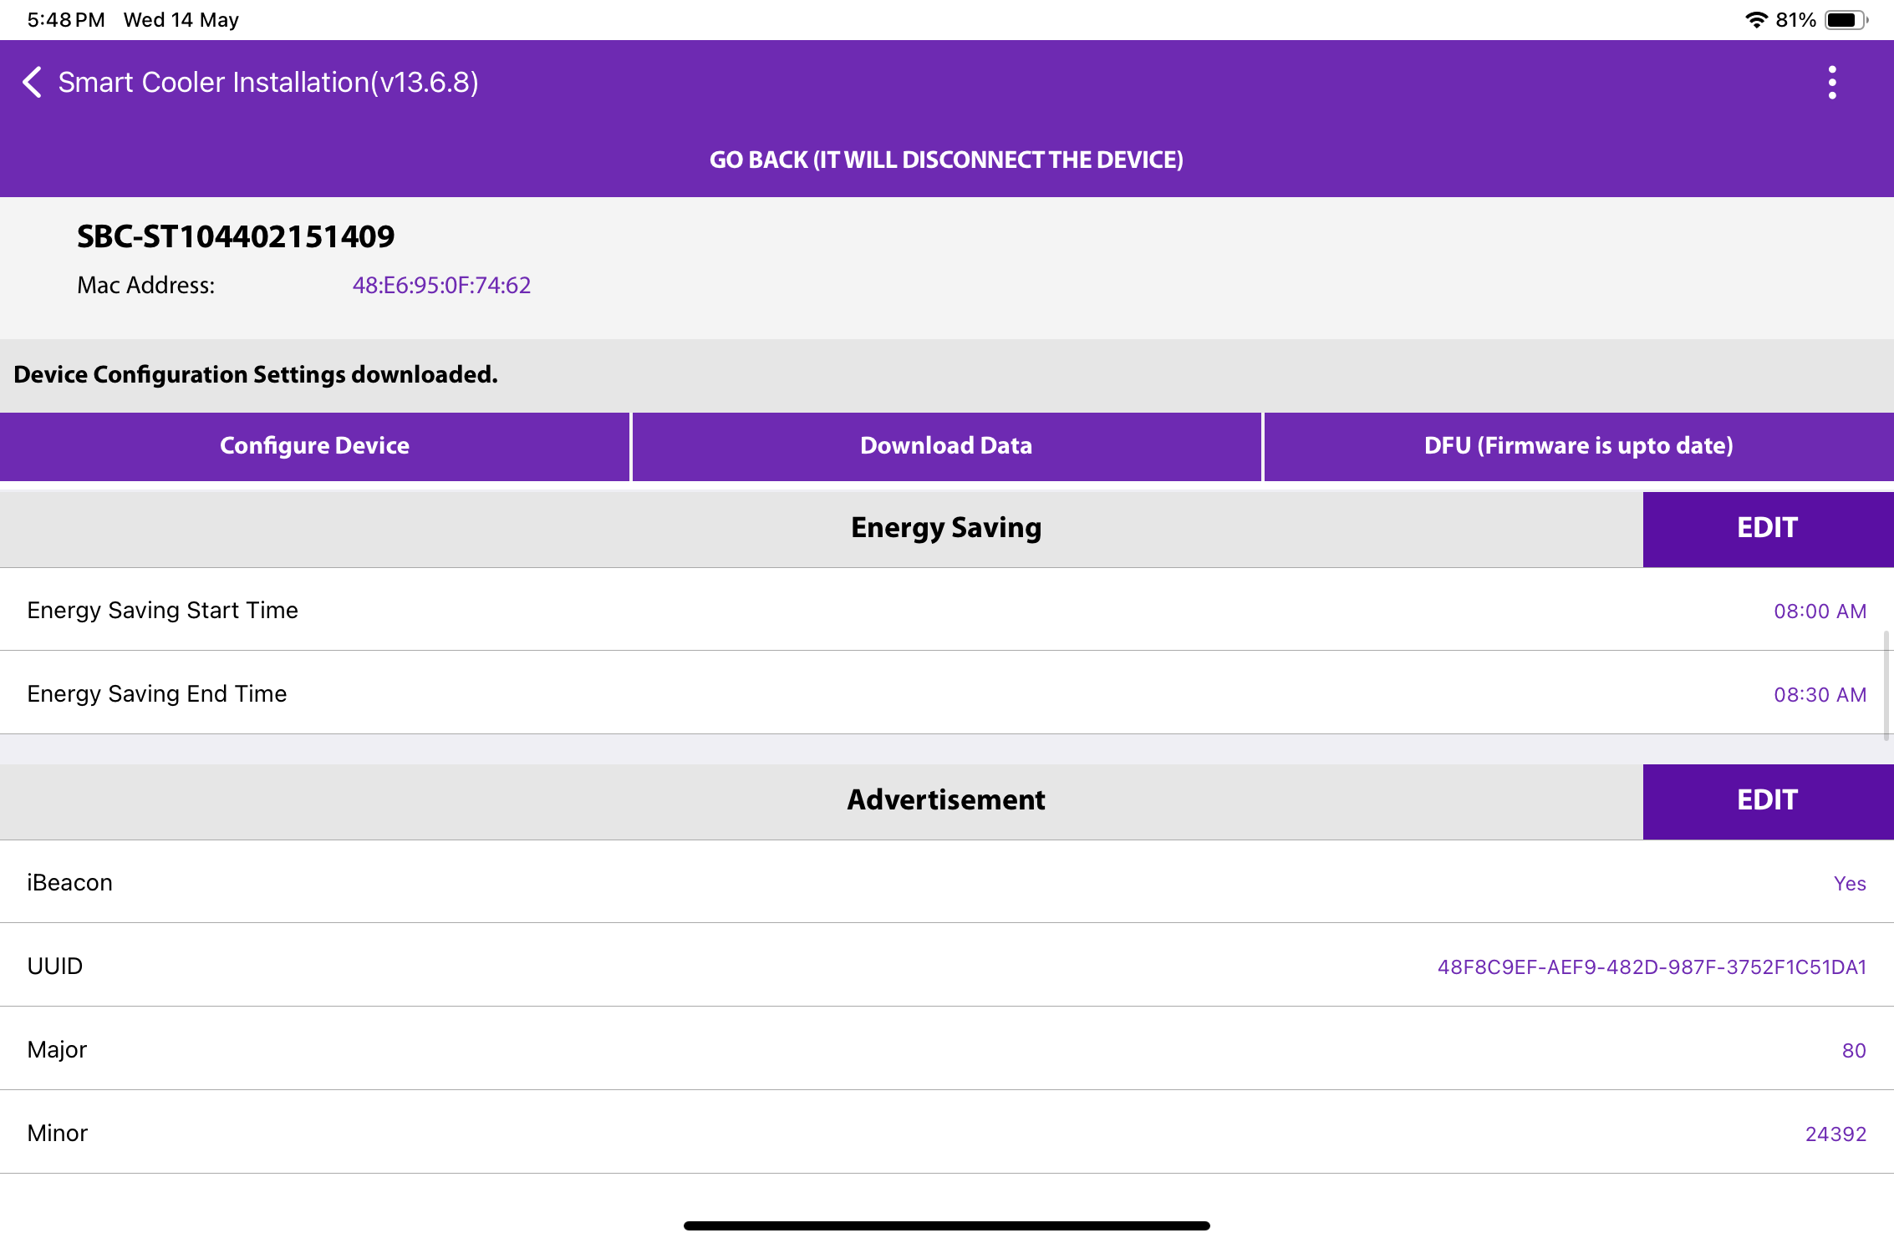
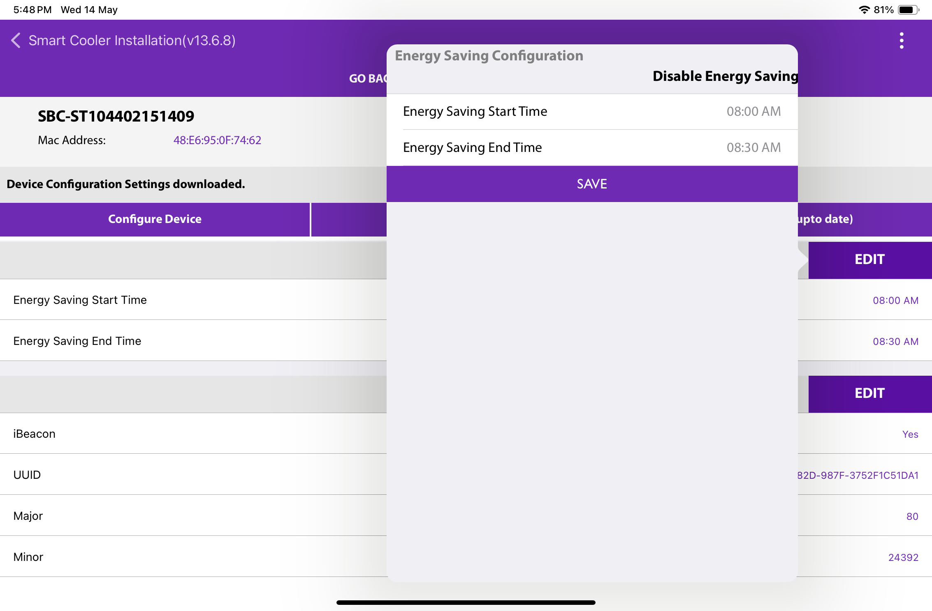
CONFIGURATION - ENERGY SAVING MODE
Enable Energy Saving Mode - Users can specify a duration for energy savings by adjusting the advertisement interval. To activate this feature, touch the row labelled "Energy Saving Start/End Time" and set your desired times. After modifying the values, make sure to press the SAVE button at the bottom to store the changes on the device.
© 2025 Vision Group

Slide 37
Disable Energy Saving Mode
Users can turn off energy-saving mode by tapping "Disable Energy Saving," as shown in the image.
After modifying the values, click the SAVE button at the bottom to store them on the device.
© 2025 Vision Group

Slide 38
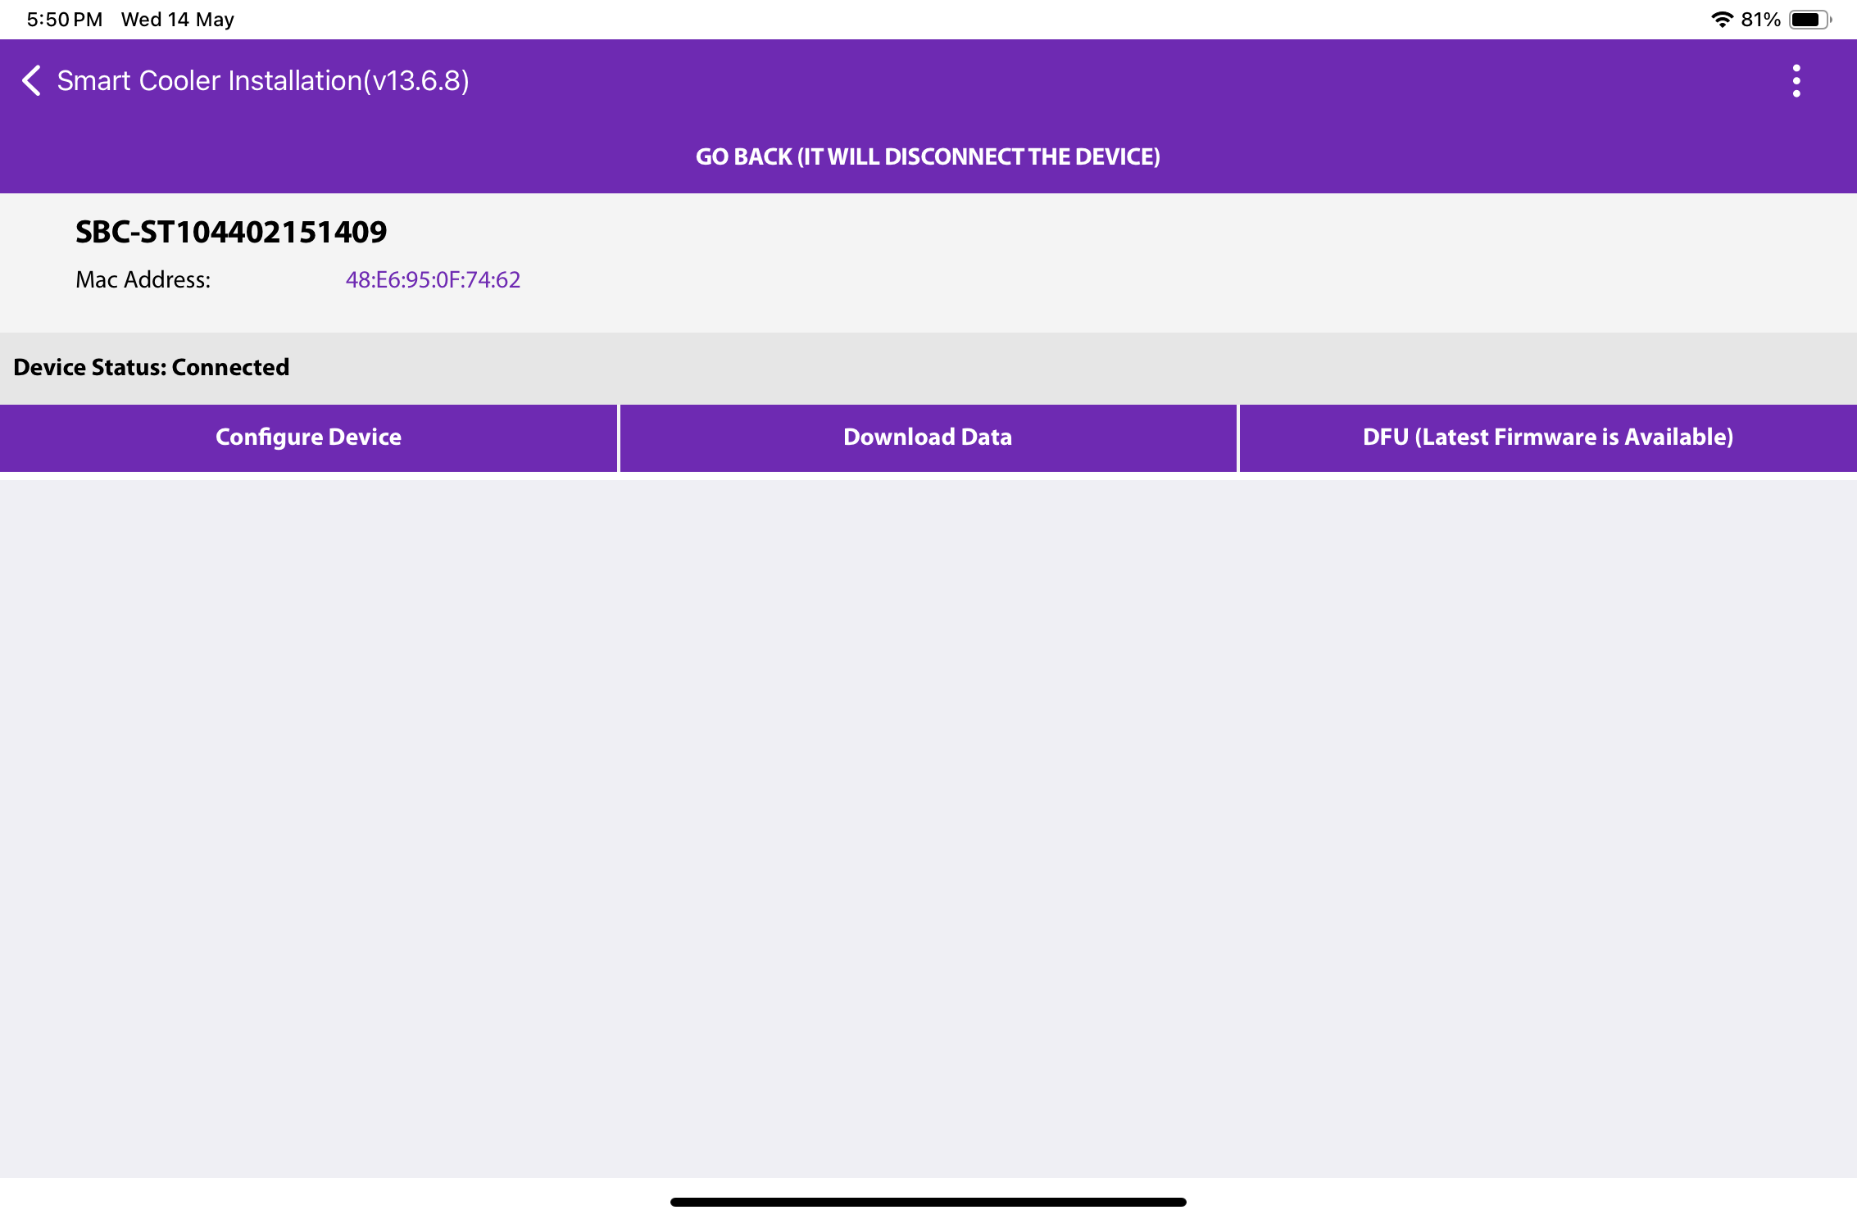
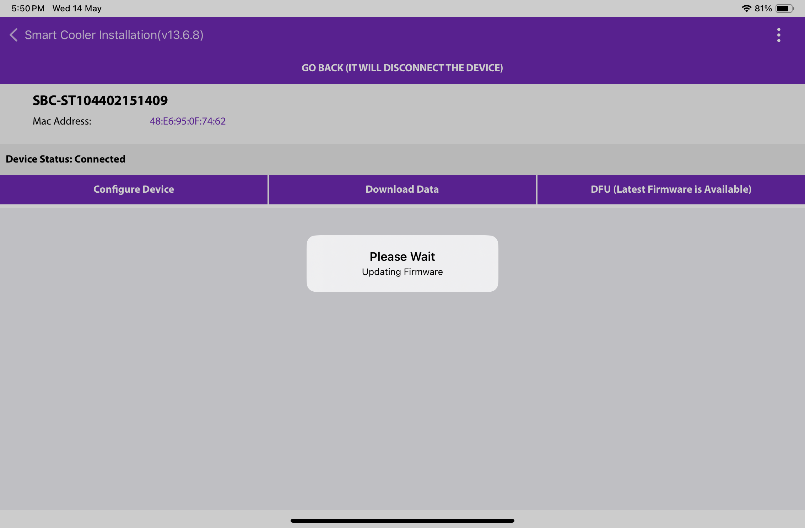
CONFIGURATION – DFU(DIRECT FIRMWARE UPDATE)
DFU (Direct Firmware Update) - The Smart device's DFU can be initiated by clicking the Update DFU button, as illustrated in the image. If the device already has the latest firmware, no DFU flag will be displayed.
© 2025 Vision Group

Slide 39
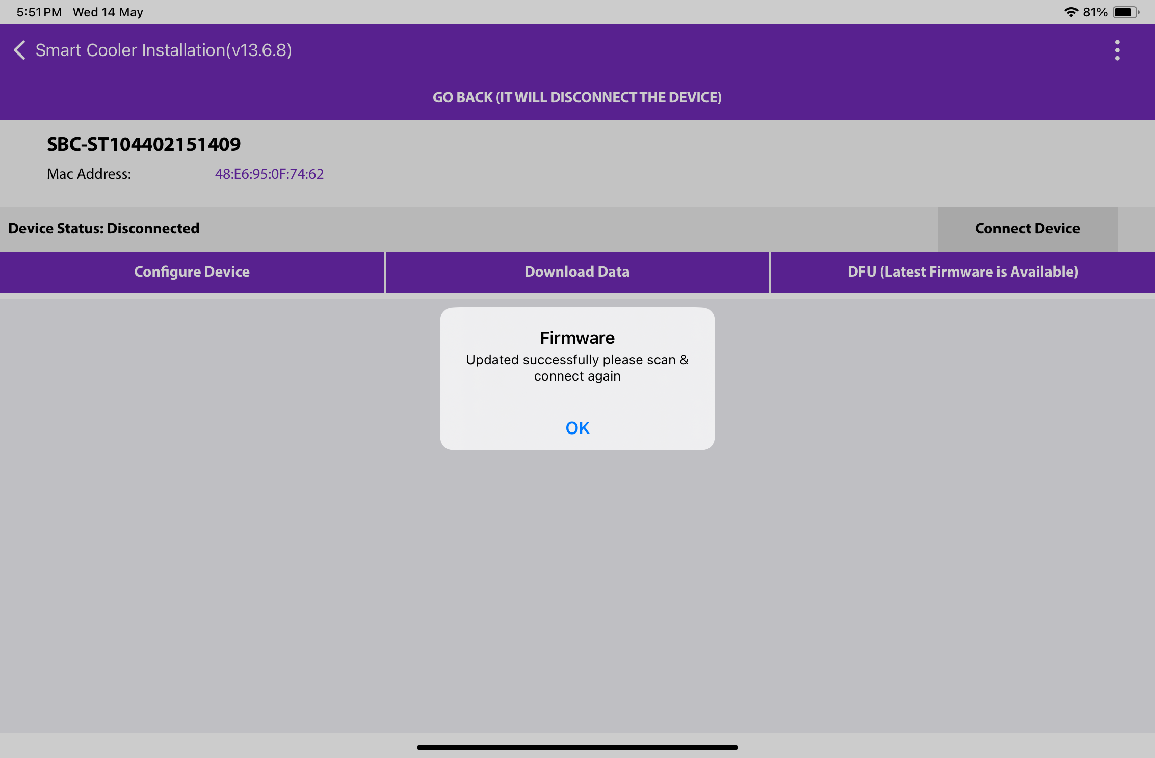
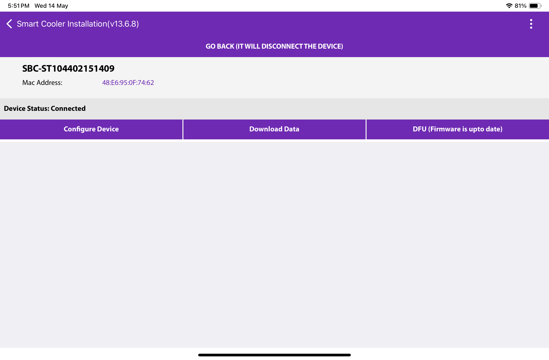
After completing the DFU update, users will see the DFU Upgrade Process. Once the DFU process is successfully finished, they can view the upgraded firmware version of the smart device.
© 2025 Vision Group

Slide 40
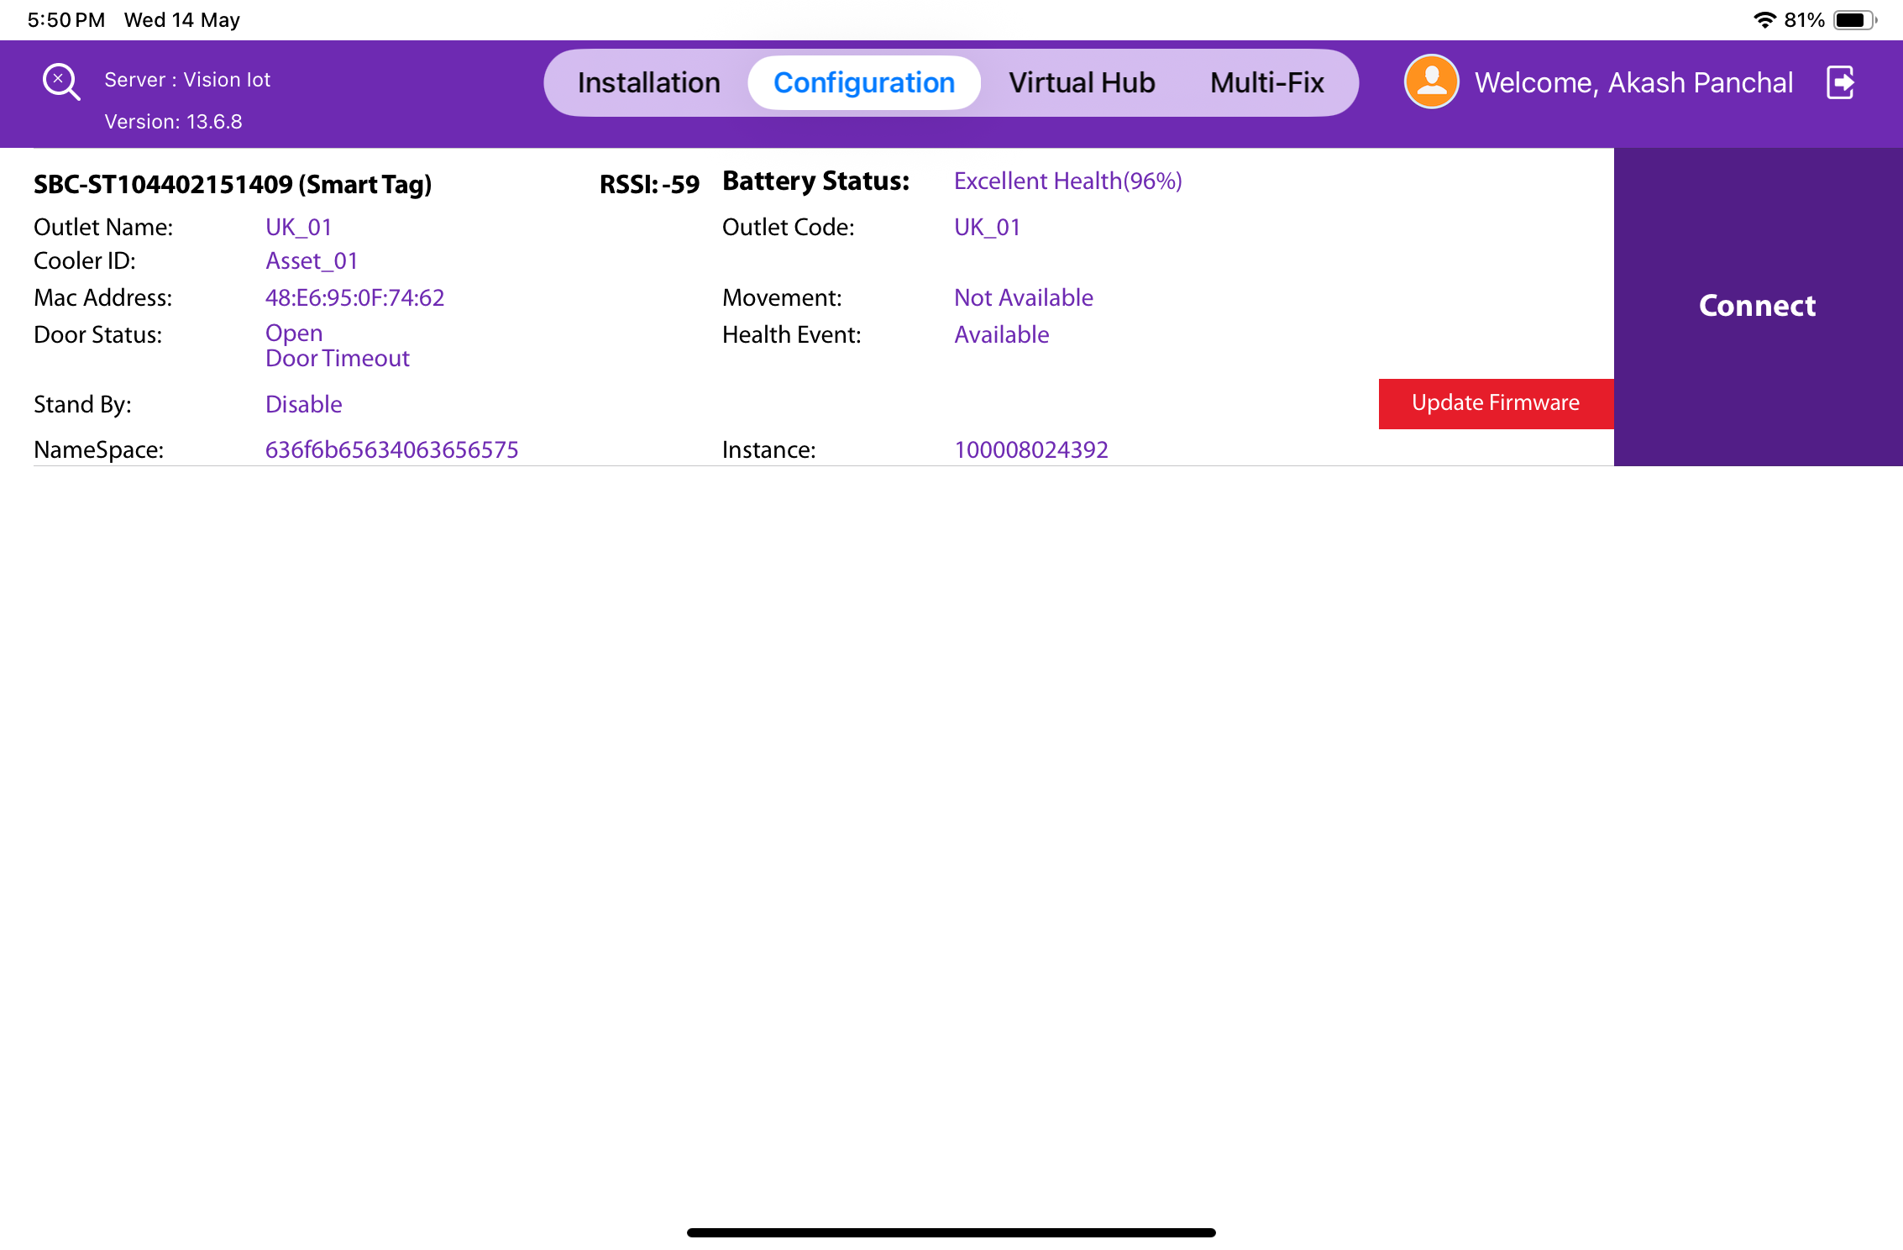
DFU VIA DFU FLAG
All SmartTag 3G, SmartTag 4G V2, and SmartTag 5G V3 devices assigned to a user can be viewed on the configuration screen. Devices with firmware versions less than or equal to a certain threshold will show an action button for firmware upgrades.
To begin the firmware upgrade, please tap the button. It is recommended that you remain near the device and stay still during this process.
© 2025 Vision Group

Slide 41
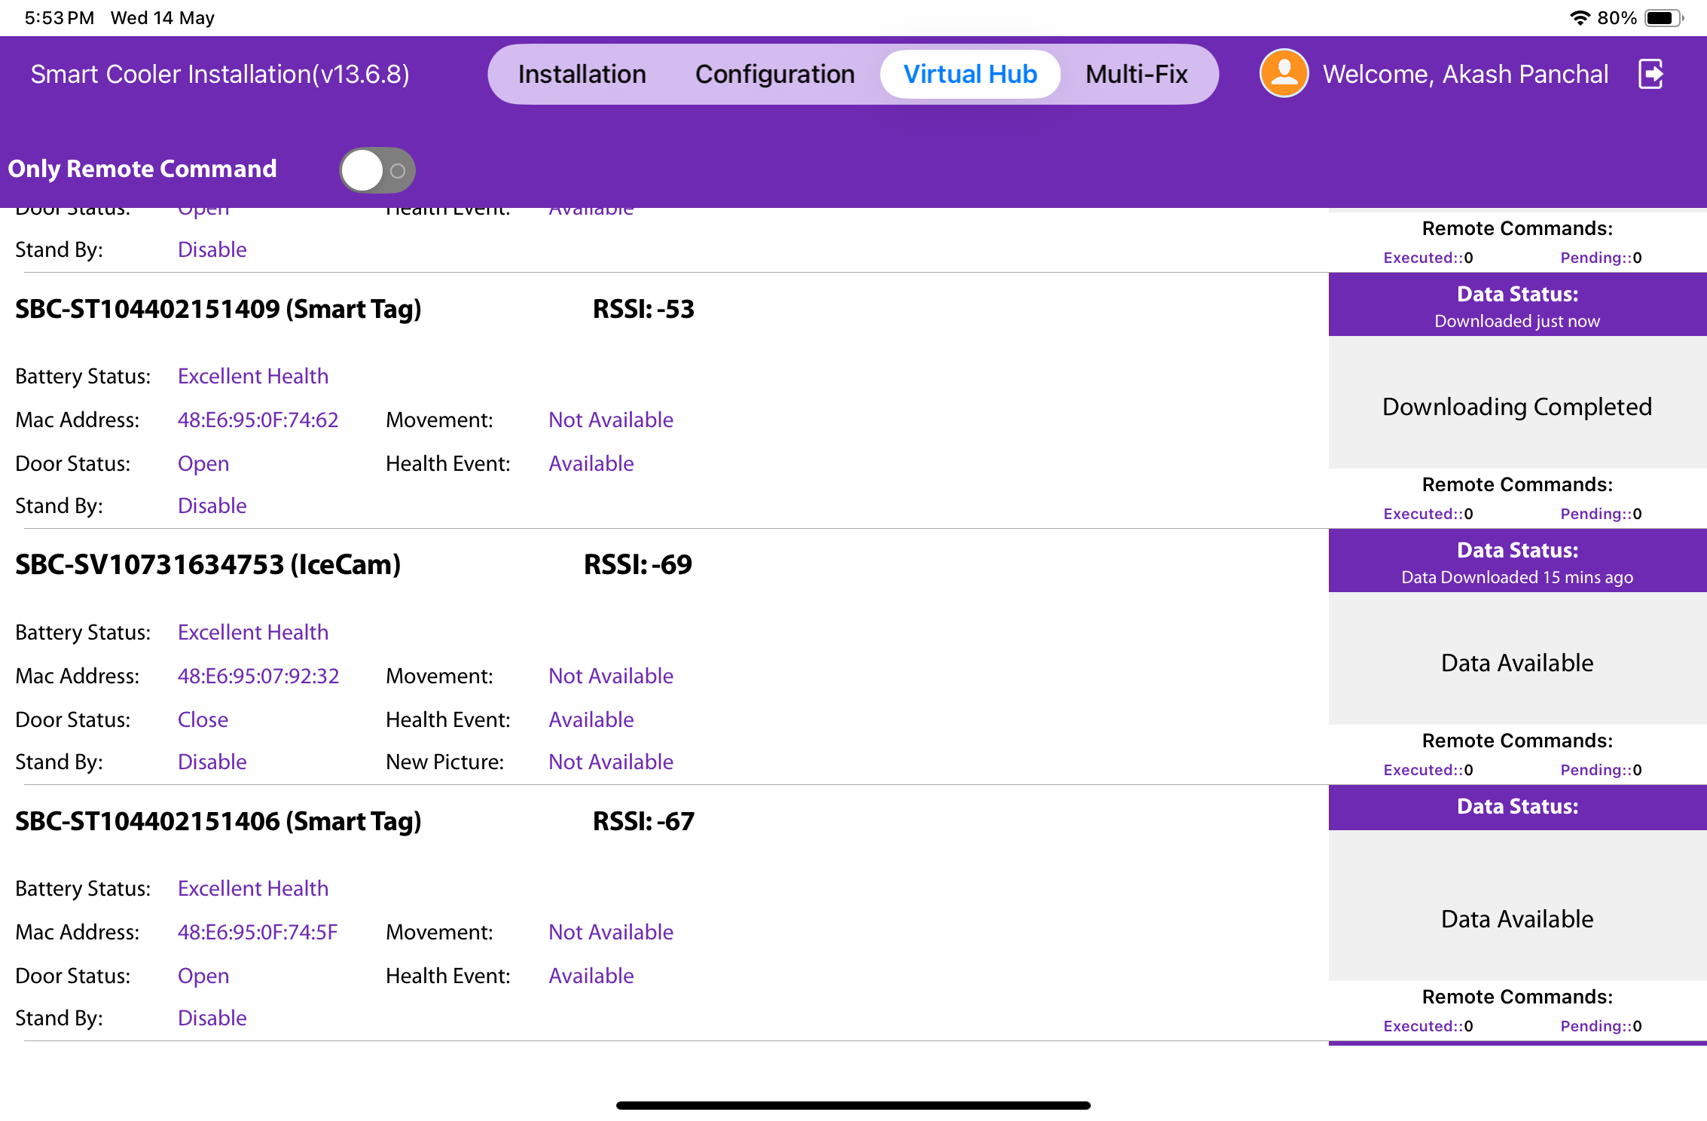
VH PROCESS (VIRTUAL HUB SCREEN PROCESS)
To access the VH Screen, click on the Virtual Hub Menu located in the bottom right corner, then select "VH." This screen displays applications that are downloading data from Smart Devices and uploading it.
Users can view the devices in their surroundings along with the status of each device. It is also possible to see the status of a device performing a “Remote Command,” although this may be displayed too quickly to notice.
© 2025 Vision Group

Slide 42
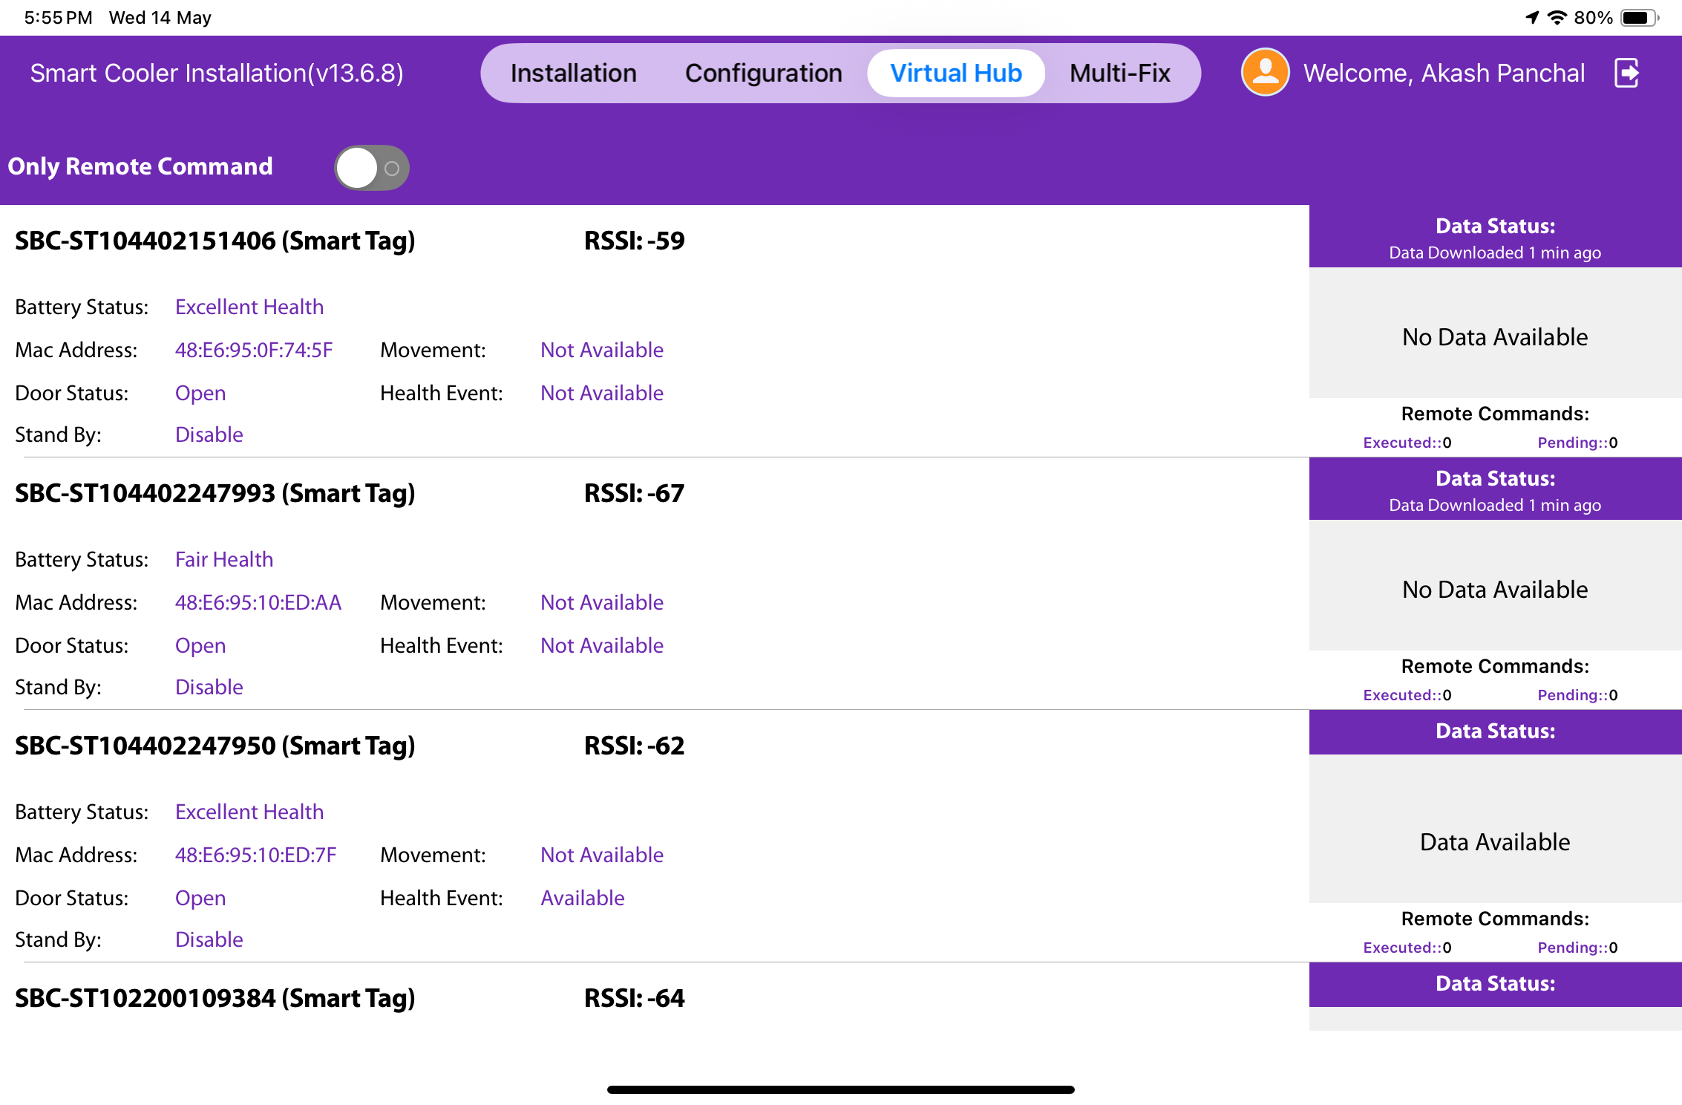
Please switch between Download and Remote commands and use only Remote commands when necessary.
By default, the switch is enabled.
• Only execute remote commands.
• If the switch is disabled, the application will begin downloading data from approved devices.
© 2025 Vision Group

Slide 43
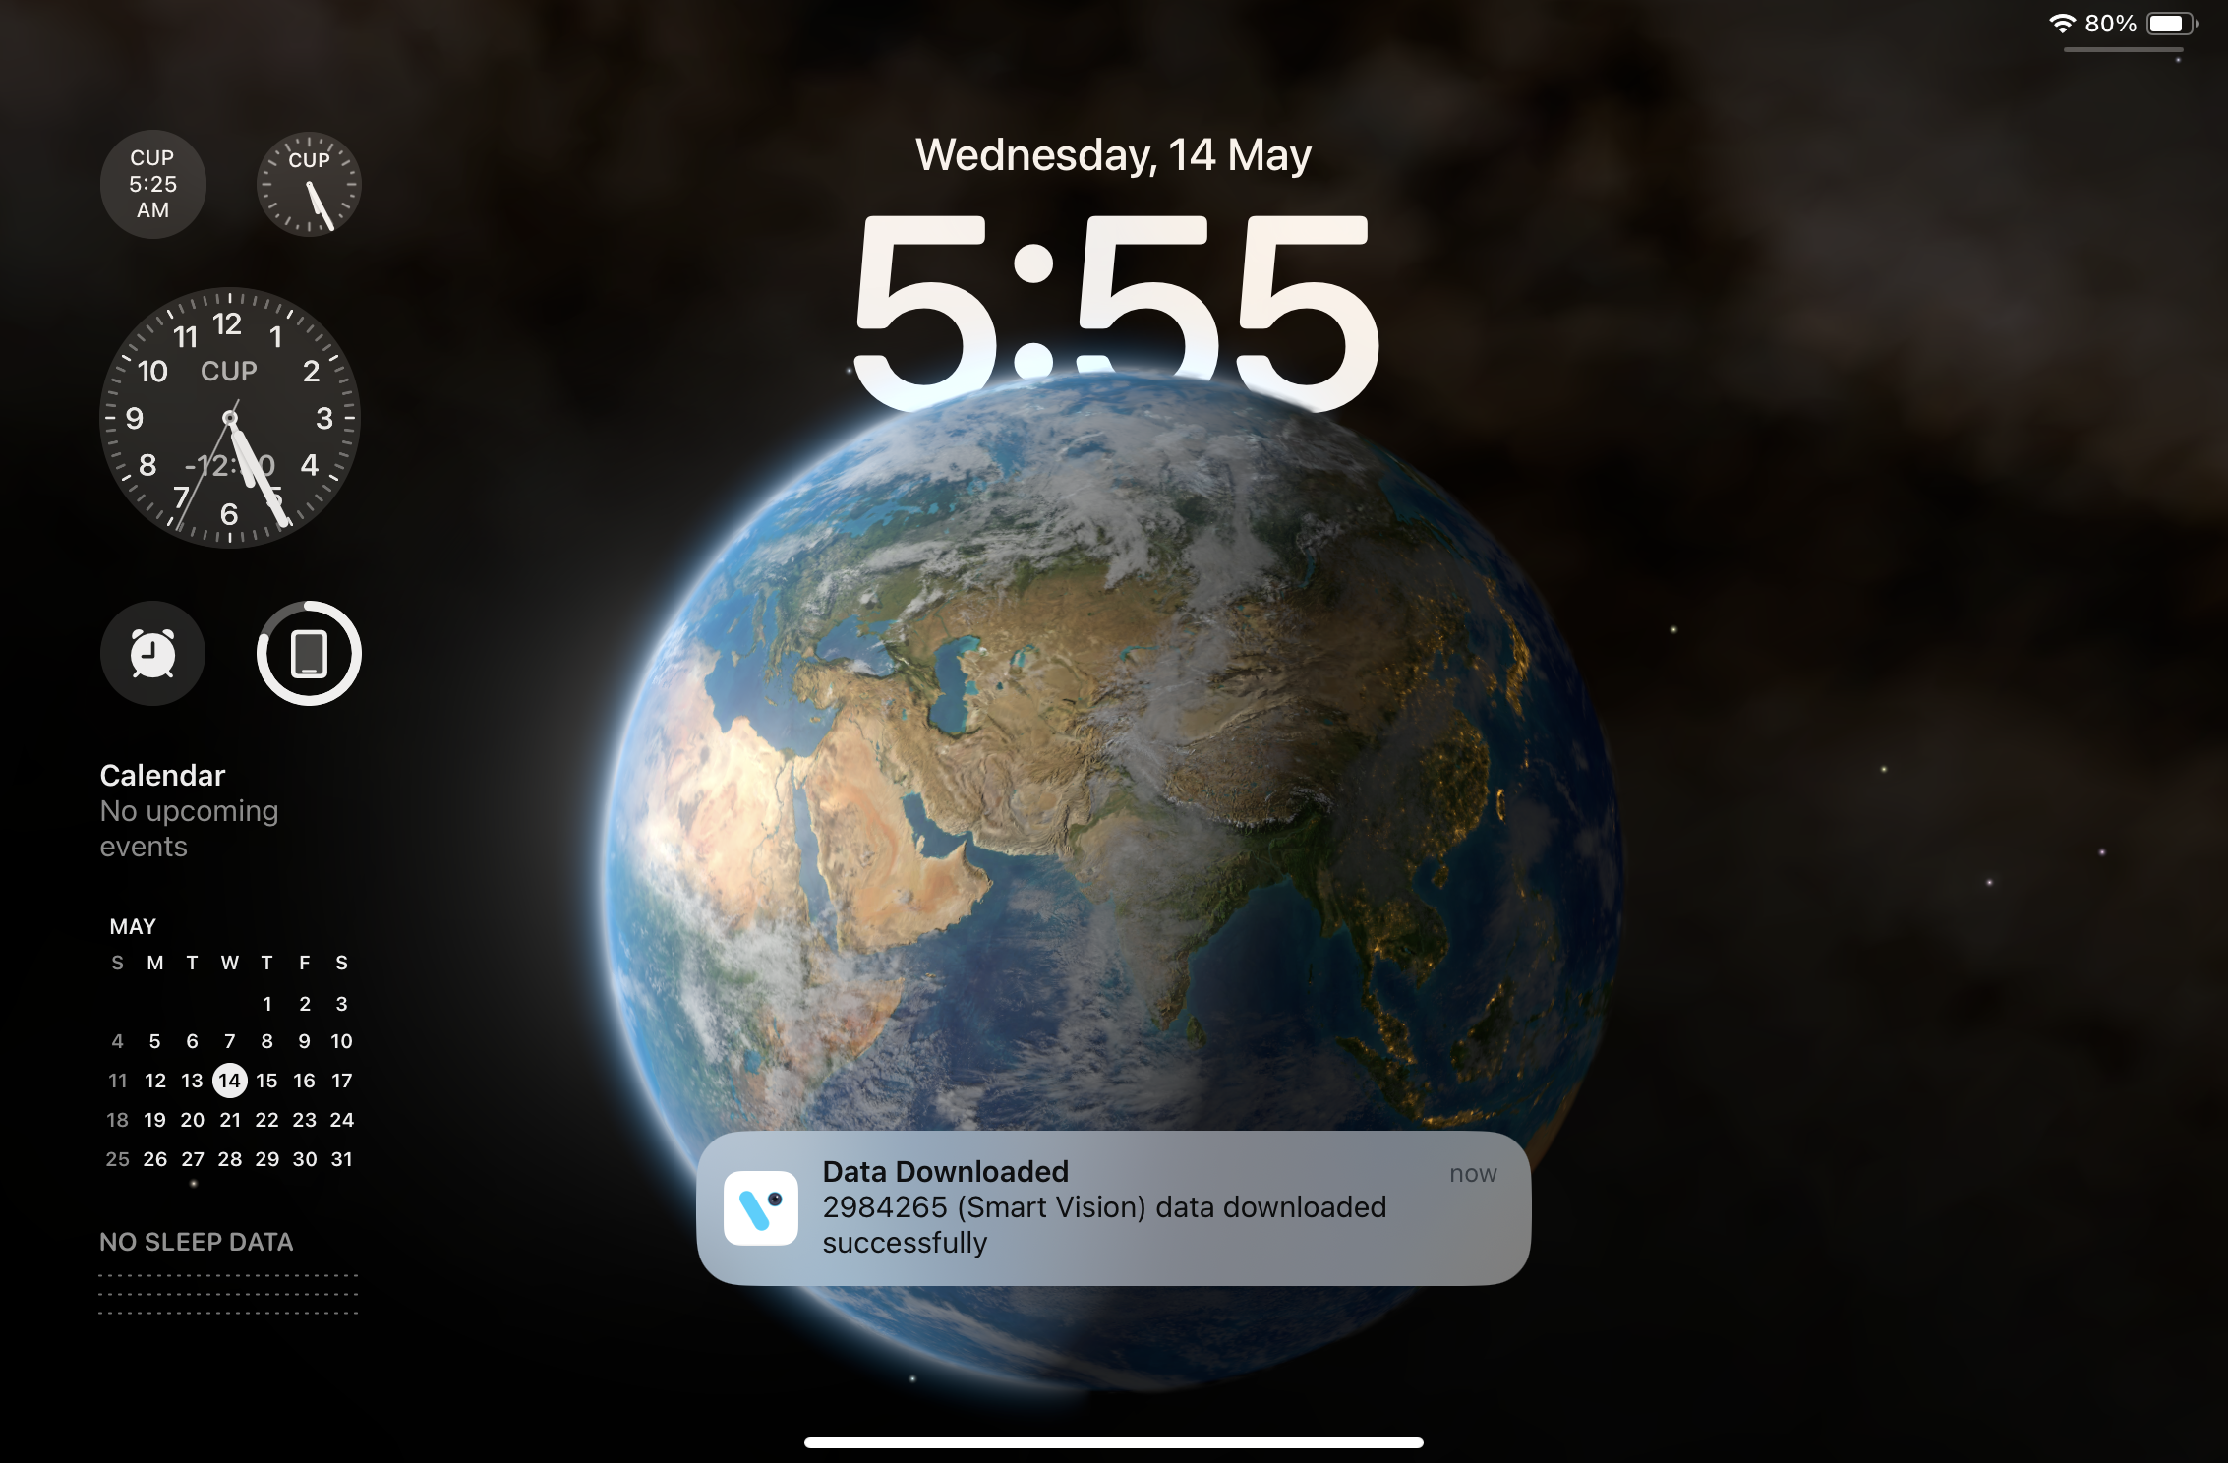
VH SCREEN - NOTIFICATION
Swipe down the notification menu to check the Virtual Hub service status when the application is running in the background.
© 2025 Vision Group

Slide 44
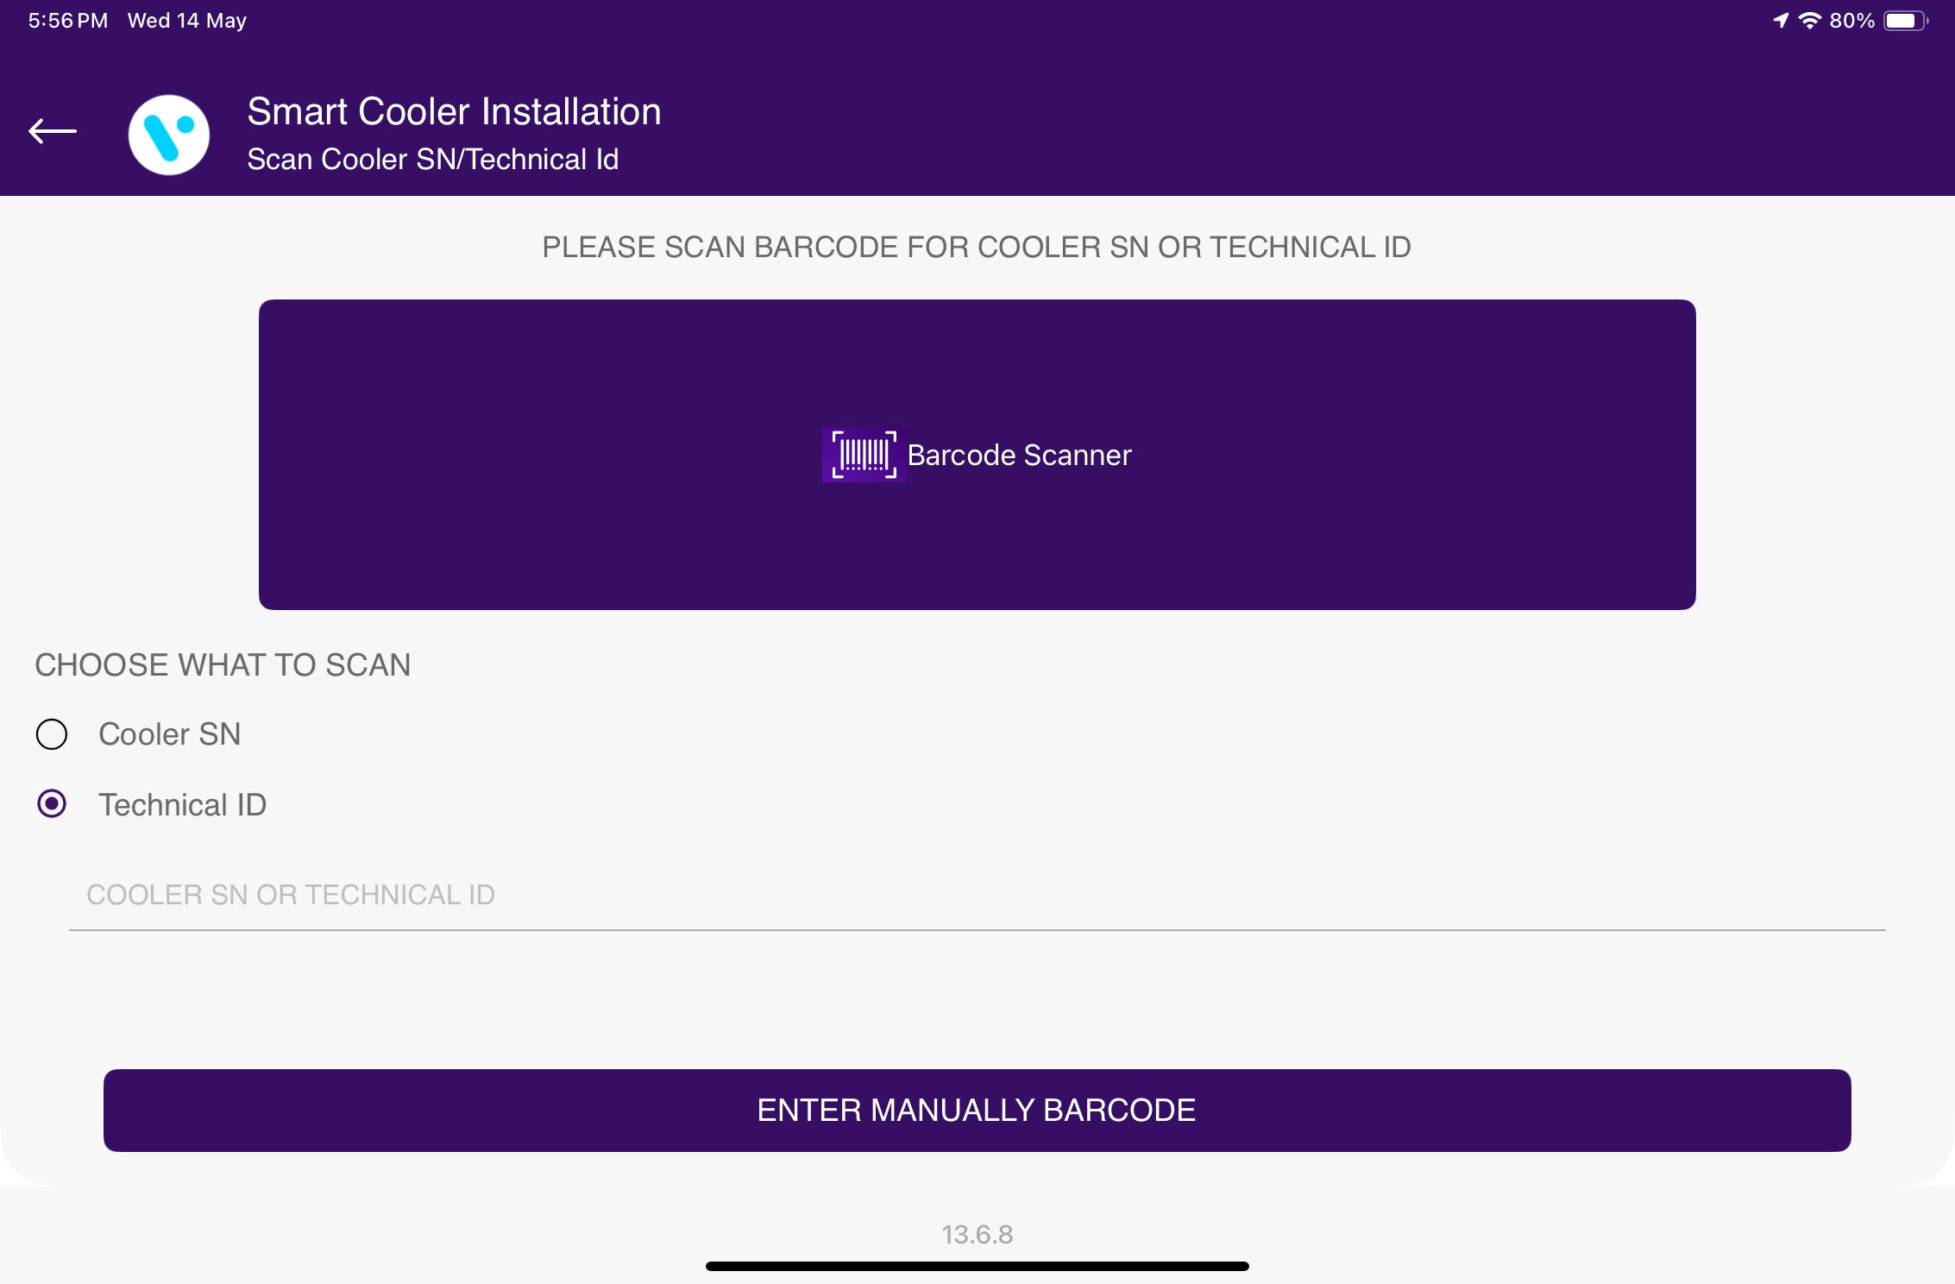
MULTI-FIX DEVICES - SMART DEVICES
Supported Devices For Multi-Fix: Smart Tags, Pencil Smart Vision, Sollatek FFMB, Sollatek GBR1, Sollatek FFXY
Ex. – Smart Tag 5GV3
Use the “Multi-Fix" feature to fix specific smart devices, as well as firmware version information and DFU functionality if the latest firmware is available for the scanned cooler.
Users can identify assets by scanning the barcode associated with the Cooler Serial Number (SN) or Technical ID. Additionally, users have the option to manually search for the barcode using the Cooler SN or Technical ID.
© 2025 Vision Group

Slide 45
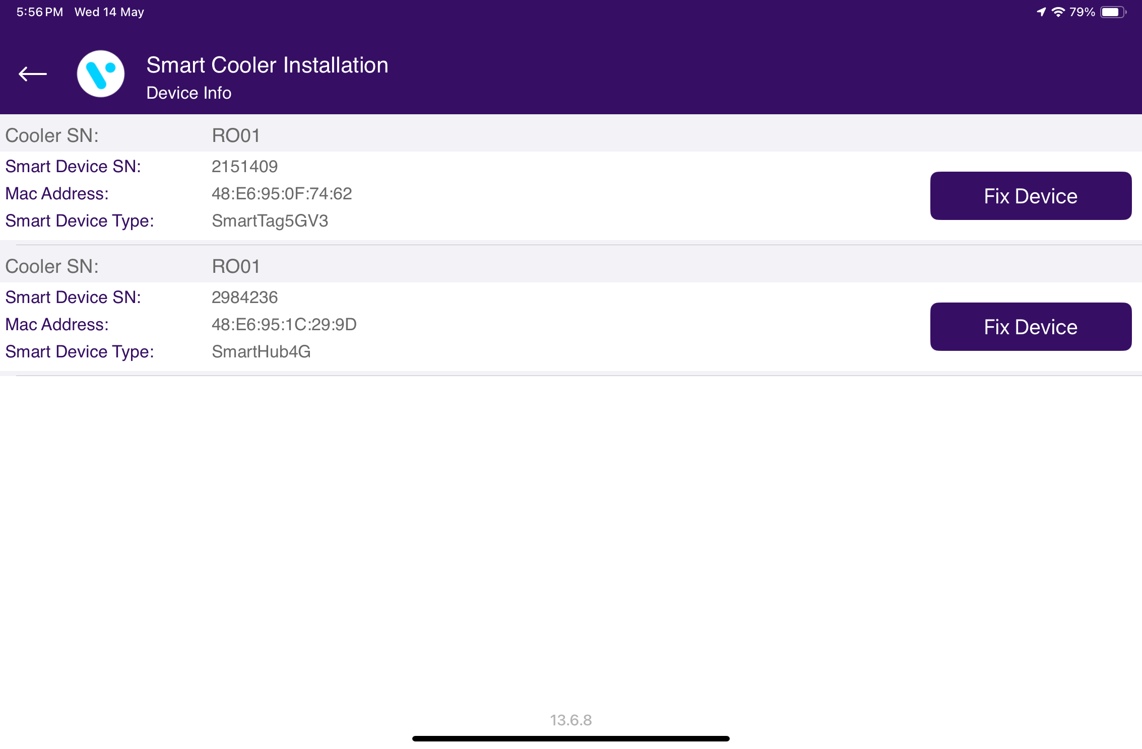
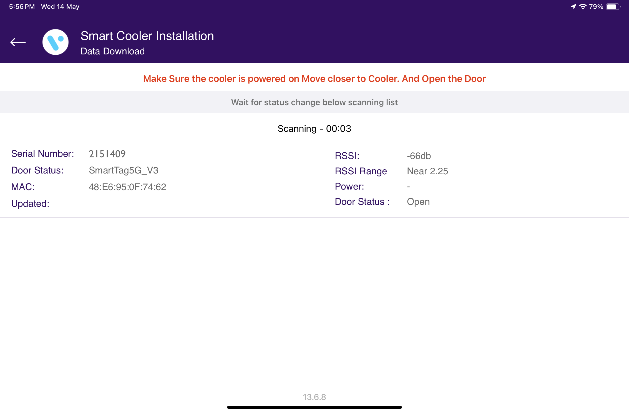
The scanned device will be corrected with the actual smart device's serial number, upgraded to the latest firmware if available, and configured accordingly.
© 2025 Vision Group

Slide 46
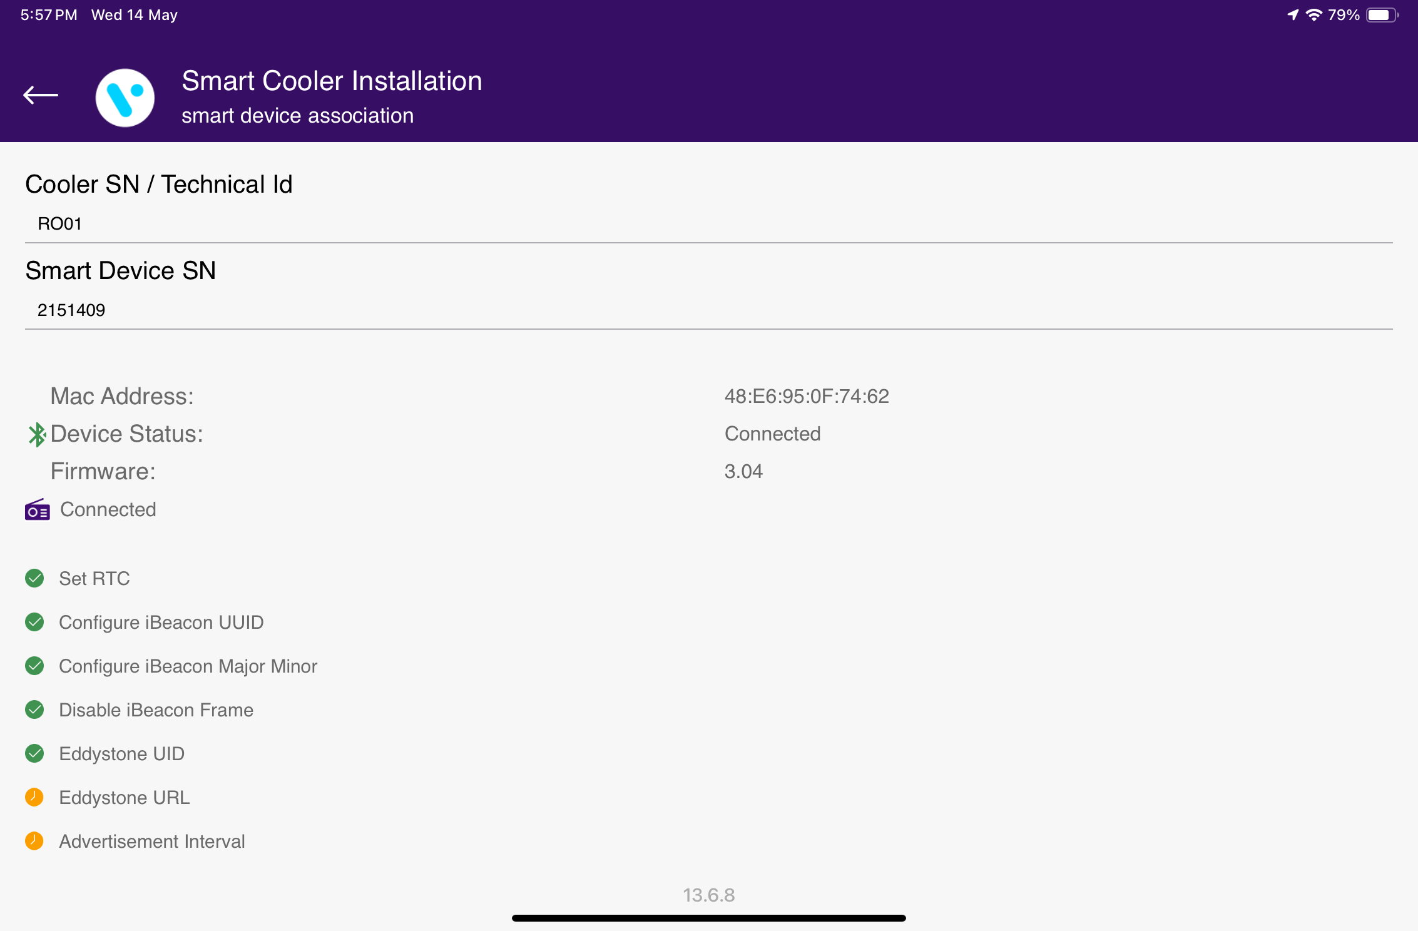
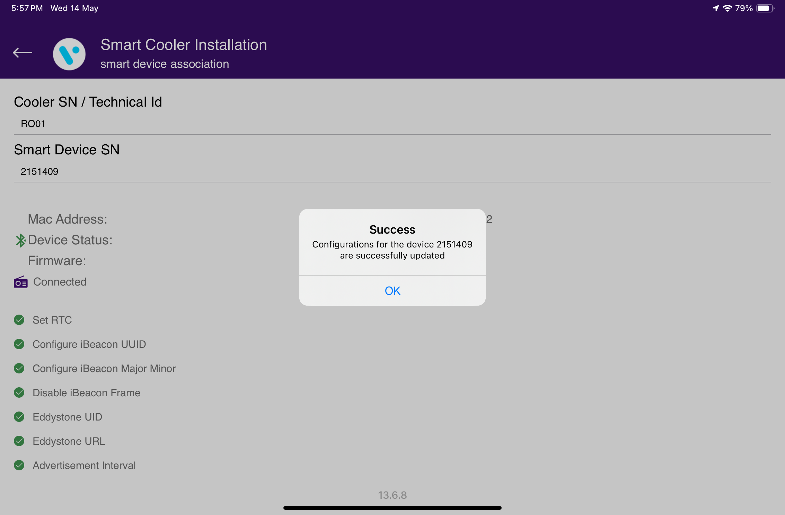
After completing the DFU process, the application starts to configure the device based on the device type and displays a success message once the entire process is complete.
© 2025 Vision Group

Slide 47
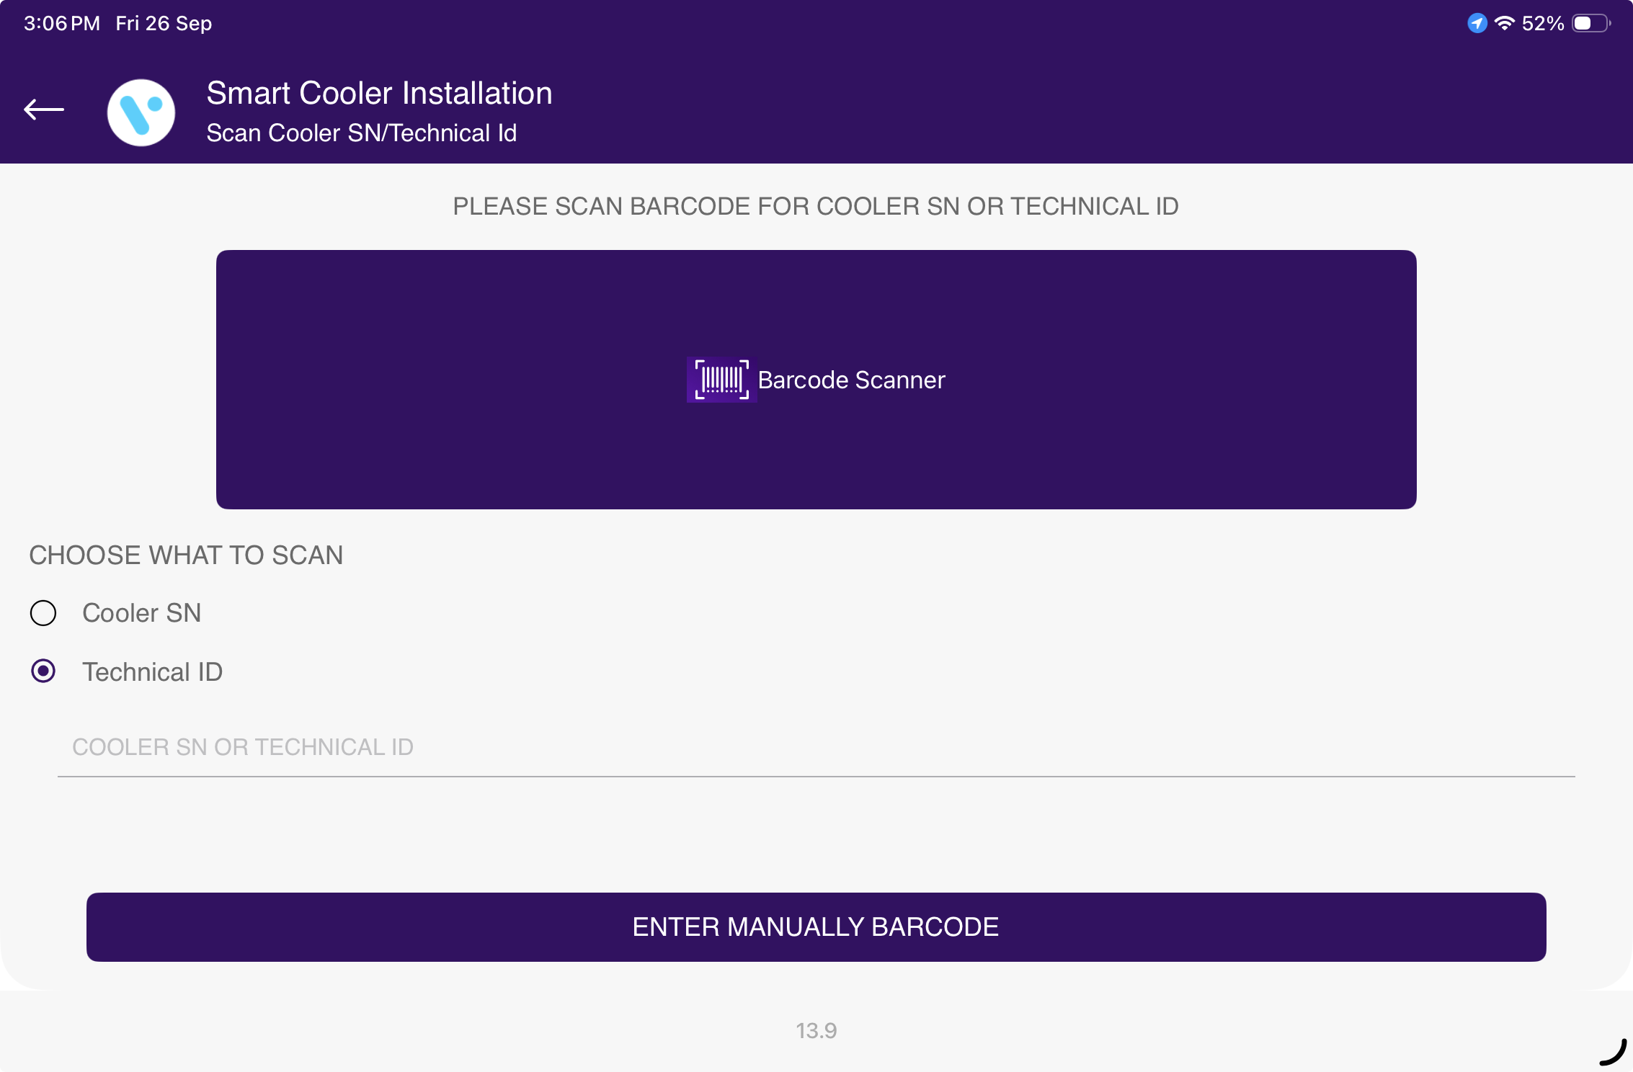
MULTI-FIX DEVICES – AON DEVICES
Supported AON Devices For Multi-Fix: Smart Tag AON, Sollatek FDEx2, Sollatek FFM2BB
Ex. – Smart Tag AON
Use the “Multi-Fix" feature to fix specific Smart Tag AON devices, as well as firmware version information and DFU functionality if the latest firmware is available for the scanned cooler.
Users can identify assets by scanning the barcode associated with the Cooler Serial Number (SN) or Technical ID. Additionally, users have the option to manually search for the barcode using the Cooler SN or Technical ID.
© 2025 Vision Group

Slide 48
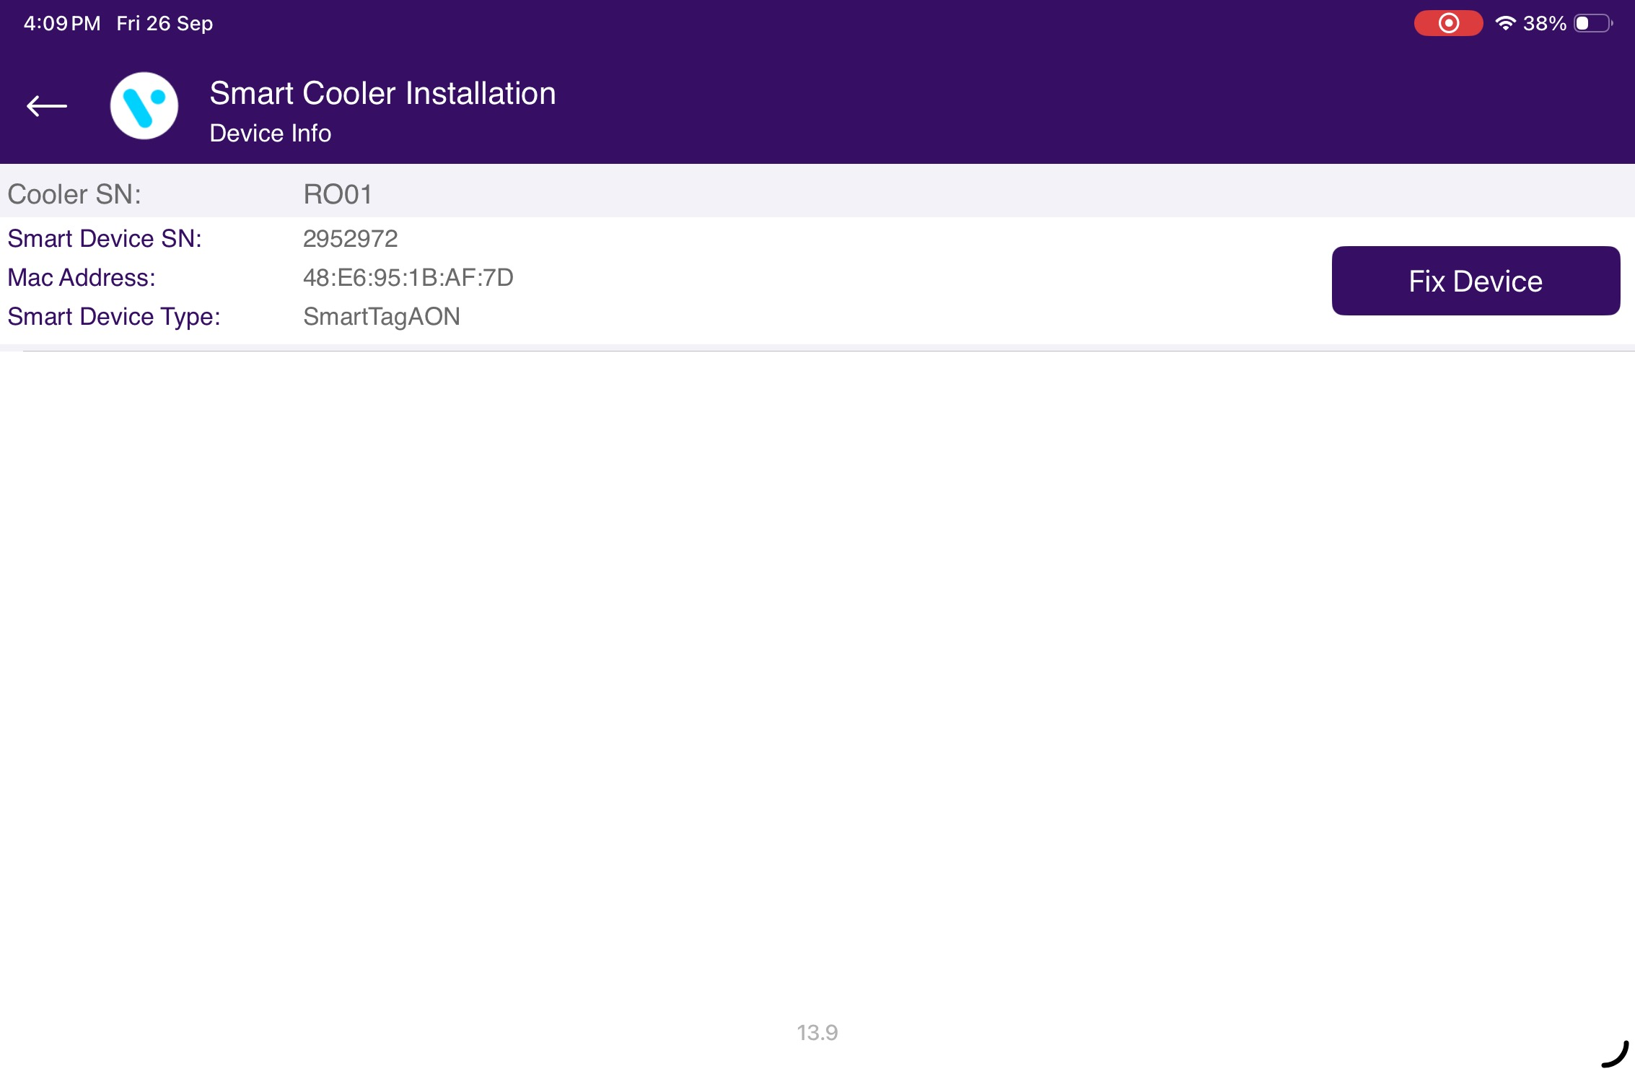

To broadcast the Smart Tag AON device during scanning, it is necessary to provide 5 to 7 door cycles (door open and close) within 30 seconds.
The scanned device will be corrected with the actual smart device's serial number, upgraded to the latest firmware if available, and configured accordingly.
© 2025 Vision Group

Slide 49


After completing the DFU process, the application starts to configure the device based on the device type and displays a success message once the entire process is complete.
© 2025 Vision Group

Slide 50

In the event of an error occurring while fixing the faulty Smart Tag AON Devices, Multi-Fix Logs will be automatically collected, along with the necessary details. An email will be drafted by the iOS application, providing an option to send it to the Vision IoT Support team.
© 2025 Vision Group

Slide 51
Ex. – Sollatek FDEx2
Use the “Multi-Fix" feature to fix specific Sollatek FDEx2 devices, as well as firmware version information and DFU functionality if the latest firmware is available for the scanned cooler.
Users can identify assets by scanning the barcode associated with the Cooler Serial Number (SN) or Technical ID. Additionally, users have the option to manually search for the barcode using the Cooler SN or Technical ID.
© 2025 Vision Group

Slide 52
The scanned device will be corrected with the actual smart device's serial number, upgraded to the latest firmware if available, and configured accordingly.
© 2025 Vision Group

Slide 53
After completing the DFU process, the application starts to configure the device based on the device type and displays a success message once the entire process is complete.
© 2025 Vision Group

Slide 54
In the event of an error occurring while fixing the faulty Sollatek Devices, Multi-Fix Logs will be automatically collected, along with the necessary details. An email will be drafted by the iOS application, providing an option to send it to the Vision IoT Support team.
© 2025 Vision Group

Slide 55

TEST AND VERIFY – SMART DEVICES
Supported Devices: Smart Tags, Pencil Smart Vision, Sollatek FFMB, Sollatek GBR1, Sollatek FFXY
Ex. – Smart Tag 5GV3
This feature involves verifying fixed devices after addressing any faulty fix features to ensure accurate iBeacon and Eddystone advertisement frame values.
Users can identify assets by scanning the barcode using the Cooler Serial Number (SN) or Technical ID. Additionally, users have the option to manually search for the barcode associated with the Cooler Serial Number or Technical ID.
© 2025 Vision Group

Slide 56


The application is requesting a door cycle to verify the data from the smart device’s door sensor.
© 2025 Vision Group

Slide 57


After completing the Door Cycle, the device will display the advertisement frame values alongside the smart device and cloud values. By pressing the Download Event button, users can log Door Events to verify the Door Event.
© 2025 Vision Group

Slide 58
TEST AND VERIFY – AON DEVICES
Supported AON Devices: Smart Tag AON, Sollatek FDEx2, Sollatek FFM2BB
Ex. – Smart Tag AON
This feature involves verifying fixed devices after addressing any faulty fix features to ensure accurate iBeacon and Eddystone advertisement frame values, GPRS Intervals values, URL values, and APN values.
Users can identify assets by scanning the barcode using the Cooler Serial Number (SN) or Technical ID. Additionally, users have the option to manually search for the barcode associated with the Cooler Serial Number or Technical ID.
© 2025 Vision Group

Slide 59


The application is requesting a door cycle to verify the data from the smart device’s door sensor.
© 2025 Vision Group

Slide 60


After completing the Door Cycle, the device will display the advertisement frame values alongside the smart device and cloud values. By pressing the Download Event button, users can log Door Events to verify the Door Event.
© 2025 Vision Group

Slide 61
Ex. – Sollatek FDEx2
This feature involves verifying fixed devices after addressing any faulty fix features to ensure accurate iBeacon and Eddystone advertisement frame values, GPRS Intervals values, URL values, and APN values.
Users can identify assets by scanning the barcode using the Cooler Serial Number (SN) or Technical ID. Additionally, users have the option to manually search for the barcode associated with the Cooler Serial Number or Technical ID.
© 2025 Vision Group

Slide 62
The application is requesting a door cycle to verify the data from the smart device’s door sensor.
© 2025 Vision Group

Slide 63
After completing the Door Cycle, the device will display the advertisement frame values alongside the smart device and cloud values. By pressing the Download Event button, users can log Door Events to verify the Door Event.
© 2025 Vision Group

Slide 64
SMART DEVICE REMOVAL OF ASSOCIATION AND REUSAGE
To properly remove a Smart Device from a cooler, please follow these steps:
1. Log in to the Vision IoT application using the BD credentials for the relevant territory.
2. Navigate to the Virtual Hub tab and ensure that all data from the Smart Device has been downloaded (the Virtual Hub tab should be in the foreground).
3. Locate the outlet and cooler where the Smart Device is installed.
4. Tap the "Remove Association" button.
5. Physically detach the device (and if it is a SmartTag or SmartVision, also remove the magnet) from the cooler.
The app must have internet access at the time of installation or later for the data to be available to the server. Additionally, the app should have internet access before attempting to reinstall the same device in this or any other location. Once the iFSA download is underway, the download will proceed via iFSA, while the removal of the association must be done through the Vision IoT application.
If you want to install the same Smart Device on a different cooler, please follow these steps:
1. Ensure you log in to the Vision IoT application again after uninstalling the Smart Device. This is necessary for the server to send the correct information and settings to the application for the new installation.
2. After uninstalling the device, make sure to log off and then log back into the Vision IoT application.
3. If you are installing the device using a different tablet, app, or BD username, make sure to log in only after the device has been successfully uninstalled.
Important Information:
1. The minimum device requirement is an iPad 8th Generation or higher, and the minimum iOS version is 14.
2. Only one user should be logged in at a time. If another user needs to log in, the application must be reinstalled.
© 2025 Vision Group

Slide 65


Thank You!
support.iot@visiongroupretail.com
+1-833-593-0144 (USA Tollfree Number)

