Slide 1
Smart Cooler Installation
iOS Installation Guide
November 2024
© 2024 Vision Group

Slide 2
APPLICATION FEATURES
ASSOCIATION – To Associate the Smart Device and Remove the association with the Cooler.
DEVICE SCANNING AND CONFIGURE – To check Device Advertisement and Configure.
DFU – Direct Firmware Update of Smart Devices.
DATA DOWNLOAD AND UPLOAD – To Download and Upload data of the Smart Devices.
FIX FAULTY DEVICES – To Fix the Faulty Devices.
TEST AND VERIFY – To verify the Faulty Device after the Fix.
© 2024 Vision Group

Slide 3
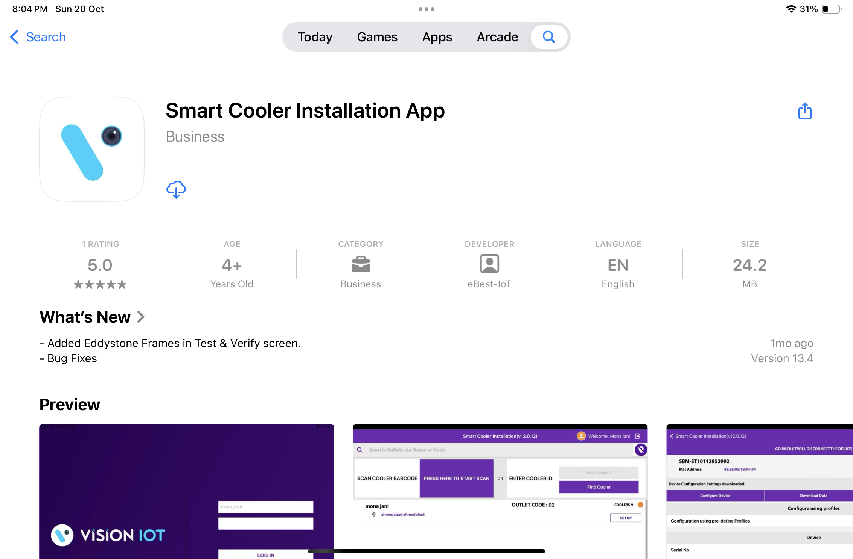
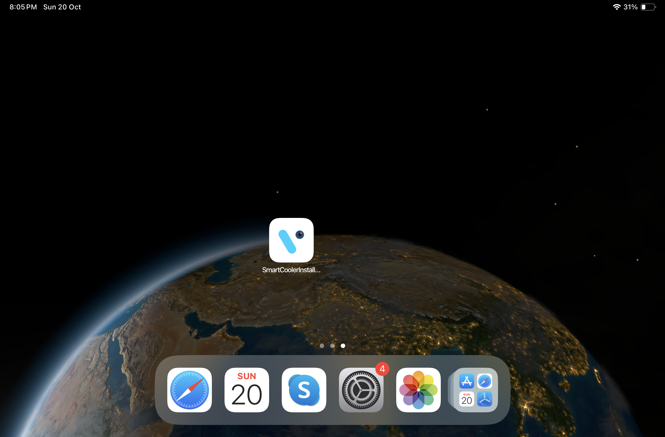
APPLICATION INSTALLATION
Please remember the following instructions: Open the App Store on an iOS device. Search for the “SMART COOLER INSTALLATION" application and install it.
Remember to delete the previous version of the application before installing a new version.
© 2024 Vision Group

Slide 4
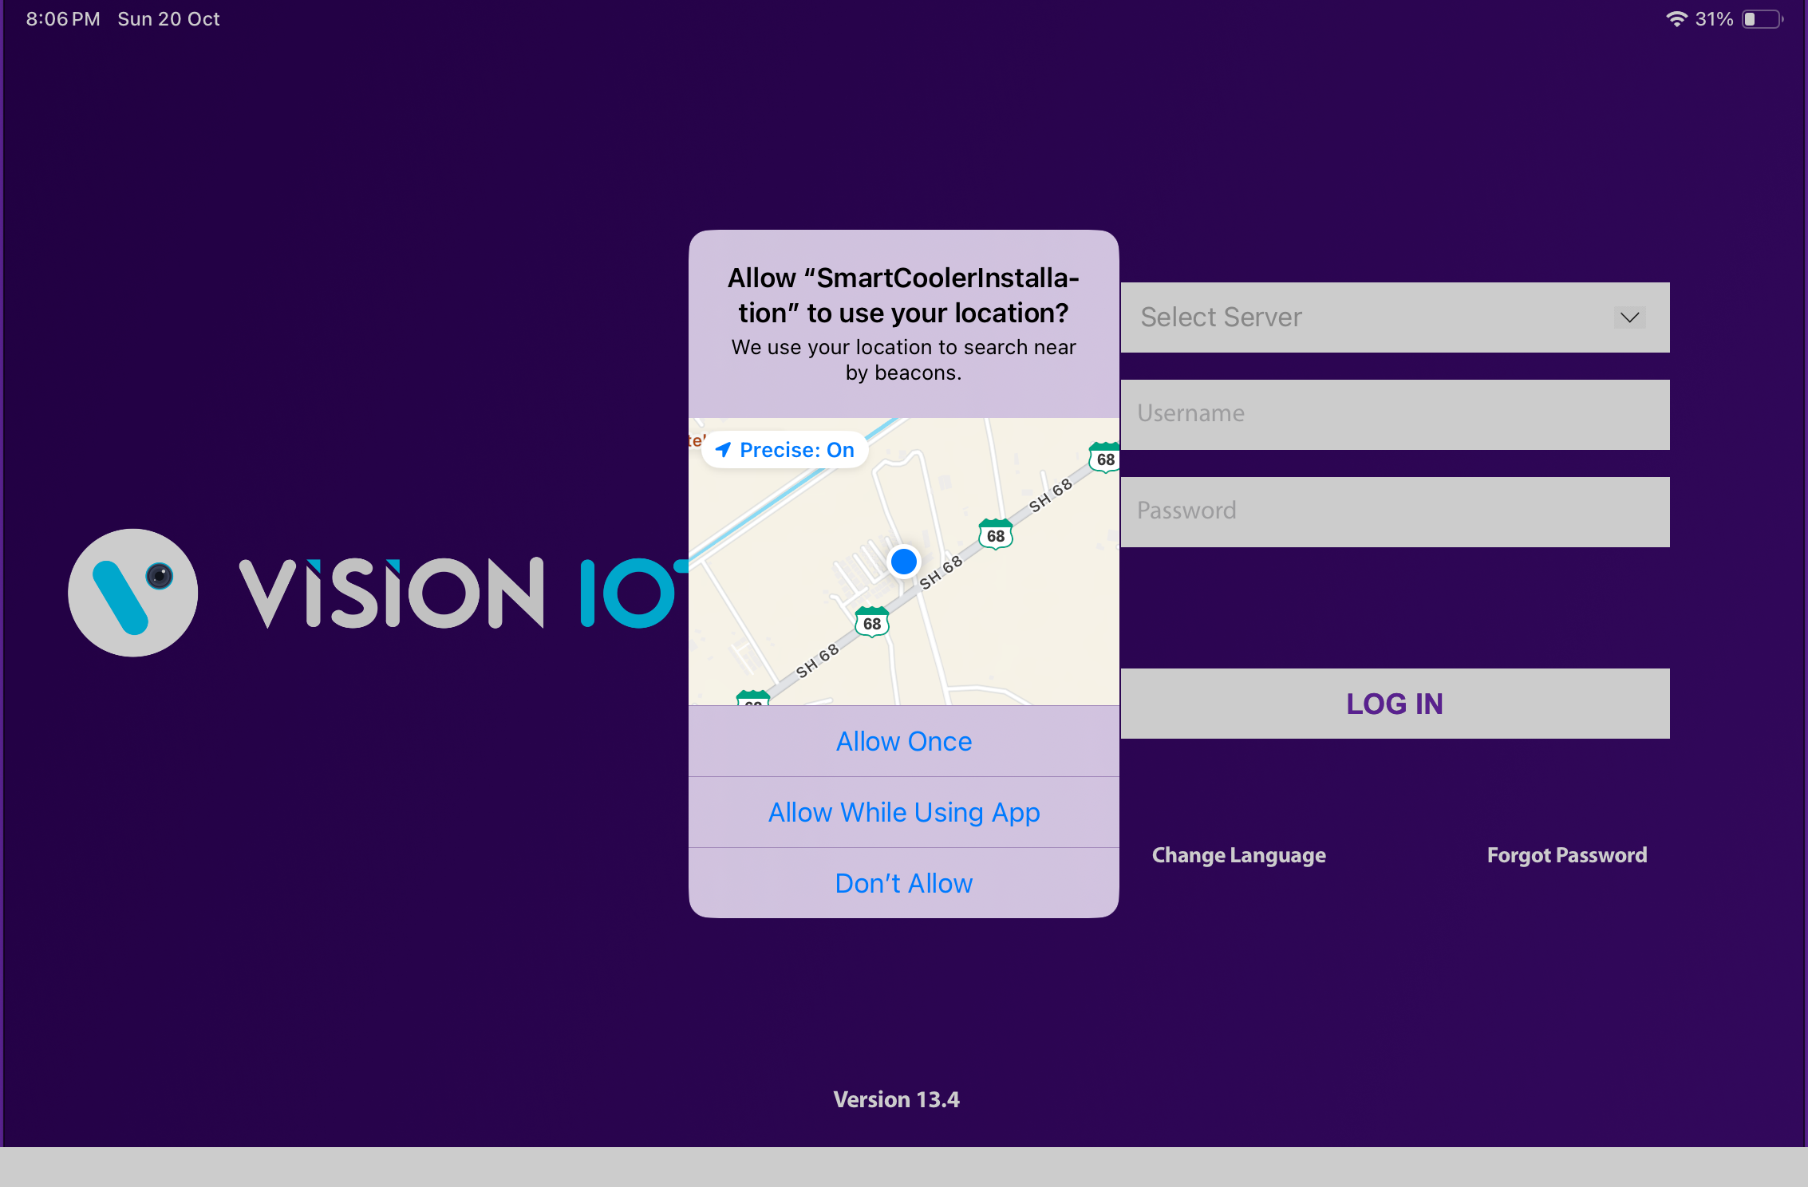
APPLICATION PERMISSION
After initial Installation & launch, the Application will ask for permission to access. Camera Permission, File and Media Permission, Location Permission, Nearby Device Permission Need to Allow.
Choose Server: The server should be ATOS Codex for CCH, and another server should be chosen for other customers and QA.
LOCATION PERMISSION
For Location (so beacons can be found) - Choose Allow While Using for iOS OS 14 and Above.
© 2024 Vision Group

Slide 5
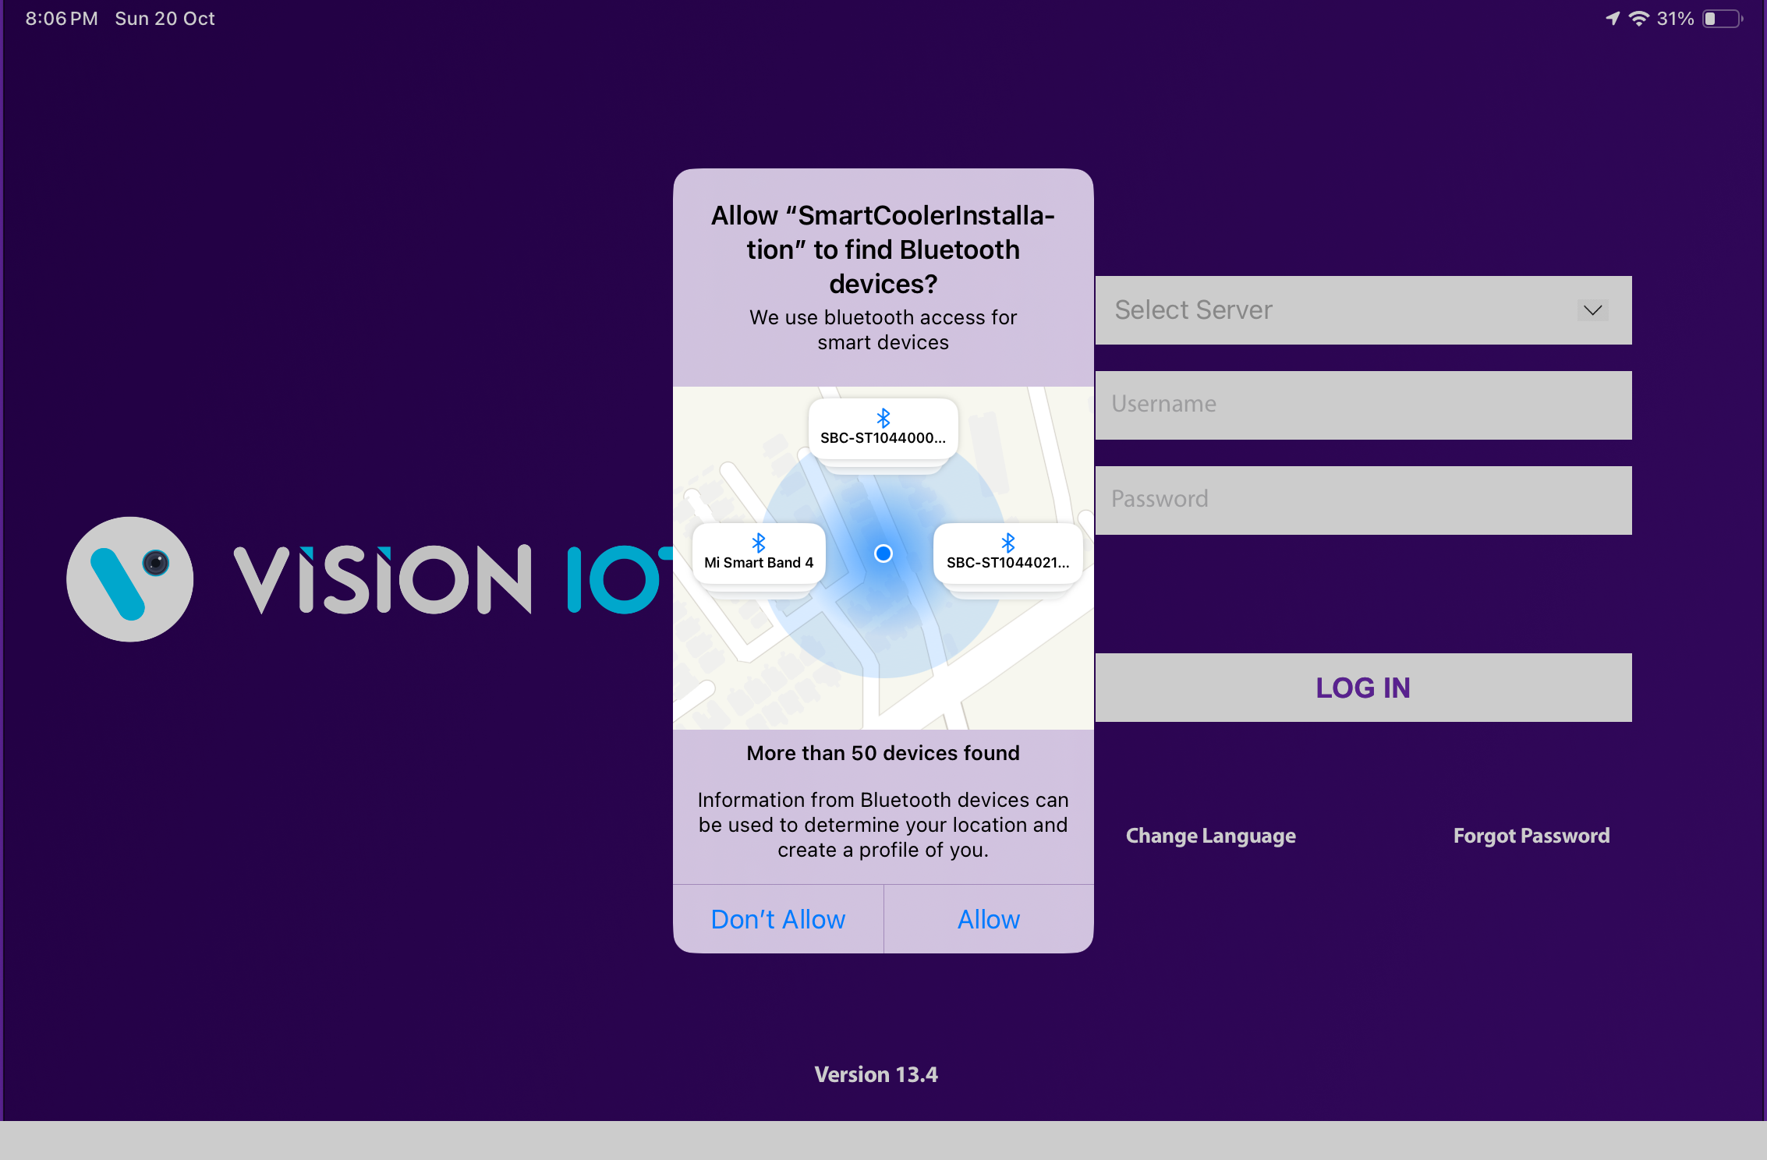
APPLICATION PERMISSION (Cont’d)
BLUETOOTH PERMISSION
Access the Bluetooth (to scan barcodes) – the first prompt on the Outlet screen -> Choose “Allow”.
© 2024 Vision Group

Slide 6
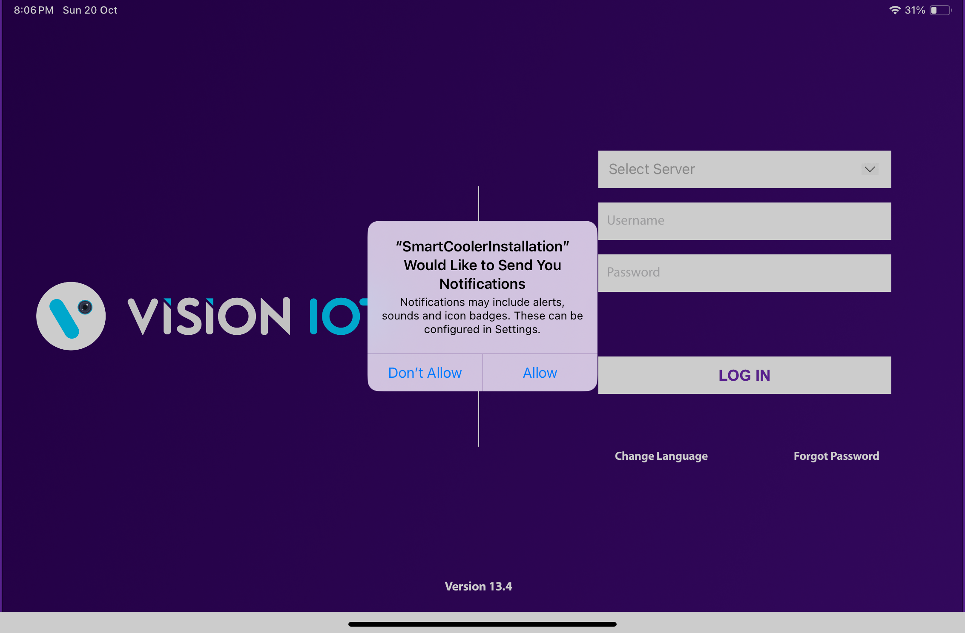
APPLICATION PERMISSION (Cont’d)
NOTIFICATION PERMISSION
Send notifications (to inform of data download) -> Choose “Allow”
© 2024 Vision Group

Slide 7
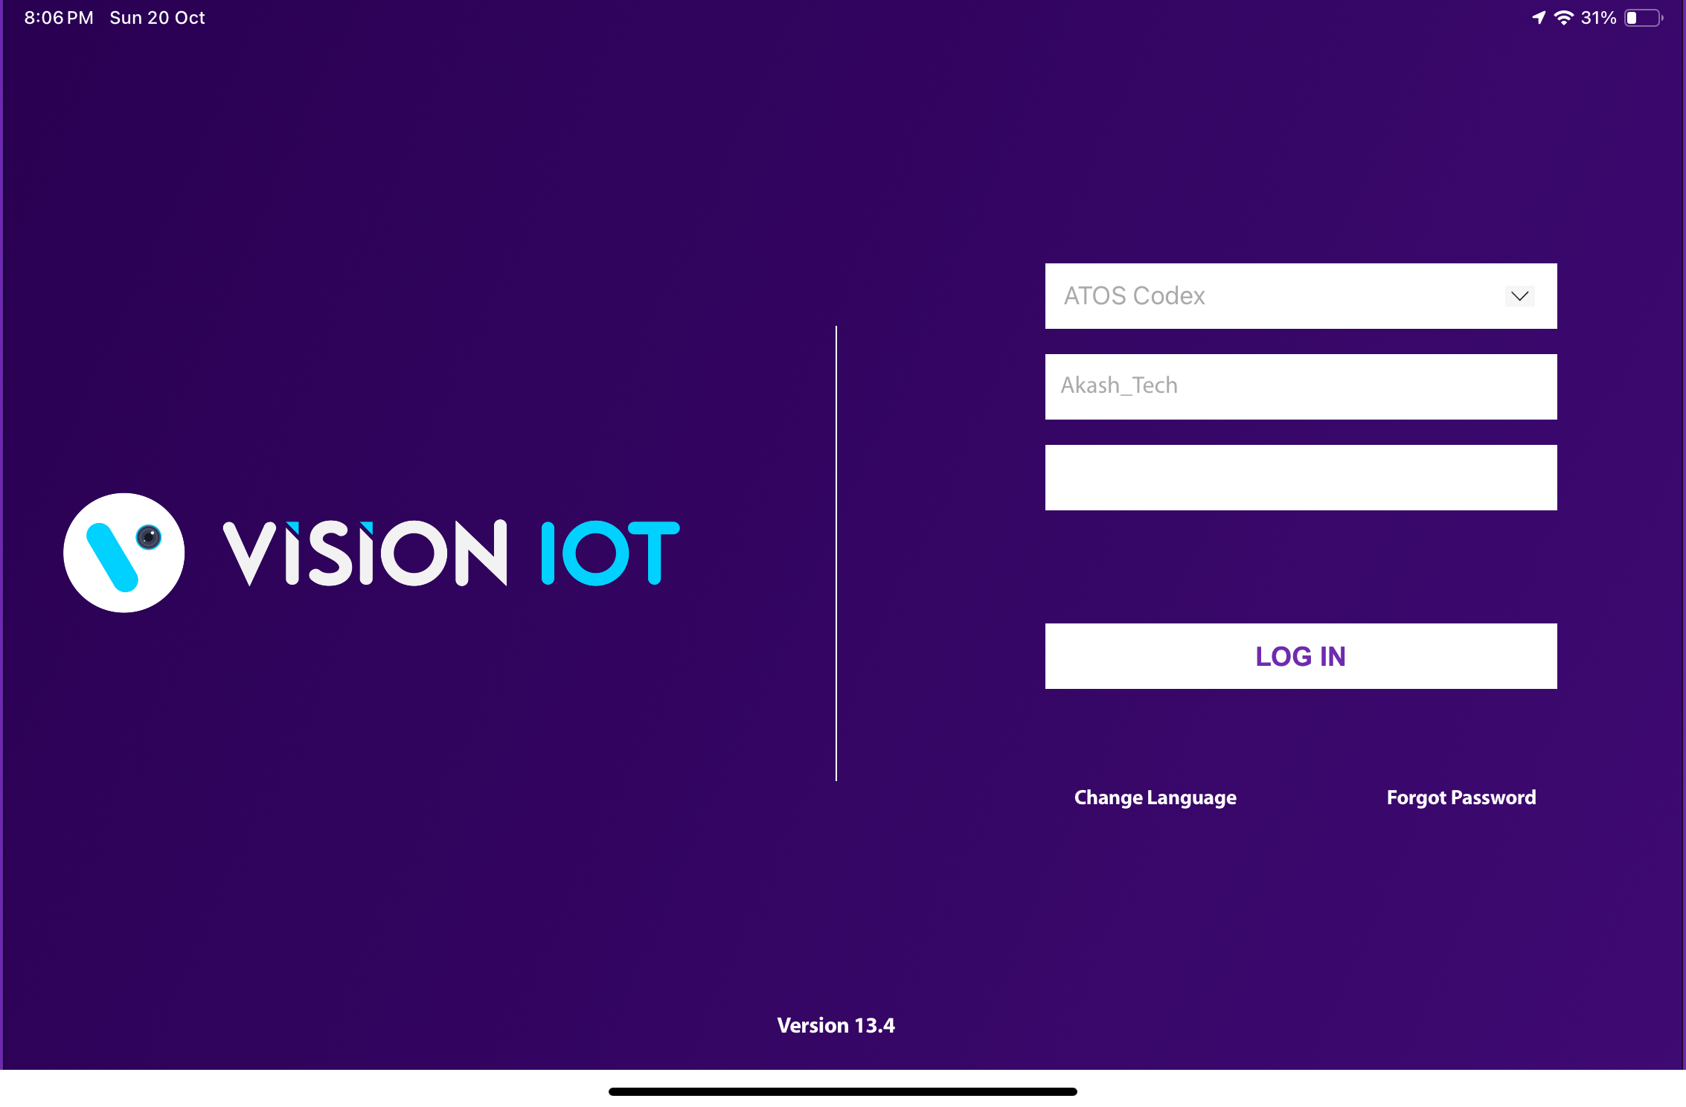
LOGIN
After successfully installing the Smart Cooler Installation Application, open it, and it will redirect you to the Login Page. Select the server from the server list and Login in the application using the credentials provided by your administrator after successful login.
Remember to ensure Bluetooth & Mobile Wi-Fi or Mobile Data are ON in the device.
The Change from v. 2.7 is that All data (outlets, assets, remote commands, firmware) is downloaded before showing the Outlet Screen.
Bluetooth also should be enabled as well as location services.
The application requires an internet connection for initial login. After the initial log in the application can work in Offline mode provided that the same username & password as the one in the online login is used.
All versions after and including 1.7 do not download device data by default. If you wish to enable this option, you should toggle the switch at the VH screen which is titled “Only Remote Command”
Minimum device requirements – iPad 8th Gen and Above Models.
The Minimum iOS version is 14 and Above.
© 2024 Vision Group

Slide 8
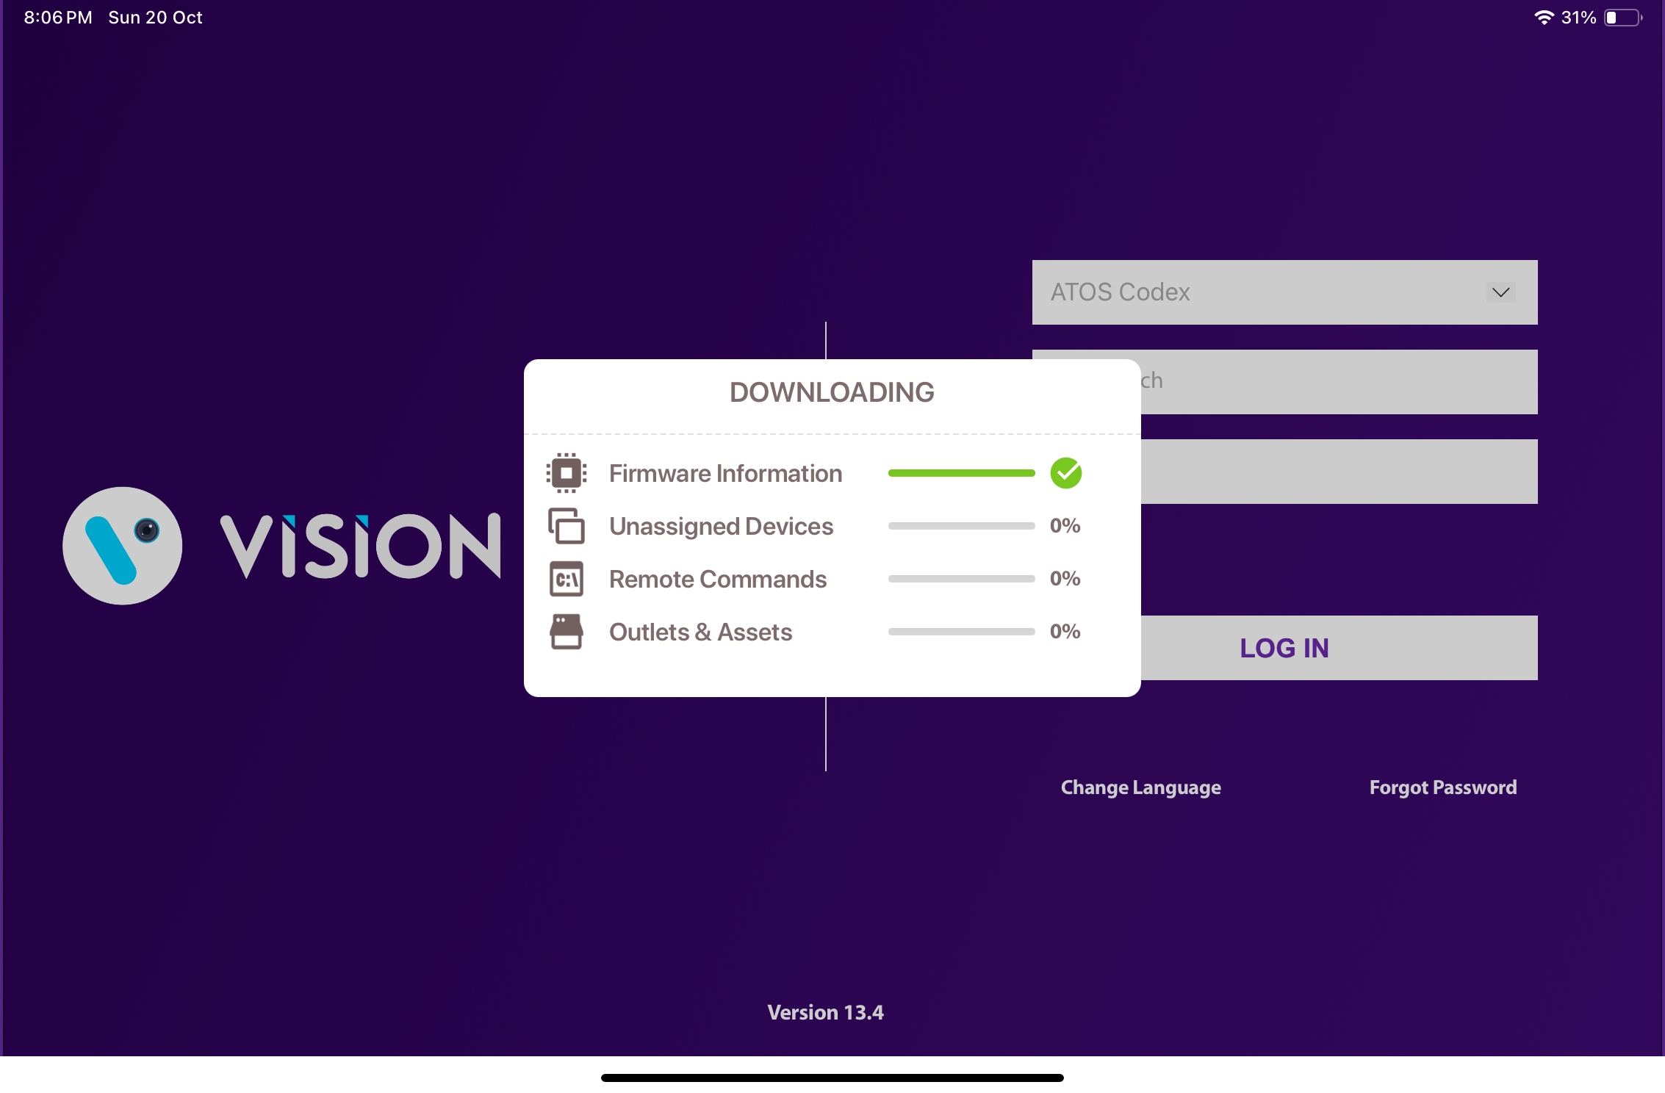
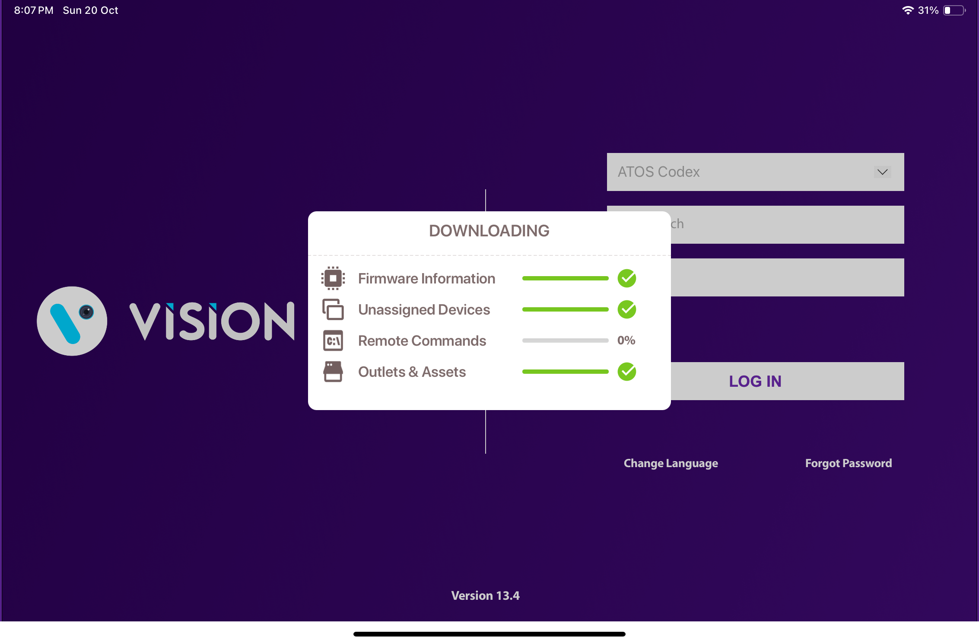
LOGIN (Cont’d)
Provide valid credentials and tap on the Login button, please be advised that the application will need some time to download data from the cloud.
The Change from v. 2.7 is that All data (Outlets & Assets, Remote Commands, Firmware Information, and Unassigned Devices ) is downloaded before showing the Outlet Screen.
Note - Internet connectivity is required during login otherwise login will fail, and the application will show network errors.
© 2024 Vision Group

Slide 9
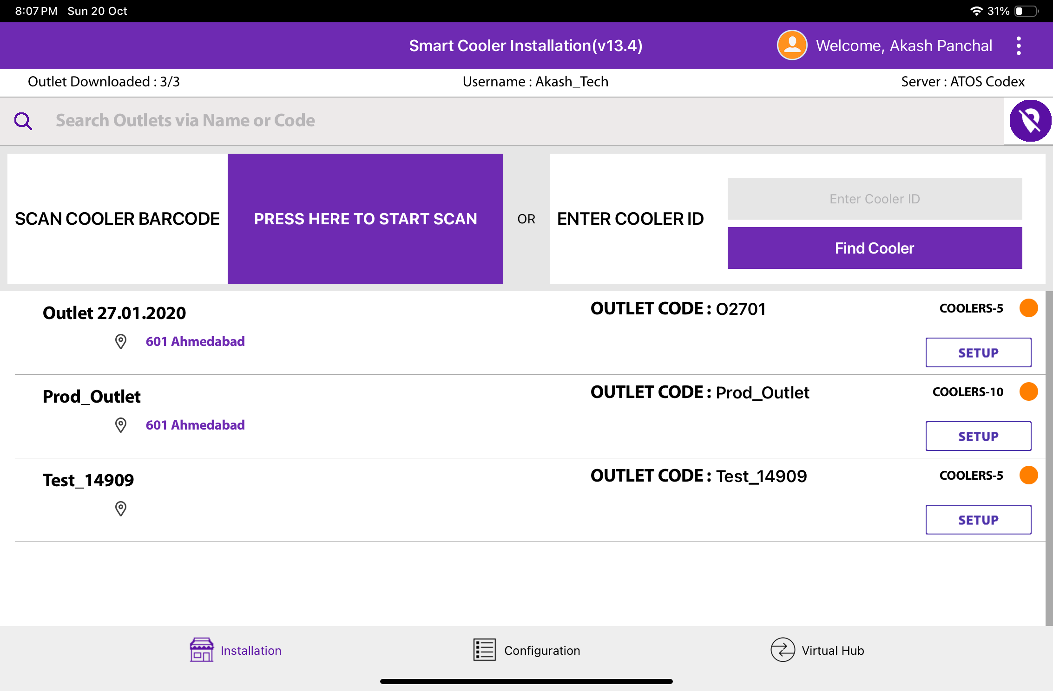
APPLICATION FUNCTIONS
1. Association Screen - Use for the Association and Remove Association.
2. Configuration Screen - Use to Check the Device Advertisement and Configuration it.
3. VH Screen - Use for the Data Download and Upload to the Server.
1
2
3
© 2024 Vision Group

Slide 10
ASSOCIATION SCREEN
Click on the Association Icon to move to the Association Screen.
Total # of outlets in BD territory and how many have been loaded, outlets are loaded at startup.
Tap on this icon to show all outlets, not only the nearest ones
If a cooler can’t be found via the barcode scanner, then enter the Technical ID or Serial Number here to find it.
Use this box to search for the Outlet Code or Outlet Name quickly. If an Outlet is found the result of the Outlet will be shown.
Coolers – 10
Shows the number of coolers in the outlet.
Red – no cooler in the Outlet is associated with Smart Device
Orange – some coolers in the outlet have been associated with smart devices, but not all
Green – all coolers in this outlet have been associated with smart devices
Tap to start the camera and scan the Cooler Barcode. If a cooler is found the association menu for this cooler will be shown.
A list of outlets will be shown on successful login.
Only Assigned User outlets will be shown, for each one the Outlet name, address & code will be displayed.
Tap on Setup to enter the Outlet and view assigned and unassigned Coolers.
© 2024 Vision Group

Slide 11
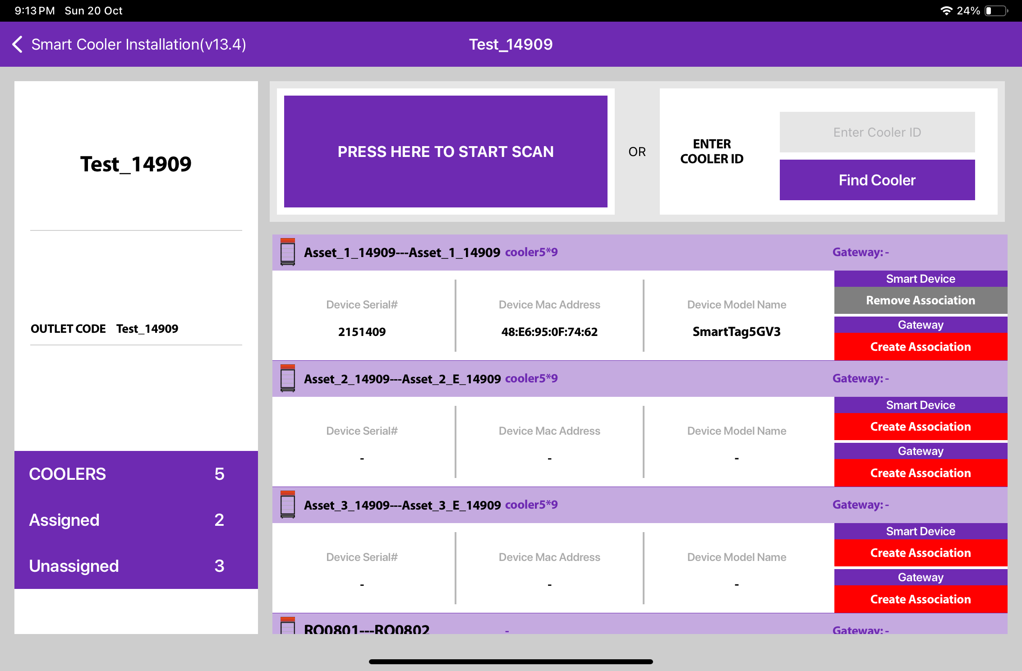
ASSOCIATOIN SCREEN (Cont’d)
Serial Number, Equipment Number, & Cooler Model
Outlet
Name
Address
Outlet Code
If a Smart Device is already associated with this cooler the information will be shown in this box.
Tap to start Smart Device association or scan the barcode of the Cooler via the scanner.
If a smart device is already associated to this cooler the button will gray with label Remove Association
© 2024 Vision Group

Slide 12
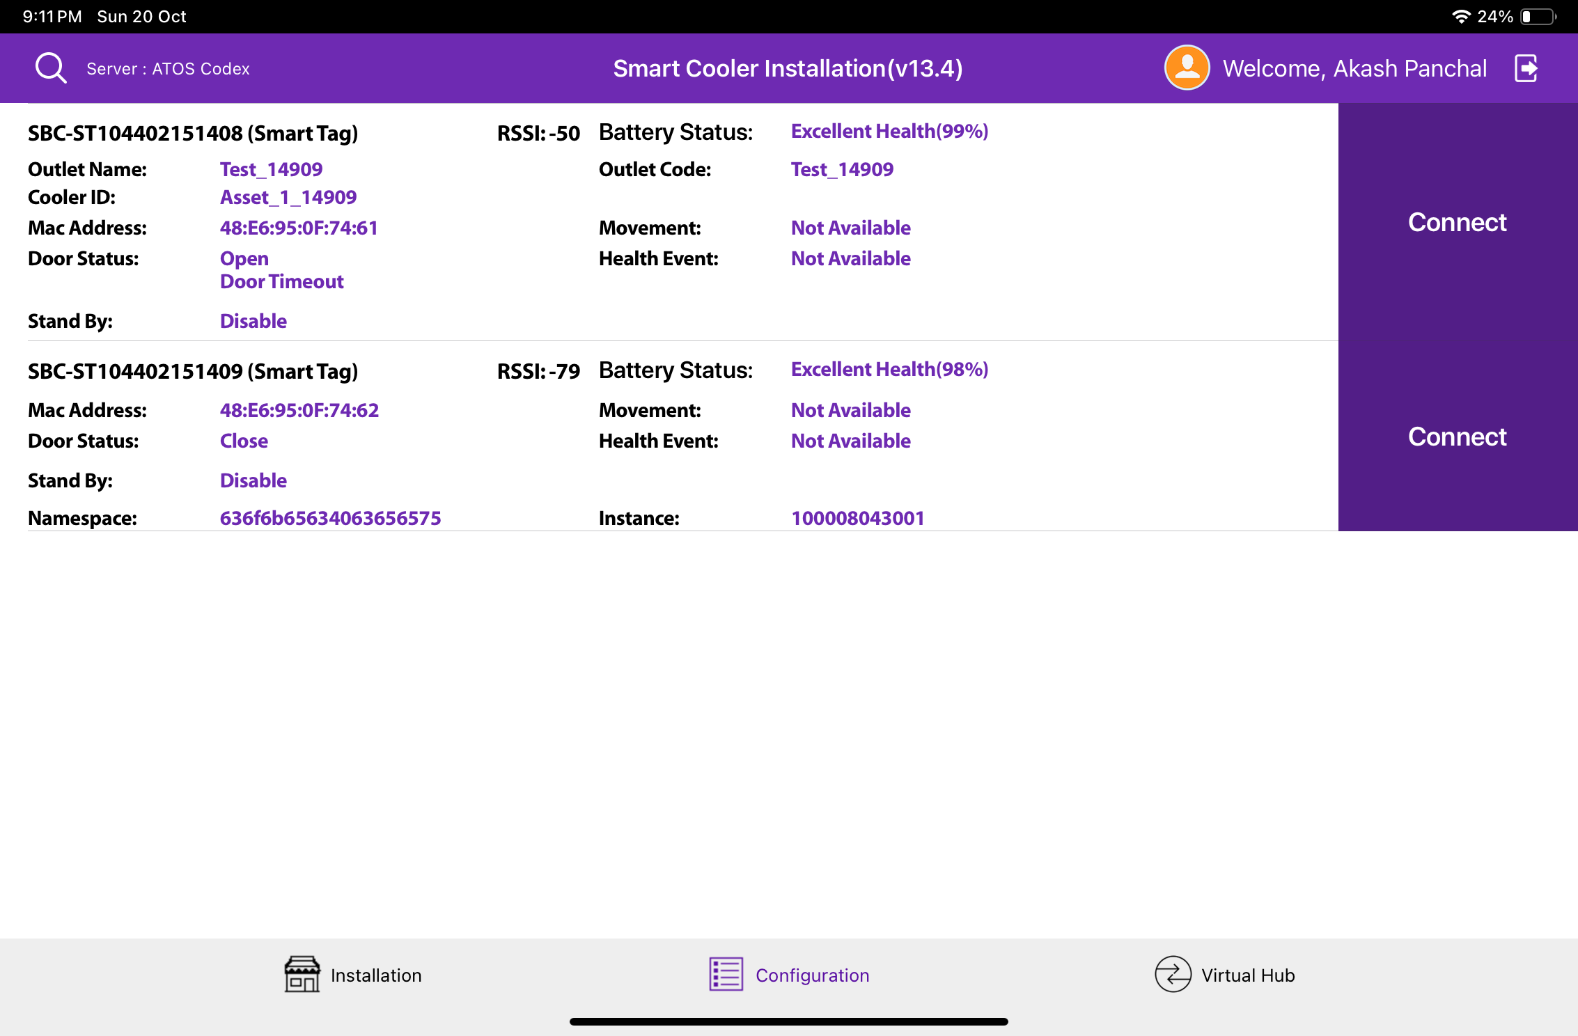
CONFIGURATION SCREEN
Click on the Configuration Icon to move to the Configuration Screen.
Smart Device # – Smart Device Serial Number
Smart Device Type – Type of Smart Device
Outlet Name – Name of Outlet of Smart Device
Cooler ID – Name of Cooler SN of Smart Device
MAC Address – Smart Device’s MAC Address
Door Status – Flag of Door Status is Open /Close
Standby – Flag Showing if Device in Standby Mode
UUID Frame – Smart Devices iBeacon UUID Namespace and Instance Value(Showing if Enable)
Battery Status – Smart Device Battery Status
RSSI – Range of Smart Devices in dB
Health Event – Health available/Not available for Smart devices
Movement Status – Movement available/Not available for Smart devices
Standby – Stand by Mode Enable/ Disable of Device

Slide 13
VH SCREEN
Click on VH Icon to move to VH Screen.
Showing the Nearest Whitelisted Devices here for which the Application Can download the Smart device’s Data and Upload it to the Server.
In each Smart Device Type, Sensor Data Flags, MAC Address, Smart Device Serial, etc. Information is showing.
The operation status of each Smart device is performed by Application-like Connection > Data Download > Data Upload Status showing.

Slide 14
ASSOCIATION PROCESS
Selecting Asset – Using Barcode Scanning:
Click on the Barcode icon, Barcode scanning window will open.
Scan the cooler barcode using the barcode scanner – Position the camera of the mobile device in such a way that the barcode of the Cooler (Technical ID) is in the box.
Outlet will automatically be selected, and a menu will be shown for choosing the device that will be installed.
B. Alternative – Selecting Outlet by entering Outlet Code or Name:
If Scanning of the Cooler serial is not possible enter either the Outlet Name or Outlet Code and Tap on “Find”.
C. Alternative – Selecting Outlet – Manual selection of cooler
If Scanning of the Cooler serial is not possible and the outlet code/name is not known, the User can manually select the outlet.
B
A
C
© 2024 Vision Group

Slide 15
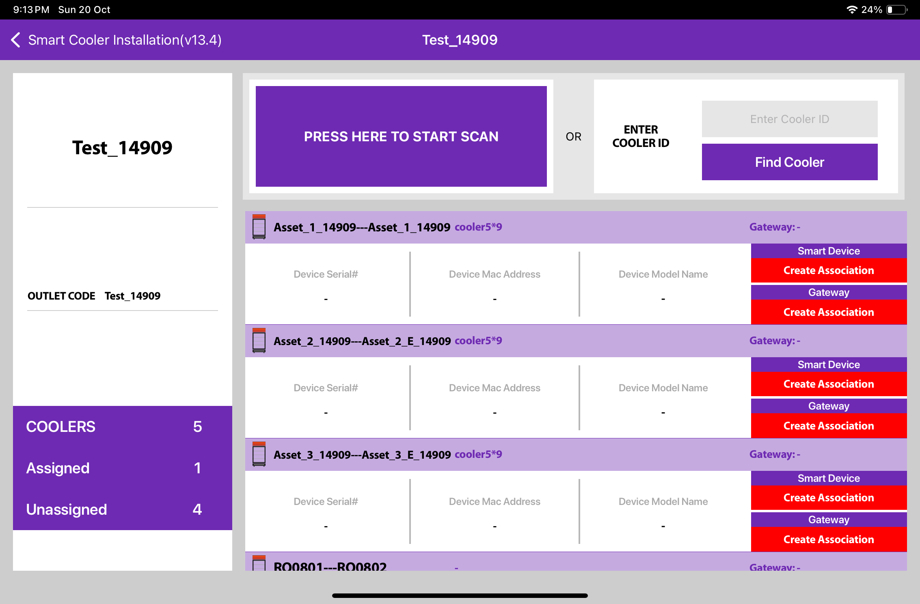
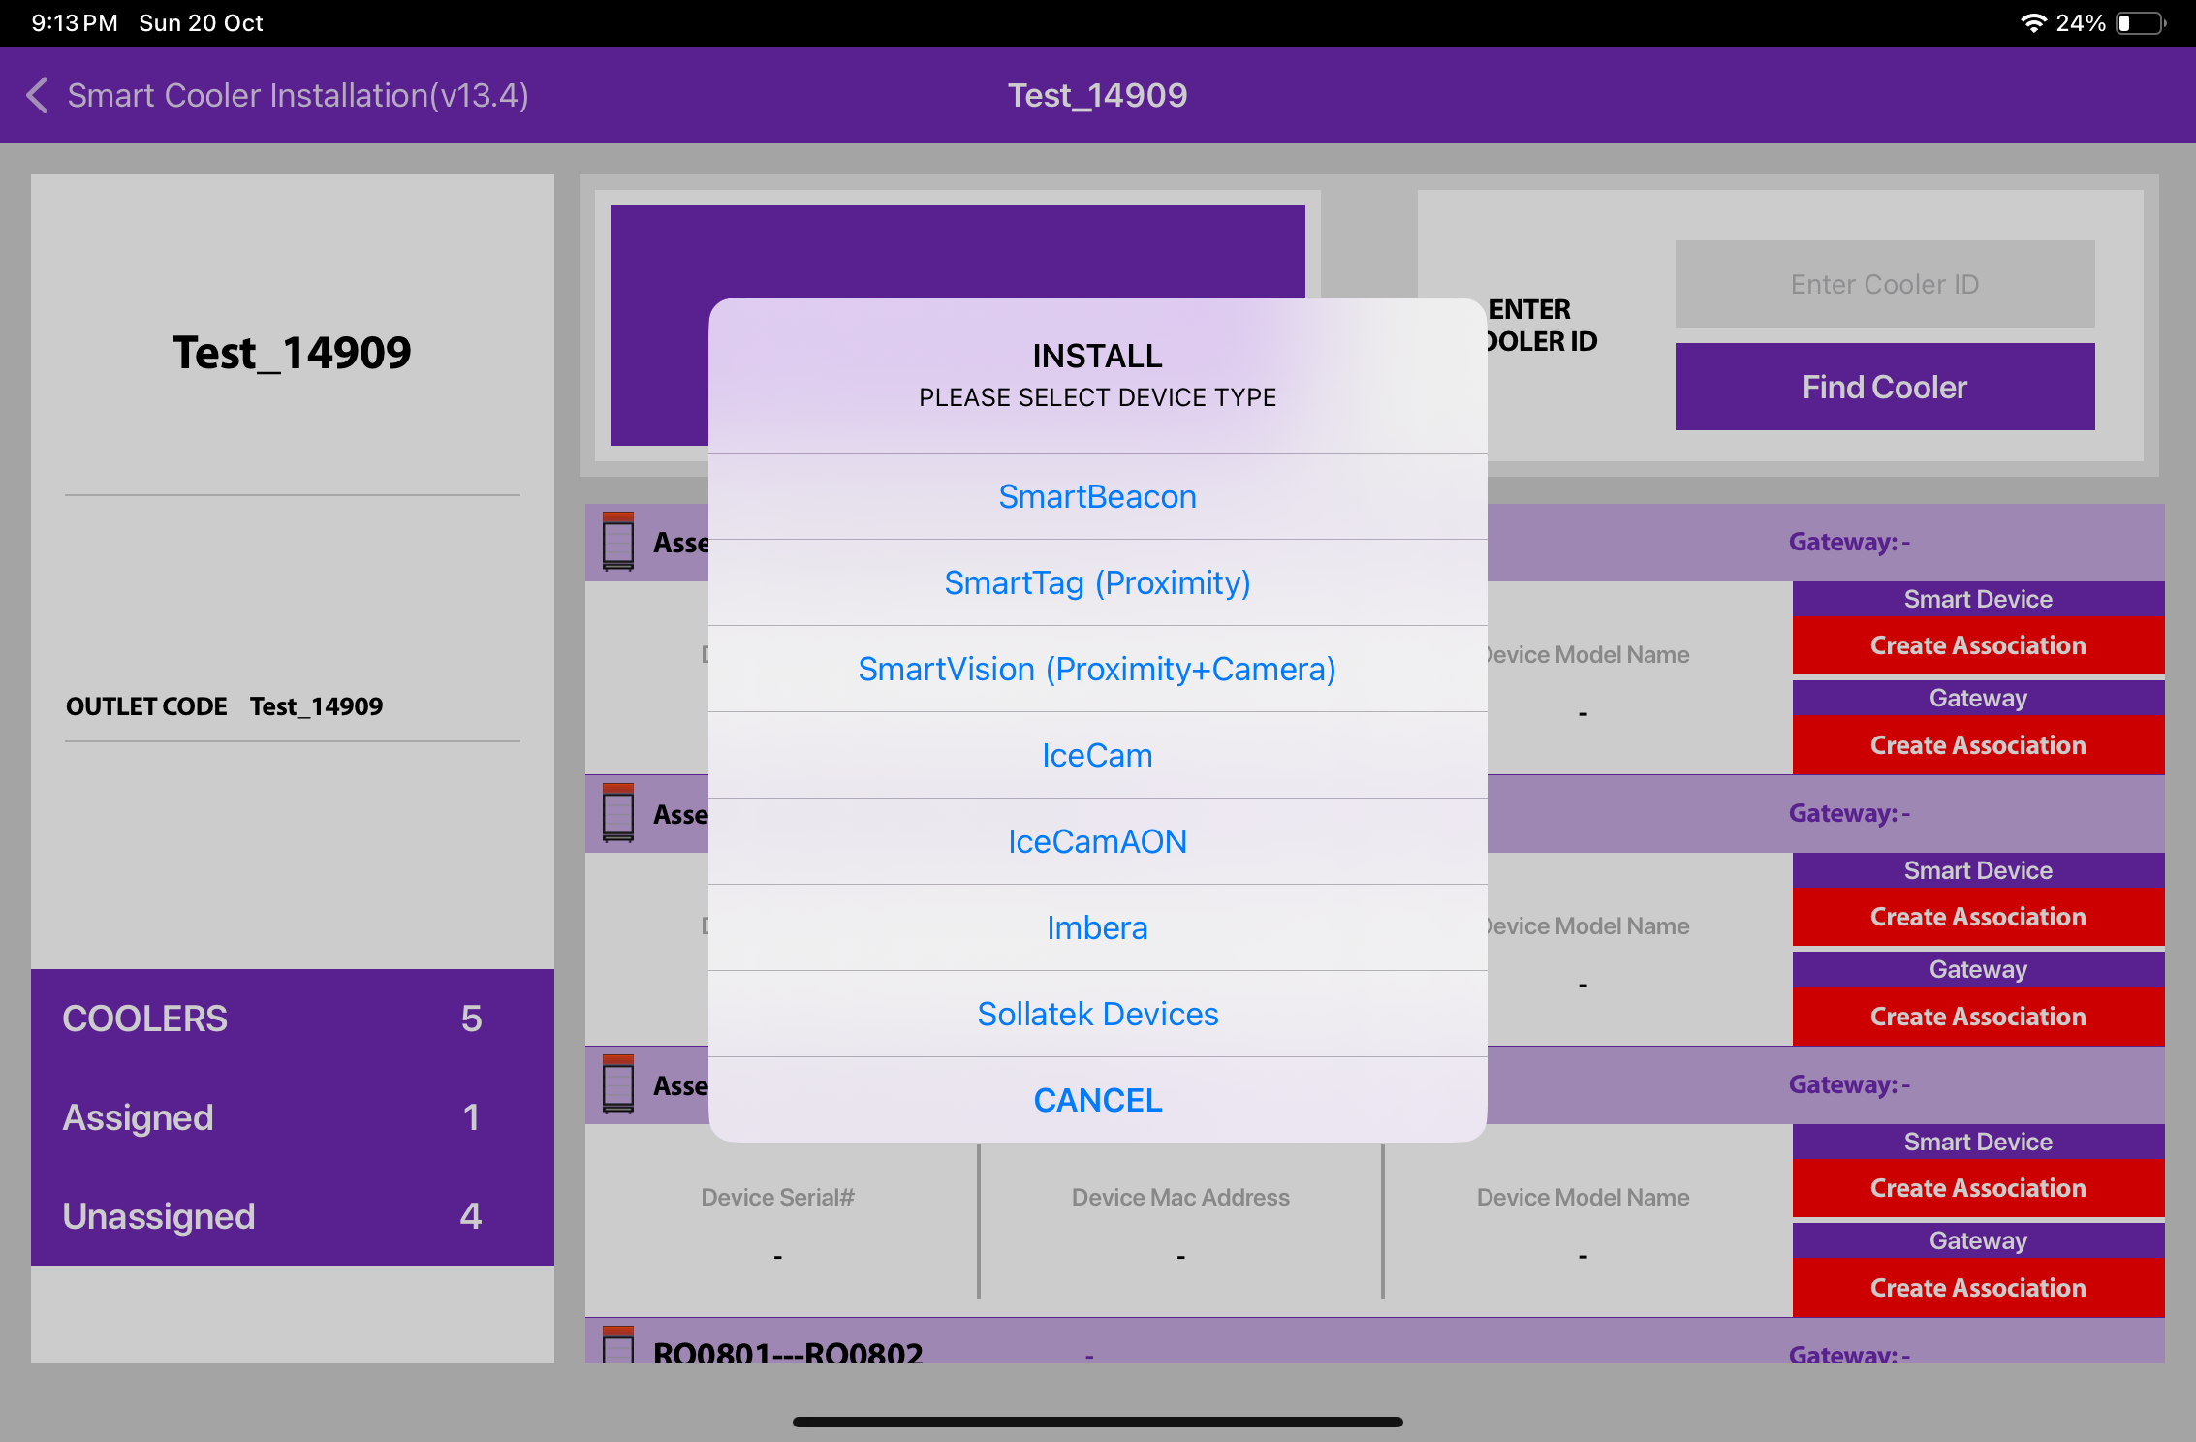
ASSOCIATION – SMART TAG
1. Selecting Cooler - A new window will open allowing the User to select the cooler for the outlet selected manually. Click on “Association” to choose the asset to install.
2. Selecting Smart Device type - A new window will open to ask for the selection of device types to be associated with. Click on “SMART TAG ” to Associate the SmartTag device.
The user will see a list of unassociated devices; the User can use the door status to identify the installed device.
© 2024 Vision Group

Slide 16
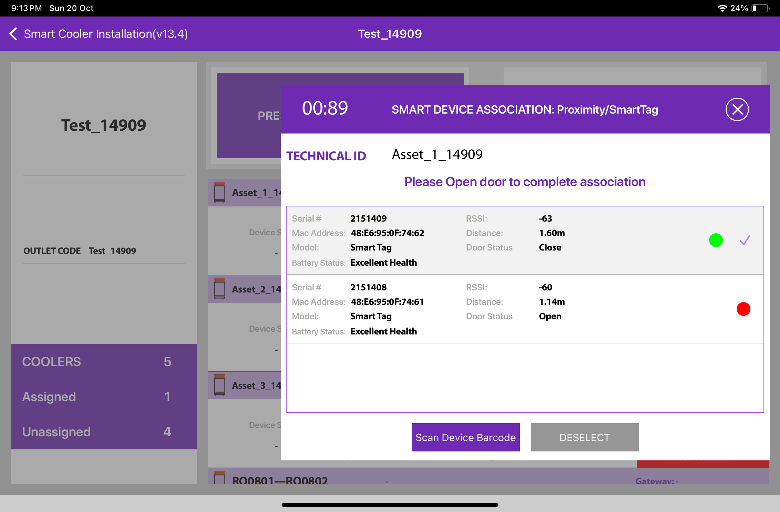
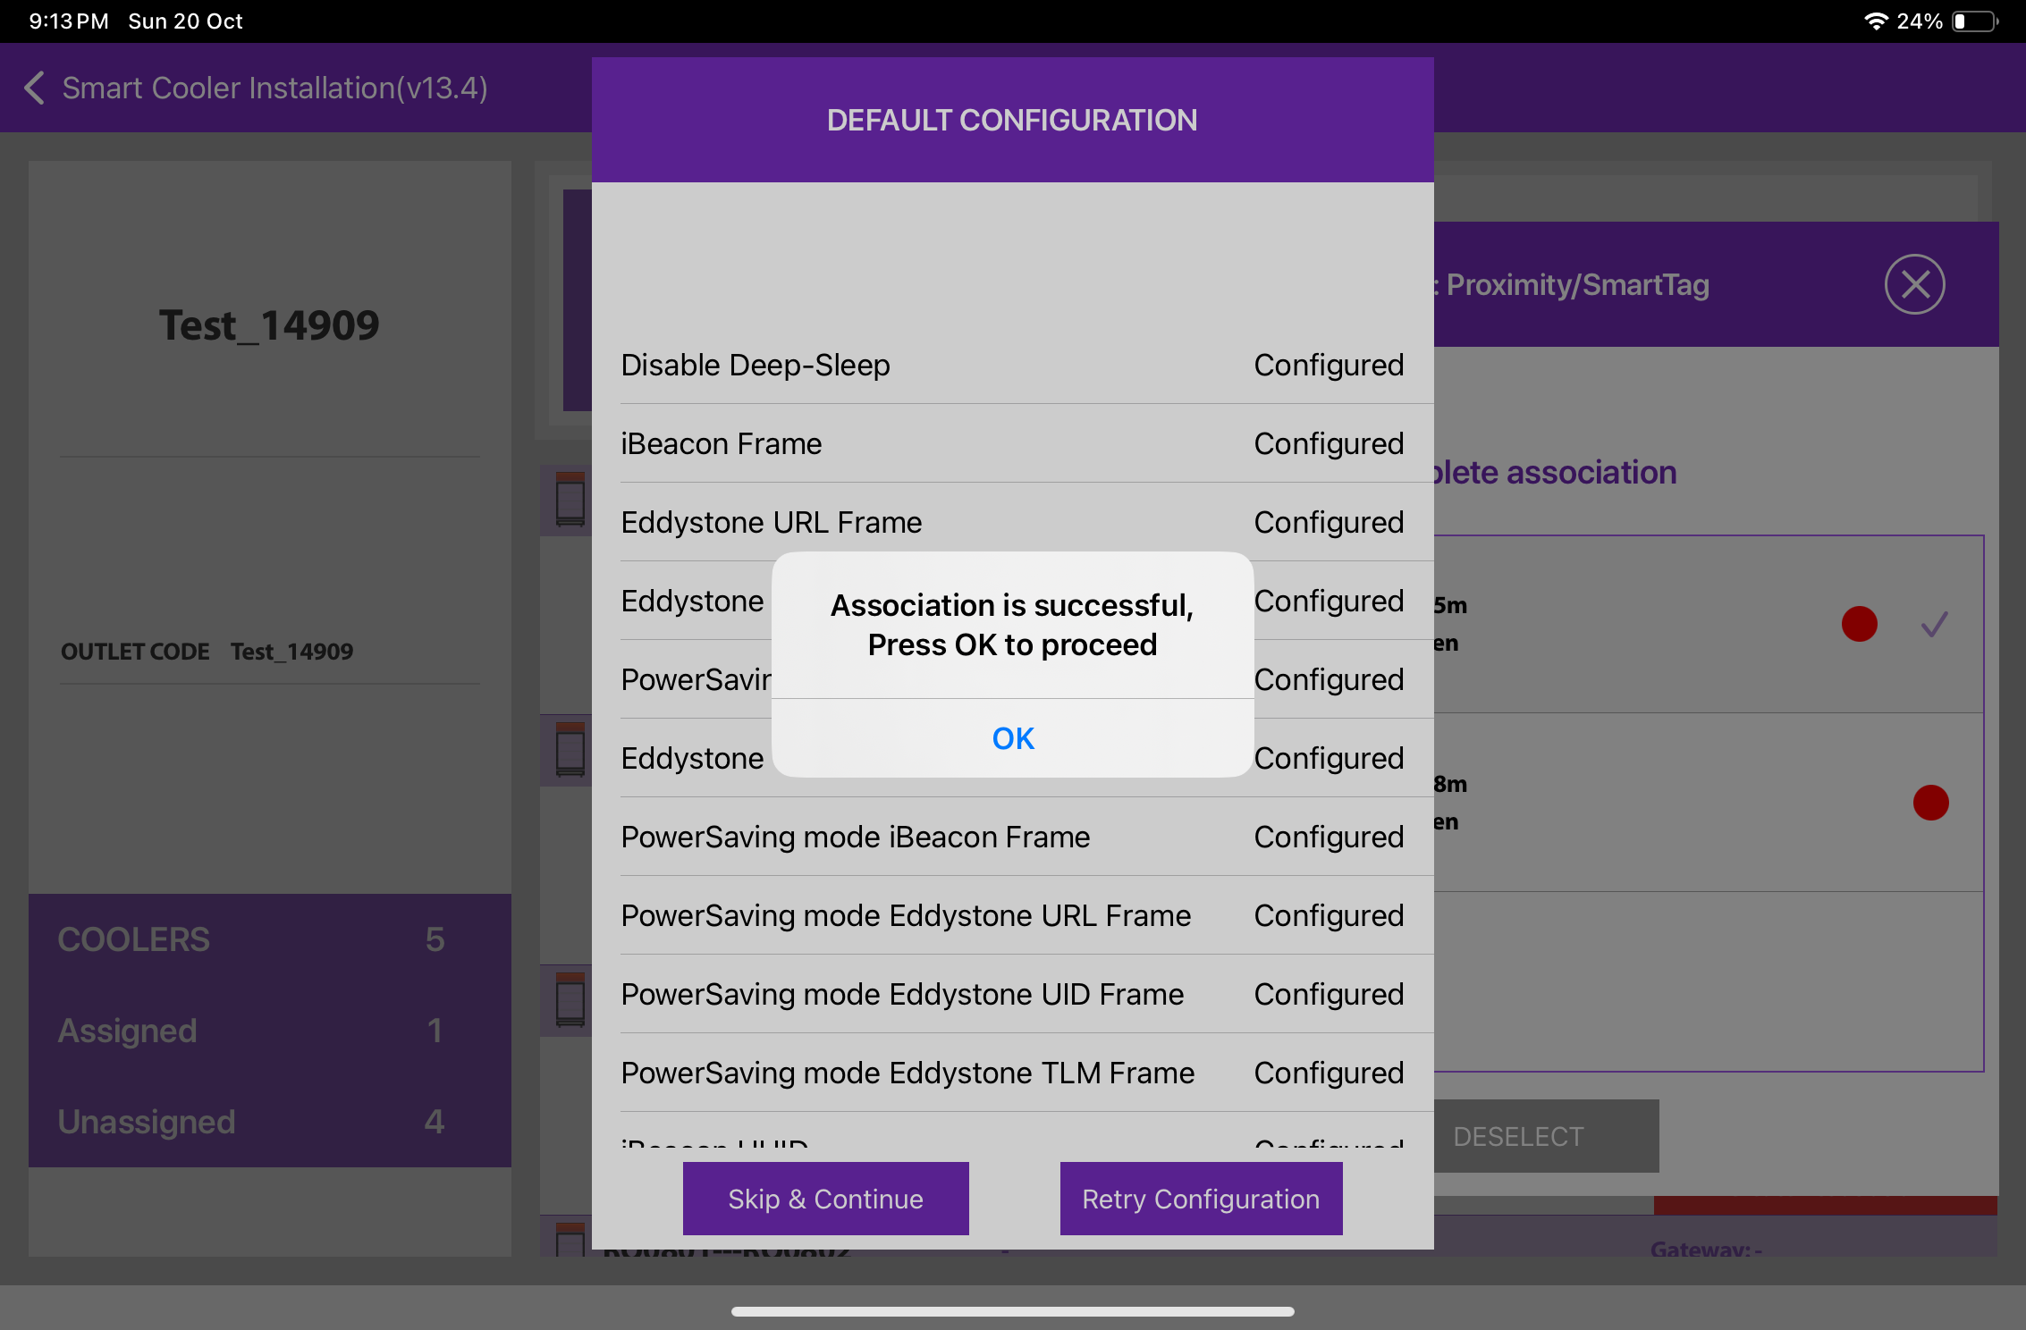
ASSOCIATION – SMART TAG (Cont’d)
3. Selecting the Device to do the association with - The user will see a list of unassociated devices; the User can use the door status to identify the installed device, After identifying the device, select the device to start Installation, and the App will give a popup to confirm the association, Click on OK to confirm. When the process is completed, the User will be returned to the Outlet Screen, and now the User see that the Proximity / Smart Tag is associated with the Cooler.
To Select the device, close the cooler Door and after the Green tick mark user needs to open the door to complete the association.
© 2024 Vision Group

Slide 17
ASSOCIATION – SMART TAG (Cont’d)
4. Smart Device Configuration Setting - On selection of the device, the application will connect to the device, make all configuration changes and provide status a success message will appear after successful association, press OK to close the popup. When this window appears the device is provisioned, and the User can press close to return to the outlet screen.
Note: Please note the device only wakes up when the cooler Door Cycle is Open and Closed.
© 2024 Vision Group

Slide 18
ASSOCIATION – SMART VISION (SINGLE DOOR OPTION)
1. Selecting Cooler - A new window will open allowing the User to select the cooler for the outlet selected manually. Click on “Association” to choose the asset to install.
2. Selecting Smart Device type - A new window will open to ask for the selection of device types to be associated with. Click on “SMART VISION ” to Associate the SmartVision device.
The user will see a list of unassociated devices; the User can use the door status to identify the installed device.
© 2024 Vision Group

Slide 19
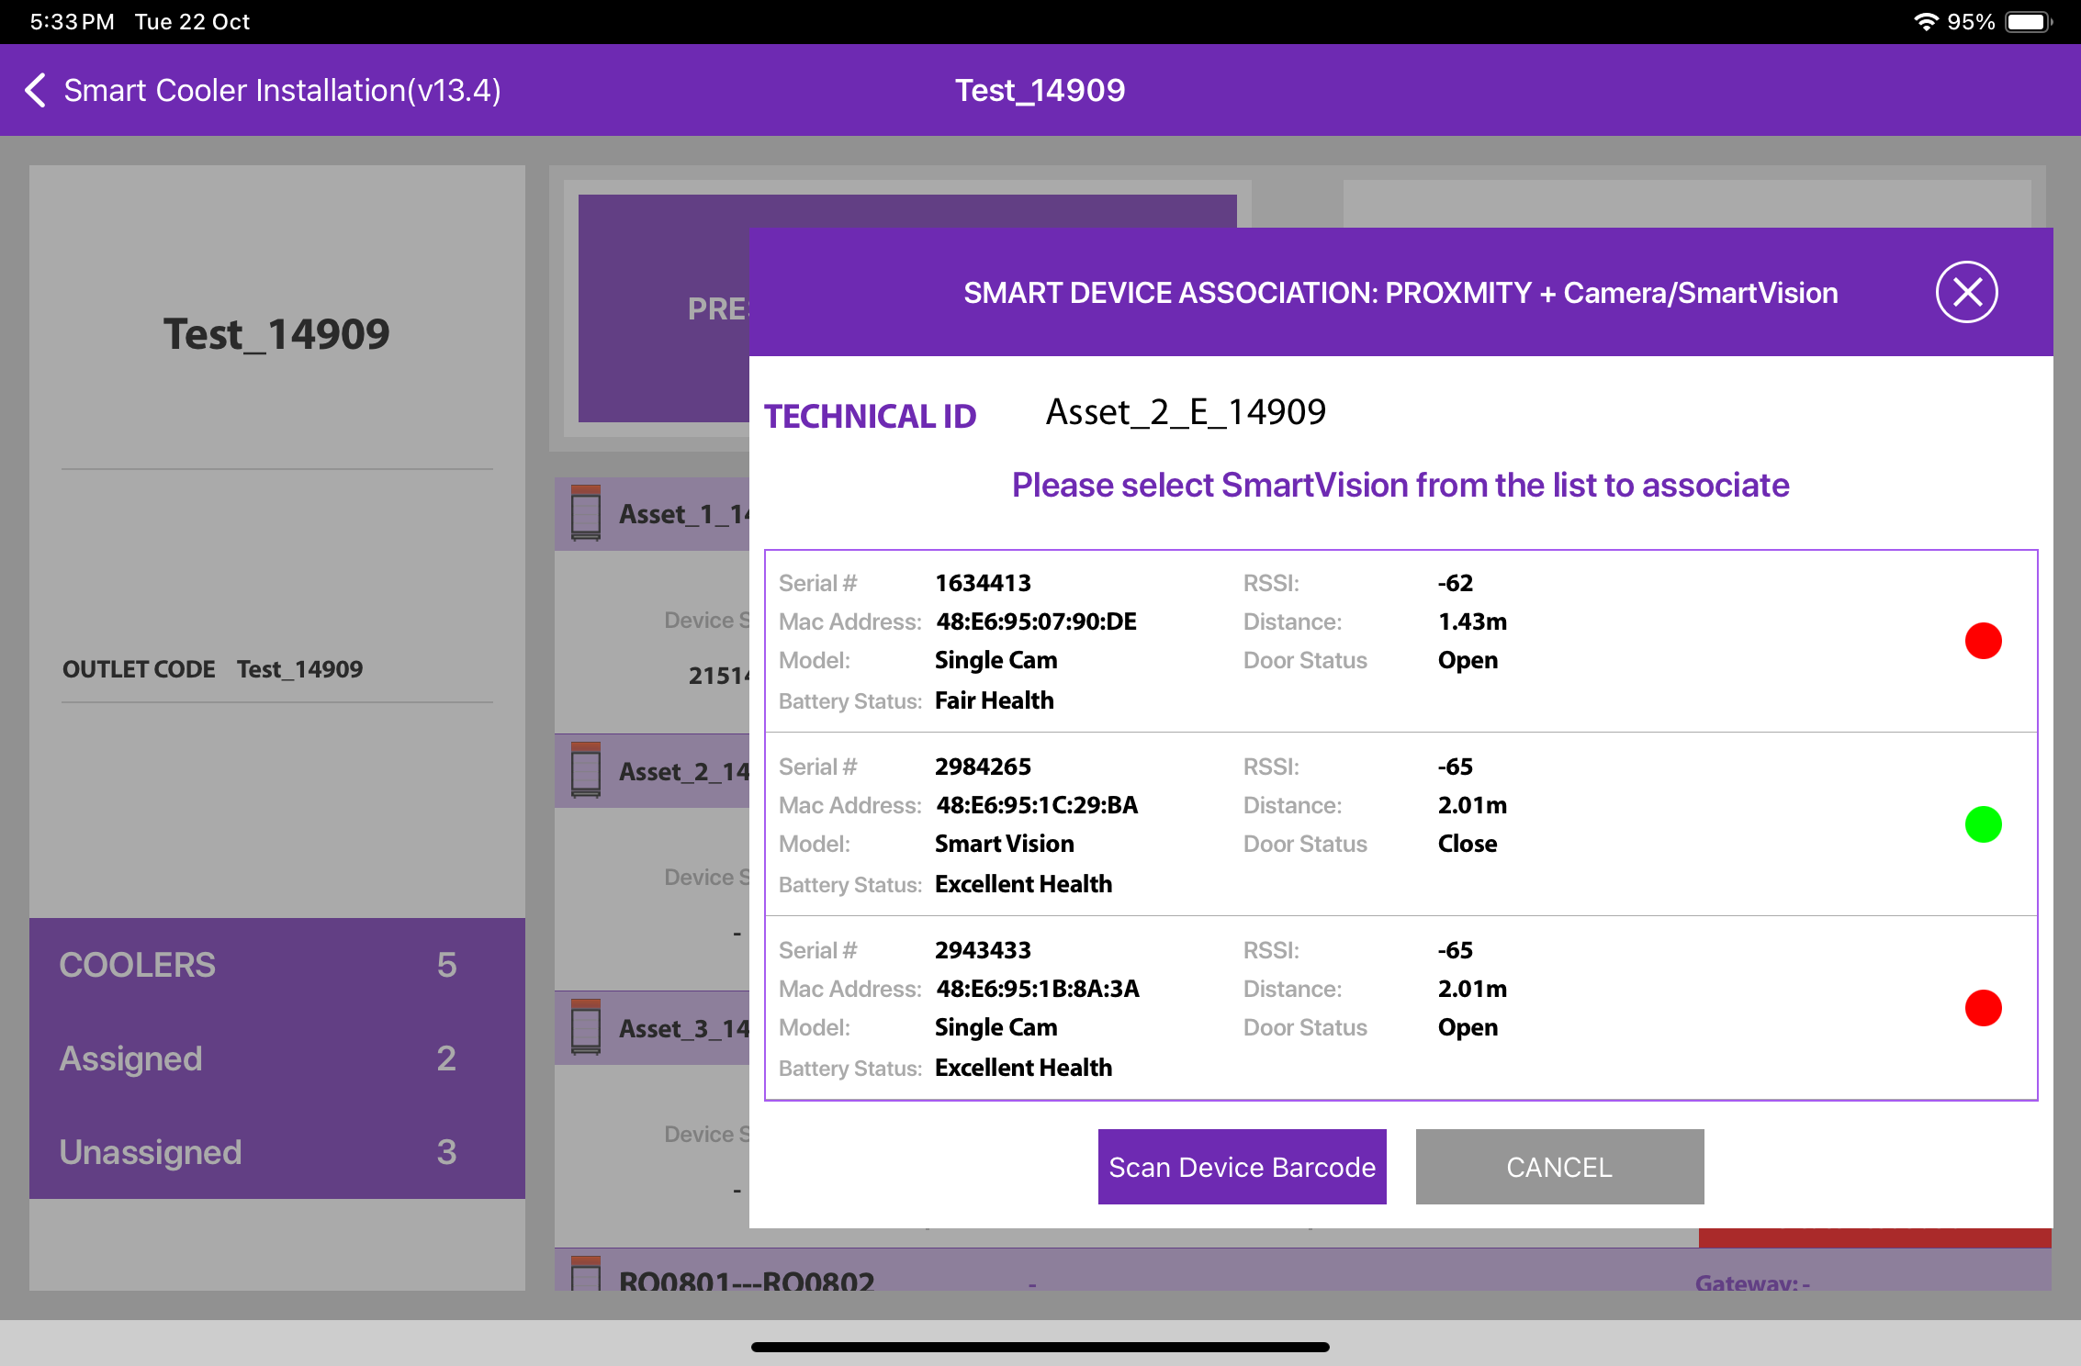
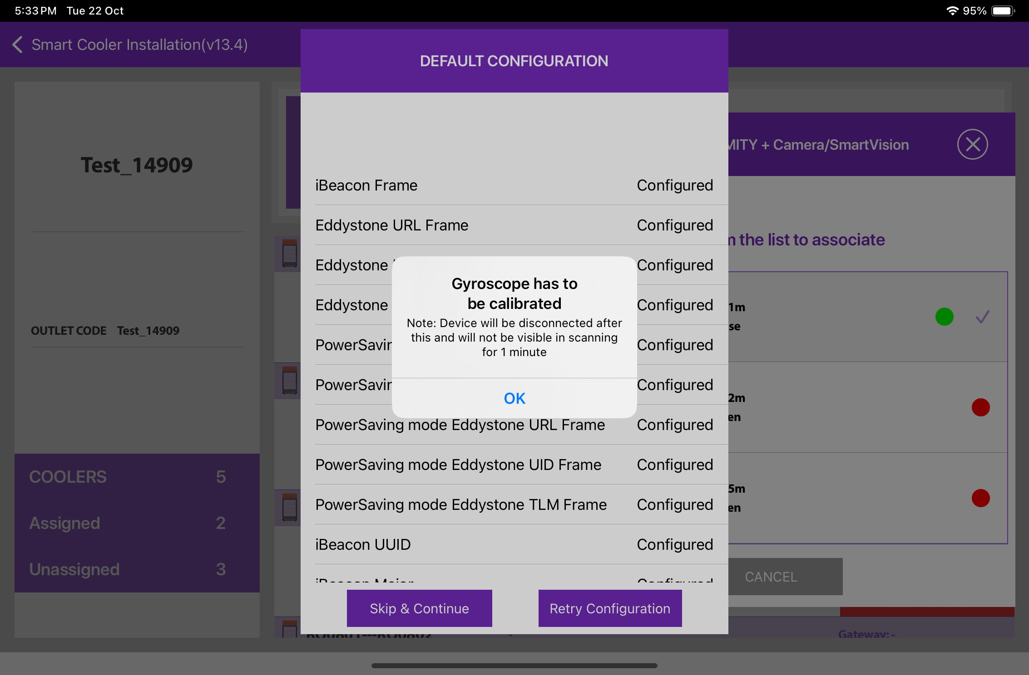
ASSOCIATION – SMART VISION (Cont’d)
3. Selecting the Device to do the association with - The user will see a list of unassociated devices; the User can use the door status to identify the installed device., After identifying the device, select the device to start Installation, App will give a popup to confirm the association, Click on OK to confirm. When the process is completed, the User will be returned to the Outlet Screen, and now the User see that the Smart Vision is associated with the Cooler. When this window appears, the device is Gyroscope calibrated, and the user can press OK to return When the door closes, a screen pop-up will show, click on OK.
To Select the device, close the cooler Door and after the Green tick mark user needs to open the door to complete the association.
© 2024 Vision Group

Slide 20
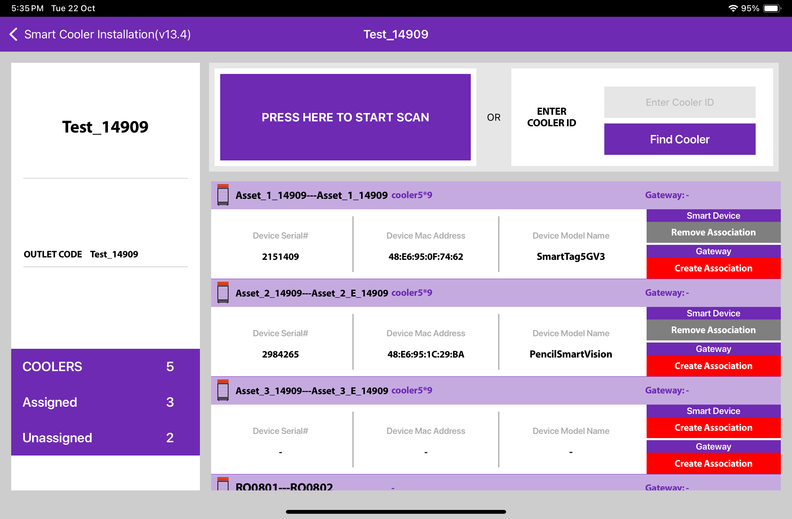
ASSOCIATION – SMART VISION (Cont’d)
4. Smart Device Configuration Setting - On selection of the device, the application will connect to the device, make all configuration changes and provide status a success message will appear after successful association, press OK to close the popup. When this window appears the device is provisioned, and the User can press close to return to the outlet screen.
Note: Please note the device only wakes up when the cooler Door is Closed for 15 seconds.
© 2024 Vision Group

Slide 21
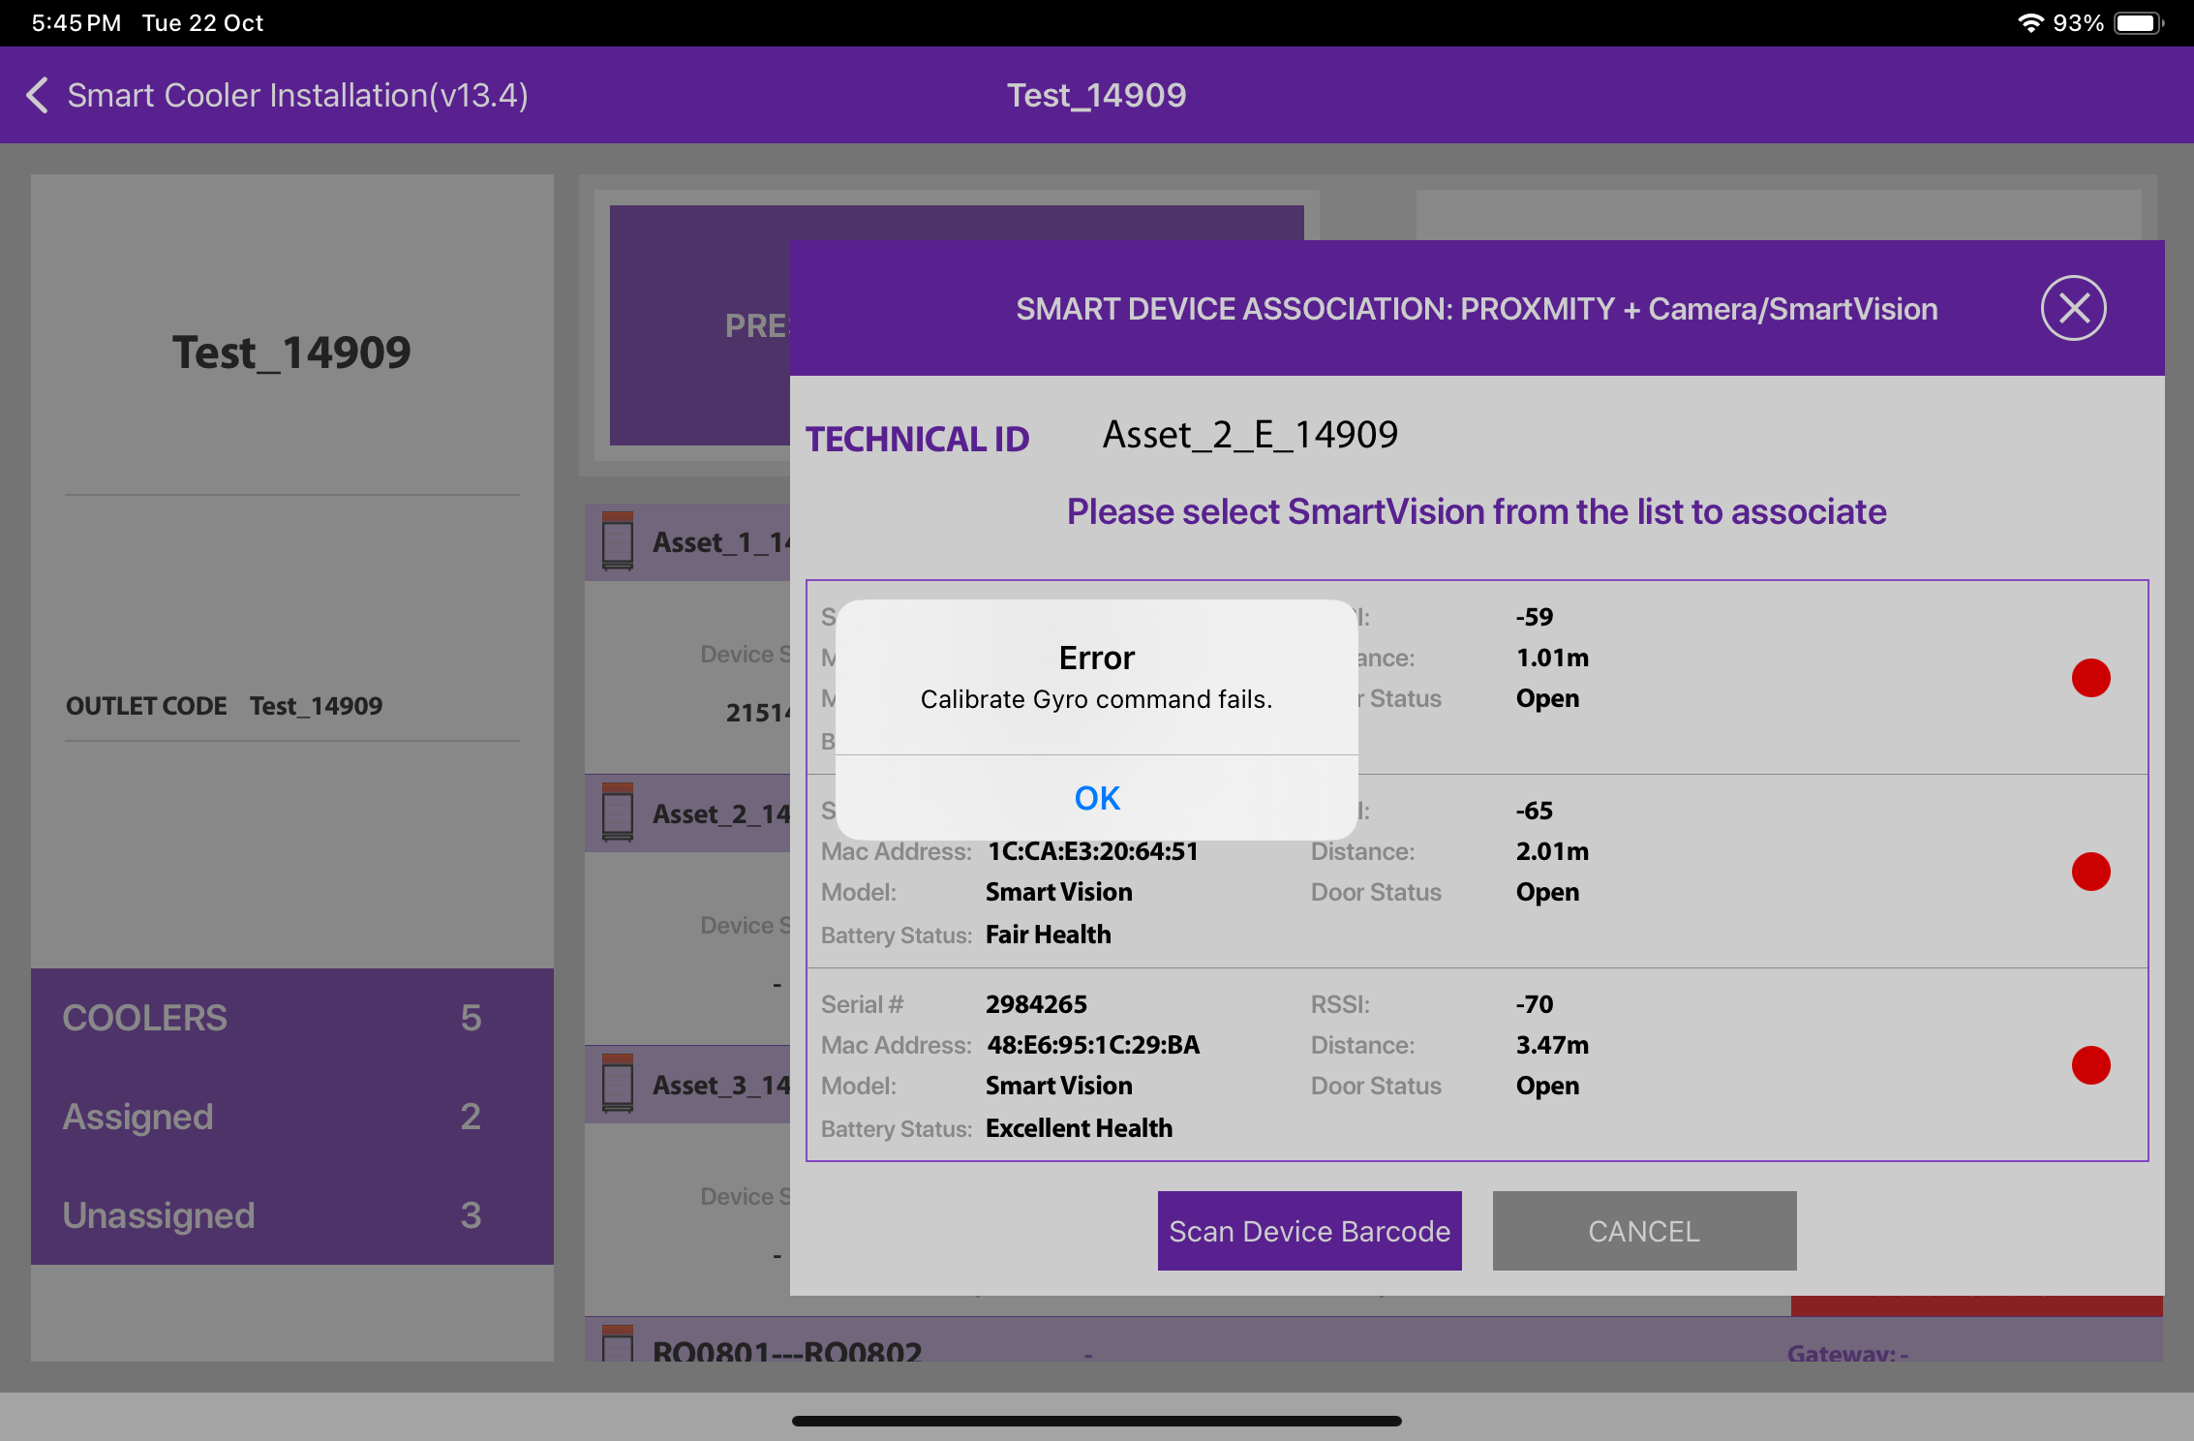
In case the gyro command is not getting a successful response, and it shows waiting or failed.
Waiting - Users can wait for 1 minute and if the pop-up does not show then try again.
Failed - Check the door status if it’s “Open” then close the door and Tap on the “Retry”.
© 2024 Vision Group

Slide 22
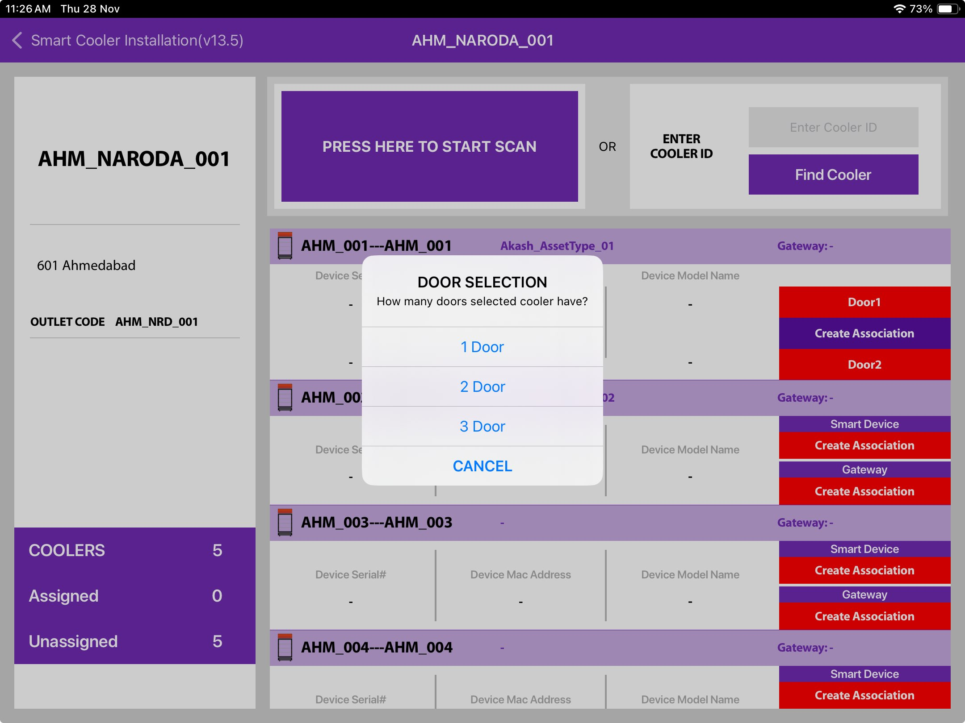
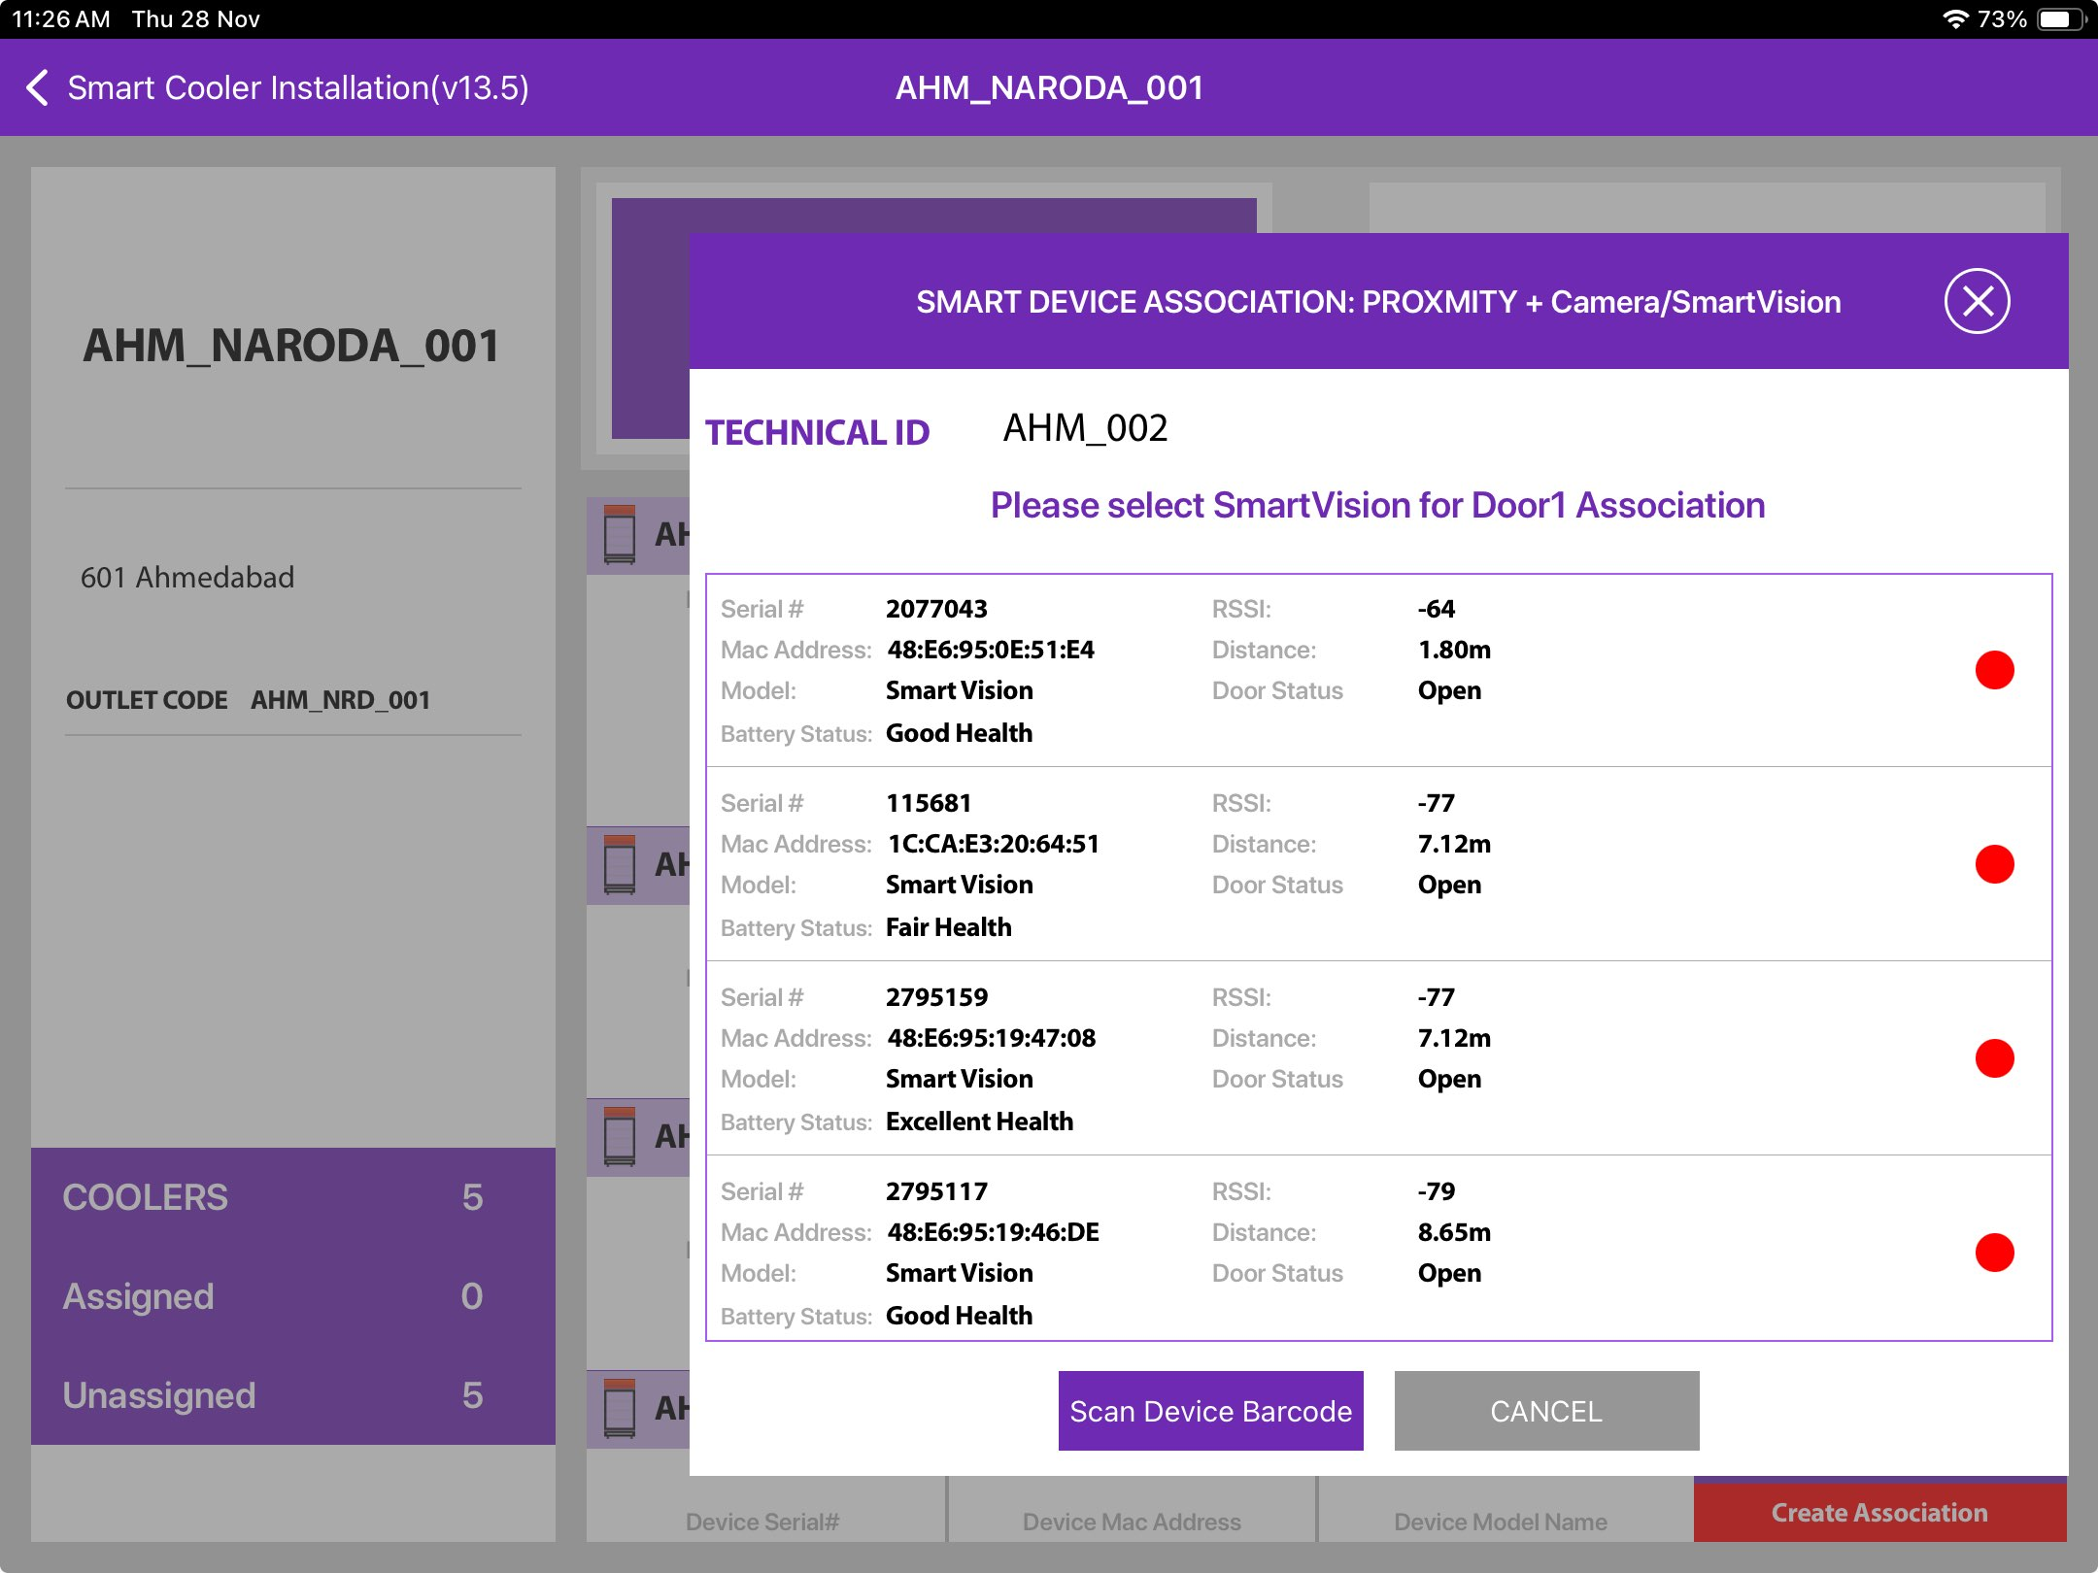
ASSOCIATION – SMART VISION (MULTI DOOR OPTION)
After Selecting the Cooler, the user can choose the Asset Type Capacity for the Association Process in case of a multi-door association process. This is the case where Asset type capacity is not assigned to the cooler.
If the user selects the Two or Three Door option for the association, the user must complete the One by One, Three Smart device’s Association to complete the Association Process for a respective cooler. Partial Association in case of multi-door option not allowed.
© 2024 Vision Group

Slide 23
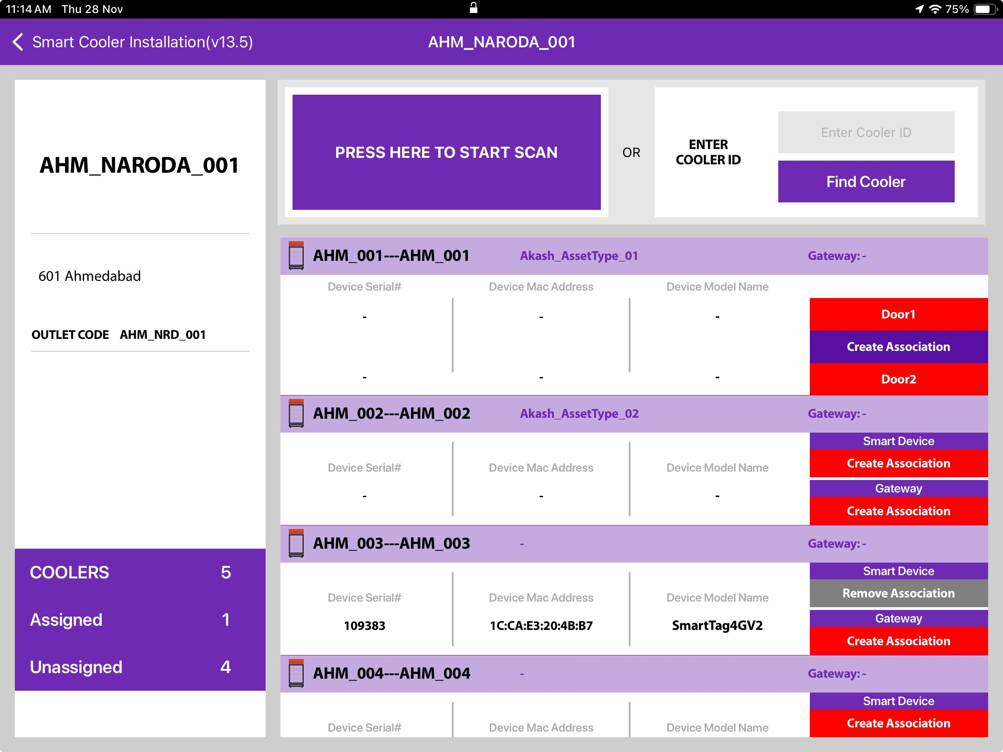
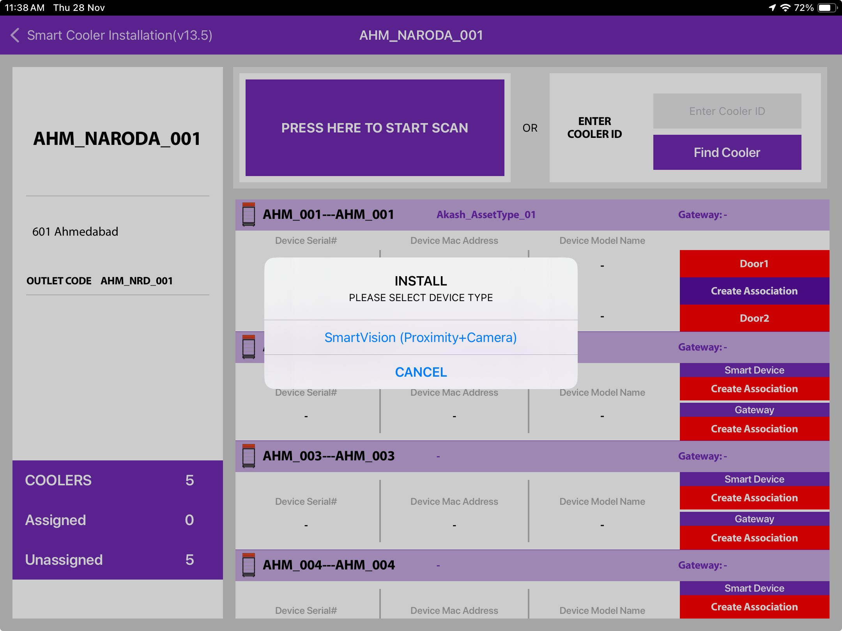
If the Cooler has already assigned asset type capacity, then the user can see the direct number of cooler doors for those coolers, the user can only associate the Pencil Smart Vision or Single cam device.
© 2024 Vision Group

Slide 24
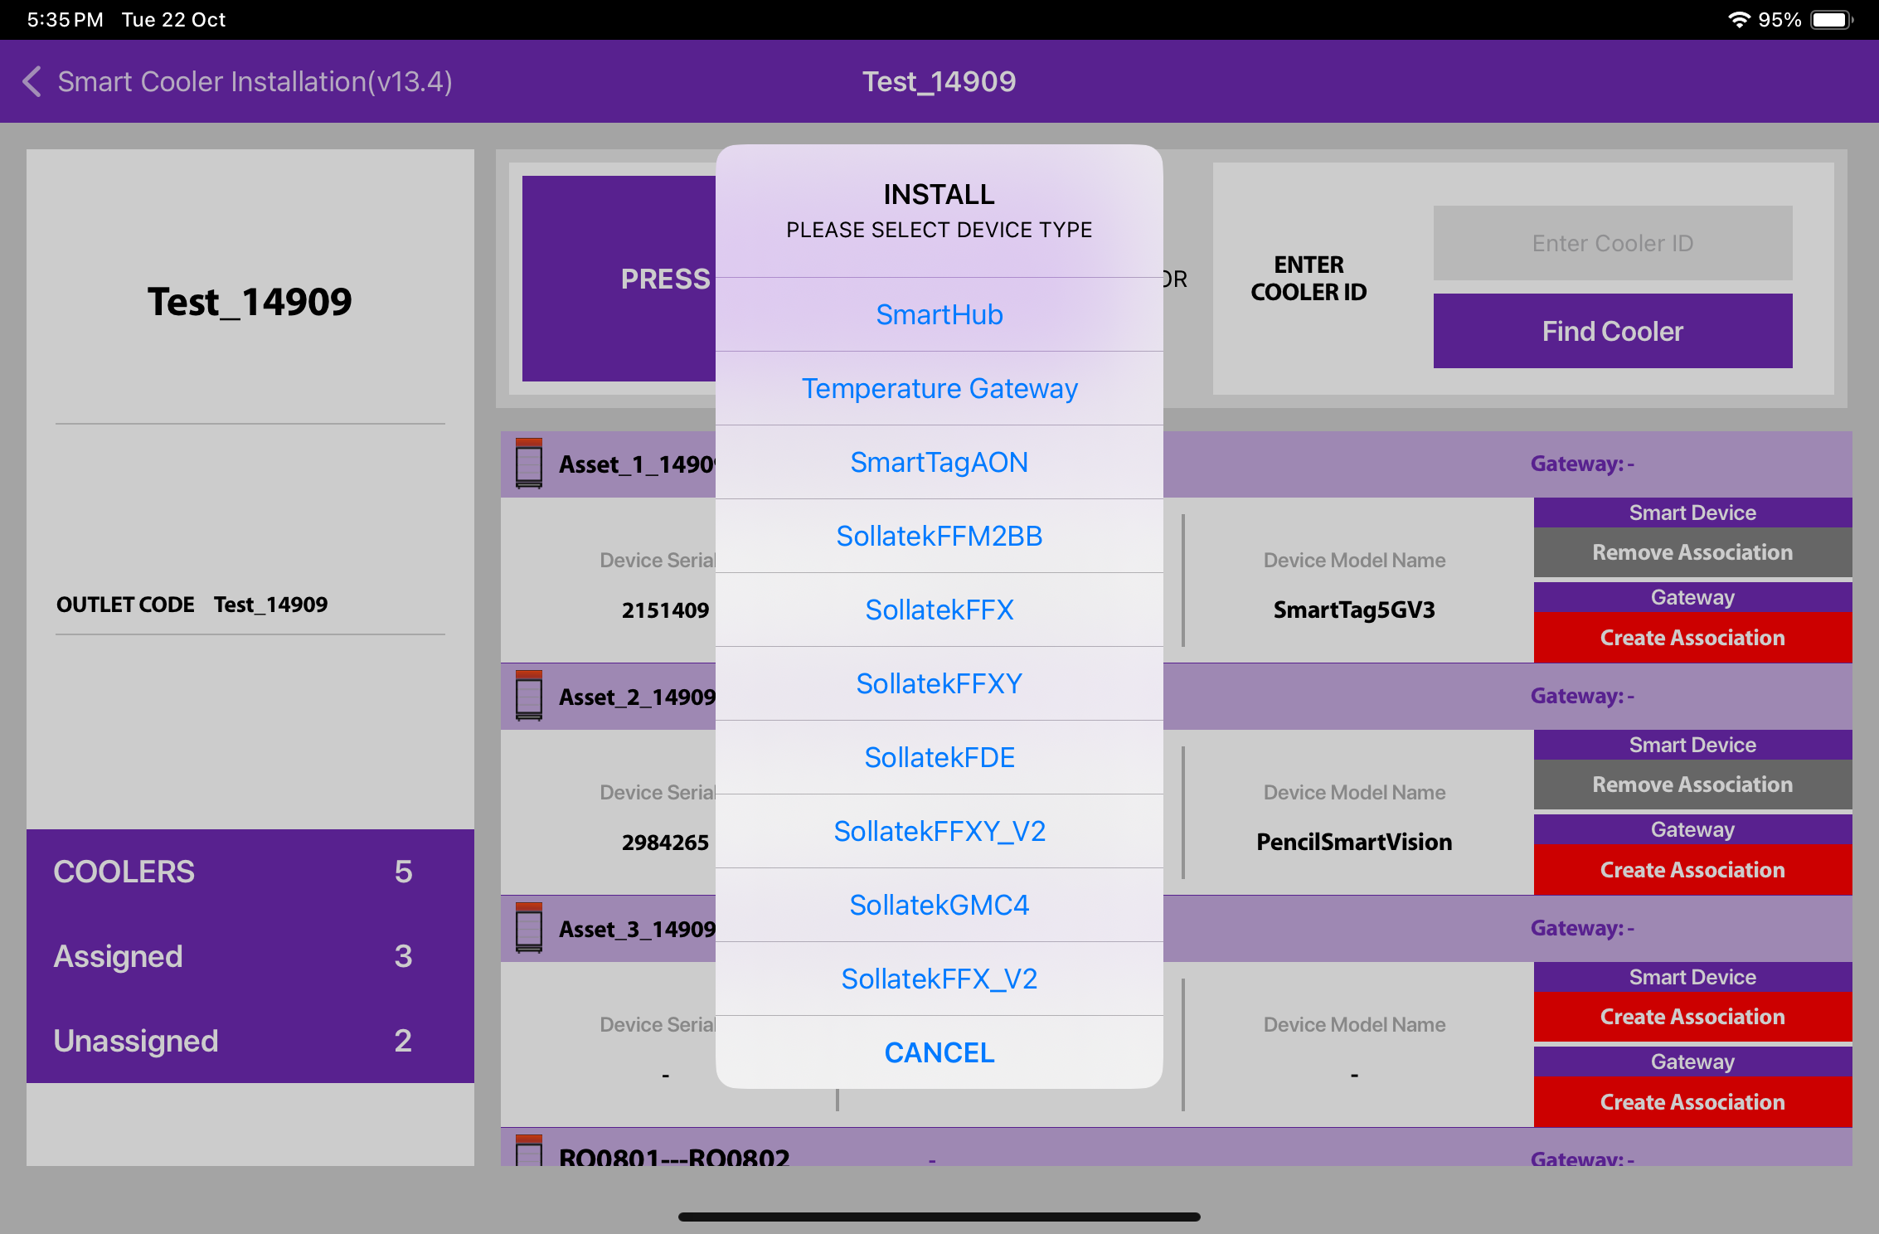
ASSOCIATION – SMART HUB
1. Selecting Cooler - A new window will open allowing the User to select the cooler for the outlet selected manually. Click on “Association” to choose the asset to install.
2. Selecting Smart Device type - A new window will open to ask for the selection of device types to be associated with. Click on “SMART HUB ” to Associate the SmartHUB device. Now Power on the Smart HUB device.
Note: Please note the gateway device is powered on at association time.
© 2024 Vision Group

Slide 25
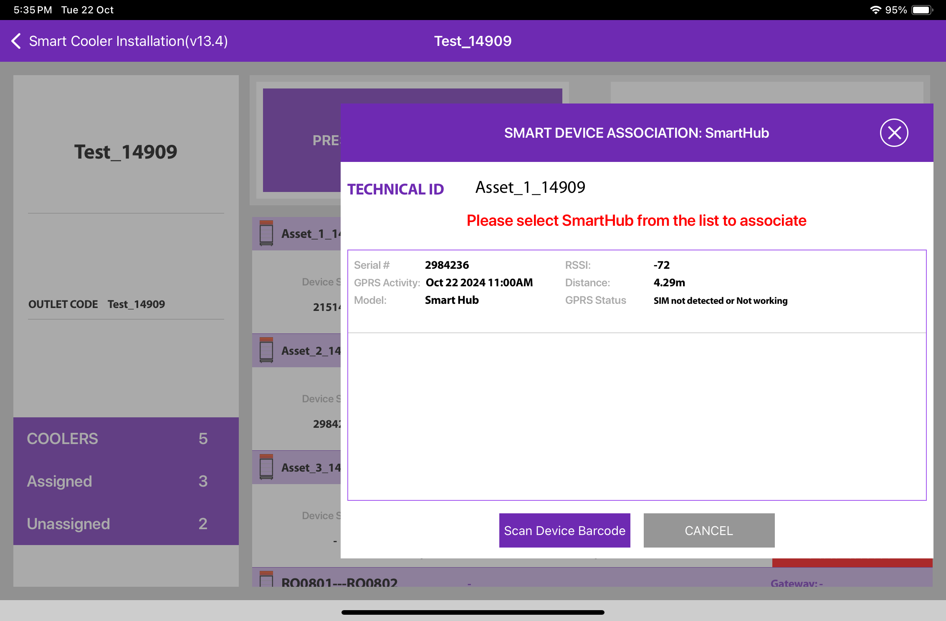
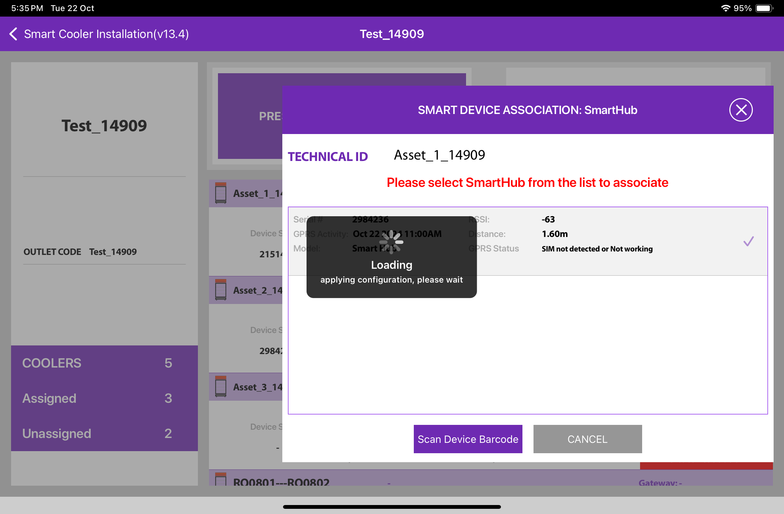
ASSOCIATION – SMART HUB
3. Selecting the Device to do the association with - The user will see a list of unassociated devices; the User can use the door status to identify the installed device, After identifying the device, select the device to start Installation, and the App will give a popup to confirm the association, Click on OK to confirm. When the process is completed, the User will be returned to the Outlet Screen, and now the User see that the Proximity / Smart Tag is associated with the Cooler.
To Select the device, close the cooler Door and after the Green tick mark user needs to open the door to complete the association
© 2024 Vision Group

Slide 26
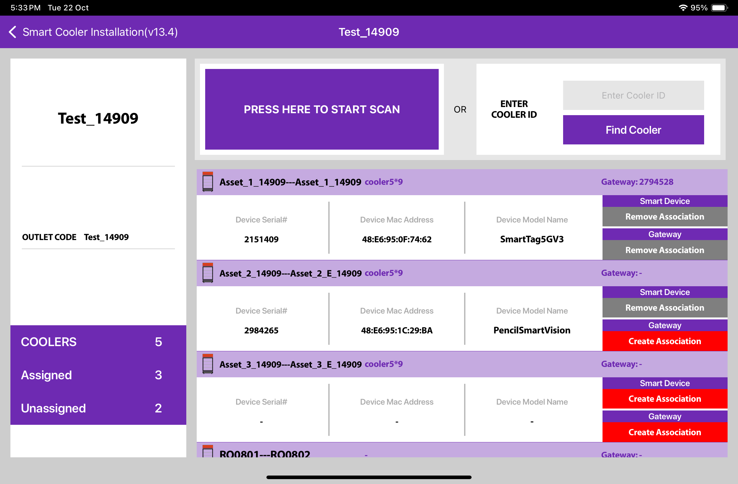
ASSOCIATION – SMART HUB (Cont’d)
3. Selecting the Device to do the association with - After identifying the device, select the device to start Installation, App will give a popup to confirm the association, Click on OK to confirm. When the process is completed, the User will be returned to the Outlet Screen, and now the User see that the Smart Hub is associated with the Cooler.
© 2024 Vision Group

Slide 27
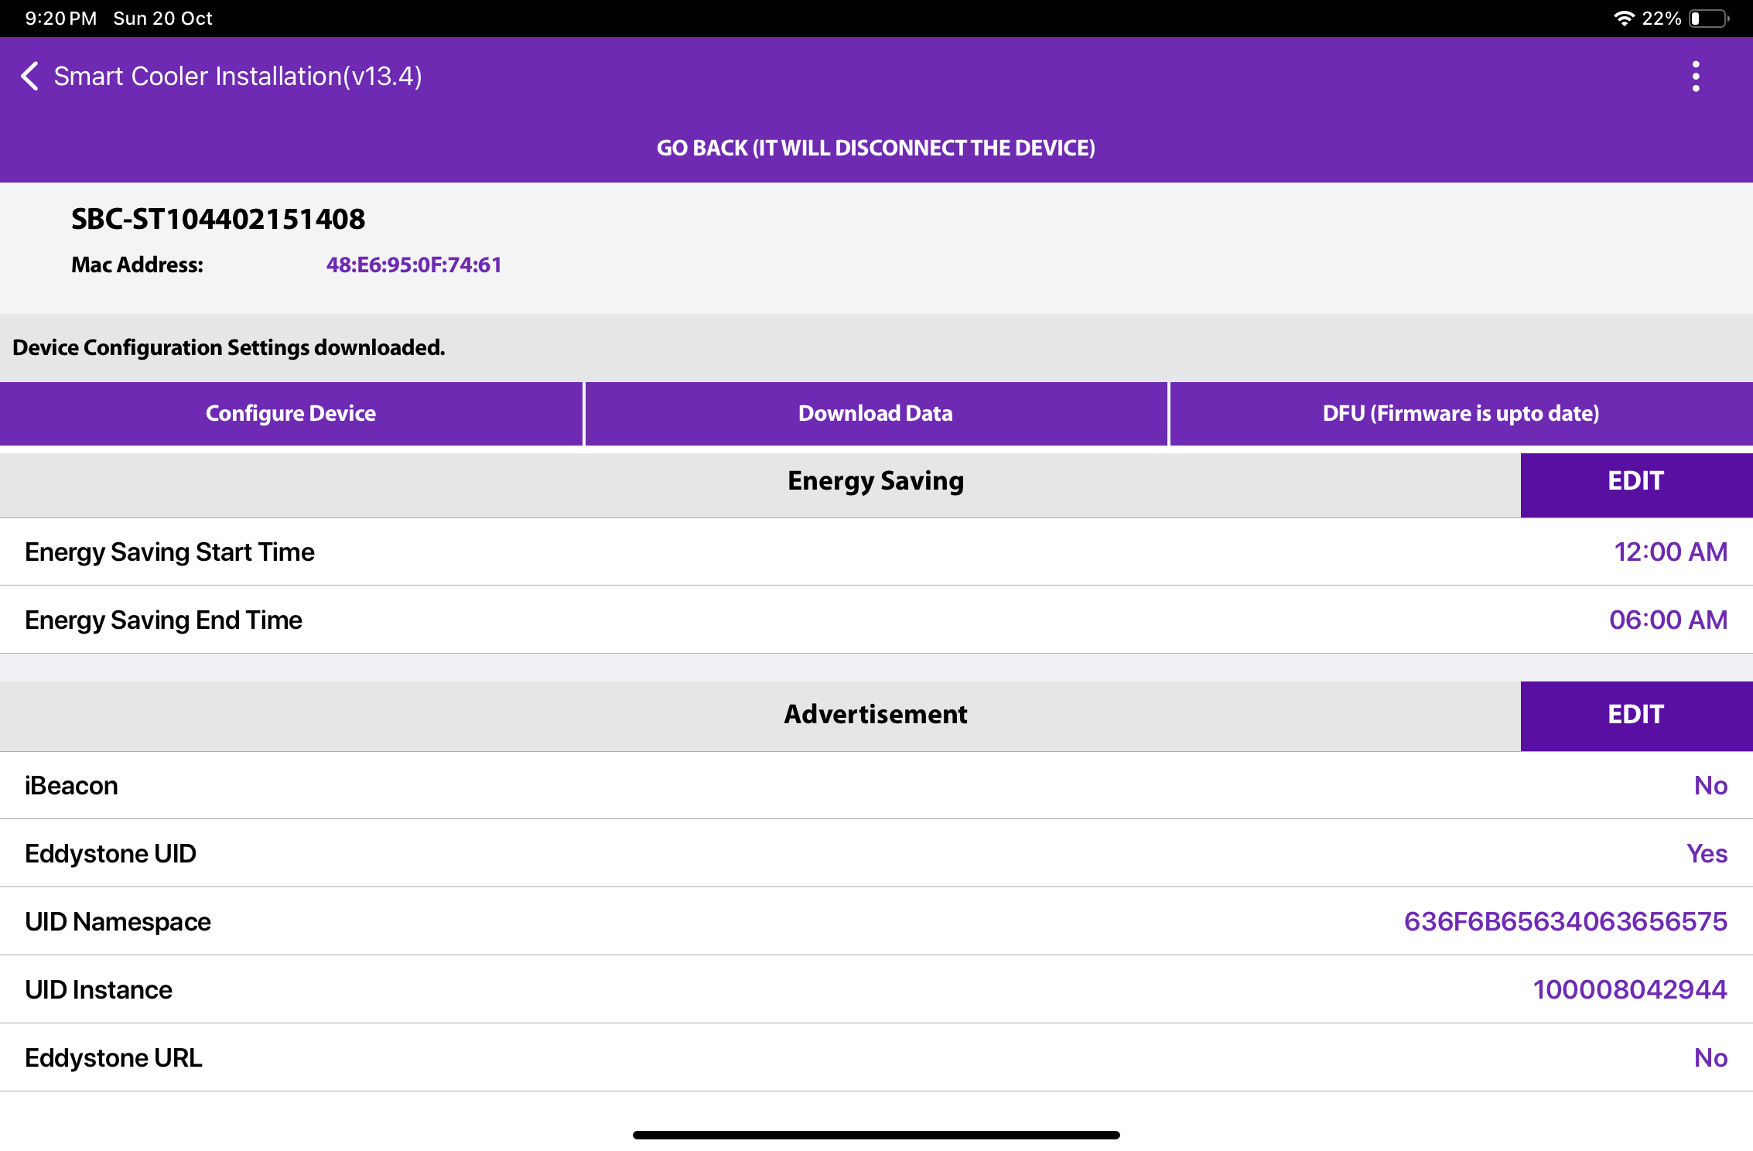
CONFIGURATION - DEEP SLEEP MODE
In Deep-sleep mode, the device neither advertises nor logs any event data. Deep sleep mode is by default enabled when installed in the field the first time.
© 2024 Vision Group

Slide 28
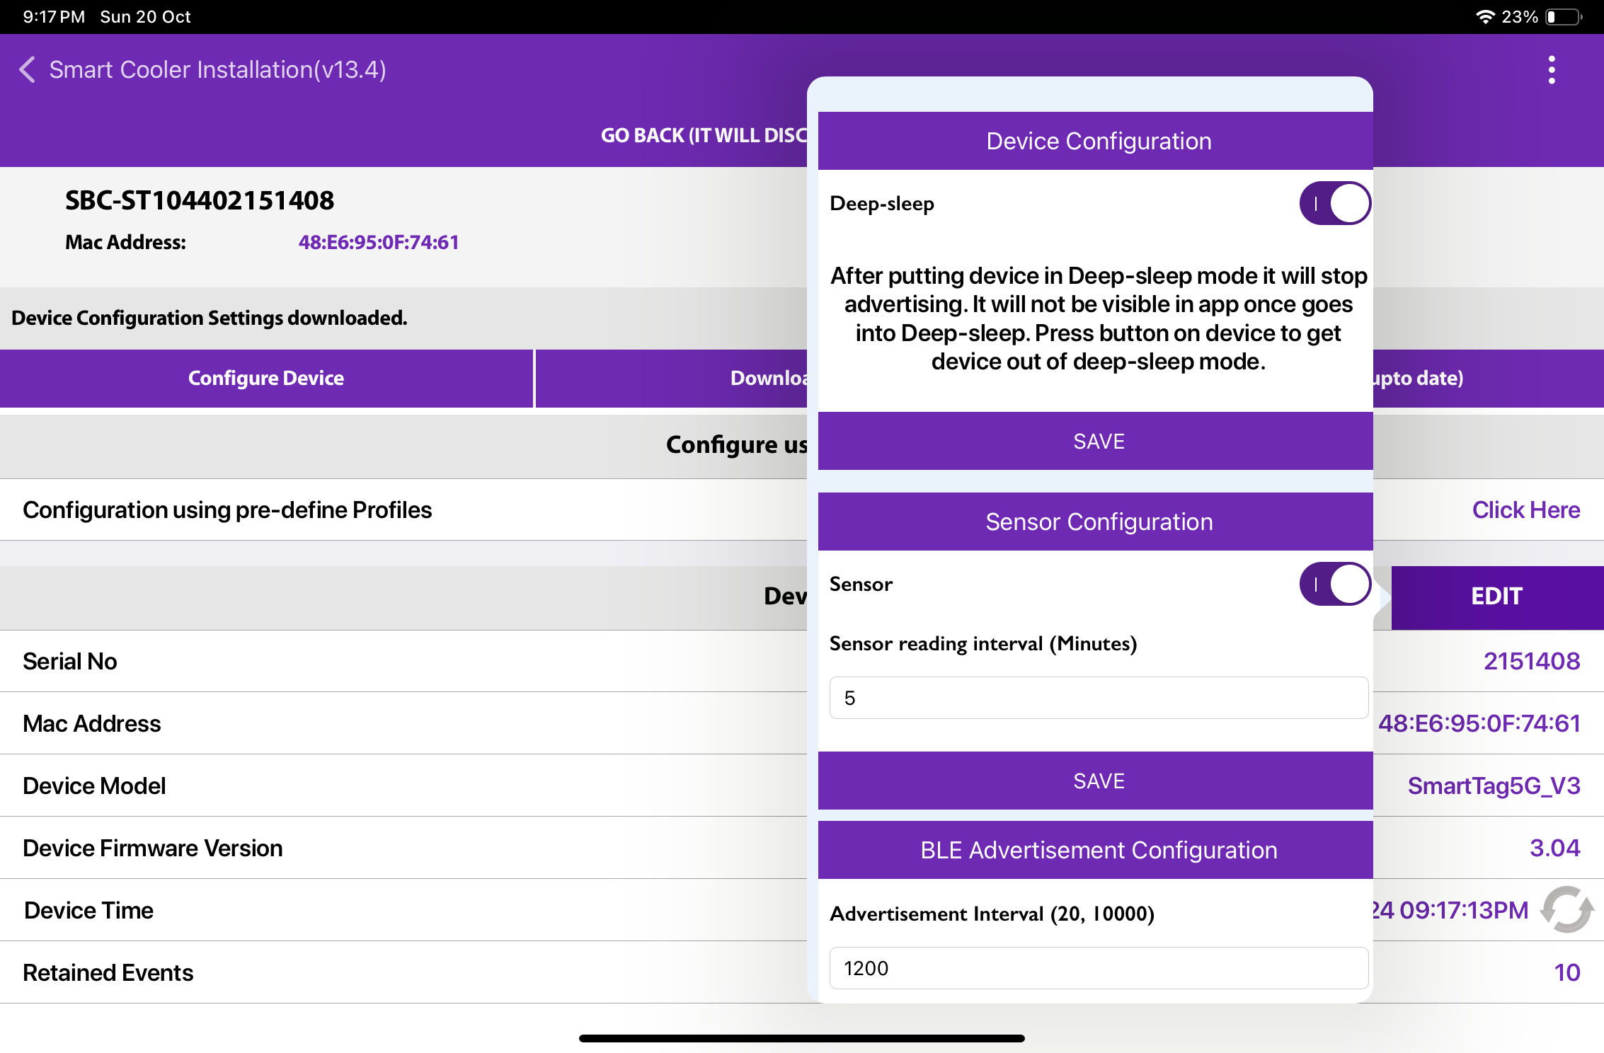
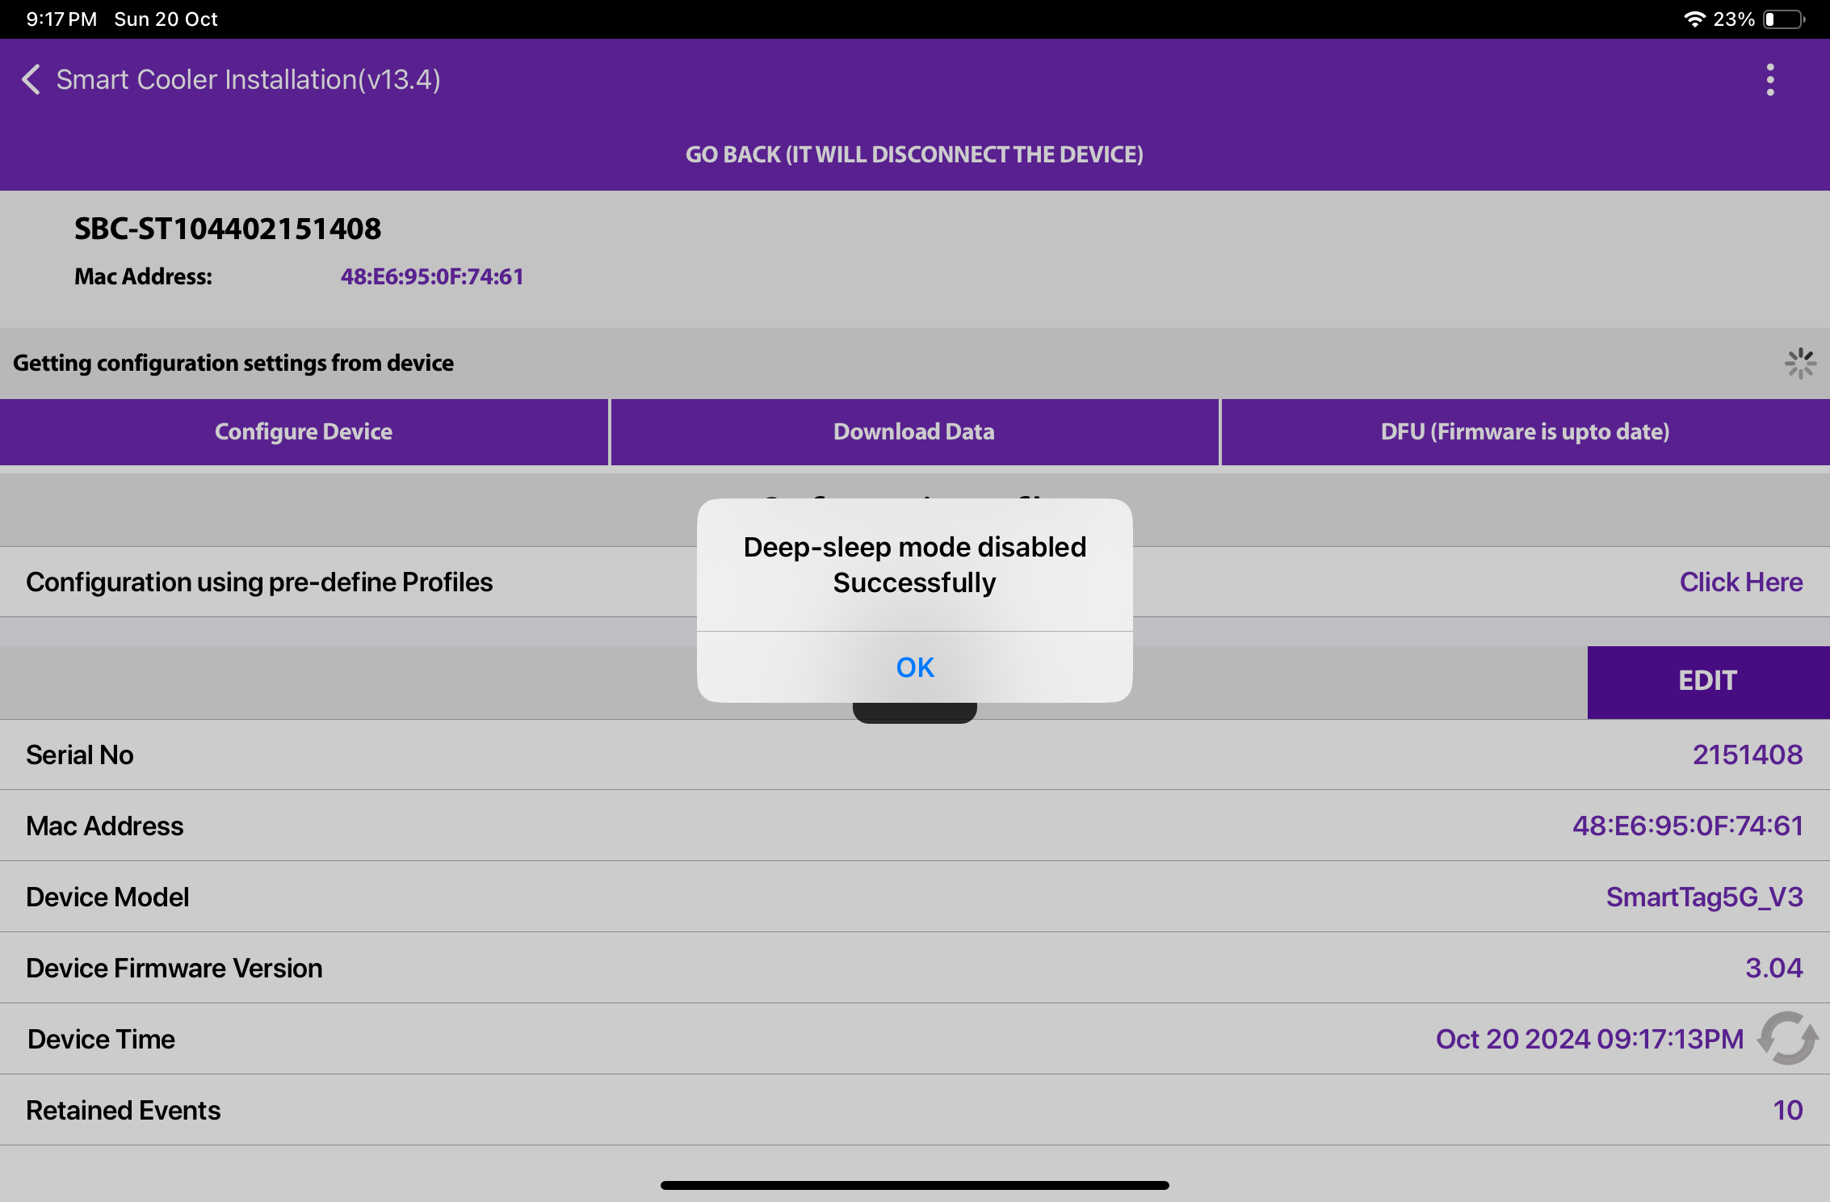
CONFIGURATION - DEEP SLEEP MODE (Cont’d)
A. To Disable Deep Sleep —To disable deep sleep mode, the user must keep the door magnet close to the device, and then the device starts advertising for 90 seconds. The user must connect to a smart device within 30 seconds. Tap on Smart Device, and after the connection, go to Edit > “Device Configuration” > “Deep Sleep” > Disable button.
After disabling deep sleep mode, the device will continuously advertise forever and log event data.
If the user doesn't disable deep sleep mode, then after 90 seconds of disconnection, the device will stop advertisement again and the user can’t see the device in scanning.
B. To Enable Deep sleep, after connection, go to Edit > “Device Configuration” > “Deep Sleep” > Enable button.
After enabling deep sleep mode, the device will stop advertising and won’t log any event.
© 2024 Vision Group

Slide 29
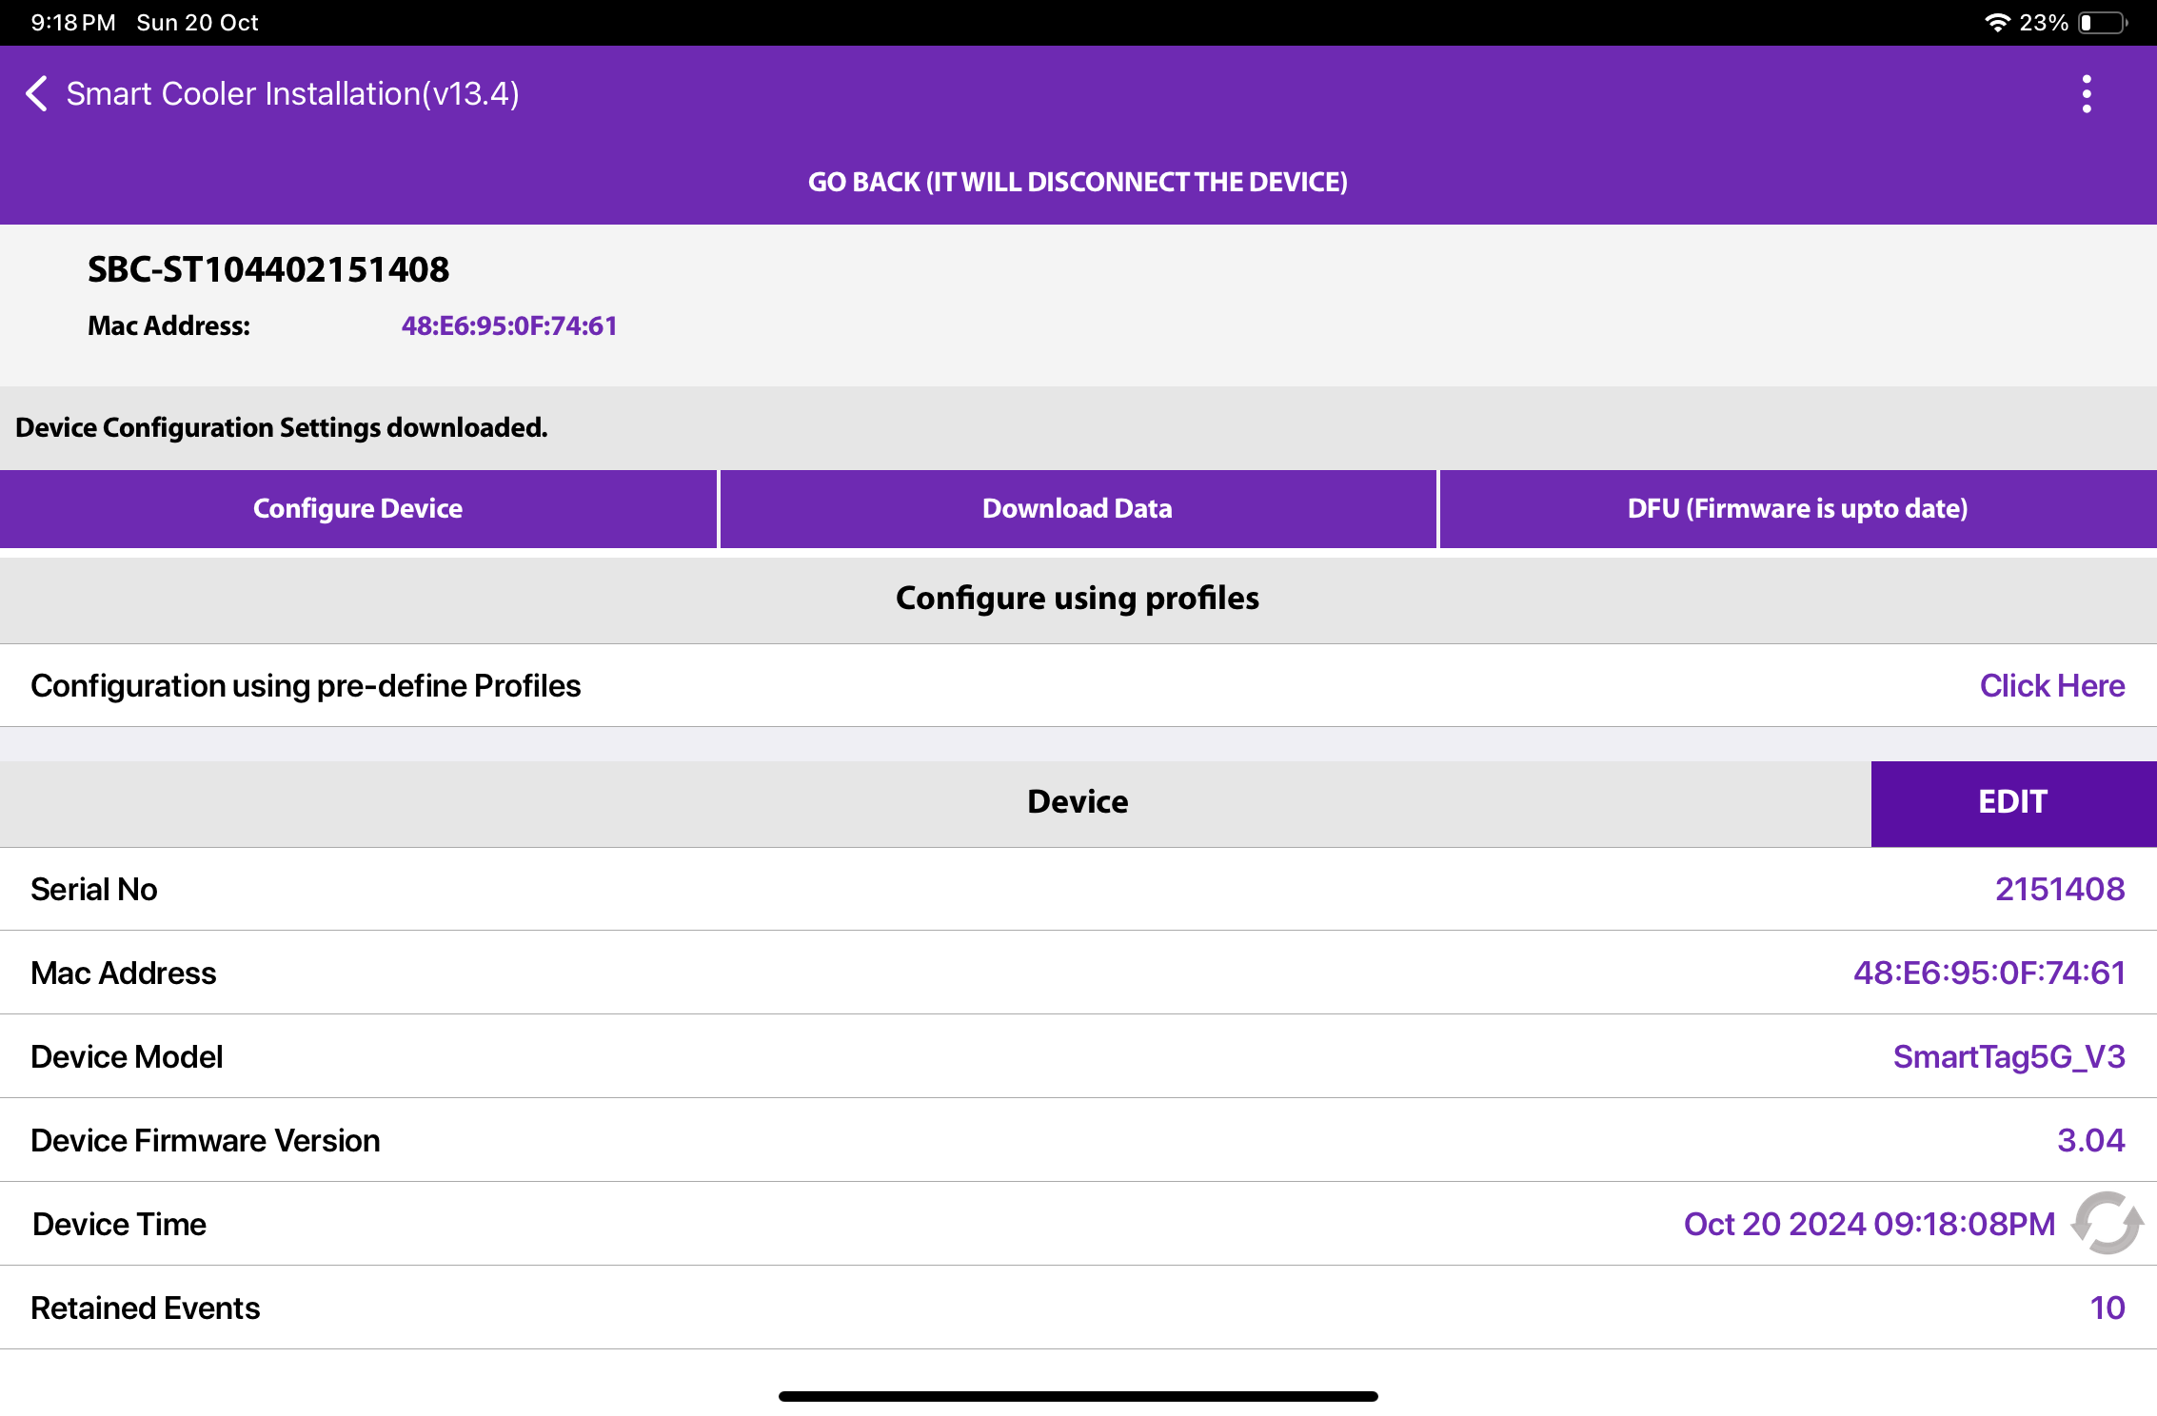
CONFIGURATION - SET HEALTH INTERVAL
After connecting with the device, the user can configure the following parameters. In the STATUS Parameters, Tap on “Heartbeat Interval (In Minutes)”.
A. Enter the Interval Value and press the “Set” button.
B. After changing the values, press the SAVE button at the bottom to save it on the device.
A
B
© 2024 Vision Group

Slide 30
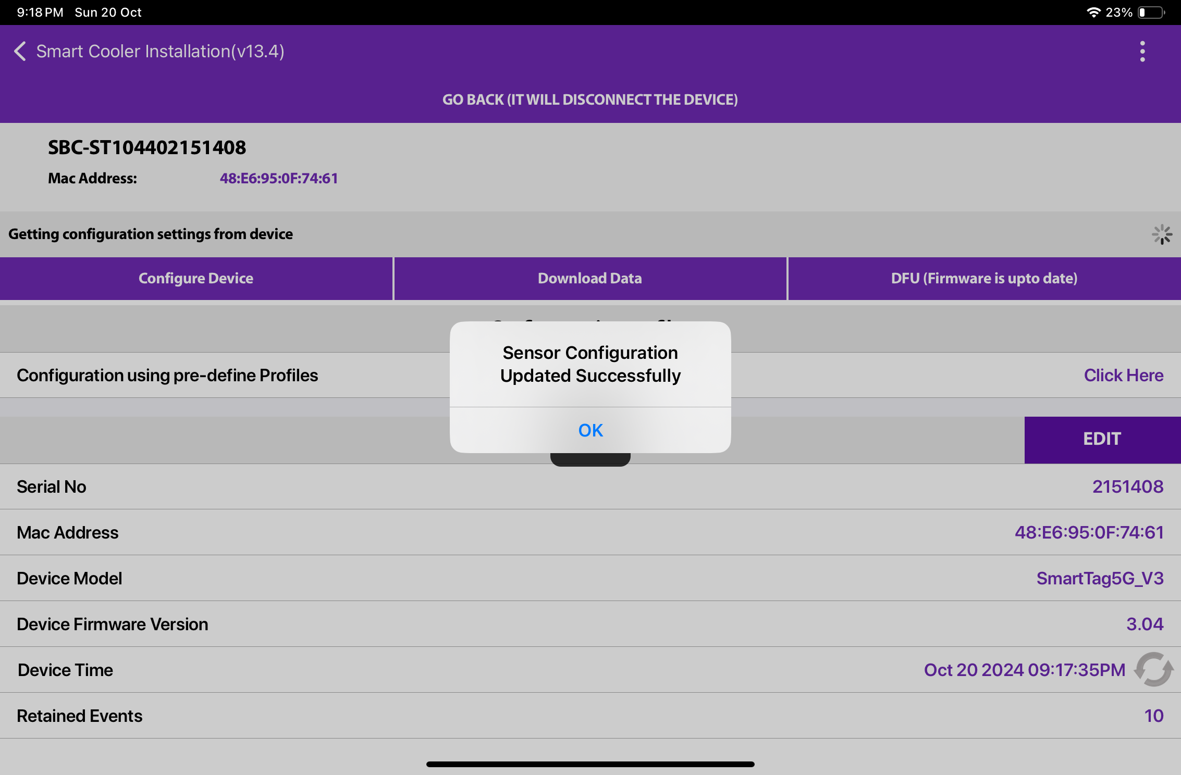
After the Sensor configuration ser successful, success message shows like below image.
© 2024 Vision Group

Slide 31
CONFIGURATION - SET CURRENT DATE TIME
After connecting with smart devices, Tap on the Refresh button in STATUS > “Current Time” row to set the current time in the device.
© 2024 Vision Group

Slide 32
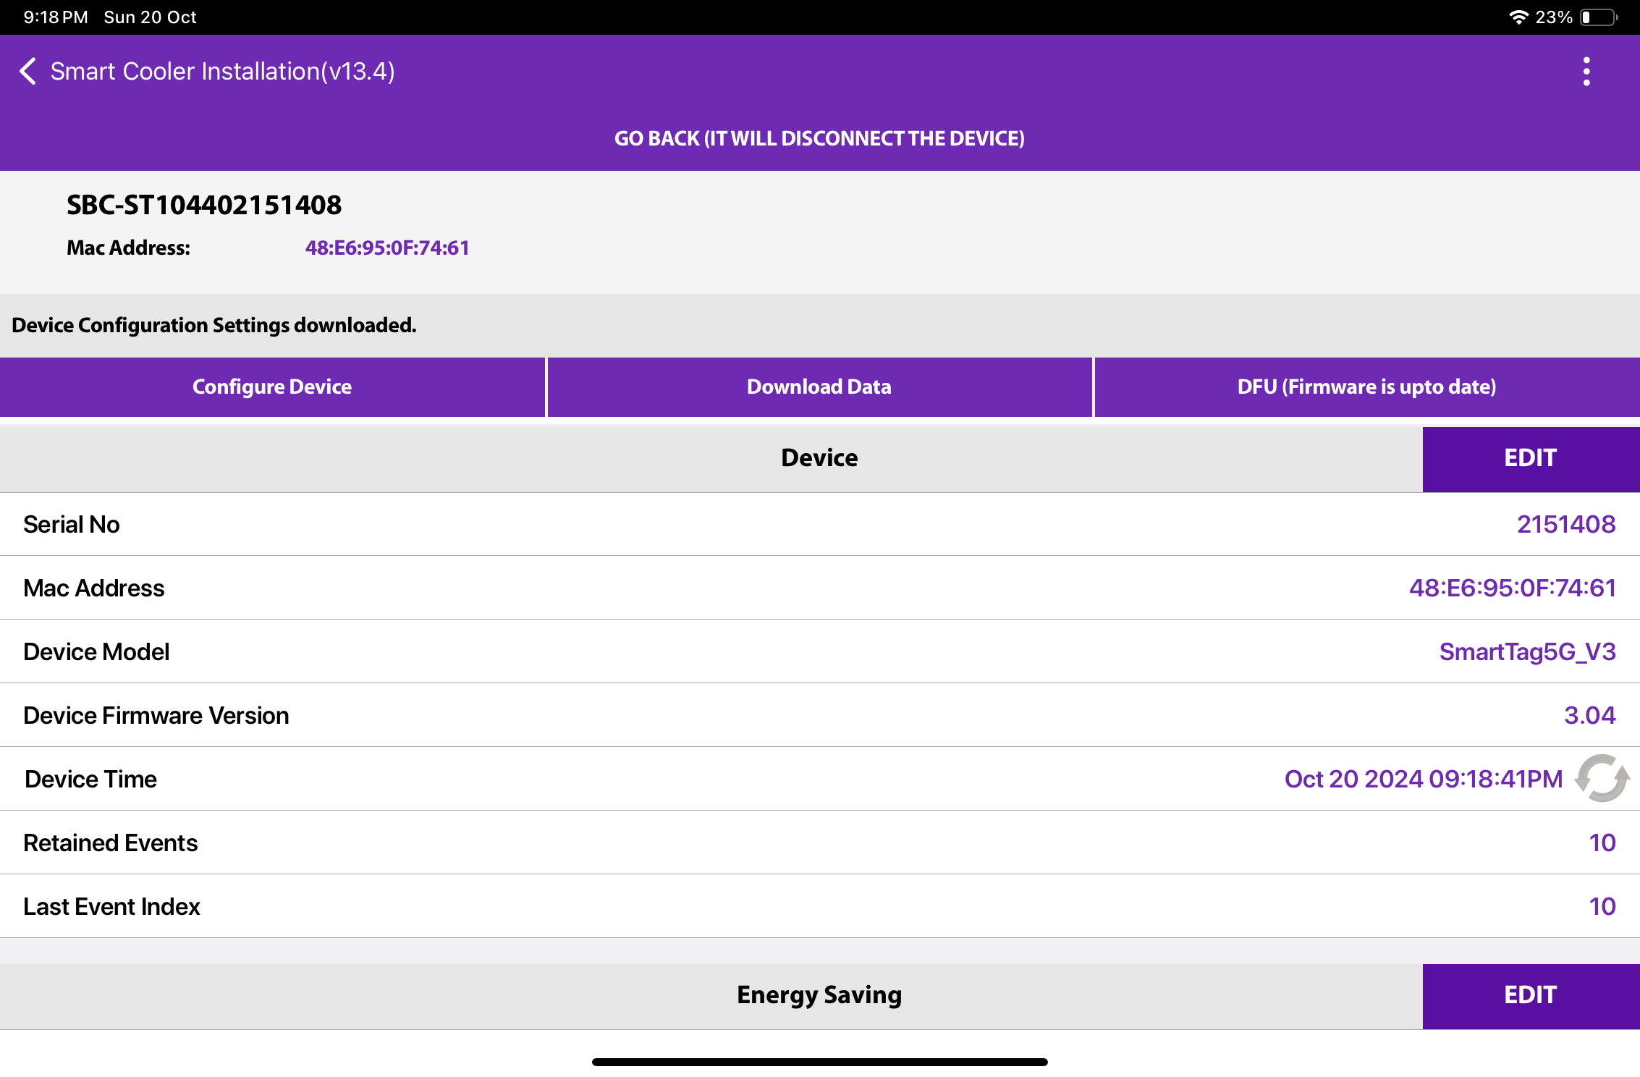
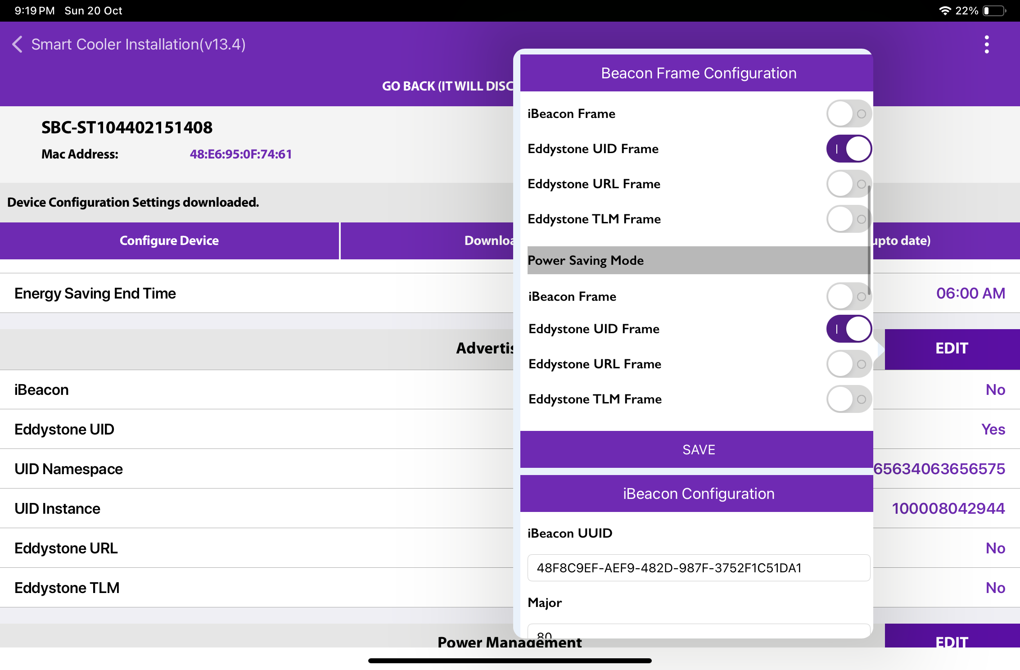
CONFIGURATION - SET IBEACON PARAMETERS
Enable/Disable iBeacon Frame - Toggle button to Enable iBeacon row to enable or disable the iBeacon frame in the iBeacon Raw.
After changing the values, press the SAVE button at the bottom to save it on the device.
© 2024 Vision Group

Slide 33
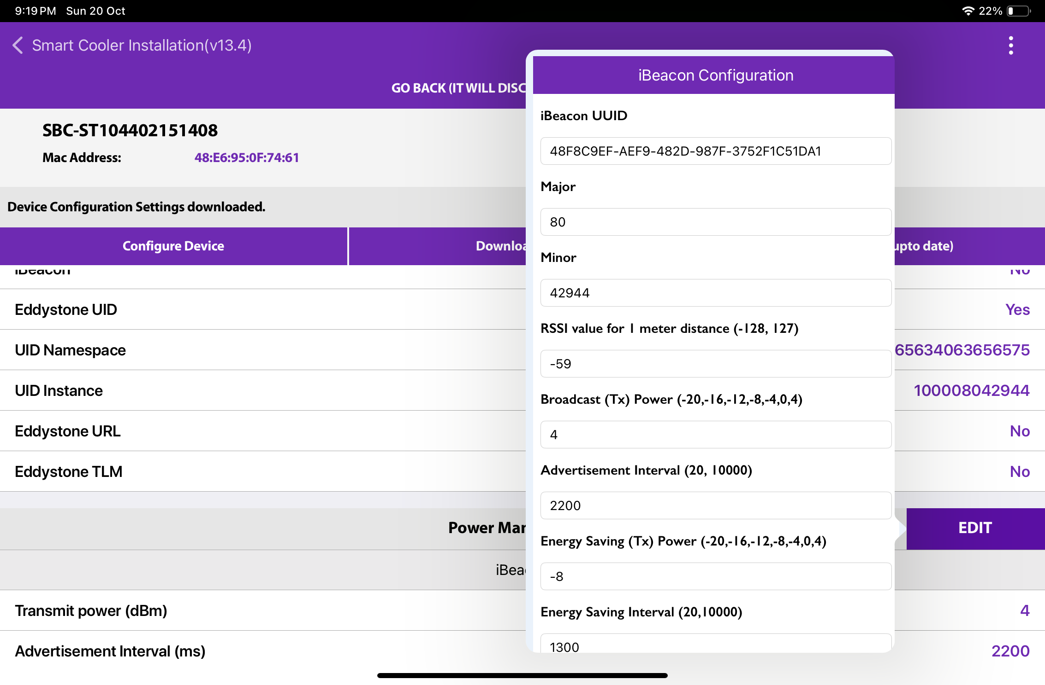
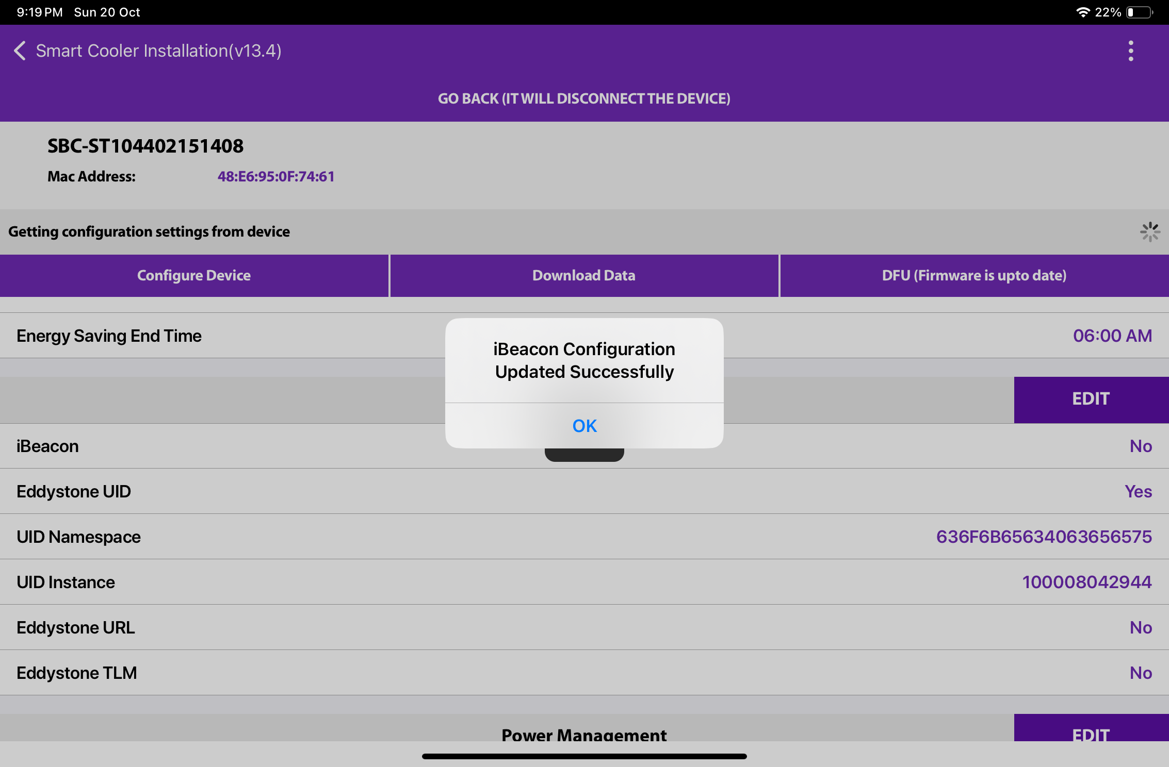
CONFIGURATION - SET IBEACON PARAMETERS (Cont’d)
Set UUID - After connection, as shown in the figure, below the iBeacon bar touch on the UUID row. Enter a 16-byte UUID.
After changing the values, press the SAVE button at the bottom to save it on the device.
© 2024 Vision Group

Slide 34
CONFIGURATION - SET IBEACON PARAMETERS (Cont’d)
Set Major - After connection, as shown in the figure, below the iBeacon bar, there is a row for Major. Click on any row and write the value as shown below. Enter the value.
After changing the values, press the SAVE button at the bottom to save it on the device.
© 2024 Vision Group

Slide 35
CONFIGURATION - SET IBEACON PARAMETERS (Cont’d)
Set Minor - After connection, as shown in the figure, below the iBeacon bar, there is a row for Minor. Click on any row and write the value as shown below. Enter the value.
After changing the values, press the SAVE button at the bottom to save it on the device.
© 2024 Vision Group

Slide 36
CONFIGURATION - SET IBEACON PARAMETERS (Cont’d)
Set RSSI - After connection, as shown in the figure, below the iBeacon bar, there is a row for RSSI. Click on any row and write the value as shown below.
Enter the value.
After changing the values, press the SAVE button at the bottom to save it on the device.
© 2024 Vision Group

Slide 37
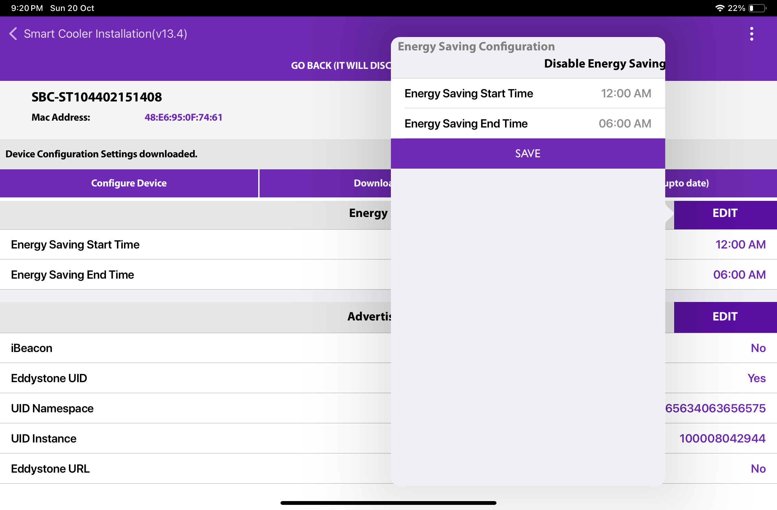
CONFIGURATION - ENERGY SAVING MODE
Set Energy saving mode - Users can set the time duration for saving power by changing the advertisement interval and it transmits power for that user needs to touch on the row Energy Saving Start/End time.
After changing the values, press the SAVE button at the bottom to save it on the device.
© 2024 Vision Group

Slide 38
CONFIGURATION - ENERGY SAVING MODE (Cont’d)
Disable Energy Saving Mode
Users can disable the energy-saving mode by tapping on “Disable Energy Saving” as shown in the image.
After changing the values, press the SAVE button at the bottom to save it on the device.
© 2024 Vision Group

Slide 39
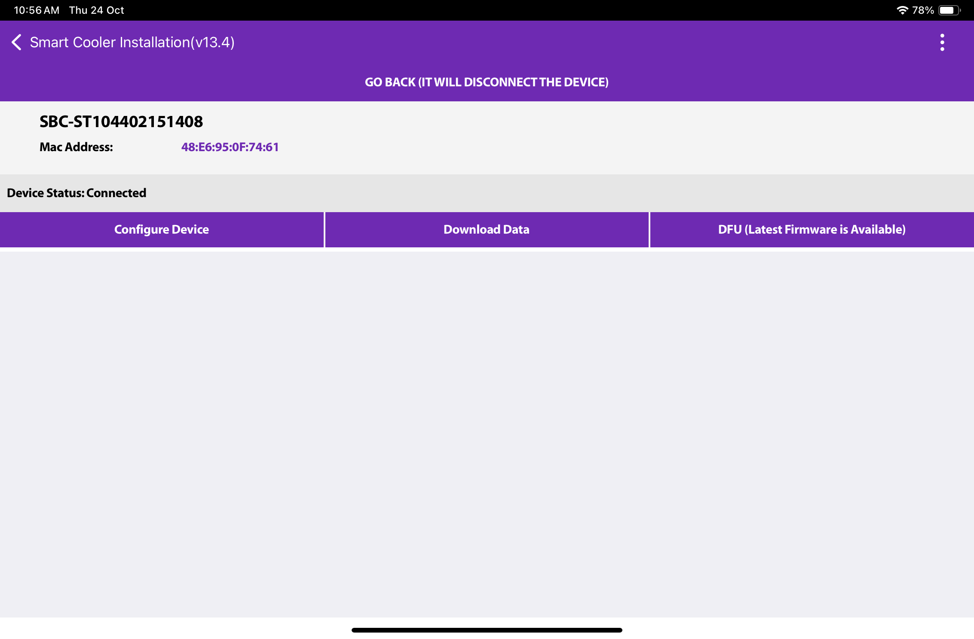
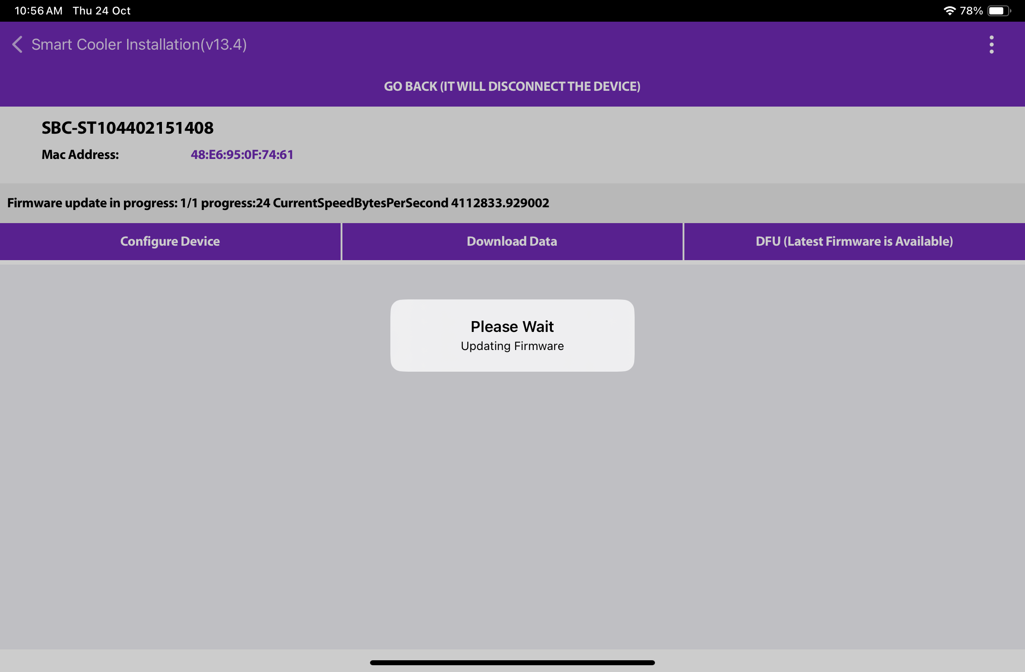
CONFIGURATION – DFU(DIRECT FIRMWARE UPDATE)
DFU - Direct Firmware Update - The Smart device’s DFU can be performed by clicking on the Update DFU Button, as shown in the image. If the Device already has the latest Firmware, then there is no DFU Flag shown.
© 2024 Vision Group

Slide 40
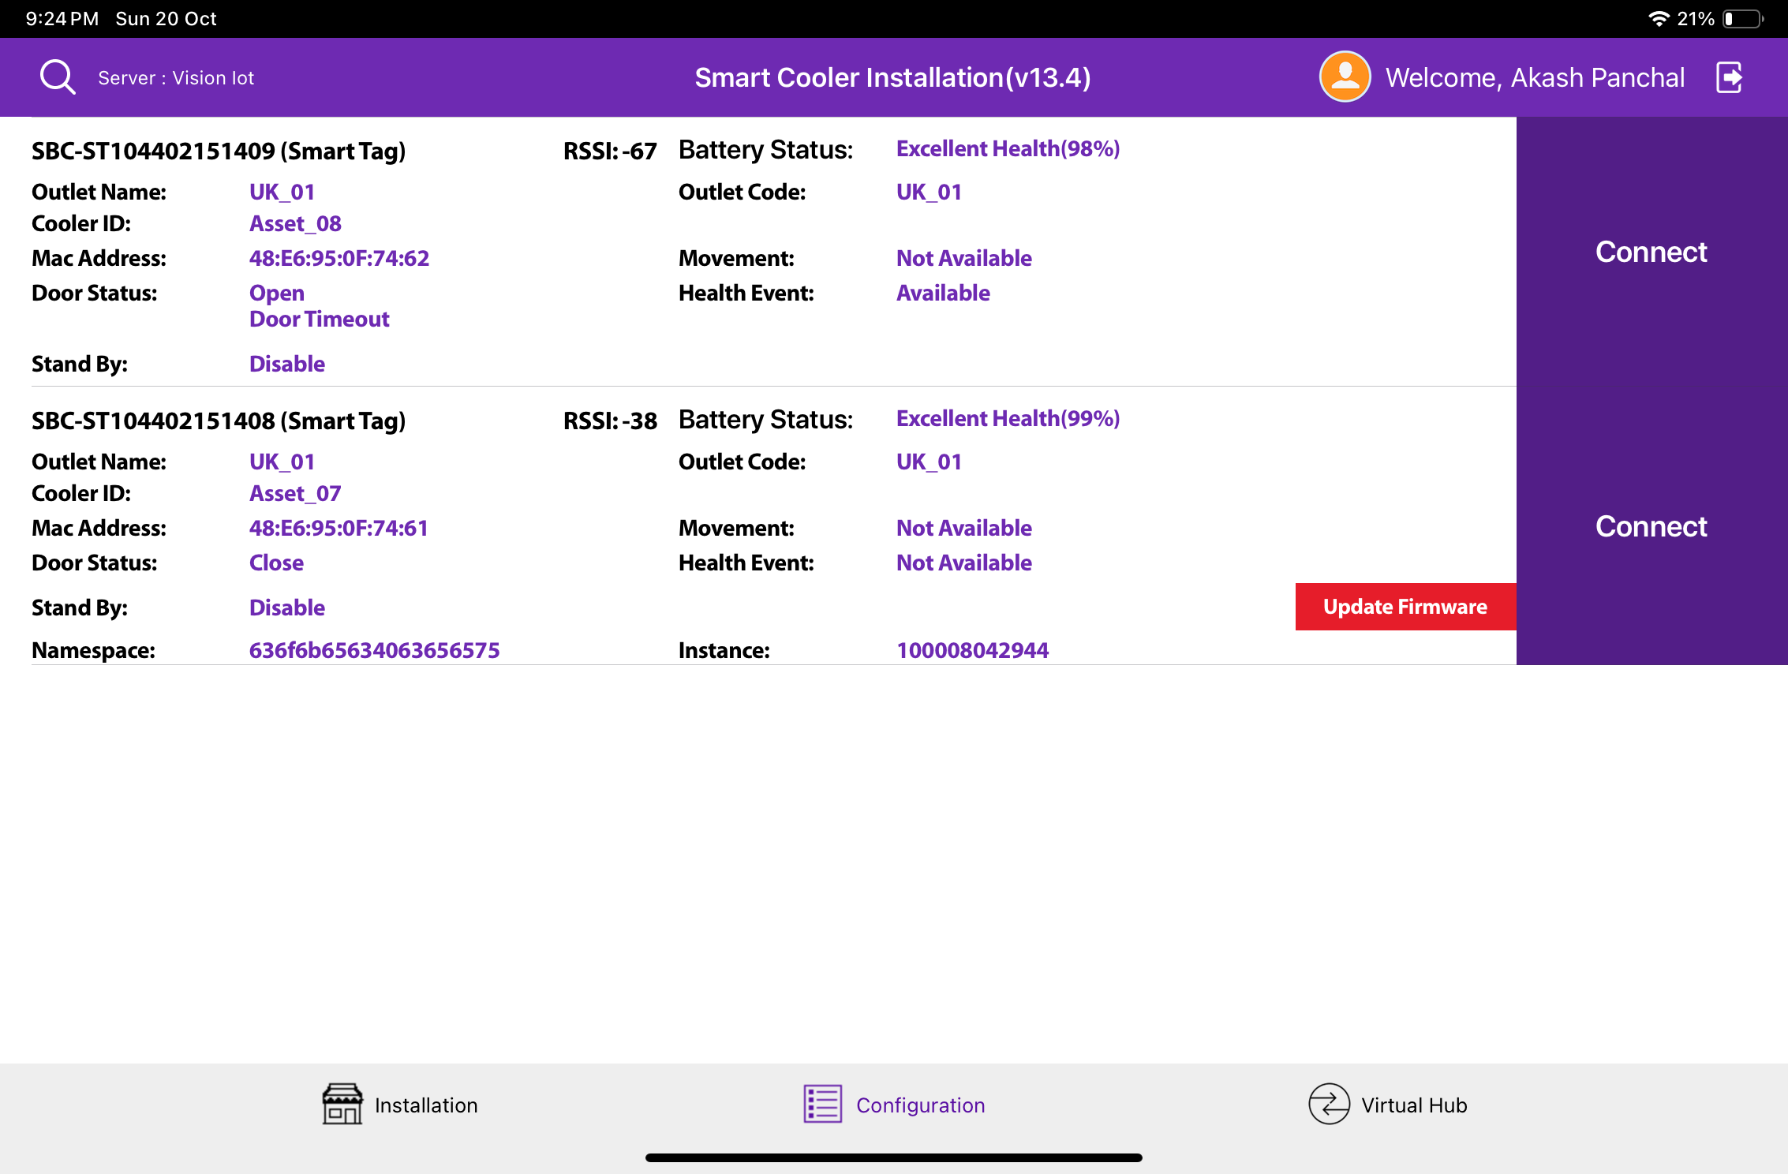
Firmware upgrade from the Configuration Screen
.
All SmartTag3G/Smarttag4GV2/SmartTag5GV3 assigned to a user can be seen on the configuration screen and the ones where the Firmware is equal to or less than then will show an action button for the upgrade of firmware.
To initiate Firmware Upgrade tap on the button.
The recommendation is that you stay close to the device and do not move while the action is performed.
© 2024 Vision Group

Slide 41
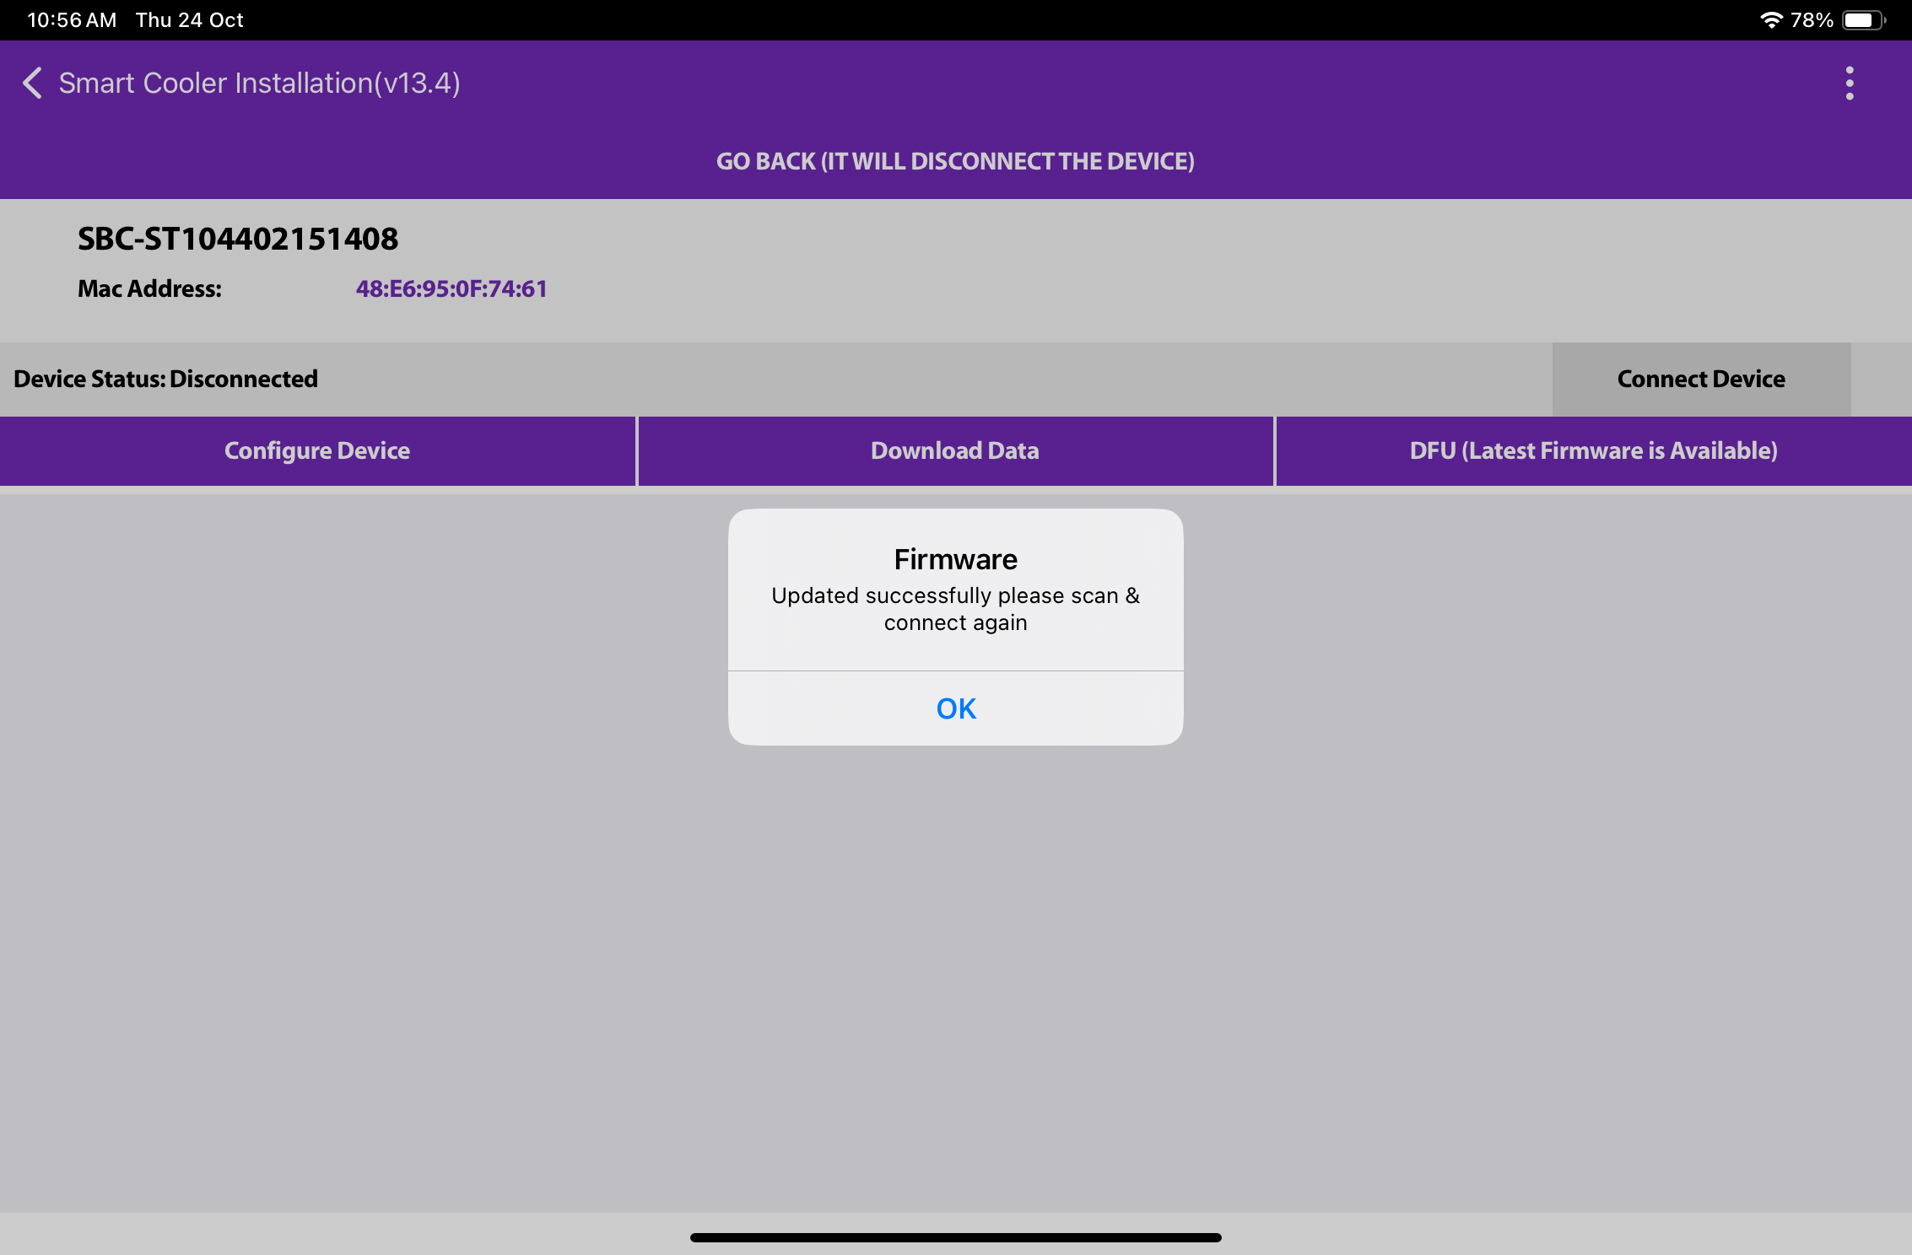
Firmware upgrade
After completing the DFU update, the user will see the DFU Upgrade Process. Once the DFU process is successfully finished, the user can view the upgraded firmware version of the smart device.
© 2024 Vision Group

Slide 42
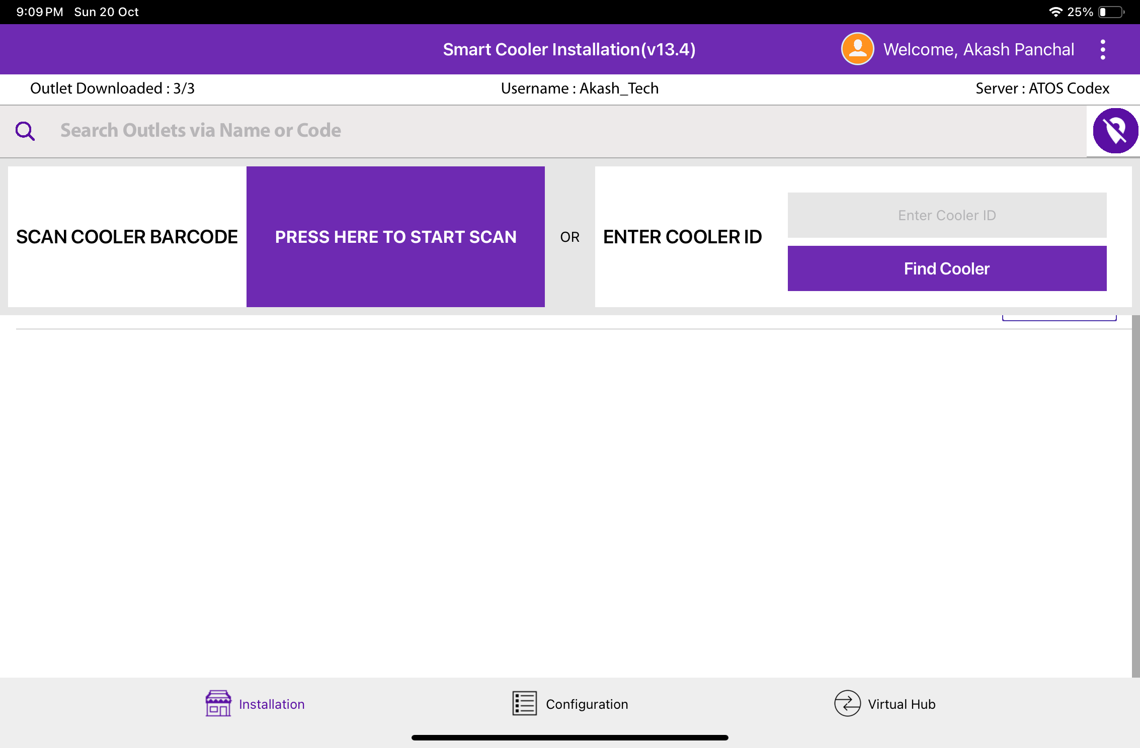
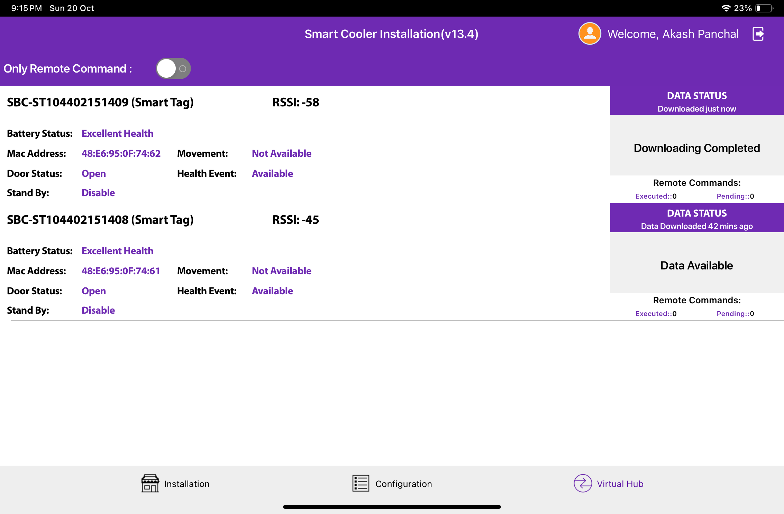
VH PROCESS (VIRTUAL HUB SCREEN PROCESS)
Select the Virtual Hub Menu at the bottom right side and then Select VH to access the VH Screen and application is data downloading from Smart Devices and Upload.
Users can see the devices around user’s and the status of each one, it is possible (but may be too fast to catch) to see the Status Performing “Remote Command”
© 2024 Vision Group

Slide 43
VH PROCESS (VIRTUAL HUB SCREEN PROCESS) – Cont’d
(Switch modes between Download & Remote commands and only remote commands).
By default, the switch is in position,
Only execute Remote Commands
If the switch is disabled, the application will start downloading data from approved devices
© 2024 Vision Group

Slide 44
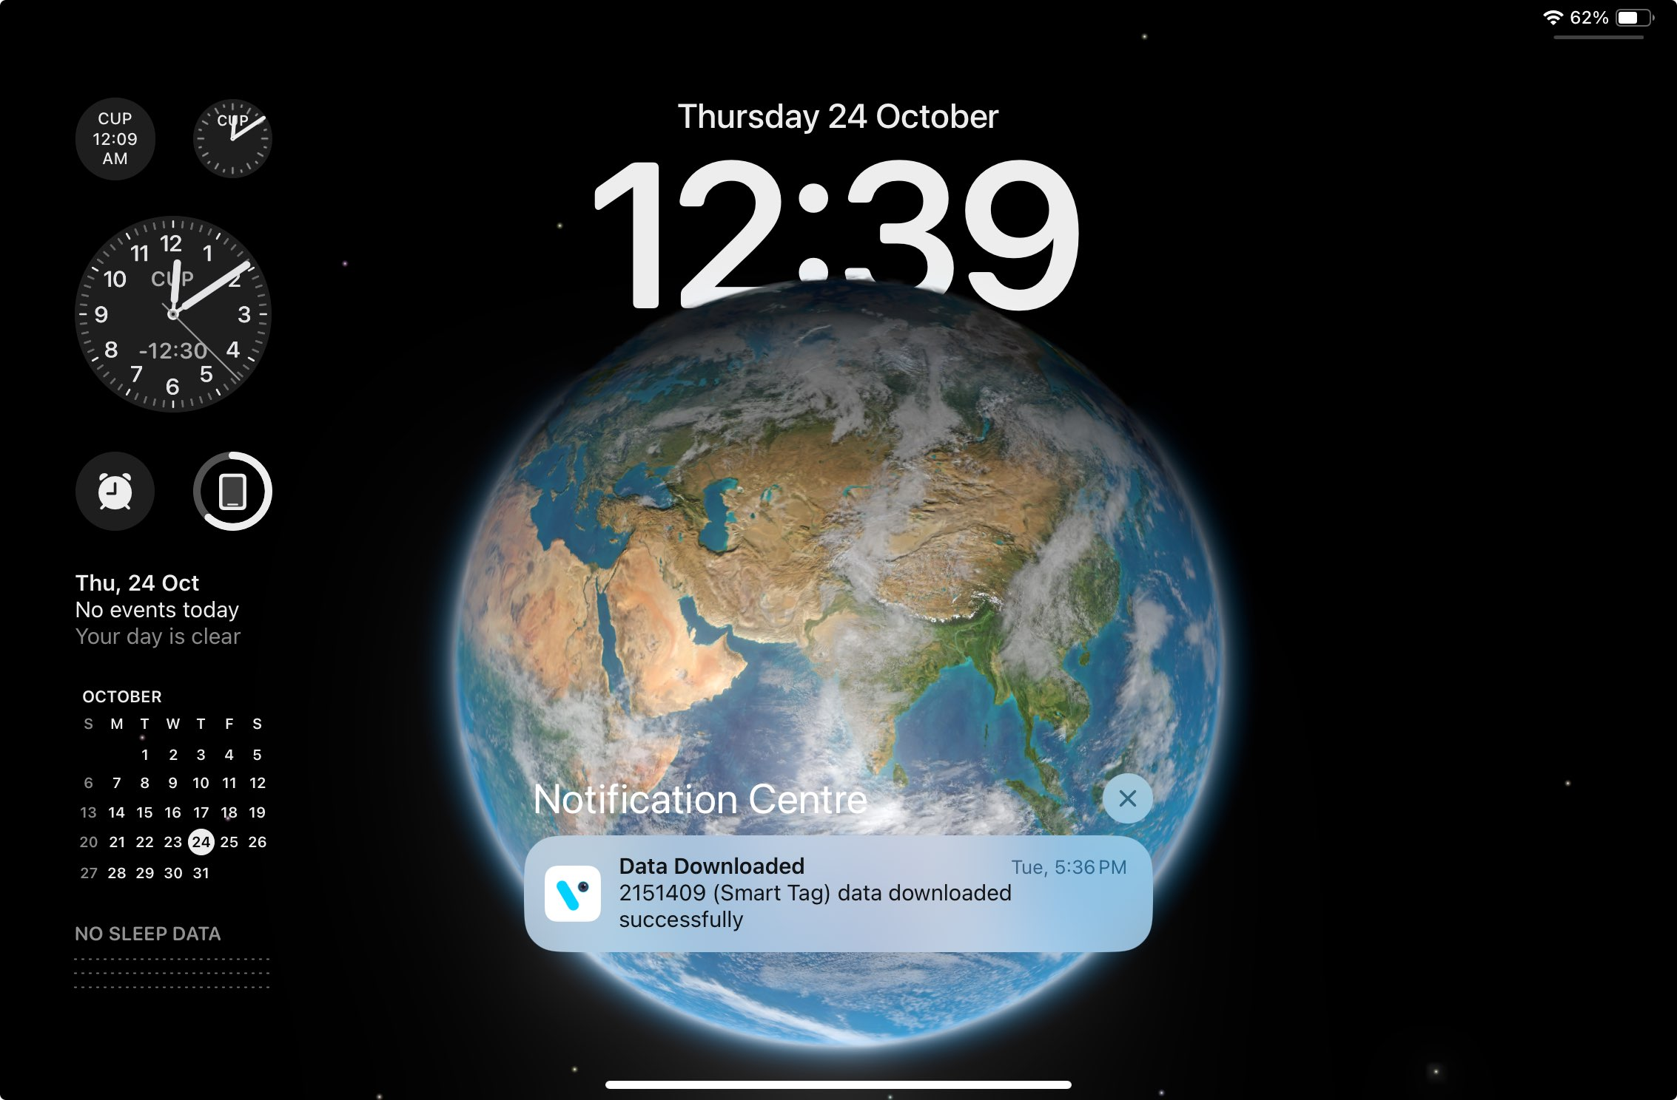
VH SCREEN - NOTIFICATION
Pull down the notification to check the Virtual Hub service status when the application runs in the background.
© 2024 Vision Group

Slide 45
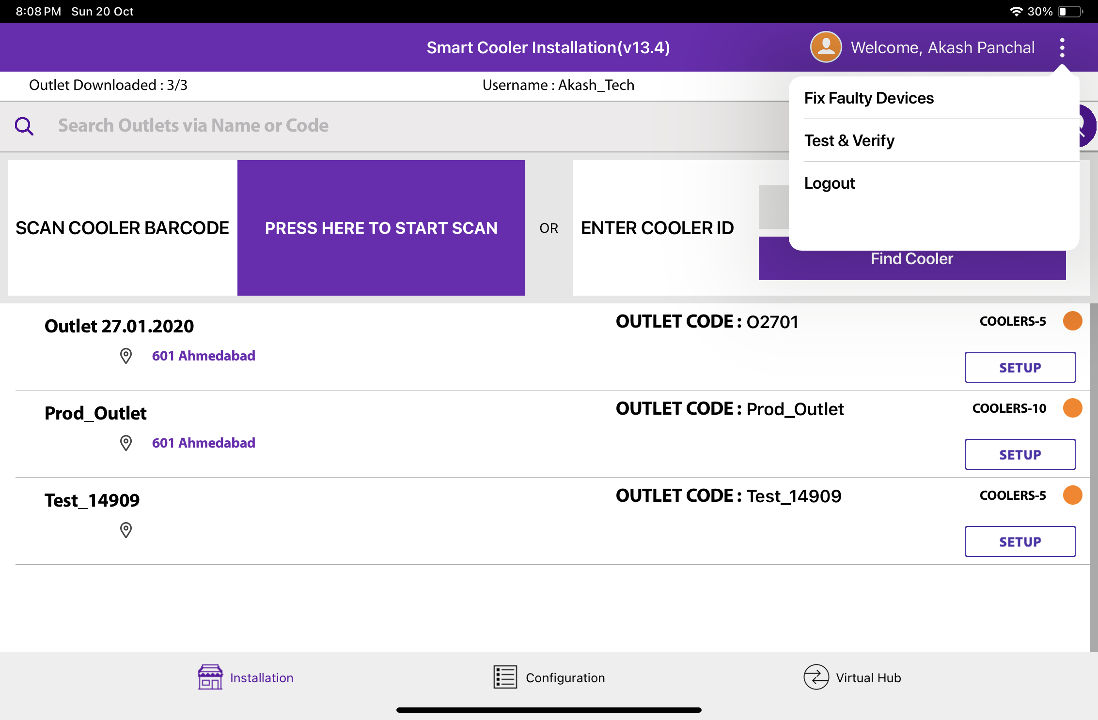
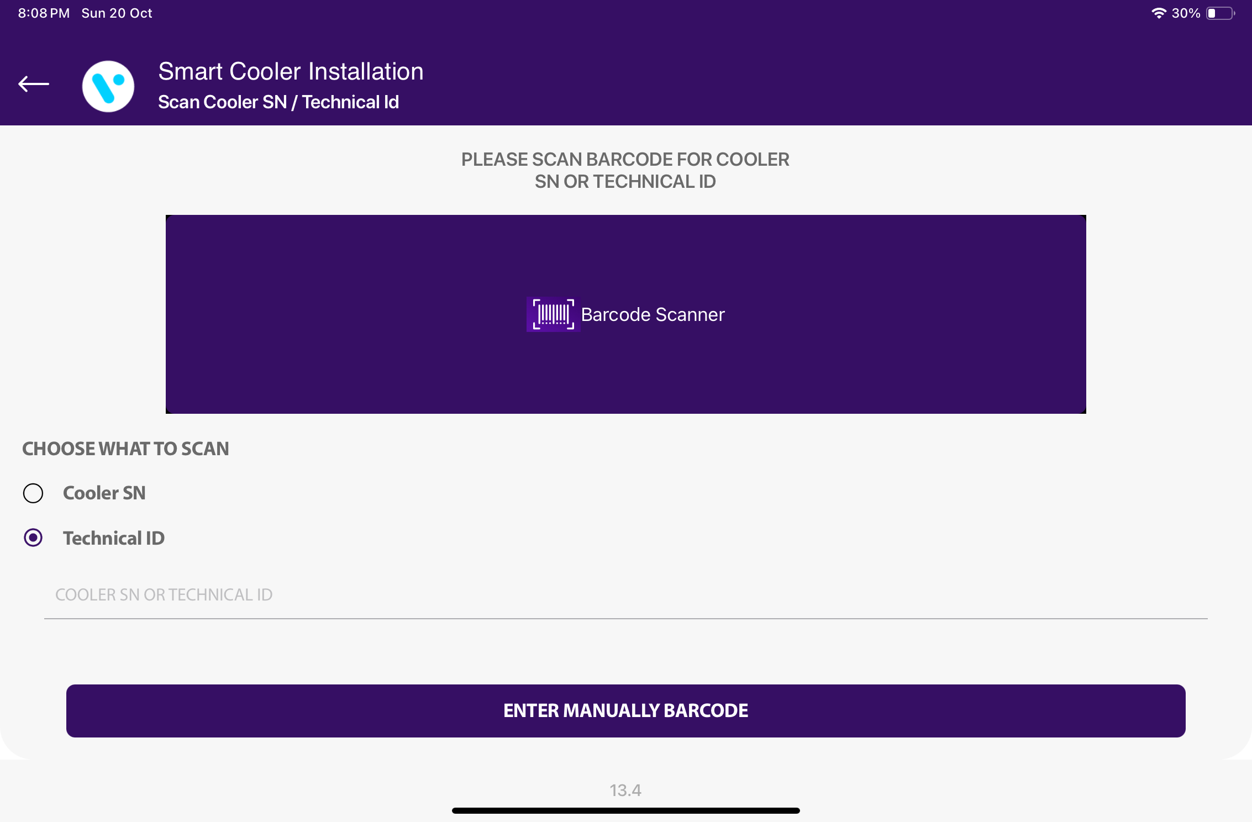
FIX FAULTY DEVICES
Use CHECK COOLER STATUS to check specific smart device current sensor data, FW version info, and DFU functionality if the latest Firmware is available for the Scanned Cooler.
Users can identify assets by SCAN BARCODE by Cooler SN or Technical ID. The user can also search by ENTER MANUALLY BARCODE of Cooler SN or Technical ID.
© 2024 Vision Group

Slide 46
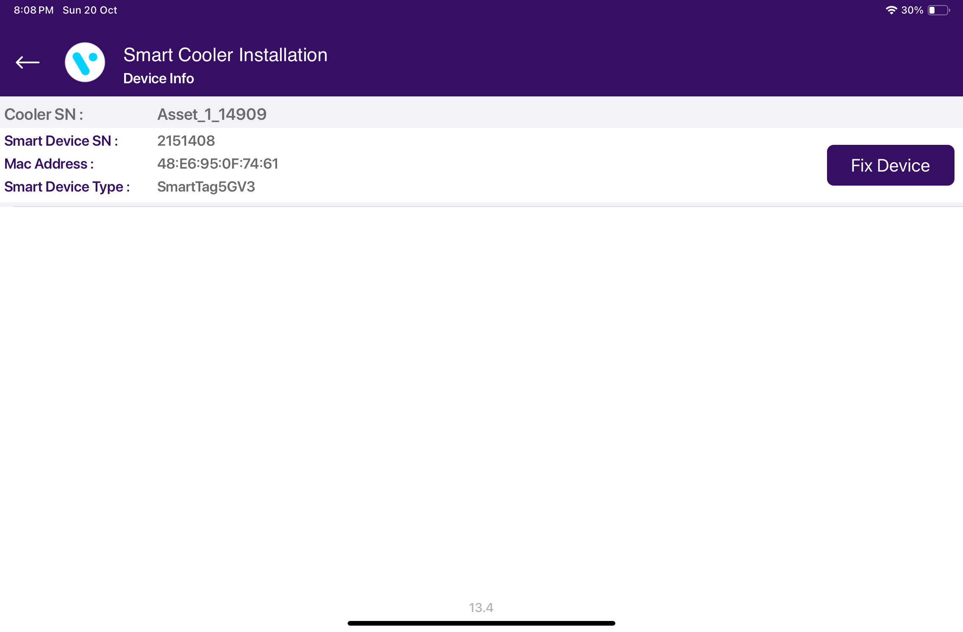
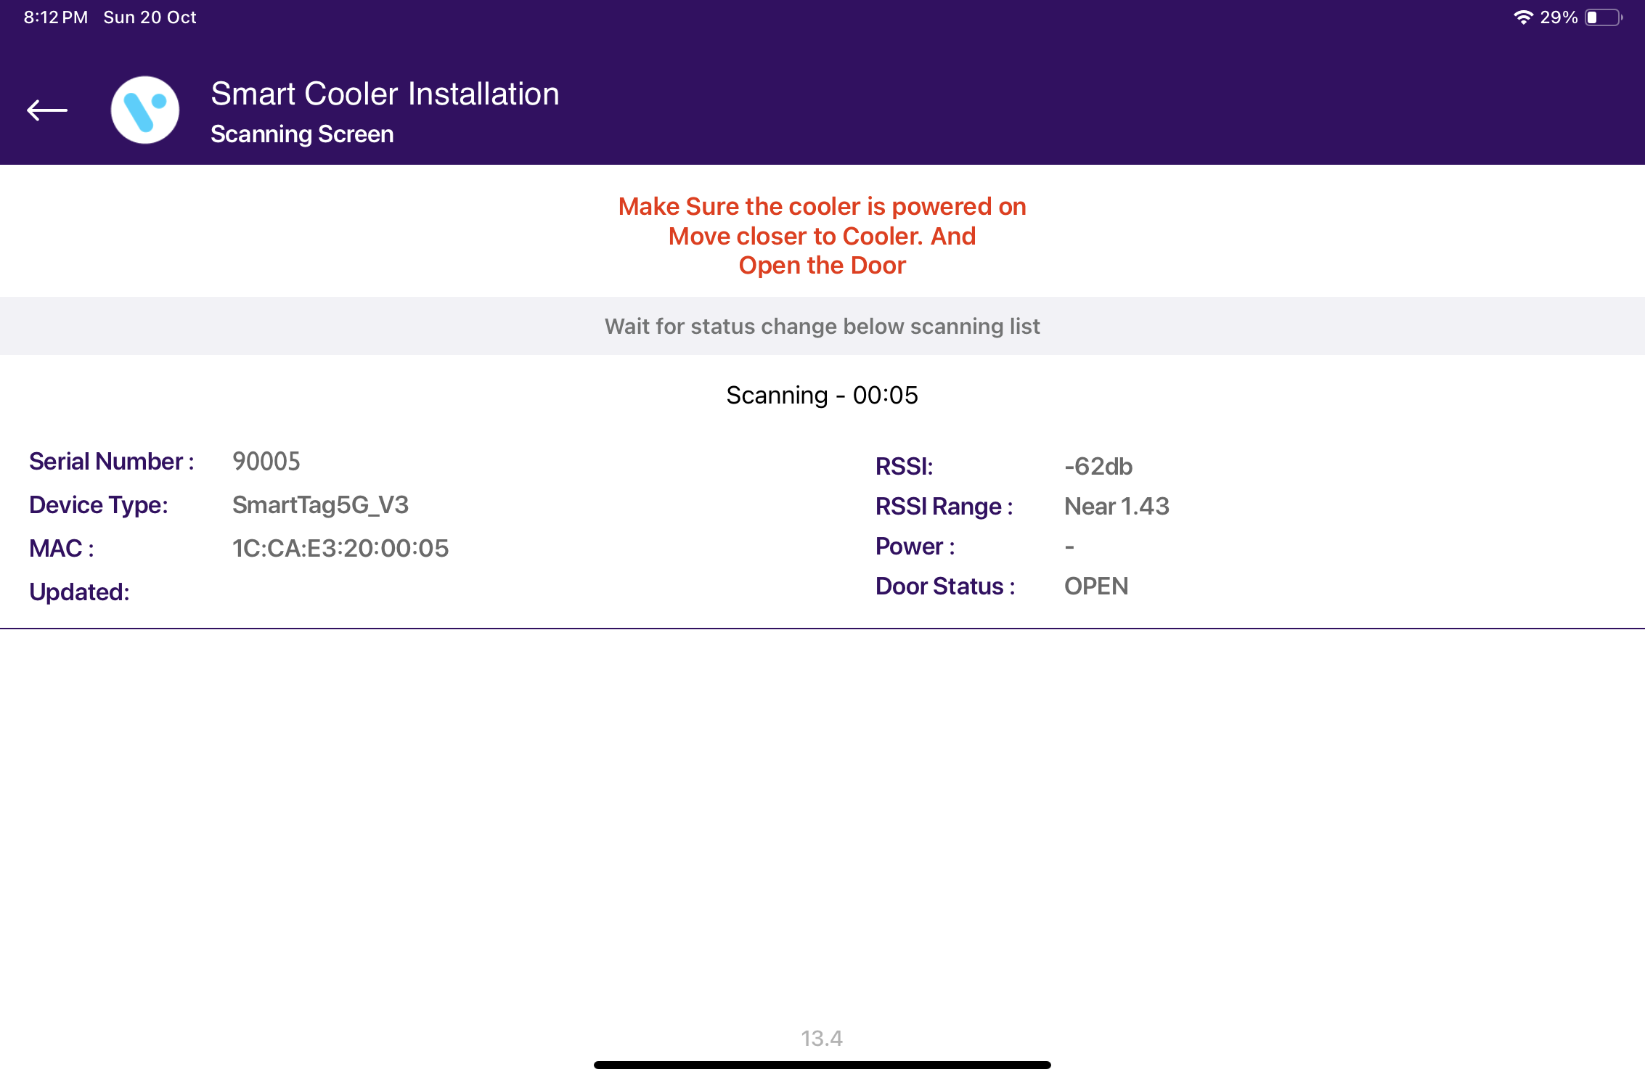
The Scanned Device will Corrected with the actual smart device serial number and Upgrade to the Latest Firmware Update if the Update is available and set the device configuration.
© 2024 Vision Group

Slide 47
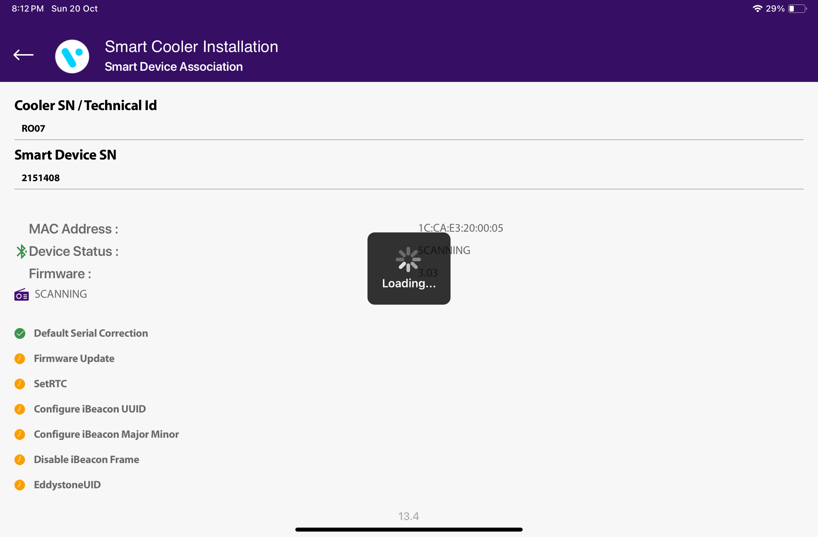
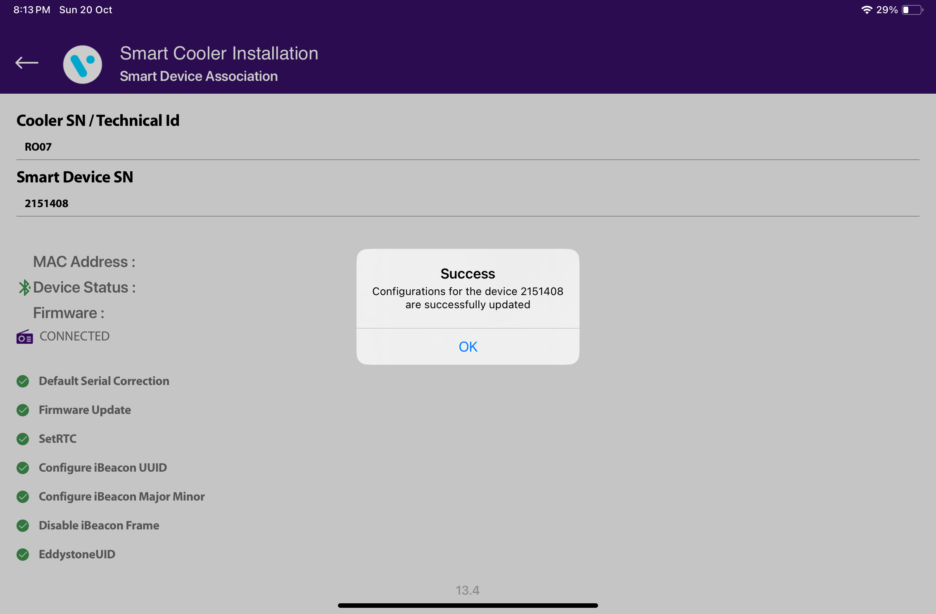
© 2024 Vision Group

Slide 48
TEST AND VERIFY
This feature involves verifying the fixed devices after faulty fix features to verify the ibeacon and Eddystone Advertisement frame values.
Users can identify assets by SCAN BARCODE by Cooler SN or Technical ID. The user can also search by ENTER MANUALLY BARCODE of Cooler SN or Technical ID.
© 2024 Vision Group

Slide 49
Application asking for door cycle to verify the smart device’s Door sensor data.
© 2024 Vision Group

Slide 50
After giving the Door Cycle, the device will show the Advertisement frame values in comparison with Smart device and Cloud values. Pressing on the Download Event button, the user can verify the Door Event Verification by logging Door Events.
© 2024 Vision Group

Slide 51
SMART DEVICE REMOVAL OF ASSOCIATION AND REUSAGE
If a Smart Device must be removed from a cooler the proper procedure is,
1.Log in to the Vision IoT application with BD credentials in whose territory is the cooler.
2. Go to the Virtual Hub tab and make sure that all the data from the Smart Device is downloaded (the Virtual Hub tab should be in Foreground).
3. Find the outlet and the cooler inside where the Smart Device is installed.
4. Tap on the button Remove Association.
5. Physically remove the device (and if it is SmartTag/SmartVision also the magnet) from the cooler.
© 2024 Vision Group

Slide 52
The app should have internet access at that or later time for the data to be available to the server (but the app should have internet access before you attempt to install the same device again in this or another location).
Once the iFSA download is in effect then the download should happen via iFSA, but the removal of association should happen via the Vision IoT application.
If you want to install the same Smart Device to a different cooler,
1. Make sure you log in to the Vision IoT application again after the Smart Device is uninstalled (this is required so that the server can send the proper information and settings to the application for the new installation).
2. If you have just uninstalled the device, make sure you log off and then log in again to the Vision IoT application.
3. If you are installing the device using a different tablet/app/BD username, make sure that you’ve logged in after the device has been successfully uninstalled.
Important
1. The minimum device is an iPad 8th Gen or higher. The minimum iOS version is 14.
2. Only one user should log in at a time and if another user needs to log in the application should be reinstalled.
© 2024 Vision Group

Slide 53
Thank You!
support.iot@visiongroupretail.com
+1-833-593-0144 (USA Tollfree Number)

