Slide 1

SMART COOLER INSTALLATION
APPLICATION USER MANUAL (iOS)
v_2.7 | JULY_2022

Slide 2

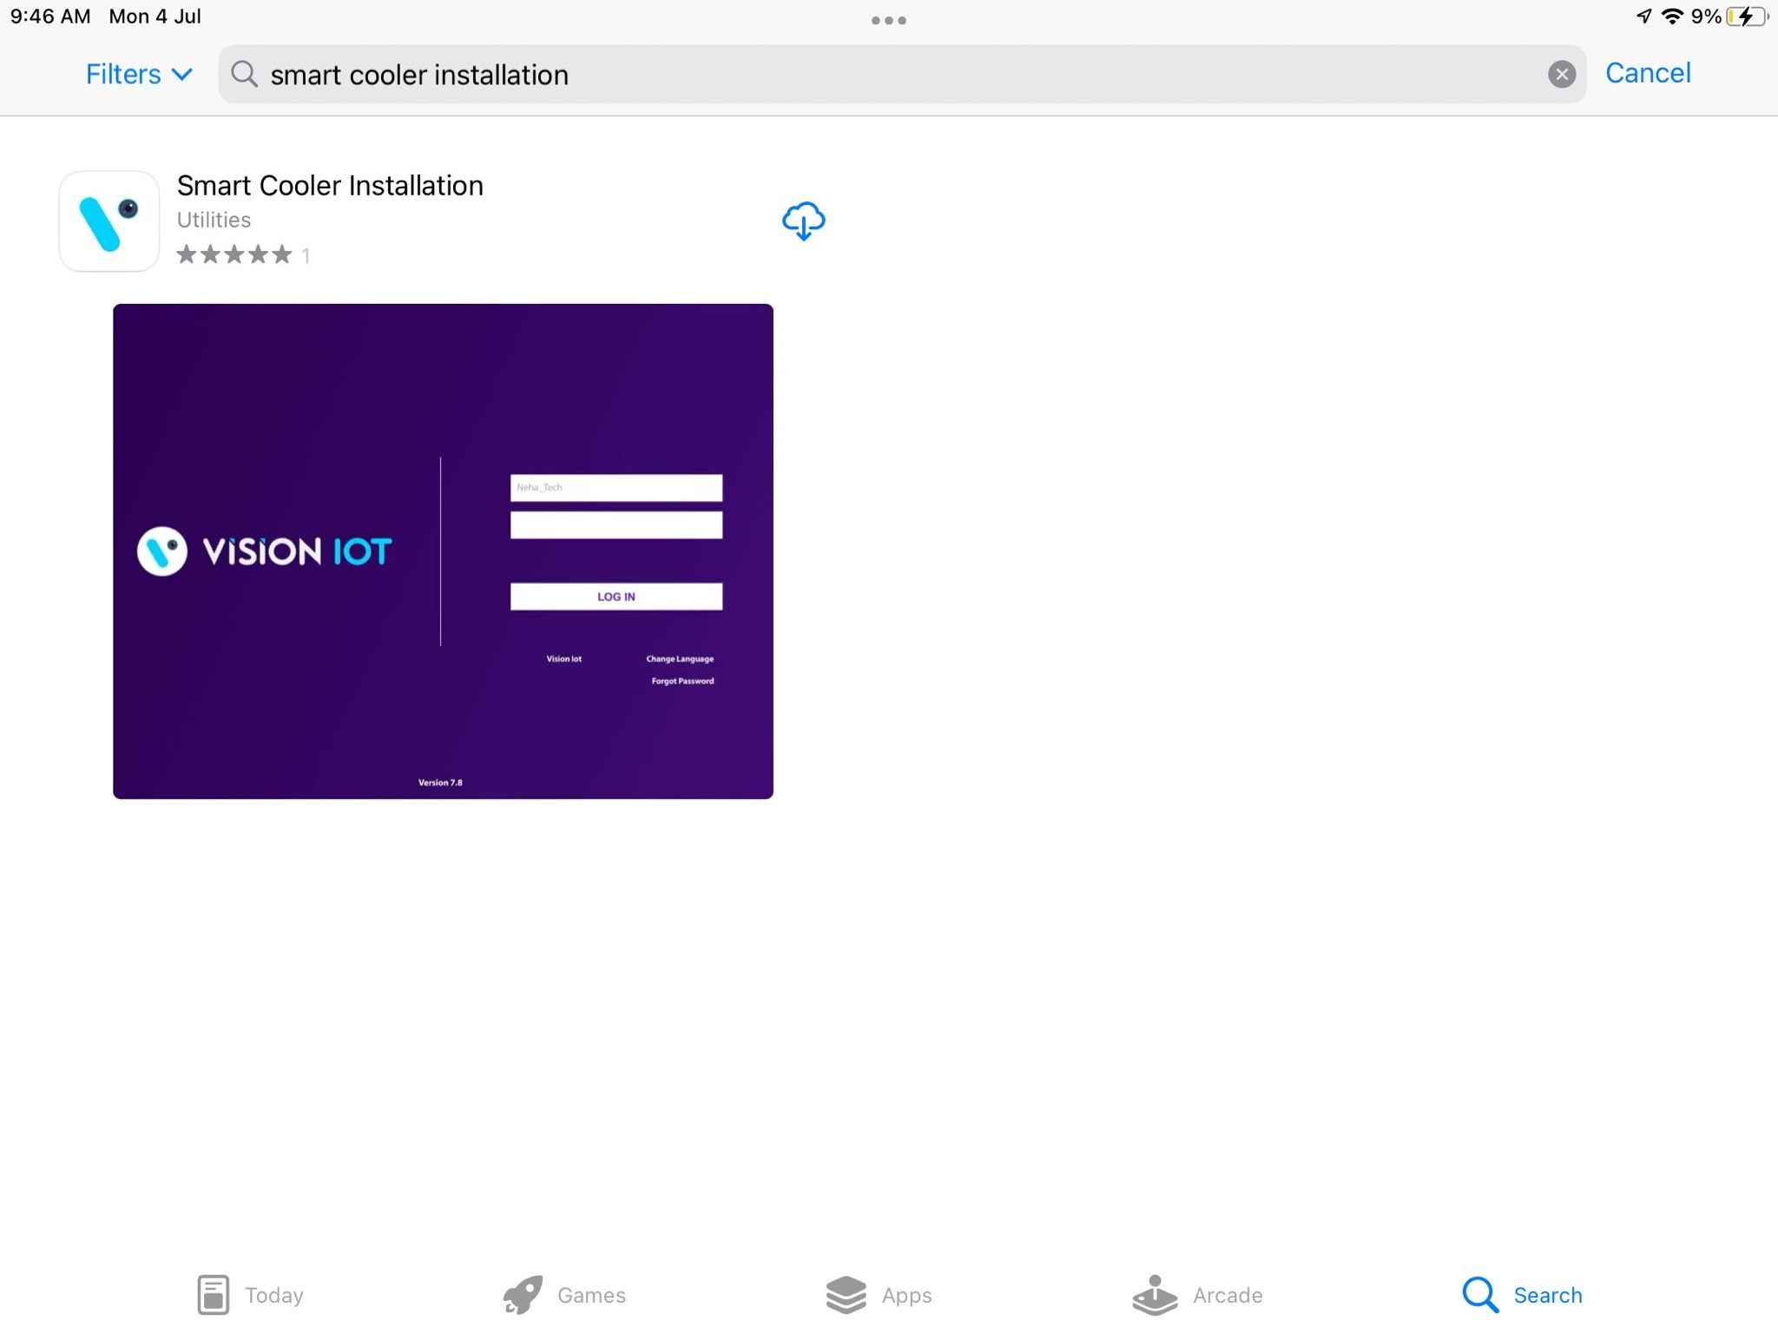
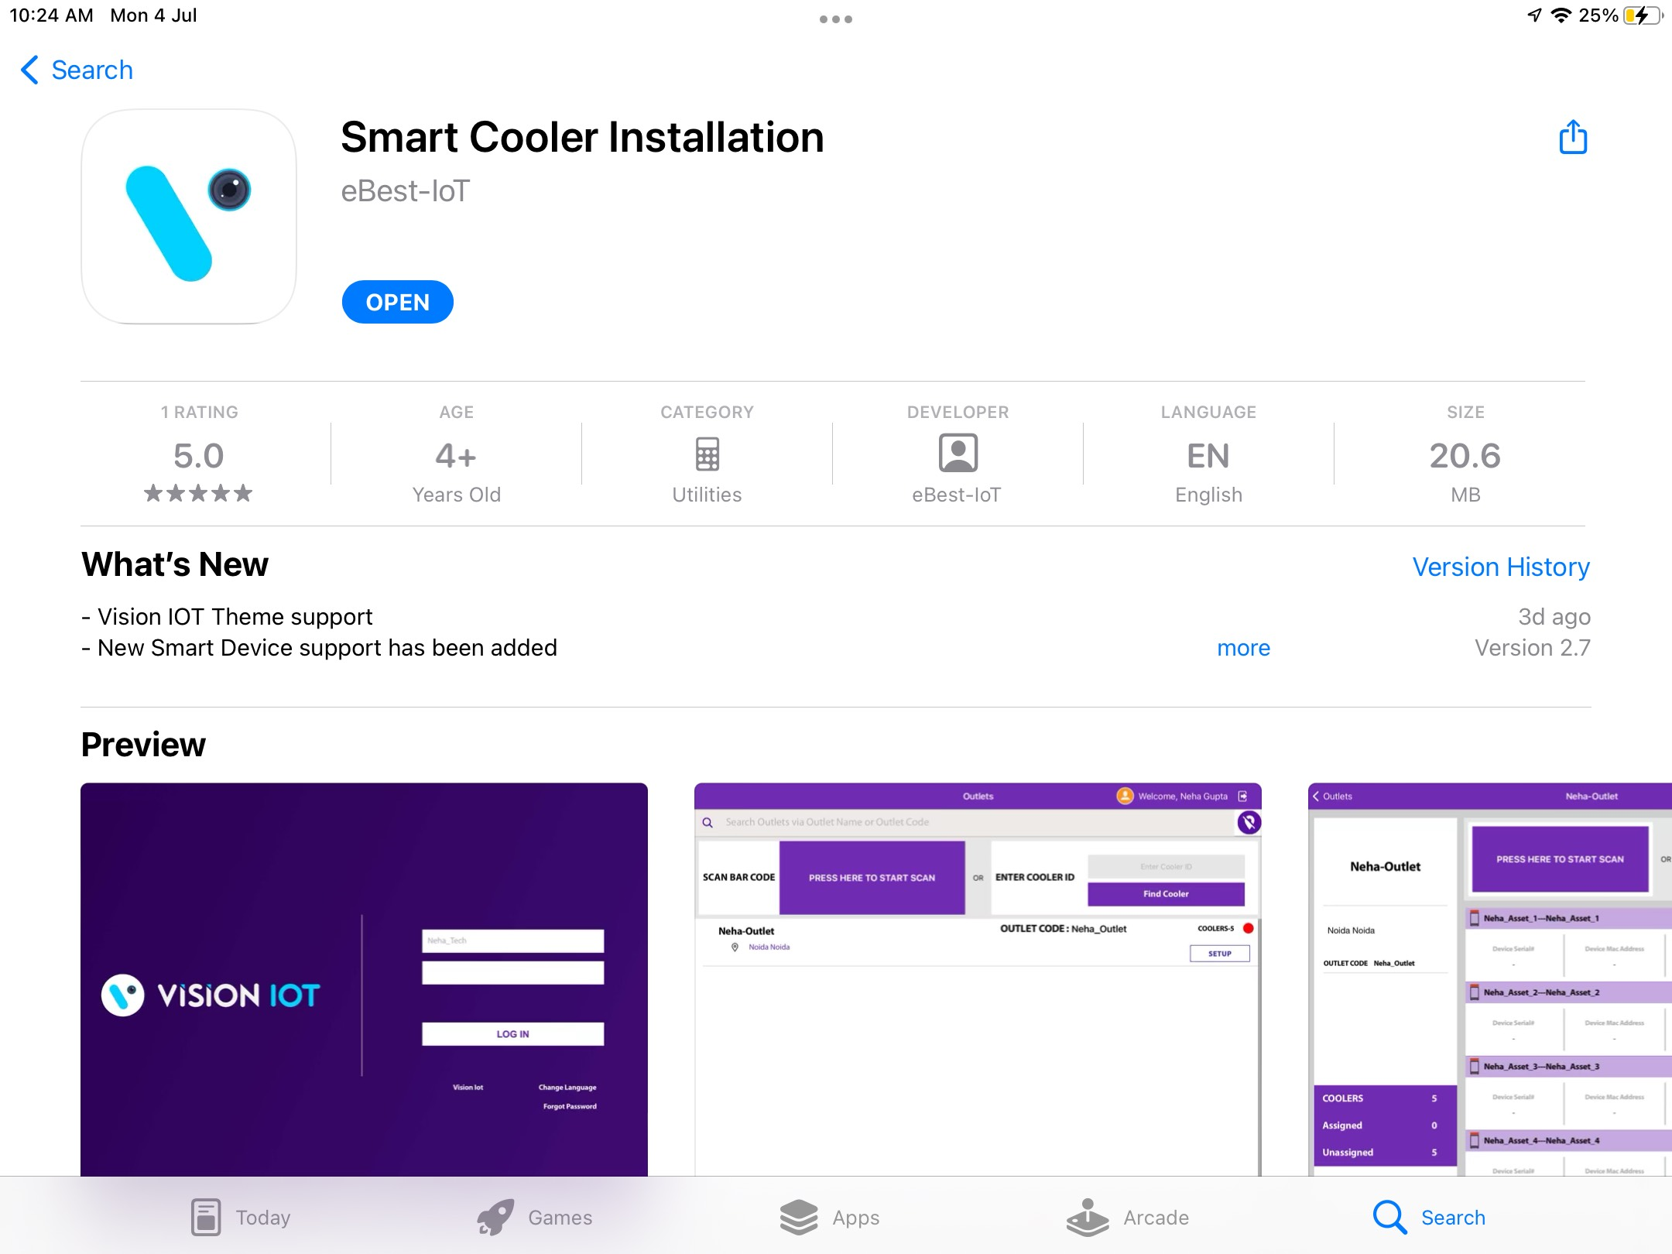
Application Installation
Open the App Store Application and Search the “Smart Cooler Installation” Application on App Store then Install the Application.
URL: https://apps.apple.com/in/app/smart-cooler-installation/id1164462746
Important Note: Before installation of every new version delete the previous one.

Slide 3
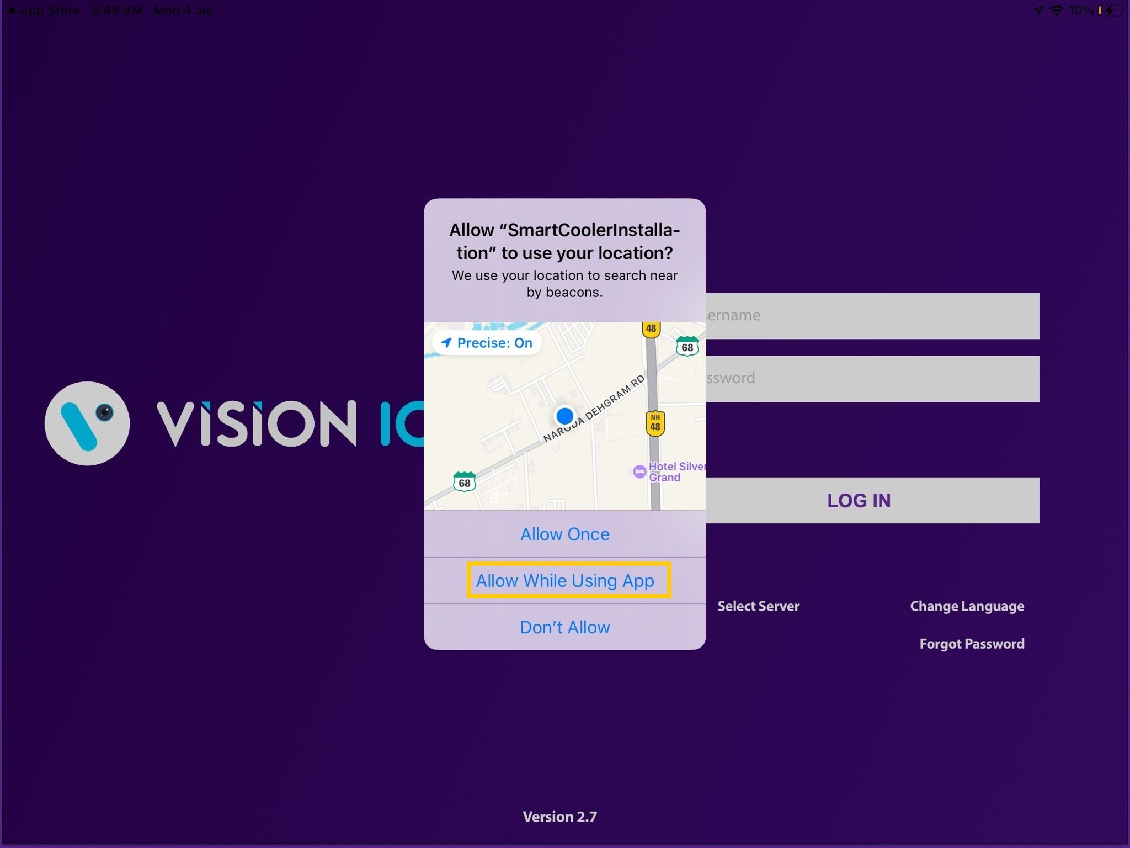
Application Permission
After initial Installation & launch, the Application will ask for permission to access.
Choose Server: For CCH, the server should be ATOS Codex, for other customers and QA another server should be chosen,
LOCATION PERMISSION
For Location (so beacons can be found) - Choose Allow While Using App on iOS 13 and above
Then Go to the iPad Settings > Application List > Location > Allow Location Access option is “Always”.

Slide 4
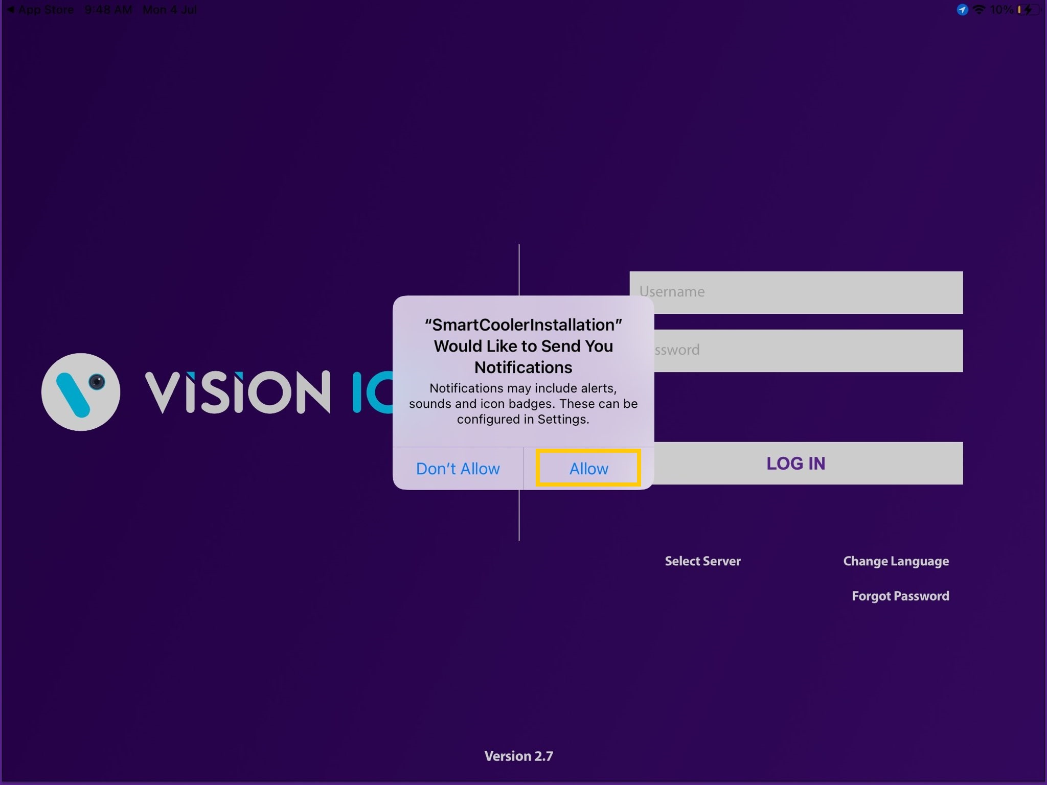
NOTIFICATION PERMISSION
Send notifications (to inform of data download) -> Choose “Allow”

Slide 5
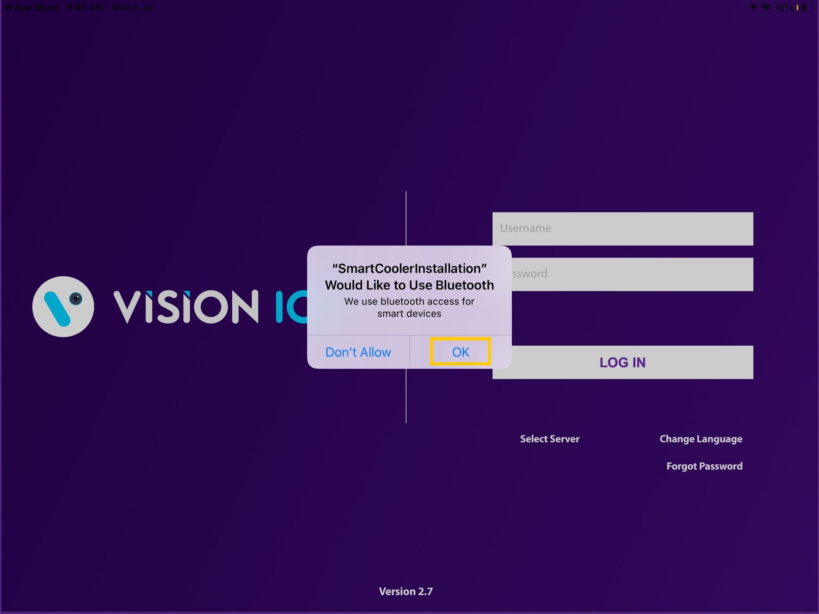
BLUETOOTH PERMISSION
Access the Bluetooth (to scan barcodes) – the first prompt on the Outlet screen -> Choose “OK”.

Slide 6
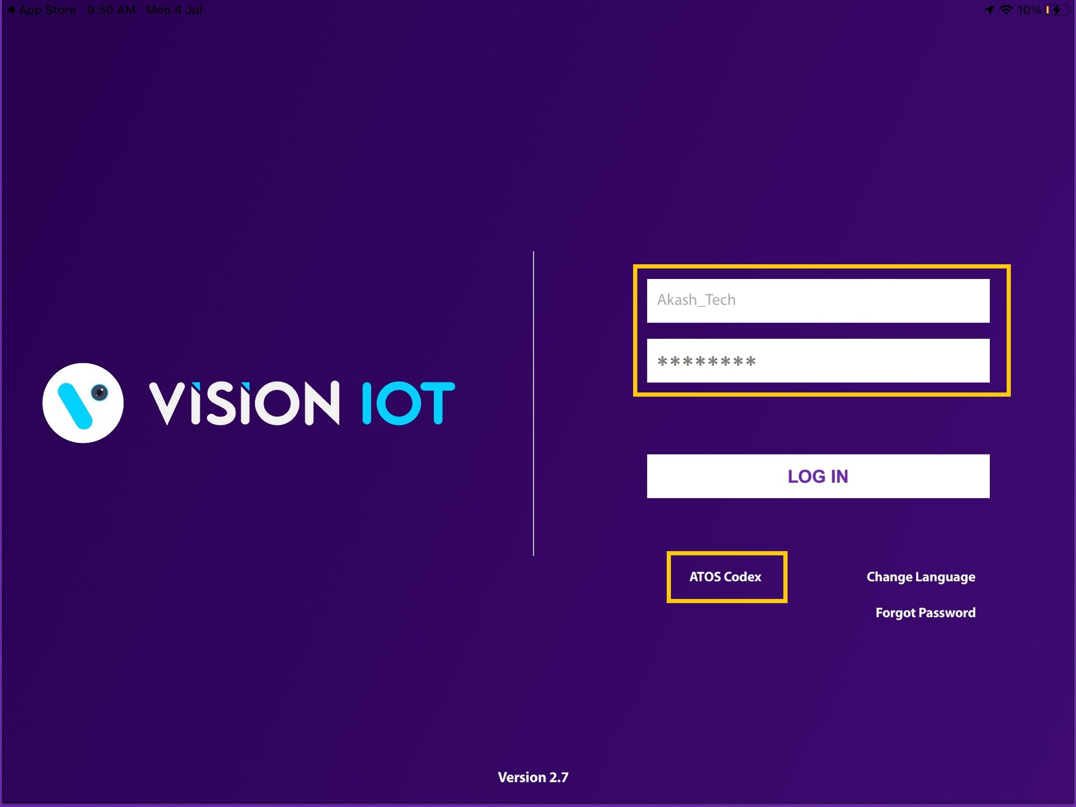
Login
After successfully installing the Smart Cooler Installation Application from App Store. Open the Application, and the application will redirect to Login Page. Select the server from the server list and Login with valid Credentials.
The Change from v. 2.7 is that All data (outlets, assets, remote commands, firmware) is downloaded before showing the Outlet Screen.
Bluetooth also should be enabled as well as location services.
The application requires an internet connection for initial login.
After the initial log in the application can work in Offline mode provided that the same username & password as the one in the online login is used.
All versions after and including 1.7 do not download device data by default. If you wish to enable this option, you should toggle the switch at the VH screen which is titled “Only Remote Command”
Minimum device requirements – iPad 8th Gen and Above Models.
The Minimum iOS version is 14 and Above.

Slide 7
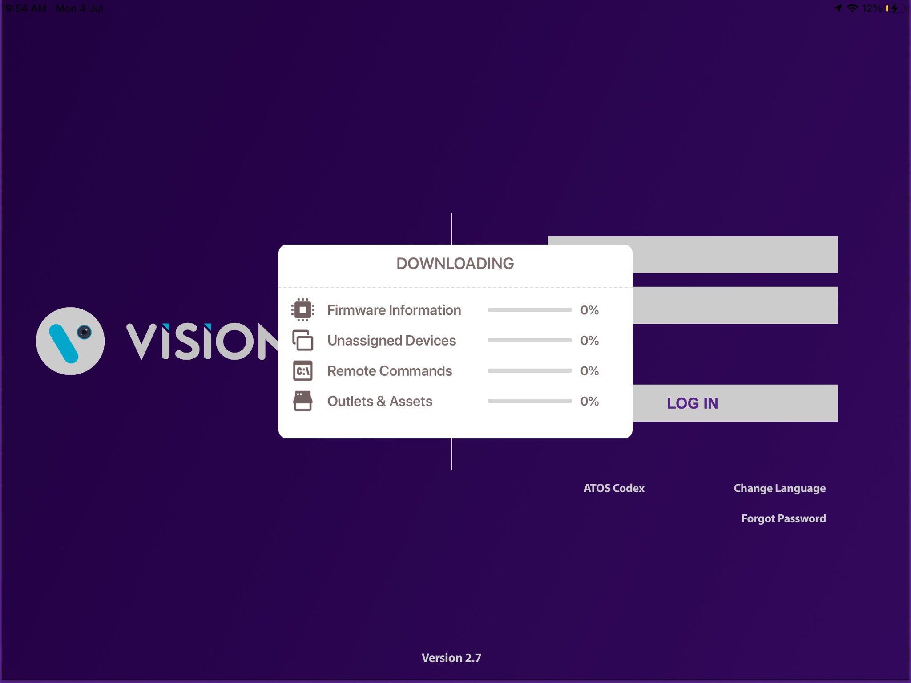

The Change from v. 2.7 is that All data (Outlets & Assets, Remote Commands, Firmware Information, and Unassigned Devices ) is downloaded before showing the Outlet Screen.

Slide 8
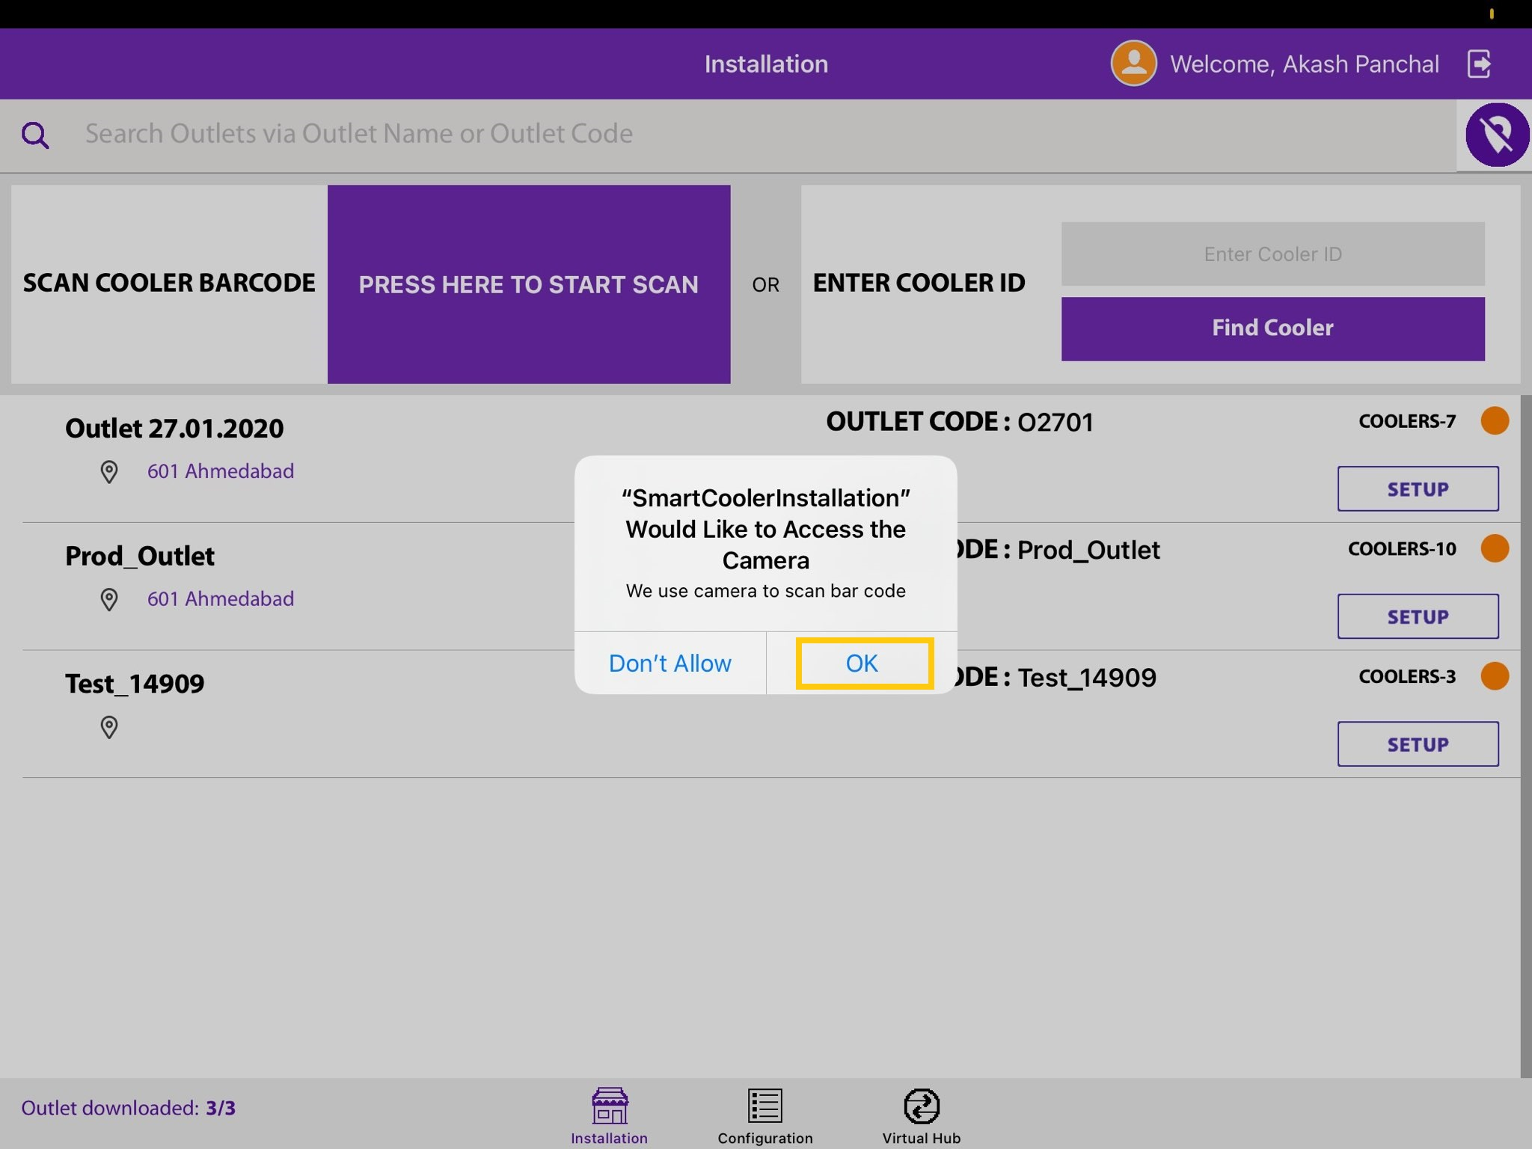
Upon the first login, the application will ask for access to the camera which is needed for scanning Barcodes. This permission should be enabled.

Slide 9
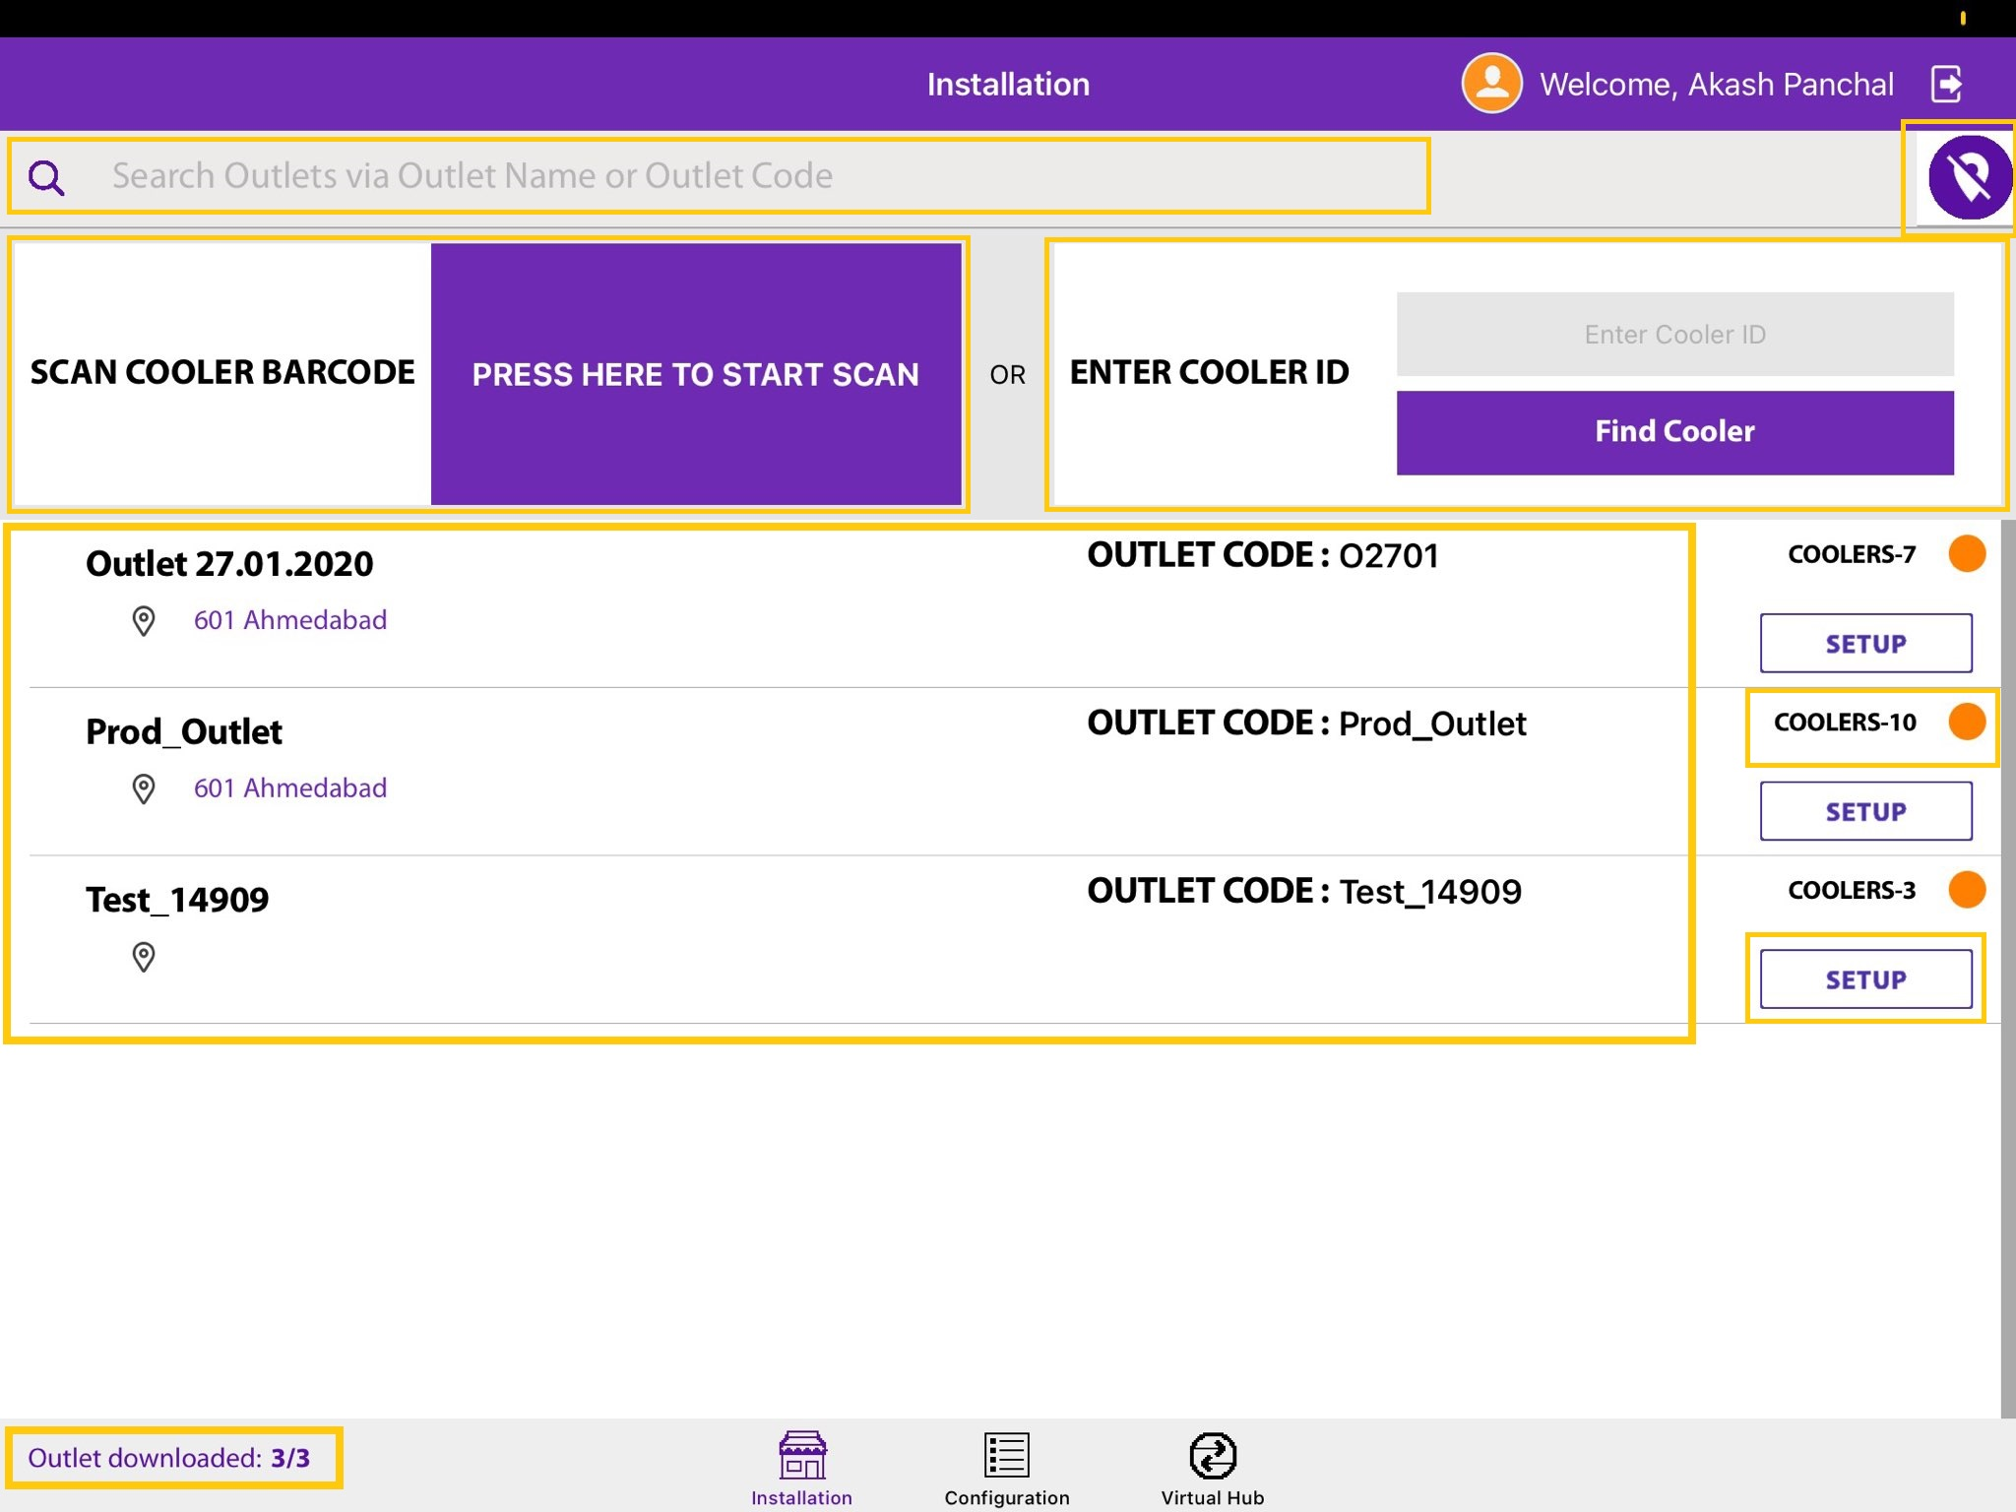
Installation Screen
Tap on this icon to show all outlets, not only the nearest ones
Use this box to quickly search for the outlet by name
Tap to start the camera and scan the Cooler Barcode. If a cooler is found the association menu for this cooler will be shown.
If a cooler can’t be found via the barcode scanner, then enter the Technical ID or Serial Number here to find it.
Coolers – 10
Shows the number of coolers in the outlet
The color of the dot shows the status
Red – no cooler in the Outlet is associated with Smart Device
Orange – some coolers in the outlet have been associated with smart devices, but not all
Green – all coolers in this outlet have been associated with smart devices
Only the nearest outlets will be shown, for each one the Outlet name, address & code will be displayed.
Total # of outlets in BD territory and how many have been loaded, outlets are loaded at startup.
Tap on Setup to enter the Outlet and view assigned Coolers.

Slide 10
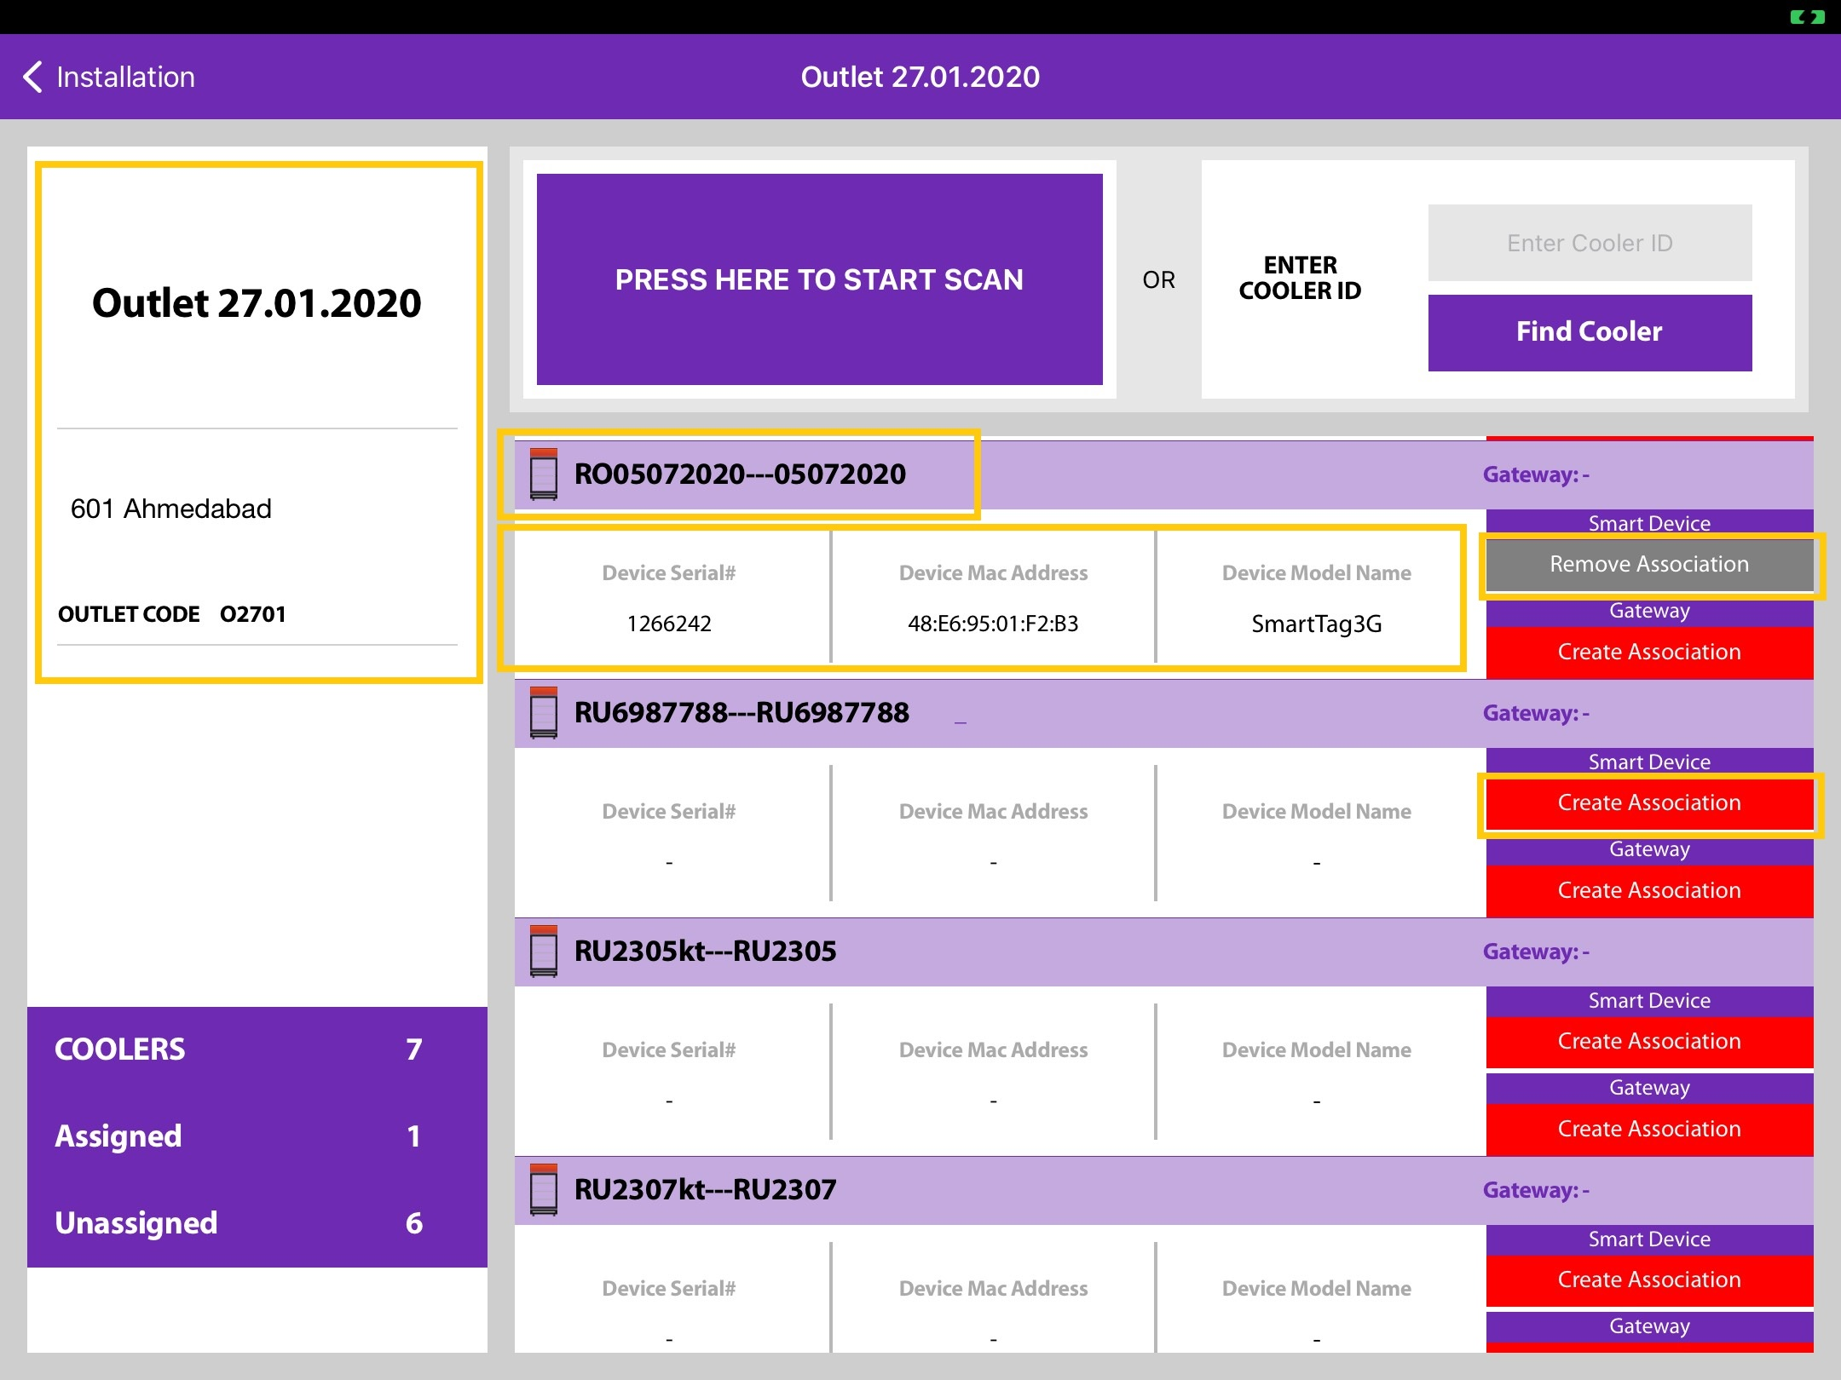
Outlet
Serial Number, Equipment Number, & Cooler Model
Outlet
Name
Address
Outlet Code
If a Smart Device is already associated with this cooler the information will be shown in this box.
Tap to start Smart Device association or scan the barcode of the Cooler via the scanner.
If a smart device is already associated to this cooler the button will gray with label Remove Association

Slide 11
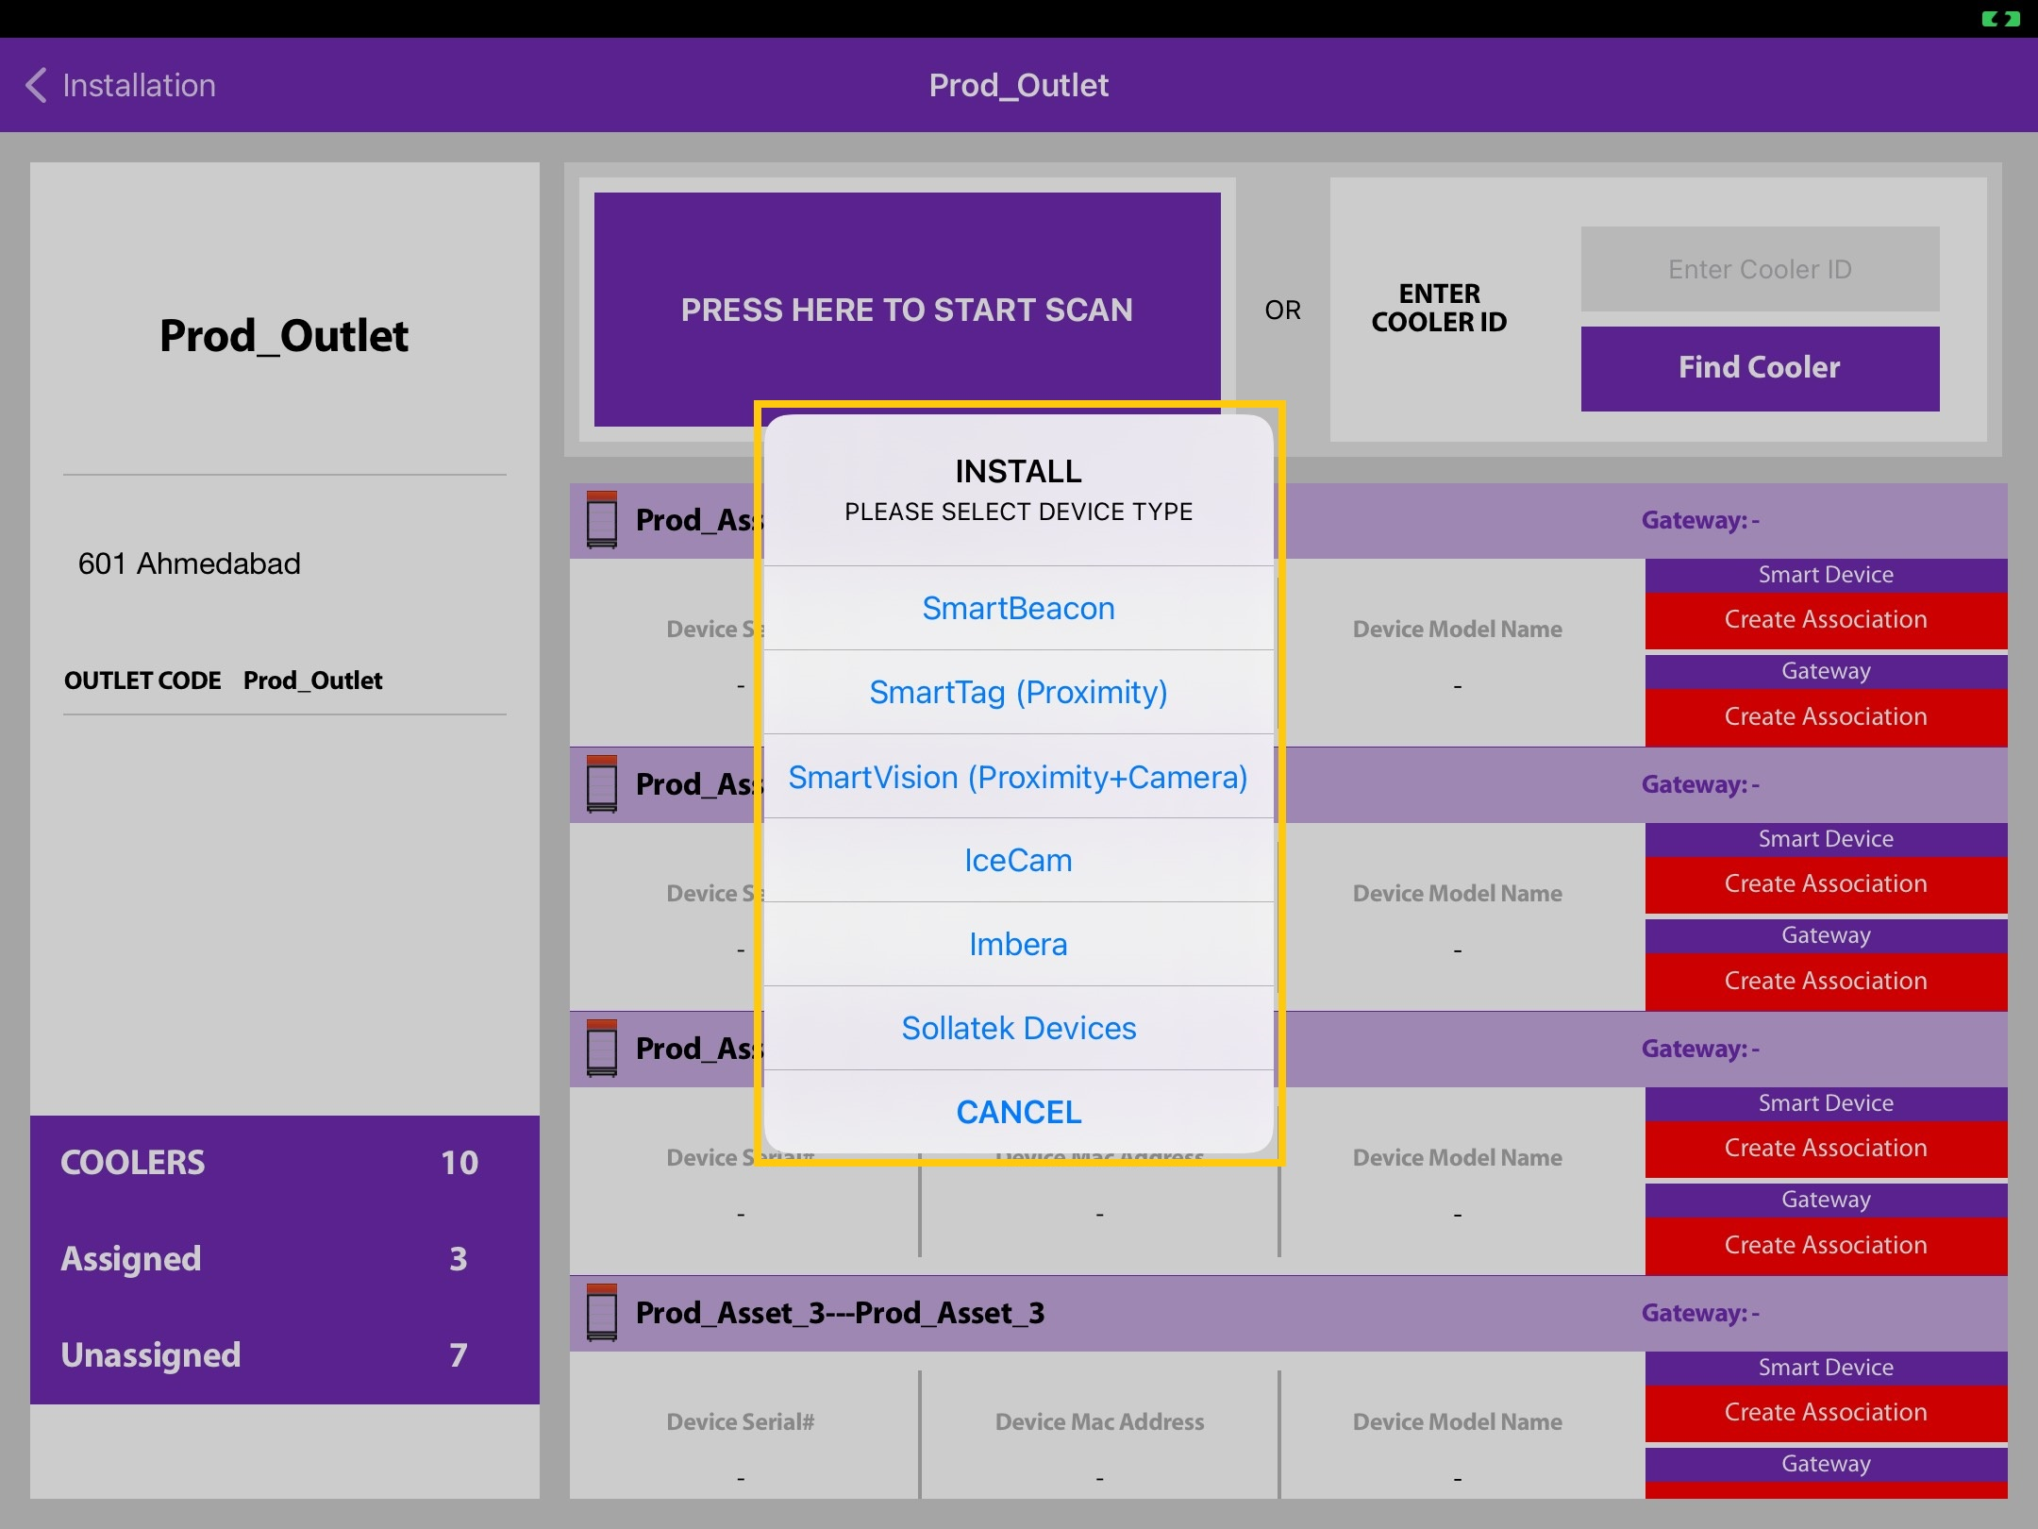
Smart Device Association
Choose a Smart Device and follow the on-screen instructions for association.
For list of Sollatek devices choose first Sollatek Devices.

Slide 12
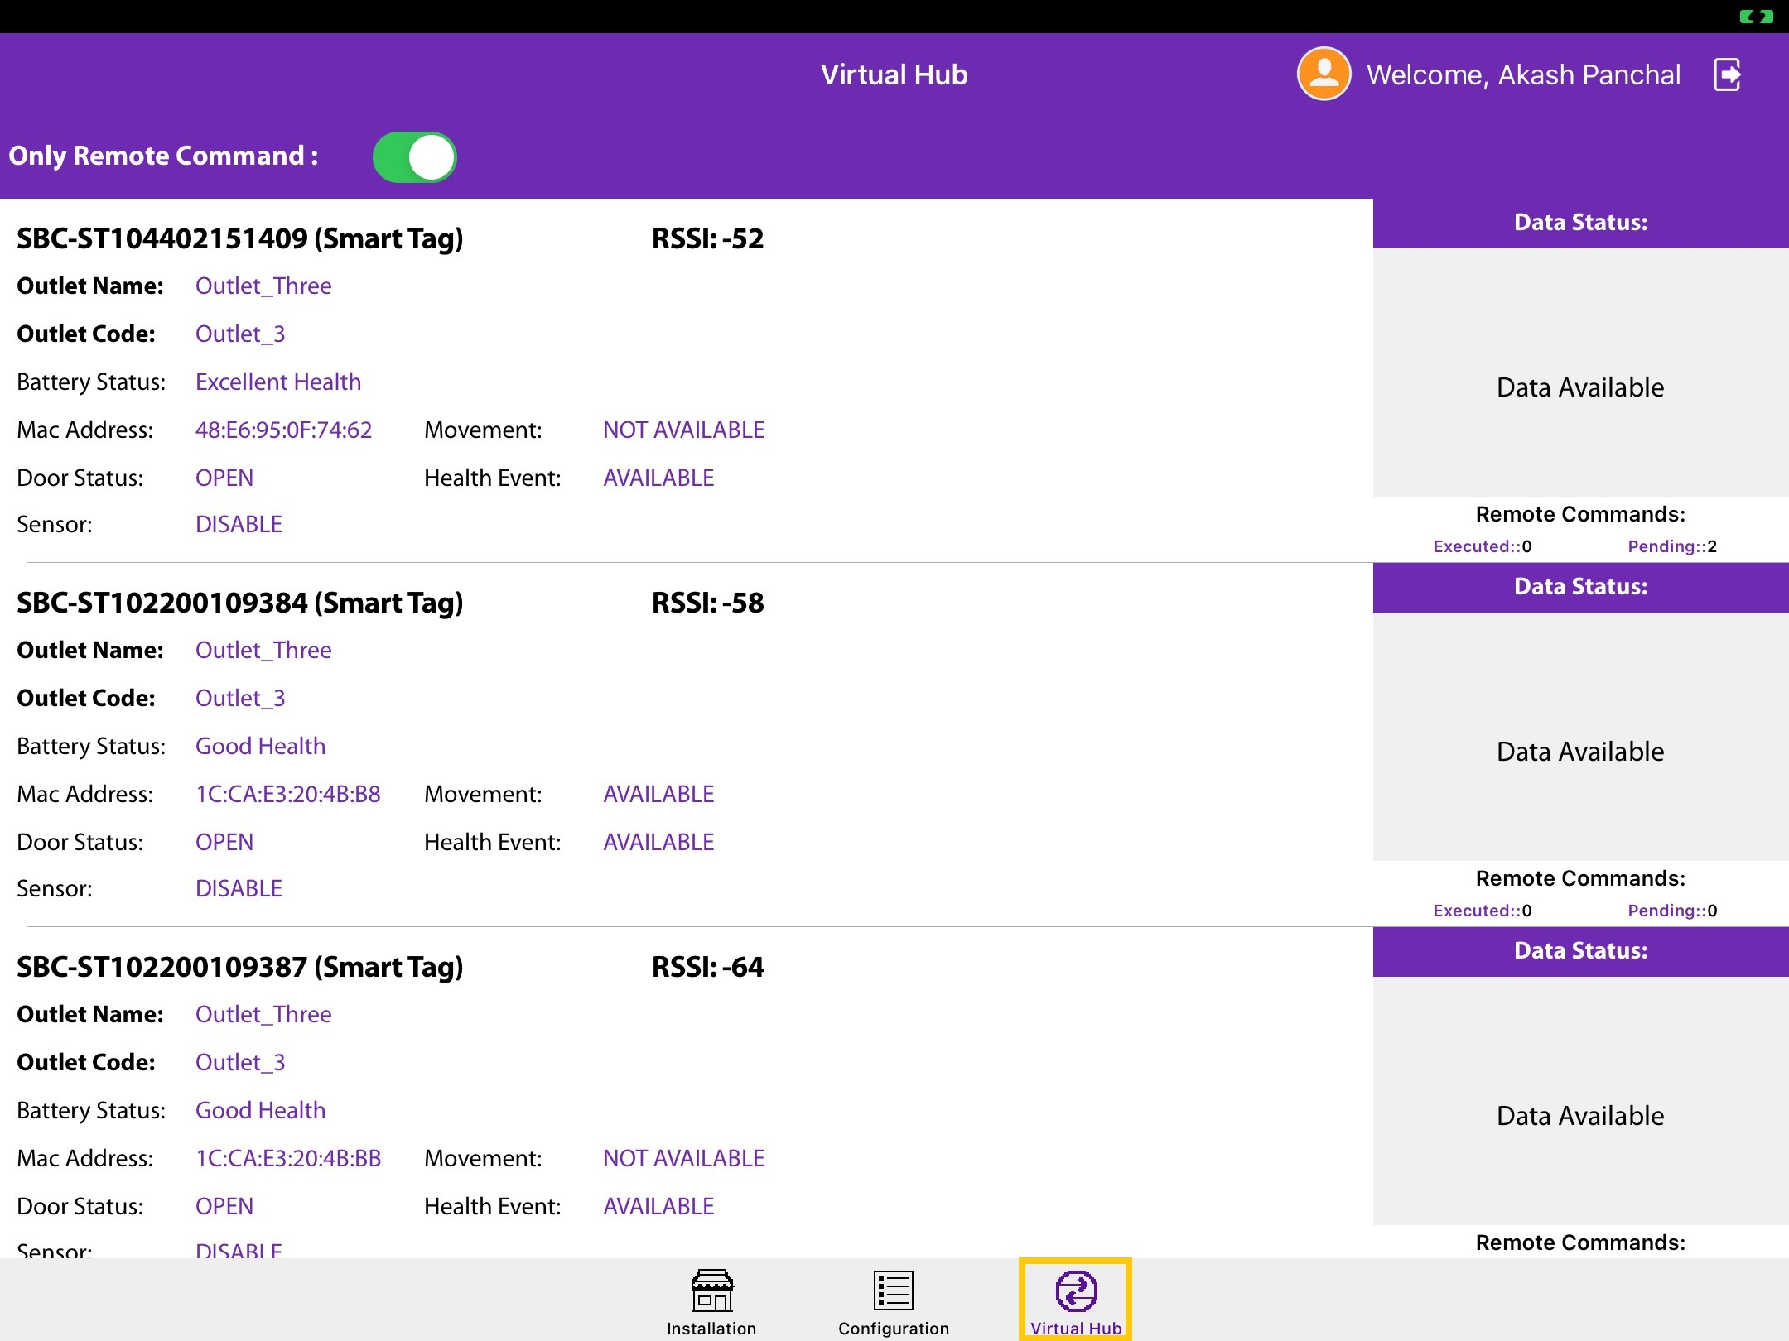
Execute Commands
(Change UUID/Eddystone/Power Saving) – 1/2)
Start the Smart Cooler Installation application.
2. Bring the application to Foreground as shown on this page.
3. Tap on the Virtual Hub button.

Slide 13
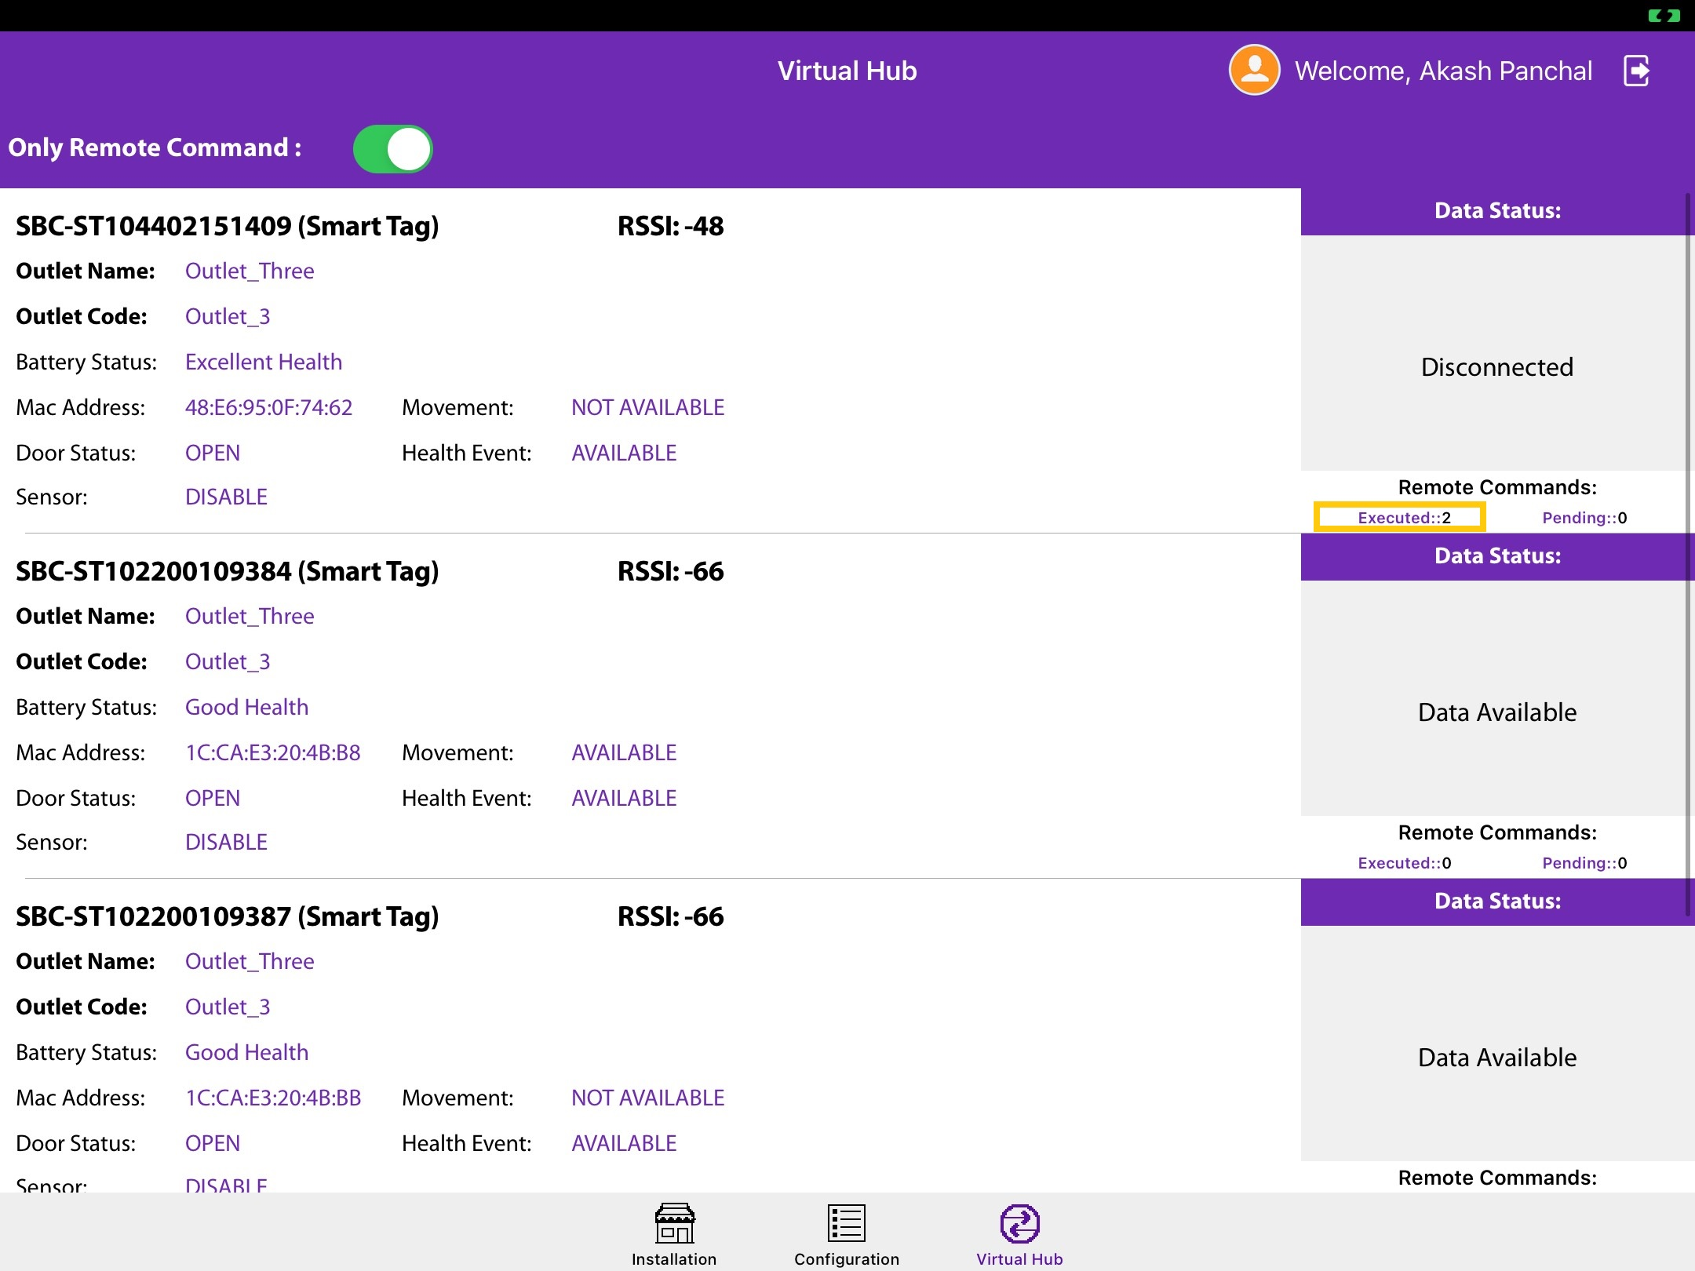
(Change UUID/Eddystone/Power Saving) – 2/2)
4. You can see the devices around you and the status of each one, it is possible (but may be too fast to catch) to see the Status “Performing Remote Command”

Slide 14
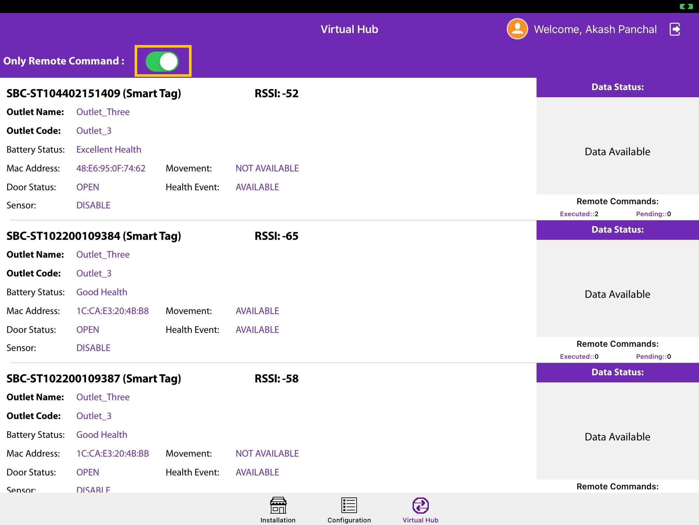
(Switch modes between Download & Remote commands and only remote commands)
By default, the switch is in position,
Only execute Remote Commands
If the switch is disabled, the application will start downloading data from approved devices

Slide 15
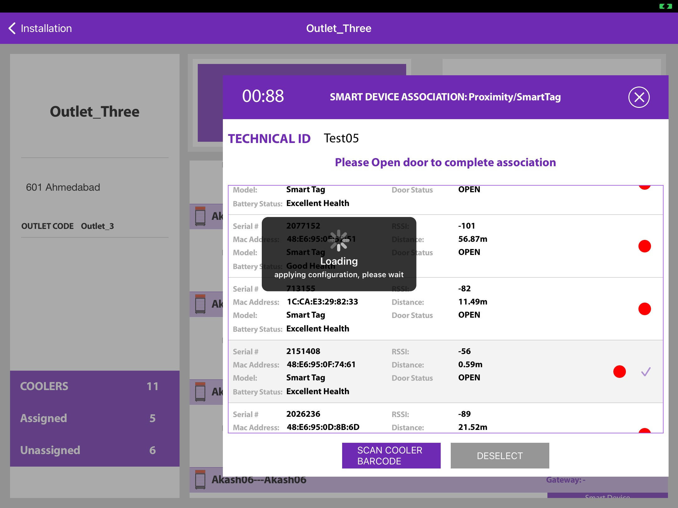
Firmware Upgrade
Firmware Upgrade During Installation
If the SmartTag3G/Smarttag4GV2/SmartTag5GV3 is with a Firmware version equal to or less than, the application will automatically upgrade, at the end of the installation process. The following window will be seen at the end of the installation cycle. The user should stay close to the device and not move away before the action has been completed.

Slide 16
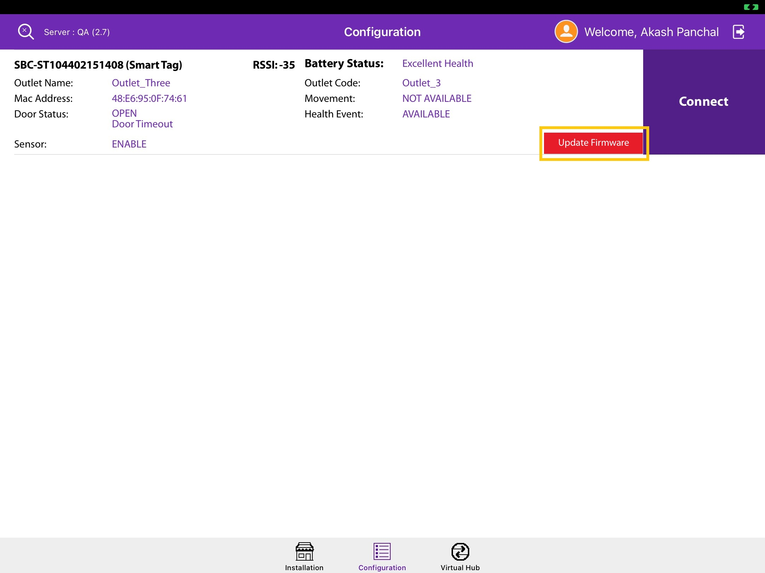
Firmware upgrade from the Configuration Screen
All SmartTag3G/Smarttag4GV2/SmartTag5GV3 assigned to a user can be seen on the configuration screen and the ones where the Firmware is equal to or less than then will show an action button for the upgrade of firmware
To initiate Firmware Upgrade tap on the button.
The recommendation is that you stay close to the device and do not move while the action is performed.

Slide 17
Firmware upgrade from the Configuration Screen
All SmartTag3G/Smarttag4GV2/SmartTag5GV3 assigned to a user can be seen on the configuration screen and the ones where the Firmware is equal to or less than then will show an action button for the upgrade of firmware
To initiate Firmware Upgrade tap on the button.
The recommendation is that you stay close to the device and do not move while the action is performed.

Slide 18
Smart Device Removal of Association and Reusage
If a Smart Device must be removed from a cooler the proper procedure is,
Log in to the Vision IoT application with BD credentials in whose territory is the cooler.
2. Go to the Virtual Hub tab and make sure that all the data from the Smart Device is downloaded (the Virtual Hub tab should be in Foreground).
3. Find the outlet and the cooler inside where the Smart Device is installed.
4. Tap on the button Remove Association.
5. Physically remove the device (and if it is SmartTag/SmartVision also the magnet) from the cooler.

Slide 19
The app should have internet access at that or later time for the data to be available to the server (but the app should have internet access before you attempt to install the same device again in this or another location).
Once the iFSA download is in effect then the download should happen via iFSA, but the removal of association should happen via the Vision IoT application.
If you want to install the same Smart Device to a different cooler,
Make sure you log in to the Vision IoT application again AFTER the Smart Device is uninstalled (this is required so that the server can send the proper information and settings to the application for the new installation).
2. If you have just uninstalled the device make sure you log off and then log in again to the Vision IoT application
3. If you are installing the device using a different tablet/app/BD username make sure that you’ve logged in after the device has been successfully uninstalled.
Important
1. The minimum device is iPad 8th Gen or higher is recommended. The minimum iOS version is 14.
2. Only one user should log in at a time and if another user needs to log in the application should be reinstalled.

Slide 20
