Slide 1

CONNECTED COOLER SERVICE
iOS Installation Guide
Dec 2023
© 2023 Vision Group

Slide 2
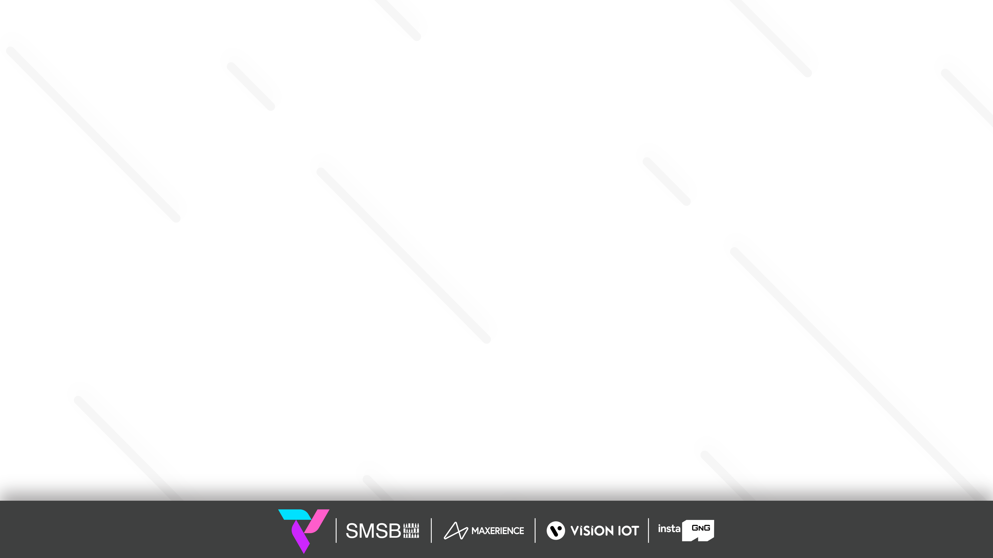
APPLICATION FEATURES
ASSOCIATE SMART DEVICE TO COOLER – For the Association Of A Smart Device With A Cooler.
SCAN COOLER (DATA DOWNLOAD AND REMOVE ASSOCIATION) – For Downloading Data And Removing Association From A Cooler.
CHANGE CONTROLLER SETTINGS– For Changing the Controller Parameters Of A Cooler.
CHECK COOLER STATUS – For Checking Cooler Association Status.
SCAN NEARBY DEVICES – For Checking Smart Device Advertisement Status.
GATEWAY SETTINGS - For Checking/Updating Gateway Device Settings.
© 2023 Vision Group

Slide 3

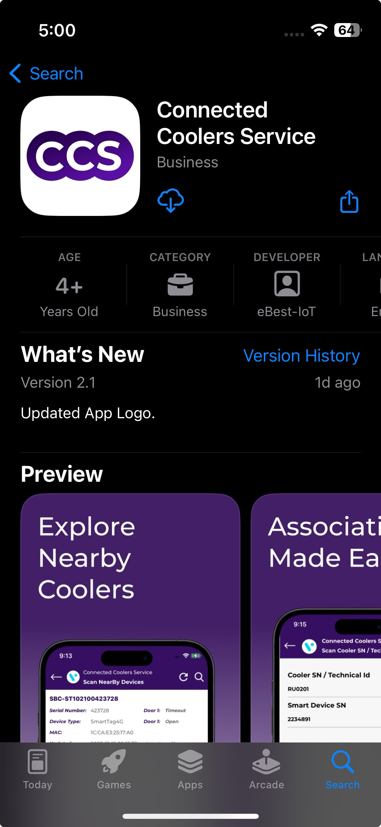
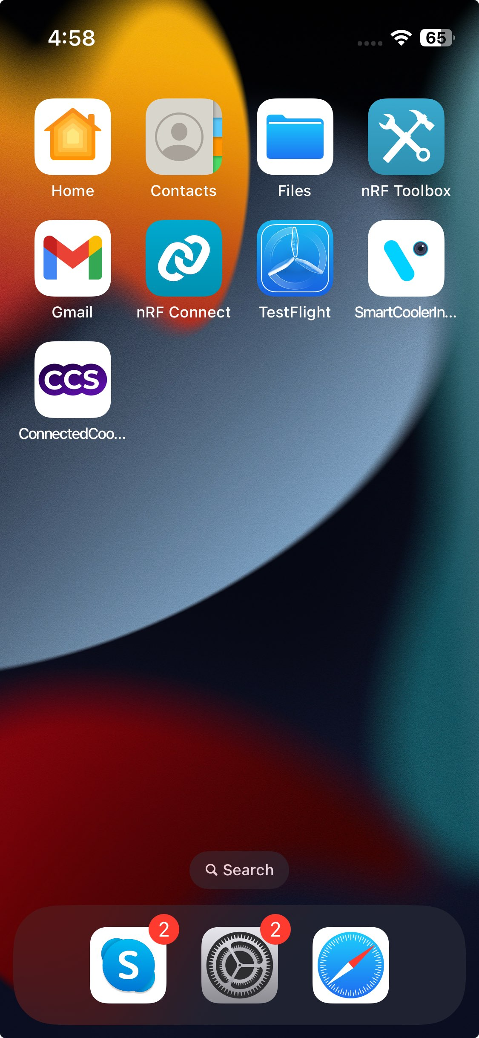
APPLICATION INSTALLATION
Open the App Store Application and Search the “CONNECTED COOLER SERVICE” Application on the App Store then Install the Application.
URL: https://apps.apple.com/in/app/connected-coolers-service/id6453411856
Important Note: Before installation of every new version delete the previous one.

Slide 4
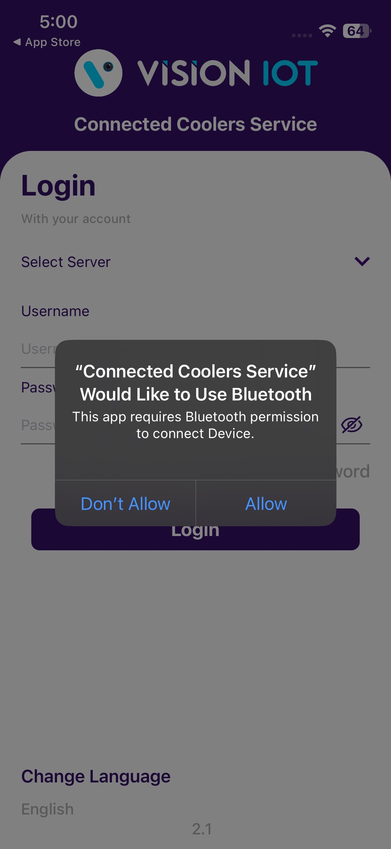
APPLICATION PERMISSION
After initial Installation & launch, the Application will ask for permission to access.
Choose Server: For CCH, the server should be ATOS Codex, for other customers and QA, another server should be chosen.
LOCATION PERMISSION
For Location (so beacons can be found) - Choose Allow While Using App on iOS 13 and above
Then Go to the iPad Settings > Application List > Location > Allow Location Access option is “Always”.
NOTIFICATION PERMISSION
Send notifications (to inform of data download) -> Choose “Allow”
BLUETOOTH PERMISSION
Access the Bluetooth (to scan barcodes) – the first prompt on the Outlet screen -> Choose “OK”.
© 2023 Vision Group

Slide 5
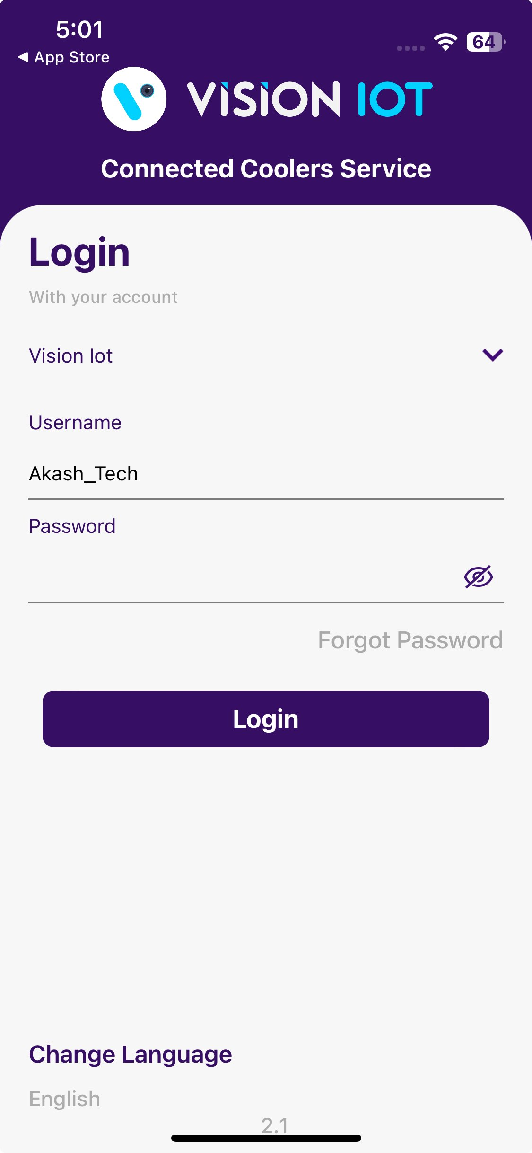
Login
After successfully installing the Connected Cooler Service Application. Open the Application, and the application will redirect to Login Page. Select the server from the server list and Login with valid user Credentials.
Bluetooth also should be enabled as well as location services.
The application requires an internet connection for initial login.
After the initial log in the application can work and the same username & password as the one in the online login is used.
Minimum device requirements – Device Has 4 GB and Up RAM at least and Bluetooth Version 4.2 and above.
The Minimum OS version of mobile is 8.0 and Above.
© 2023 Vision Group

Slide 6
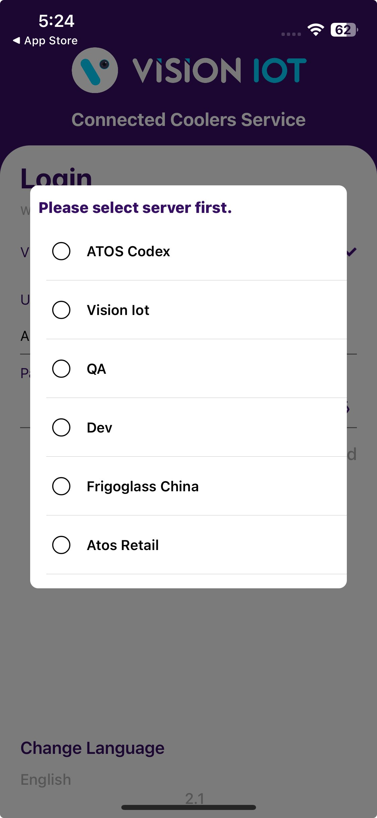
Select Server shows several options, depending on the Client and Factory you should choose a different option,
  For CCH installations from Romania and Russia choose the ATOS Codex server.
  For CCH installations from China choose the Frigoglass China server.
  For Other installations choose Vision IOT or contact the VISION IOT Team.
If a user is logging in for a first-time Username (User ID) and Password should be entered, and Language should be chosen. The username and password are case-sensitive.
To change the language, tap on Change Language and use can choose the language. Currently, there is English language support available.
© 2023 Vision Group

Slide 7
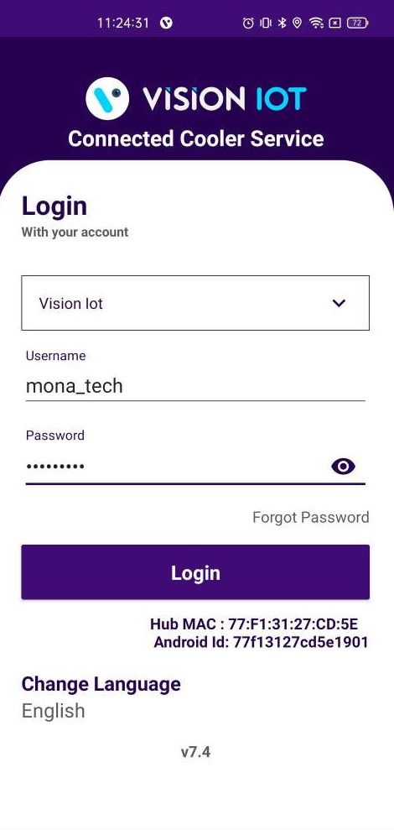
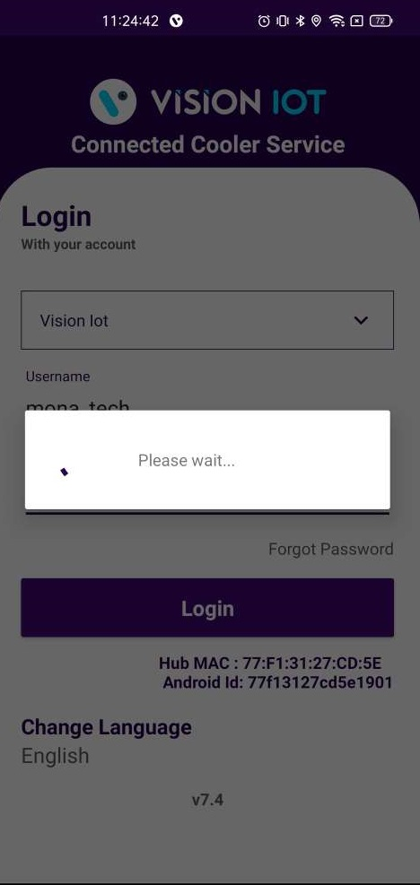
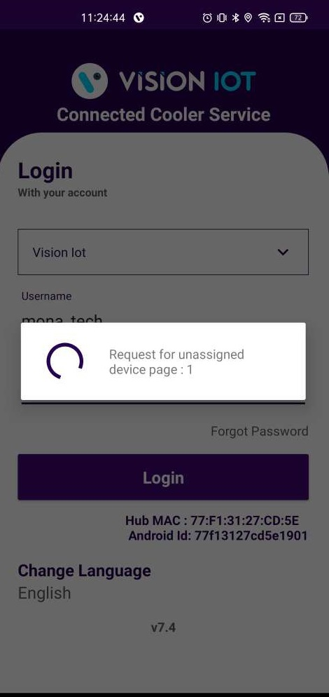
Provide valid credentials and tap on the Login button, please be advised that the application will need some time to download data from the cloud.
Note
Internet connectivity is required during login otherwise login will fail, and the application will show network errors.
© 2023 Vision Group

Slide 8
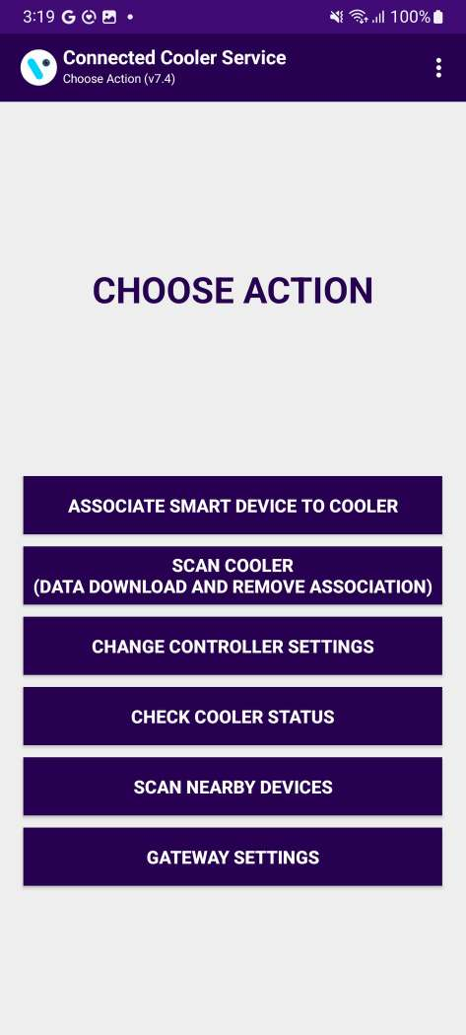
CONNECTED COOLER SERVICE – CHOOSE ACTION
After successful login, the following screen will appear. Please choose an ACTION from the list as per the required operation.
ASSOCIATE SMART DEVICE TO COOLER
– For the Association Of A Smart Device With a Cooler.
SCAN COOLER (DATA DOWNLOAD AND REMOVE ASSOCIATION)
– For Downloading Data And Removing Association From a Cooler.
CHANGE CONTROLLER SETTINGS
– For Changing the Controller Parameters Of a Cooler.
CHECK COOLER STATUS
– For Checking Cooler Association Status.
SCAN NEARBY DEVICES
– For Checking Smart Device Advertisement Status.
GATEWAY SETTINGS
– For Checking/Updating Gateway Device Settings.
© 2023 Vision Group

Slide 9
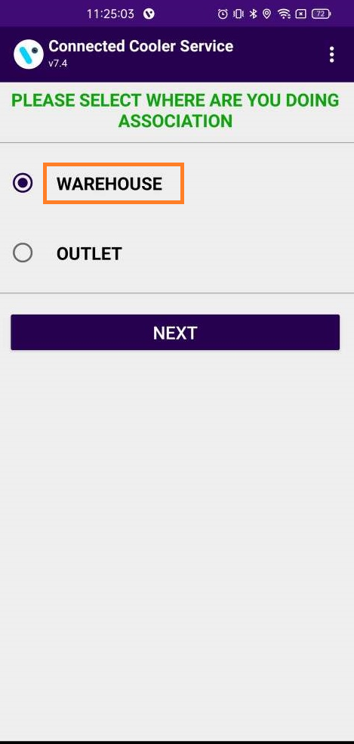
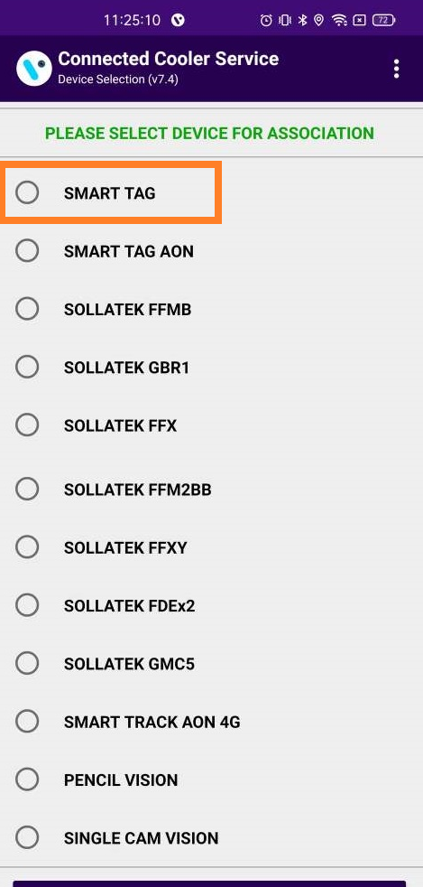
ASSOCIATE SMART DEVICE TO COOLER - ASSOCIATE SMART DEVICE
After successful login selects the ASSOCIATE SMART DEVICE TO COOLER option for associating a smart device with a cooler.
Please choose one of the two options and tap on NEXT (see the second screenshot).
Note – Sollatek Devices associated with the warehouse will automatically be put into deep sleep mode after the association is completed.
After choosing one of the two options the following screen will appear. If a SmartTag is associated, please choose SMART TAG and click on START.
Note: Select Device Type as Per Smart Device Type Which needs to be associated.
© 2023 Vision Group

Slide 10
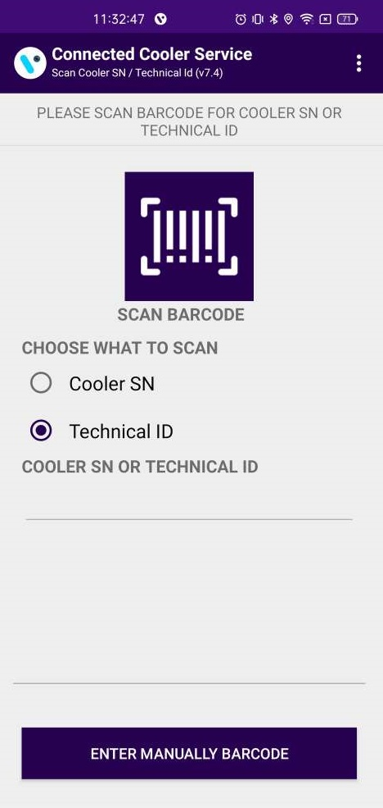
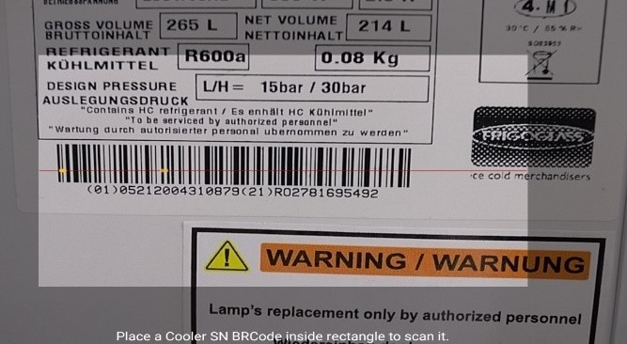
Scan the barcode of the cooler - Select which identification method you will use for the association and then click on the “SCAN barcode” icon or “enter BARCODE manually”.
© 2023 Vision Group

Slide 11
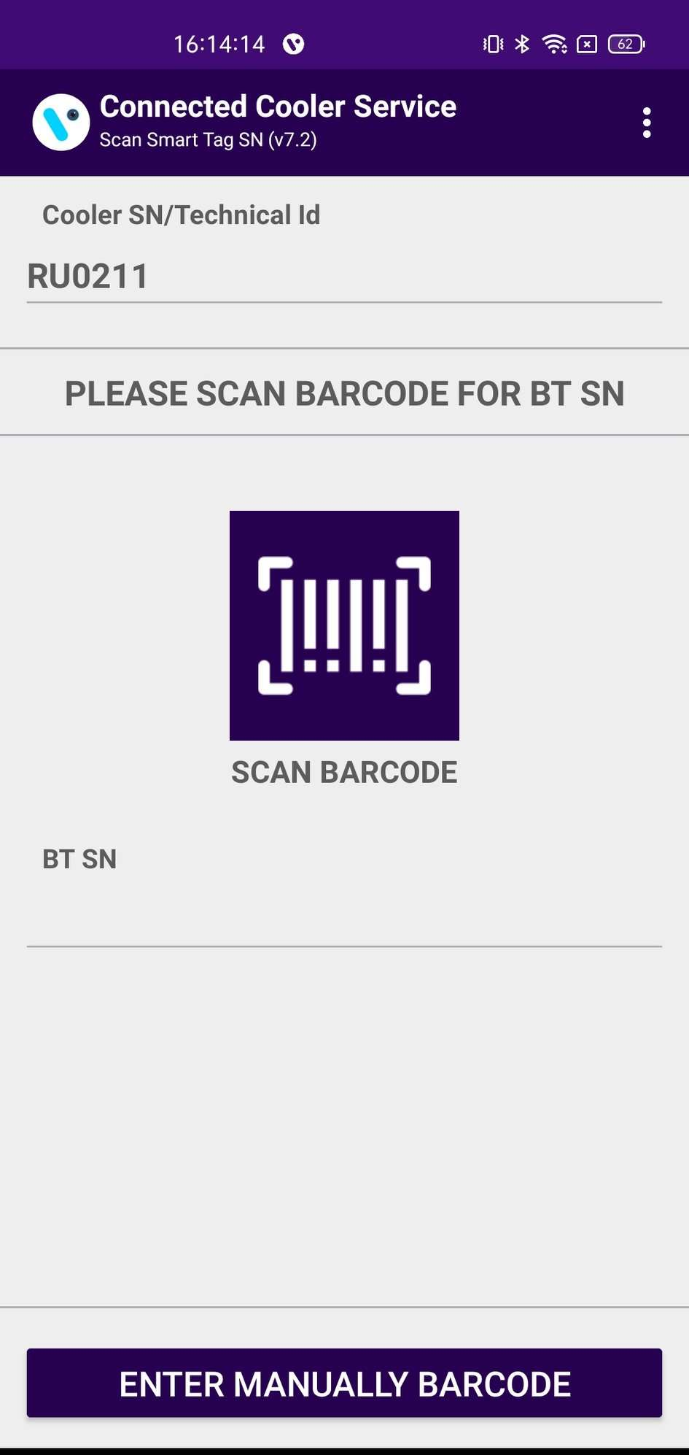
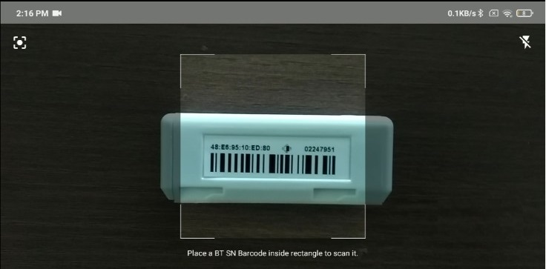
After opening and closing the door of the cooler to wake up the SmartTag, tap again on SCAN BARCODE and scan the barcode of the SmartTag. SmartTag Serial Number could be also entered manually by taping back and taping on ENTER MANUALLY BARCODE. On this screen, the Cooler Serial Number which was scanned in the previous step could be seen.
© 2023 Vision Group

Slide 12
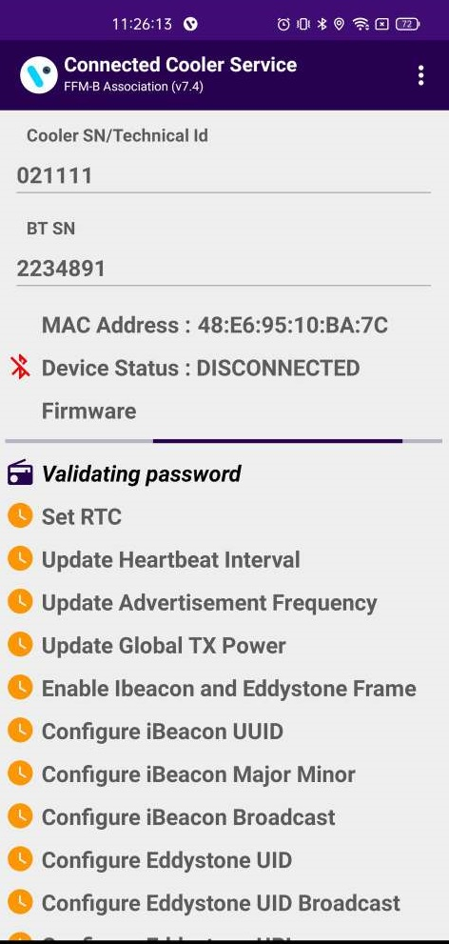
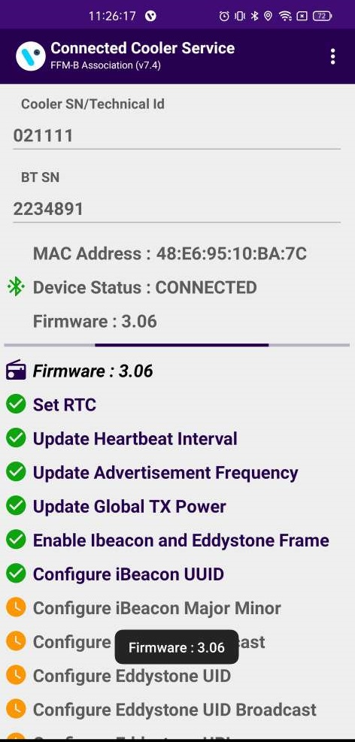
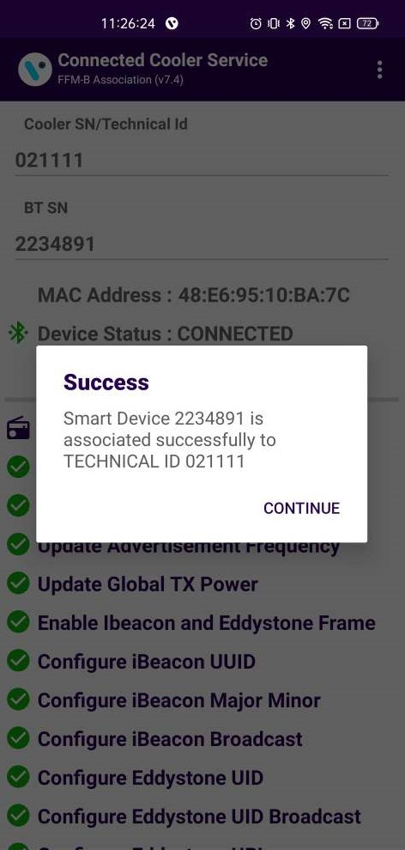
After the SmartTag Serial Number is successfully scanned the following screen will be shown. It will initialize the association process and respectively show a success message.
If the latest Firmware Version of the Smart device is available, then DFU will happen first and then the association process will initialize. The Cooler Serial Number and SmartTag Serial Number can be seen on the screen.
If Scanning Timer reaches 30 seconds open and closes the door again. If this doesn’t help check if the SmartTag and the Magnet are installed correctly.
After a successful association of a cooler with a smart device and the successful upload of that association to the cloud, an OK message is shown.
© 2023 Vision Group

Slide 13
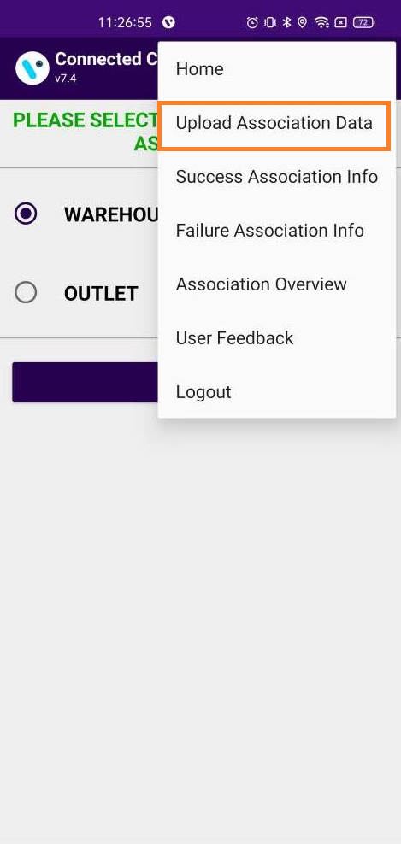
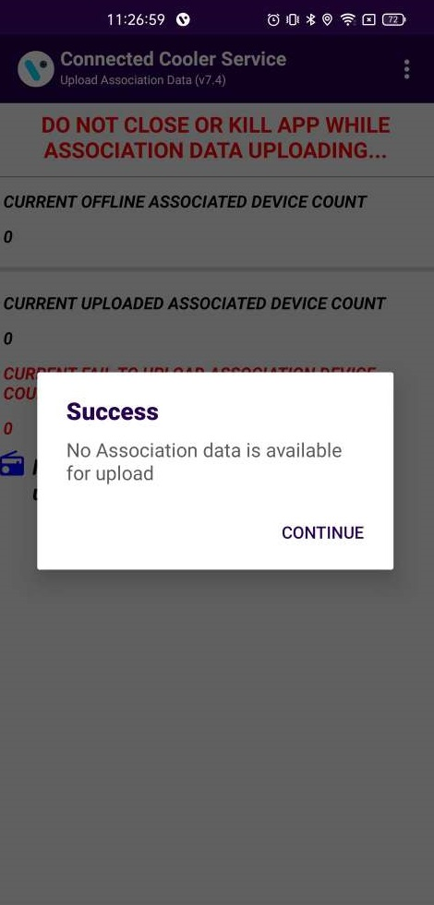
ASSOCIATE SMART DEVICE TO COOLER – LOGS > UPLOAD ASSOCIATION DATA
UPLOAD ASSOCIATION DATA
To check if all the associated data is uploaded, tap on the hamburger menu in the upper right corner and then tap on Upload Association Data. Once data is uploaded a prompt saying all Association data uploaded was successful will appear. If there is no data for upload a prompt saying that will be shown.
© 2023 Vision Group

Slide 14
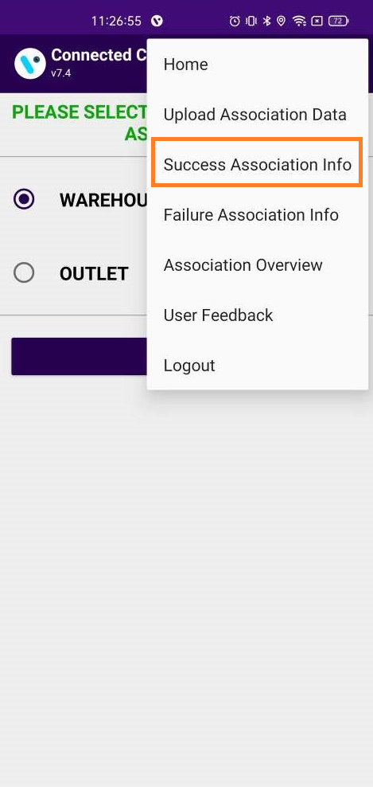
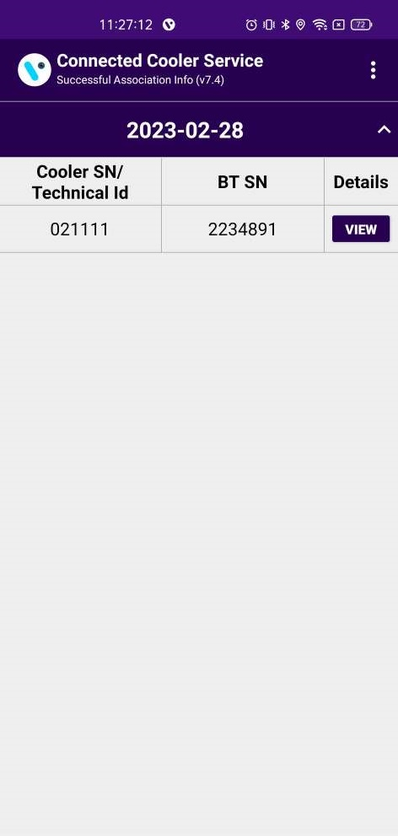
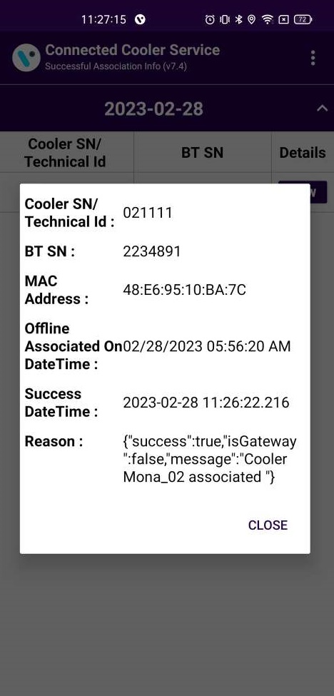
ASSOCIATE SMART DEVICE TO COOLER – LOGS > SUCCESS ASSOCIATION INFO
SUCCESS ASSOCIATION INFO
To check all Successful Associations Info, tap on the hamburger menu in the upper right corner and then tap on Success Association Info and view the button showing details of the association.
© 2023 Vision Group

Slide 15
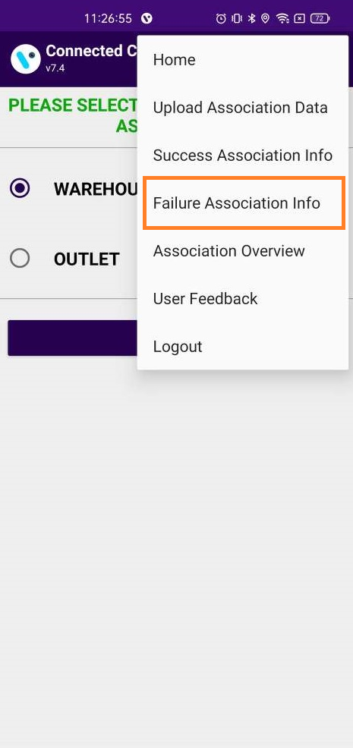
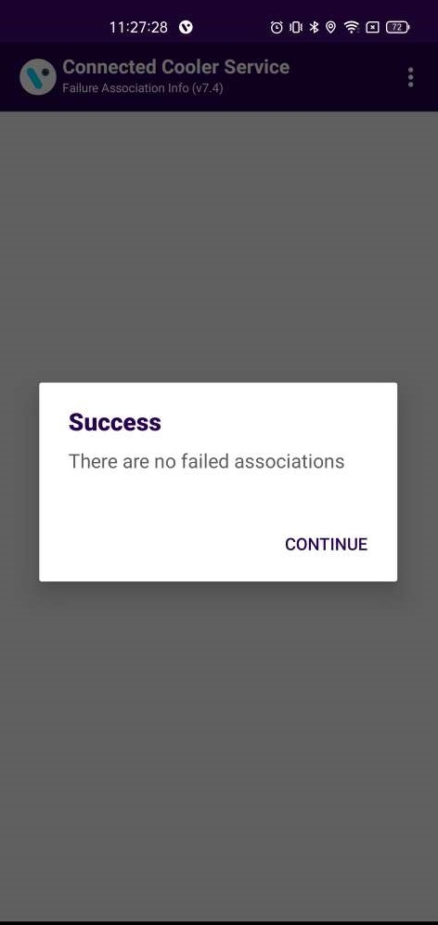
ASSOCIATE SMART DEVICE TO COOLER – LOGS > FAILED ASSOCIATION INFO
FAILED ASSOCIATION INFO
To check all Failed Associations Info, tap on the hamburger menu in the upper right corner and then tap on Failure Association Info.
© 2023 Vision Group

Slide 16
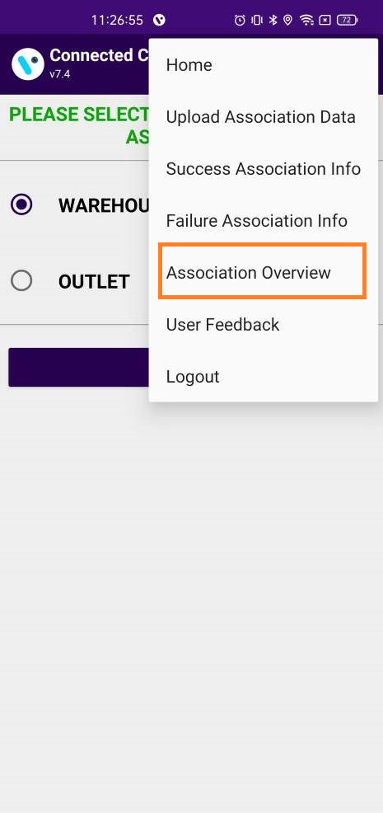
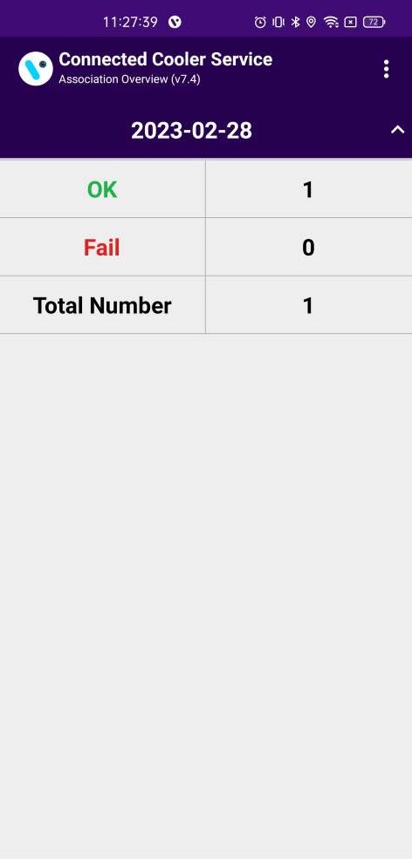
ASSOCIATE SMART DEVICE TO COOLER – LOGS > ASSOCIATION OVERVIEW
ASSOCIATION OVERVIEW
To check all Failed Associations Info, tap on the hamburger menu in the upper right corner and then tap on Failure Association Info.
© 2023 Vision Group

Slide 17
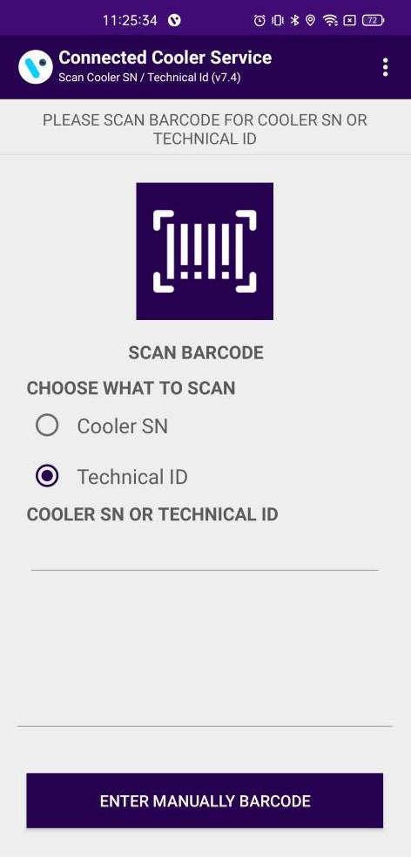
SCAN COOLER - DATA DOWNLOAD
DATA DOWNLOAD
After successful login selects the SCAN COOLER option for Download and Remove Association of the Cooler.
Users can identify assets by SCAN BARCODE - Cooler SN or Technical ID.
The user can also search by ENTER MANUALLY BARCODE for entering Cooler SN or Technical ID.
© 2023 Vision Group

Slide 18
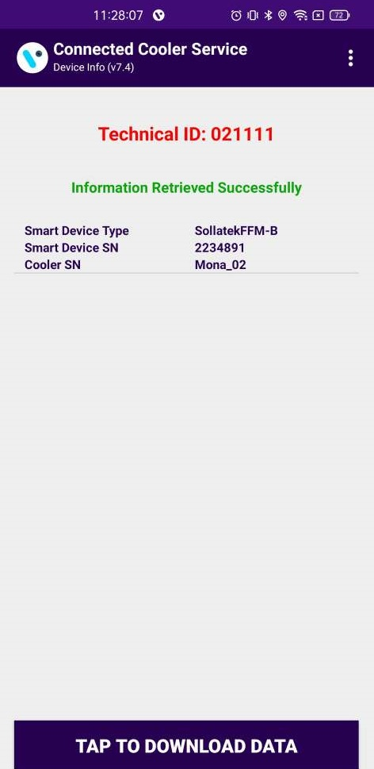
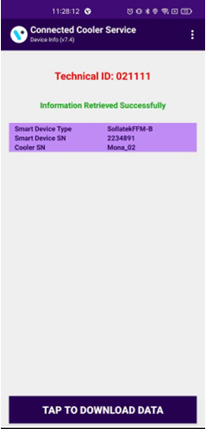
Information about the asset is presented.
Tap on the smart device from which data needs to be downloaded.
Tap on TAP TO DOWNLOAD DATA to start data download from a smart device.
© 2023 Vision Group

Slide 19
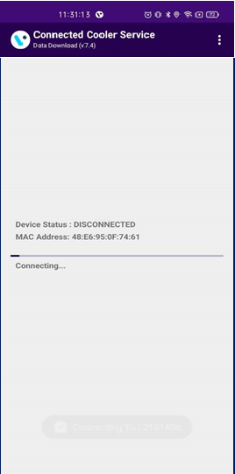
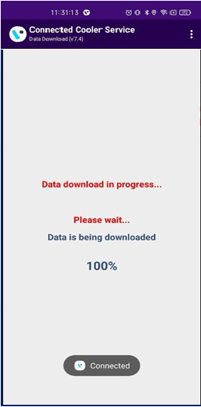
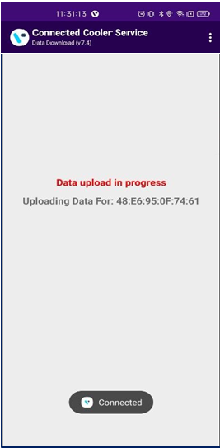
Information about the asset is presented.
Tap on the smart device from which data needs to be downloaded.
After Successfully Data Download, Data will upload to the cloud.
© 2023 Vision Group

Slide 20
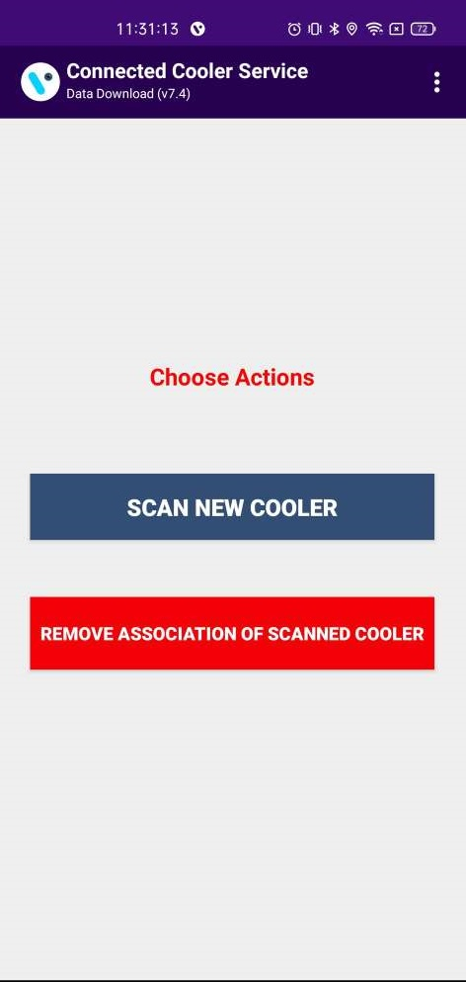
After the data is successfully downloaded from the smart device below screen will appear.
Users can SCAN NEW COOLER or enter manually Cooler SN or Technical ID as shown in the below image.
© 2023 Vision Group

Slide 21
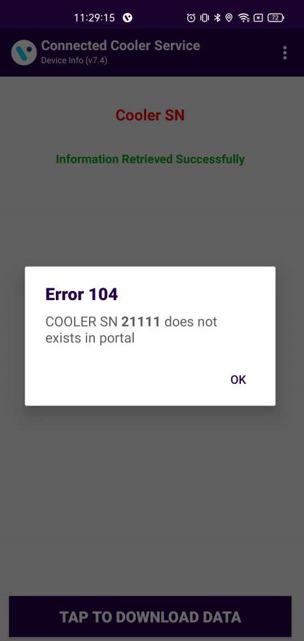
If the Cooler SN or Technical ID is invalid, then the application will give an error message which is visible in the image below.
© 2023 Vision Group

Slide 22
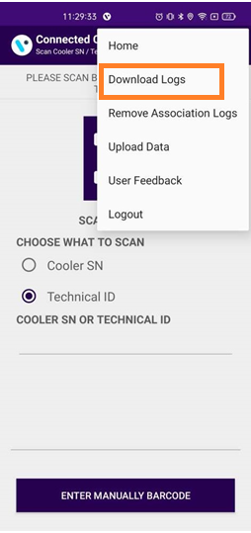
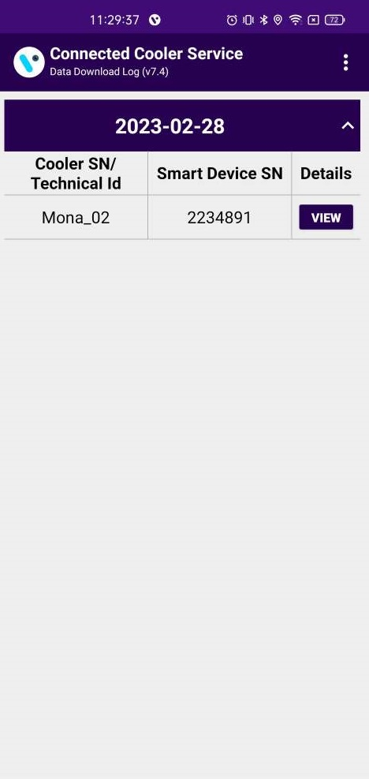
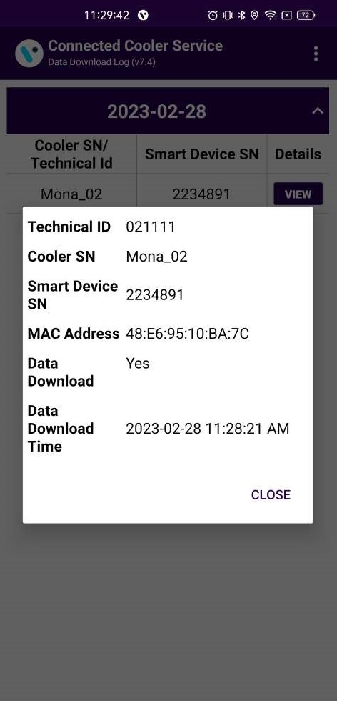
SCAN COOLER - LOGS > DATA DOWNLOAD LOGS
DOWNLOAD LOGS
To all the data that is downloaded, tap on the hamburger menu in the upper right corner and then tap on DATA DOWNLOAD LOGS.
© 2023 Vision Group

Slide 23
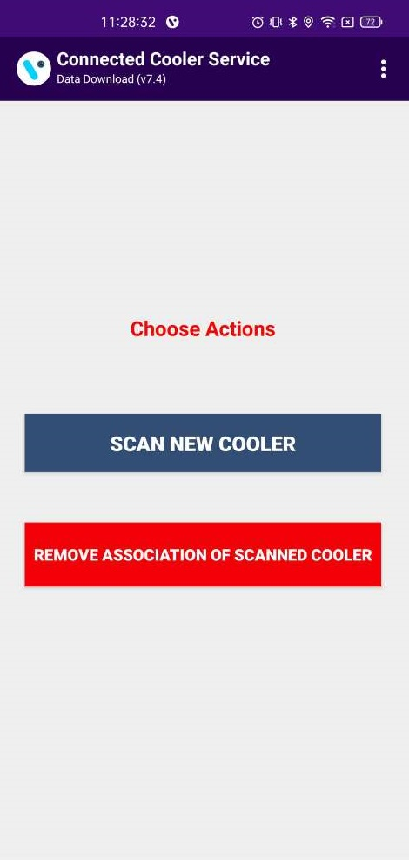
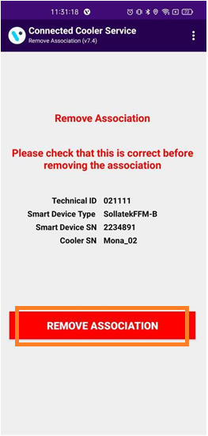
SCAN COOLER – REMOVE ASSOCIATION
REMOVE ASSOCIATION
After the Data Upload process is completed below screen will appear, where the association can be removed, to do so click on the REMOVE ASSOCIATION OF SCANNED COOLER button.
Click on REMOVE ASSOCIATION to remove the device association from the cooler as shown in the image below.
© 2023 Vision Group

Slide 24
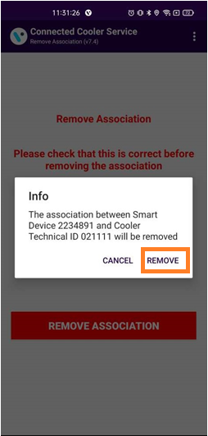
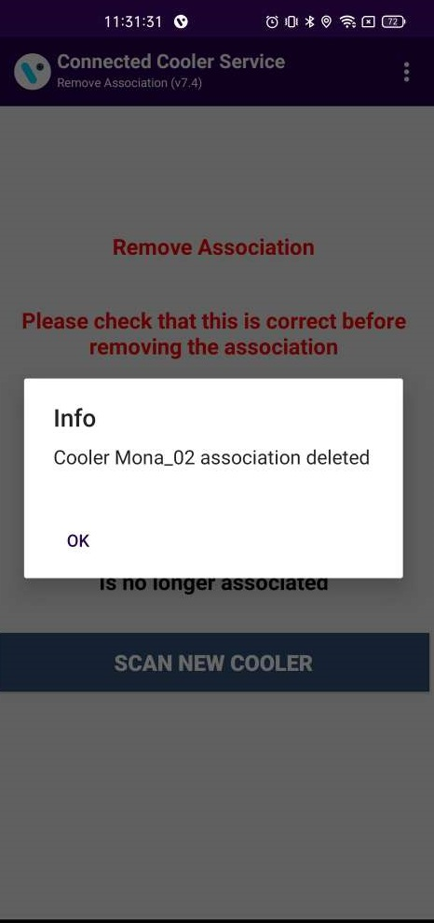
A pop-up message will appear prompting you to remove the association. Click the REMOVE button to remove the association of the device or CANCEL not to remove the association.
After removing the association successfully, a pop-up window will prompt you to confirm, click on the OK button.
© 2023 Vision Group

Slide 25
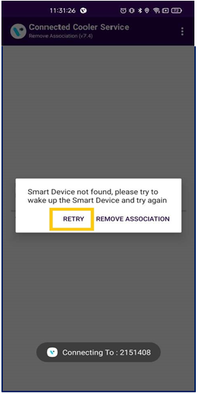
If the device is not found within the next 60 seconds, the user will be prompted to Retry the scan for the device or to remove the association. This might happen when a device has a low or no battery charge or some other issue. Clicking on RETRY will again scan for the device.
Choosing to Remove the association will bring you back to the First Point of the current section and removal of the association will be possible.
© 2023 Vision Group

Slide 26
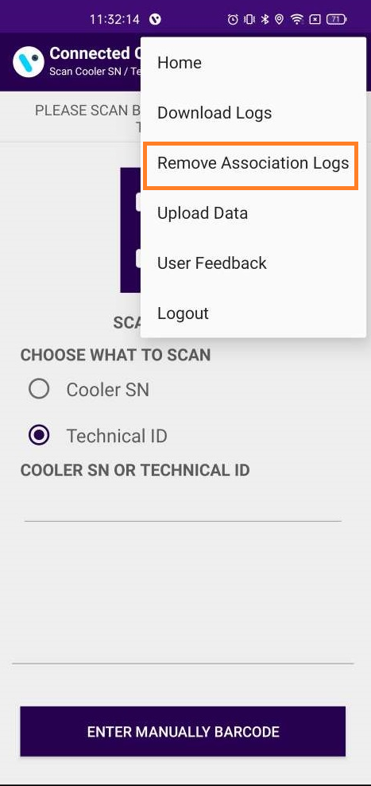
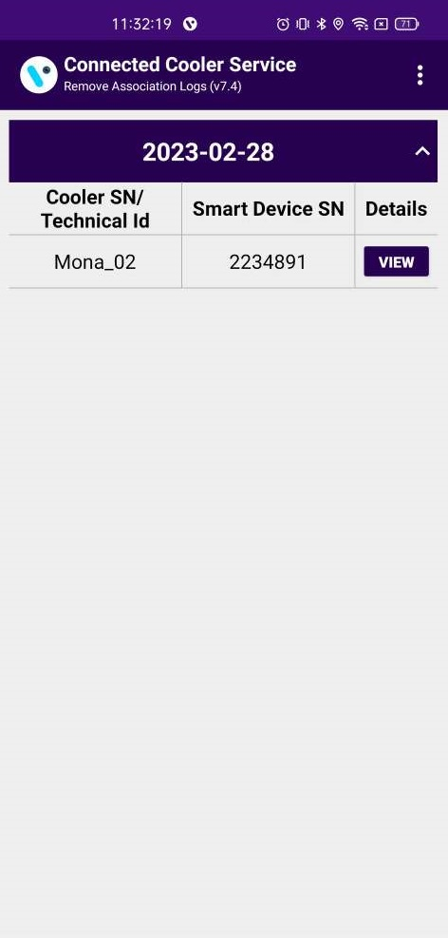
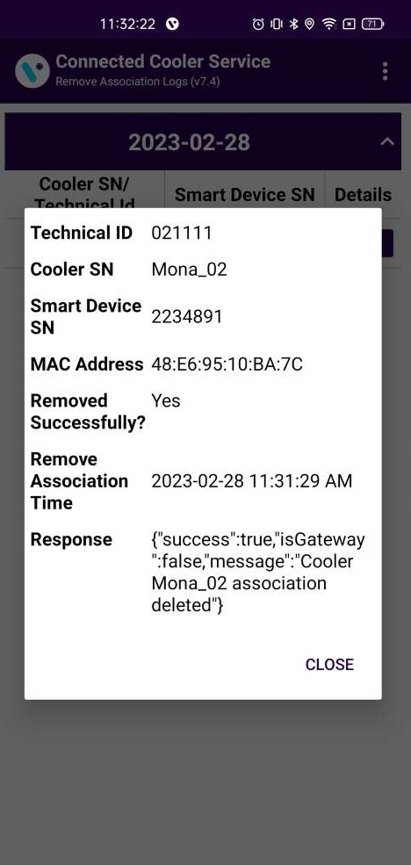
SCAN COOLER - LOGS > REMOVE ASSOCIATION LOGS
REMOVE ASSOCIATION LOGS
To check the removed association, tap on the hamburger menu in the upper right corner and then tap on REMOVE ASSOCIATION LOGS.
© 2023 Vision Group

Slide 27
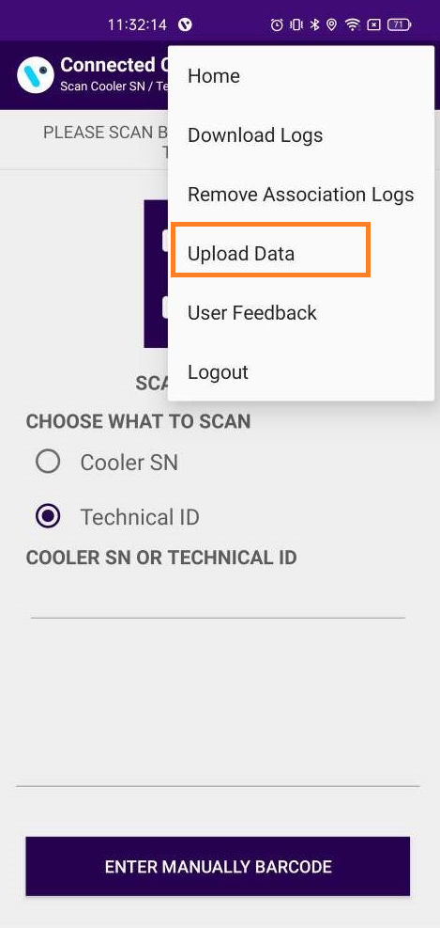
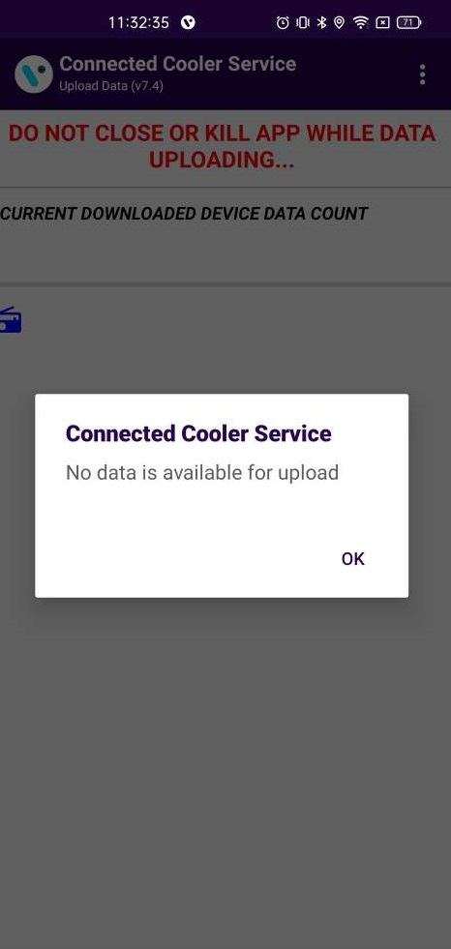
SCAN COOLER - LOGS > UPLOAD DATA
UPLOAD DATA
If any network error or loss of the internet connection occurs during download, the data will be stored in the application.
After getting a proper internet connection click on the UPLOAD DATA button to upload the data stored in the application.
Note: Do not close the application while data is uploaded.
© 2023 Vision Group

Slide 28
SCAN COOLER - LOGS > UPLOAD DATA
UPLOAD DATA
If any network error or loss of the internet connection occurs during download, the data will be stored in the application.
After getting a proper internet connection click on the UPLOAD DATA button to upload the data stored in the application.
Note: Do not close the application while data is uploaded.
© 2023 Vision Group

Slide 29
CHANGE CONTROLLER SETTINGS- CHANGE CONTROLLER SETTINGS
Change specific controller parameters via the Connected Cooler Service application. To change specific parameters of the FFA / JEA / FDE controller for Sollatek device types.
List of Supported Devices to Change FFA Settings:
  Sollatek FFM2BB – FFA
  Sollatek FFM-B – FFA
  Sollatek FFX – FFA / JEA
  Sollatek FFXy – FFA / JEA
  Sollatek GBR3 – FFA
  Sollatek JEA – JEA
  Sollatek FDE – FDE
Below FFA / JEA / FDE Parameters are available for change using the change CONTROLLER Setting functionality.
  dnI – Normal mode cut-in value – Day Mode
  dnO – Normal mode cut-out value – Day Mode
  nnI – Normal mode cut-in value – Night Mode
  nnO – Normal mode cut-out value – Night Mode
  dF3 – Defrost Start Interval – In Hours
  dF4 – Defrost End Interval – In Minutes
  L0 – Enable Light Regulation by Logic
© 2023 Vision Group

Slide 30
For Sollatek FFA/JEA Device type the following parameters can be modified,
FFA/JEA (EvoCool)
Parameters | Purpose | Min | Max | Resolution | Unit
dnI | Normal mode cut-in value – Day Mode | -40 | 40 | 0.1 | °C
dn0 | Normal mode cut-out value – Day Mode | -40 | 40 | 0.1 | °C
nnI | Normal mode cut-in value – Night Mode | -40 | 40 | 0.1 | °C
nn0 | Normal mode cut-out value – Night Mode | -40 | 40 | 0.1 | °C
dF3 | Defrost Start Interval (hours) | N/A, 1 | 255 | 1 | hours
dF4 | Defrost Duration (minutes) | N/A, 1 | 255 | 1 | minutes
dOt | Learning algorithm door operation duration threshold | 1 | 255 | 1 | seconds
L0 | Enable Light Regulation by Logic | No | Yes | N/A | N/A
L1 | Lights ON delay (NIGHT to DAY mode switch) | 0 | 255 | 1 | minutes
L2 | Lights OFF delay (DAY to NIGHT mode switch) | 0 | 255 | 1 | minutes
L3 | Lights switch enable / No / Yes | No / Yes
© 2023 Vision Group

Slide 31
For Sollatek FDE Device type the following parameters can be modified,
FDEx2
Parameters | Purpose | Min Value | Max Value | Resolution | Unit
CIn | Cut IN value in Normal mode | -28 | 45 | 0.1 | °C
COn | Cut Out value in Normal mode | -28 | 45 | 0.1 | °C
OST | Offset value (display) | -10 | 10 | 0.5 | °C
DrC | Door Closure for ES (EnergySaving) initiation | 2 | 8 | 1 | hours
CIe | Cut In value in Eco mode | -28 | 45 | 0.1 | °C
Coe | Cut Out value in Eco mode | -28 | 45 | 0.1 | °C
DST | Defrost Start Timer (hours) | 0 | 24 | 1 | hours
DET | Defrost end Timer (minutes) | 0 | 99 | 1 | minutes
© 2023 Vision Group

Slide 32
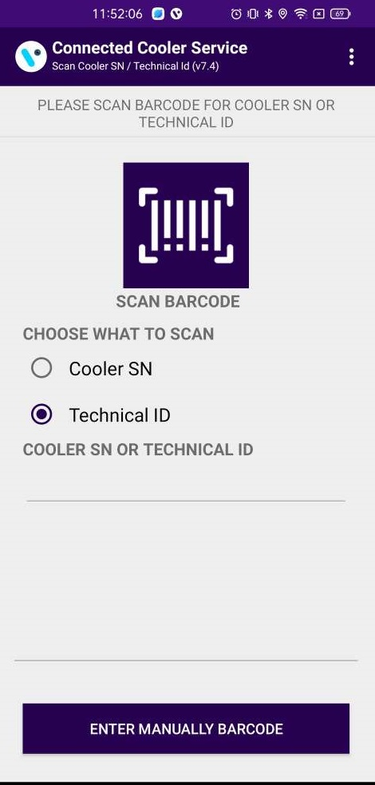

Choose the CHANGE FFA SETTING(FFA) option to update the FFA/JEA Parameters of smart devices.
Users can identify assets by SCAN BARCODE by Cooler SN or Technical ID. The user can also search by ENTER MANUALLY BARCODE of Cooler SN or Technical ID.
Information about the asset is presented for changing FFA/JEA parameters and by tapping on the Parameter the user can change the values of the FFA parameters.
© 2023 Vision Group

Slide 33



By tapping on the parameter, the user can change the values of the FFA parameter and after successfully changing the FFA parameter success message will appear.
© 2023 Vision Group

Slide 34
CHECK COOLER STATUS - CHECK COOLER STATUS
Use CHECK COOLER STATUS to check specific smart device current sensor data, FW version info, and DFU functionality if the latest Firmware is available for the Scanned Cooler.
Users can identify assets by SCAN BARCODE by Cooler SN or Technical ID. The user can also search by ENTER MANUALLY BARCODE of Cooler SN or Technical ID.
© 2023 Vision Group

Slide 35


Information about the asset is presented to check the cooler status.
Below is the data which is shown on the CHECK COOLER STATUS screen:
Showing for EBEST Smart device:
BATTERY STATUS – Showing Battery Status HIGH, MEDIUM, POOR
Showing for EBEST and SOLLATEK Smart device:
DOOR STATUS – Showing Door status OPEN or CLOSE
FW STATUS – Showing FIRMWARE VERSION and UPDATE option
LIGHT – Showing LIGHT ON/OFF status
Showing for SOLLATEK Smart device:
COMPRESSOR – Showing Cooler COMPRESSOR ON/OFF status
FAN – Showing Cooler FAN ON/OFF status
POWER – Showing Smart device POWER Status MAINS/BATTERY
ALARM – Showing Cooler Alarm COUNT in Status
CONTROLLER STATUS – Showing Cooler Controller Status OK /NOT OK
VOLTAGE – Showing Cooler Voltage in VOLT
CABINET TEMP – Showing Cooler Cabinet Temperature in CELSIUS
GPRS STATUS – Showing SUCCESSFUL GPRS CONNECTION in status
LAST GPRS ACTIVITY – Showing LAST GPRS ACTIVITY DATE-TIME in Status
© 2023 Vision Group

Slide 36



CHECK COOLER STATUS - DFU
DFU
Tap on the Flag Button For DFU of the Smart device.
The DFU (Direct Firmware Upgrade) of the Smart device can be performed by clicking on the Update notification as shown in the image.
After performing the DFU update operation user can see the DFU Upgrade Process as shown in the image.
© 2023 Vision Group

Slide 37


After the successful DFU process is complete user can see the Upgraded FW version of the smart device as seen in the Image.
© 2023 Vision Group

Slide 38

SCAN NEARBY DEVICES- SCANNING FOR VISION IOT SMART DEVICES
Scan Nearby Devices functionality can be used for checking the advertisement of the smart device in Bluetooth range.
As shown in the first image there is a list of all available smart devices that are coming into range.
© 2023 Vision Group

Slide 39


Users can search the Smart device with the help of the Scan Barcode option or Manual Enter option. The scanned result will be shown as in the last image.
© 2023 Vision Group

Slide 40


SCAN NEARBY DEVICES- SCANNING FOR CAREL DEVICES
Users can search for smart devices with the help of the Scan Barcode option or Manual Enter option only with the MAC Address of a Carel device.
The scanned result will be shown as the last image.
Note: User can search Wellington Smart device and Nexo device using Device Name.
© 2023 Vision Group

Slide 41

GATEWAY SETTINGS- GATEWAY SETTINGS
Use GATEWAY SETTINGS to check specific smart device current APN and URL data.
Users can identify assets by SCAN BARCODE by Cooler SN or Technical ID. The user can also search by ENTER MANUALLY BARCODE of Cooler SN or Technical ID.
© 2023 Vision Group

Slide 42



GATEWAY APN
By tapping on the parameter, the user can change the values of the gateway APN value, and after successfully changing the APN success message will appear.
© 2023 Vision Group

Slide 43



GATEWAY URL
By tapping on the parameter, the user can change the values of the gateway URL value and after successfully changing the URL success message will appear.
© 2023 Vision Group

Slide 44
MESSAGES – SCAN COOLER MESSAGES
Detailed Message | Short Message | User Story
Cooler SN or Technical ID <Cooler SN> is associated with Gateway <GW SN> | Error 101 | If Cooler is available in the portal and not associated with any smart device but associated with any gateway.
Cooler SN or Technical ID <Cooler SN> is associated with Smart Device <SD SN> | Error 102 | If Cooler is available in the portal and not associated with any gateway but associated with any smart device.
Cooler SN or Technical ID <Cooler SN> is associated with Gateway <GW SN> and Smart Device <SD SN> | Error 103 | If Cooler is available in the portal but associated with Smart Device and the gateway.
Cooler SN or Technical ID <Cooler SN> does not exist in portal | Error 104 | If the cooler does not available in the portal.
Duplicate Cooler SN on cloud, try with the Technical ID or check with the Support Staff | Error 110 | Duplicate Cooler SN on a cloud, try with the Technical ID or check with the Support Staff
Duplicate Technical ID on cloud, try with the Cooler SN or check with the Support Staff | Error 111 | Duplicate Technical ID on a cloud, try with the Cooler SN or check with the Support Staff
© 2023 Vision Group

Slide 45
MESSAGES – OK/SUCCESS MESSAGES
Detailed Message | Short Message | User Story
No Association Data Is Available For Upload | OK | Shown when there is no data for upload.
All Association Data Was Uploaded Successfully | OK | Shown when all association data is uploaded.
There Are No Failed Associations | OK | Shown on the failure association info screen when there are no associations that have failed.
Smart Device <SD SN> Is Associated Successfully To Cooler <Cooler SN> | OK | Shown after successful association.
© 2023 Vision Group

Slide 46
MESSAGES – ALERTS MESSAGES
Detailed Message | Short Message | User Story
You Must Upload Association Data In Order To Logout | Alert 50 | Shown when the user presses logout but offline associated data is available.
Do You Want To Upload Association Data To Avoid Missing Data? | Alert 51 | Shown on the device selection screen when offline associated data is available.
Please Select What Smart Device You Want To Associate | Alert 52 | Shown on the device selection screen when the user does not select any device option for the association.
No Associations Were Uploaded | Alert 53 | Shown on successful association info when no successful info is there.
Cooler Serial Number Is Not Scanned | Alert 54 | Shown on the cooler SN screen when the user canceled the barcode reading.
Smart Device Serial Number Is Not Scanned | Alert 55 | Shown on the smart device SN screen when the user canceled the barcode reading.
You Must Upload Association Data | Alert 56 | Shown on the device selection screen when offline data is available.
© 2023 Vision Group

Slide 47
MESSAGES – ERROR MESSAGES
Detailed Message | Short Message | User Story
The Barcode Scanner Is Not Supported | ERROR 50 | Shown on scan cooler SN and scan smart device SN screen if the cell phone does not support the barcode scanner.
Smart Device Is Not Available For Association | ERROR 51 | Shown on scan smart device SN screen when smart device not found in unassigned list.
Smart Device Is Already Associated | ERROR 52 | Shown on the scan smart device SN screen if the smart device is already associated.
Smart Device Serial Number Is Not Valid | ERROR 53 | Shown on the scan smart device SN screen if the smart device SN is not valid.
Cooler Serial Number Was Not Scanned | ERROR 54 | Shown on scan cooler SN when the user cancels the barcode scanning or any issue while barcode scanning arises.
Cooler Has Another Device Associated To It | ERROR 55 | Shown on the scan cooler SN screen if the cooler has a smart device already associated with it.
Please Enter Cooler Serial Number | ERROR 56 | Shown on the scan cooler SN screen when in manual mode for cooler SN and the user presses the save button without entering the cooler SN.
Please Enter Smart Device Serial Number | ERROR 57 | Shown on the scan smart device SN screen when in manual mode for smart device SN and the user presses the save button without entering the smart device SN.
Smart Device Configuration Failed, Please Try Again | ERROR 58 | Shown on the association screen when a command fails.
Smart Device Configuration File Missing | ERROR 59 | Shown on the association screen when configuration JSON missing for the smart device.
Not All Association Data Was Uploaded Successfully | ERROR 60 | Shown when some associations failed to be uploaded.
© 2023 Vision Group

Slide 48
Smart Device Not Found, Please Try To Wake Up The Smart Device And Try Again | ERROR 61 | Shown on the association screen when the application is not able to connect to the smart device.
Session Expired, Please Check Your Internet Connection And Login Again | ERROR 62 | Shown when user session expired (token expired) on the server.
Please Check Your Internet Connection And Try Again | ERROR 63 | Shown when wi-fi and mobile data are off, and the user calls the API.
Cannot Connect To The Smart Device, Please Change The Smart Device | ERROR 64 | Shown on the association screen when the smart device connection is not working (when the device was found but did not connect to the phone after the 2nd retry).
Cannot Connect To The Server, Please Try Again | ERROR 65 | Shown on login and upload association data screen when API calling in between timeout happen or any server connection error.
Cooler Serial Number Is Not Valid | ERROR 66 | Shown on cooler SN screen when the cooler serial number is not valid.
Invalid Response From The Server | ERROR 67 | Shown on the uploading association when the server gives the invalid response.
Device Is Not Connected, Please Connect Again | ERROR 68 | Shown on the association screen when we are trying to execute the command and the device is not connected.
Device Configuration Not Available | ERROR 69 | Shown when smart device type configuration is not found for the device.
© 2023 Vision Group

Slide 49
Thank You!
© 2023 Vision Group

