Slide 1

SMART COOLER INSTALLATION
ANDROID USER MANUAL
v_5.1 | AUG_2022

Slide 2

Application Features
Association – To Associate the Smart Device to Cooler.
Remove Association – To Remove Association the Smart Device to Cooler.
Device Scanning and Configure – To check Device Advertisement and Configure
DFU – Direct Firmware Update of Smart Devices.
Data Download and Upload – To Download and Upload data of the Smart Devices

Slide 3
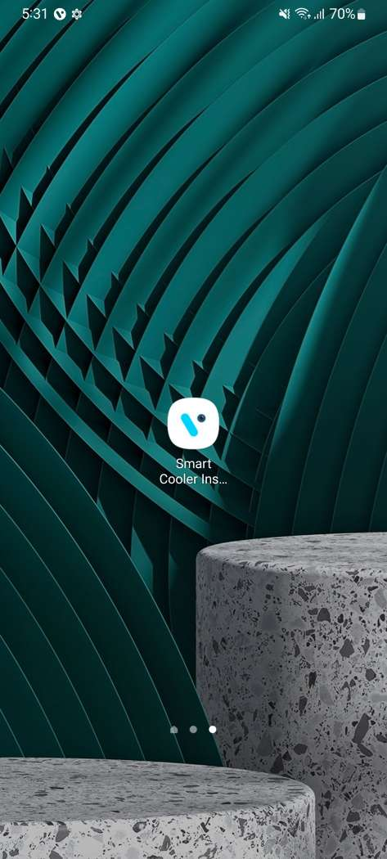
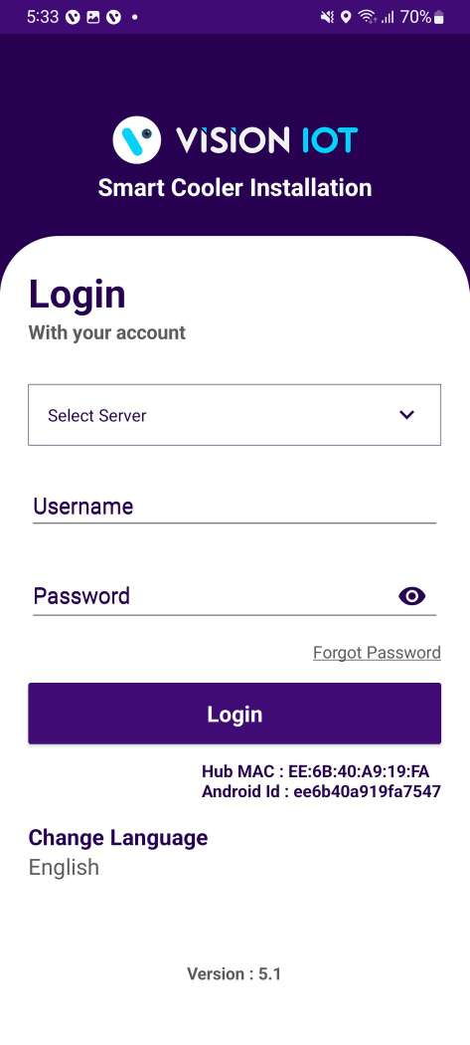
Application Installation
Open the Play Store Application and Search the “Smart Cooler Installation” Application on Play Store then Install the Application.
URL: https://play.google.com/store/search?q=Smart%20Cooler%20Installation&c=apps
The installation application is compatible only with Smartphones having Android V8.0 and above.
Open VISION IOT’s Smart Cooler Installation Application.
Login in the application using the credentials provided by your administrator – after successful login, the user will be directed to the Outlet list view screen.
Suggested Note: Before installation of every new version delete the previous one.
Note: Please ensure Bluetooth & Mobile Wi-Fi or Mobile Data must be ON the device.

Slide 4
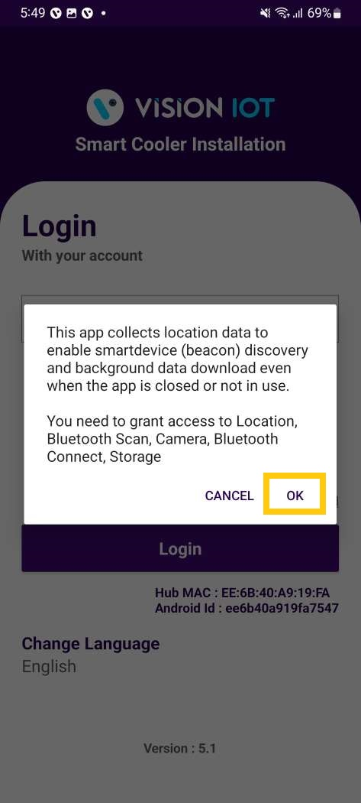
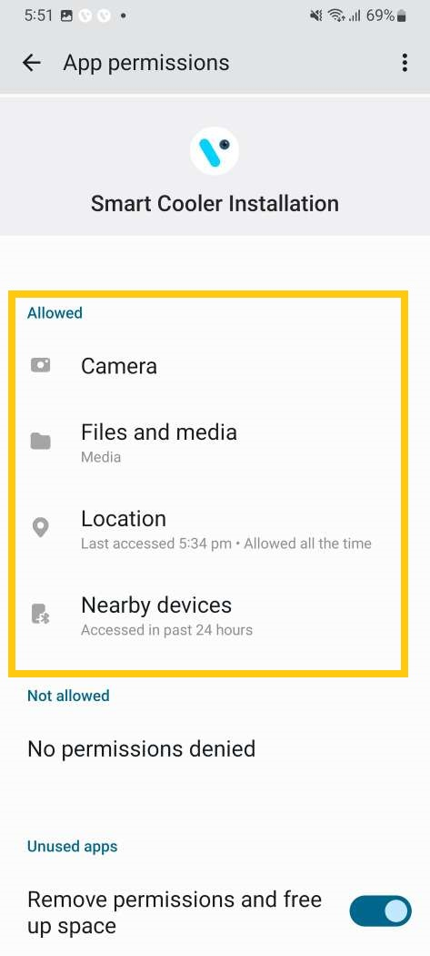
Application Permission
After initial Installation & launch, the Application will ask for permission to access.
Choose Server: For CCH, the server should be ATOS Codex, for other customers and QA, another server should be chosen.
Camera Permission, File and Media Permission, Location Permission, Nearby Device Permission Need to Allow.
PERMISSIONS
For Location (so beacons can be found) - Choose Allow While Using App on as per Handset OS.
Then Go to the Phone Settings > App Permissions > Location > Allow Location Access option is “Always”.
Same way Other Permissions like File and Media, Camera, Nearby Device need to Allow.

Slide 5

Login
After successfully installing the Smart Cooler Installation Application from Play Store. Open the Application, and the application will redirect to Login Page. Select the server from the server list and Login with valid Credentials.
The Change from v. 5.1 is that All data (outlets, assets, remote commands, firmware) is downloaded After showing the Outlet Screen.
Bluetooth also should be enabled as well as location services.
The application requires an internet connection for initial login.
After the initial log in the application can work in Offline mode provided that the same username & password as the one in the online login is used.
Minimum device requirements – Device Has 4 GB and Up RAM at least and Bluetooth Version 4.2 and above.
The Minimum OS version is 8.0 and Above.

Slide 6
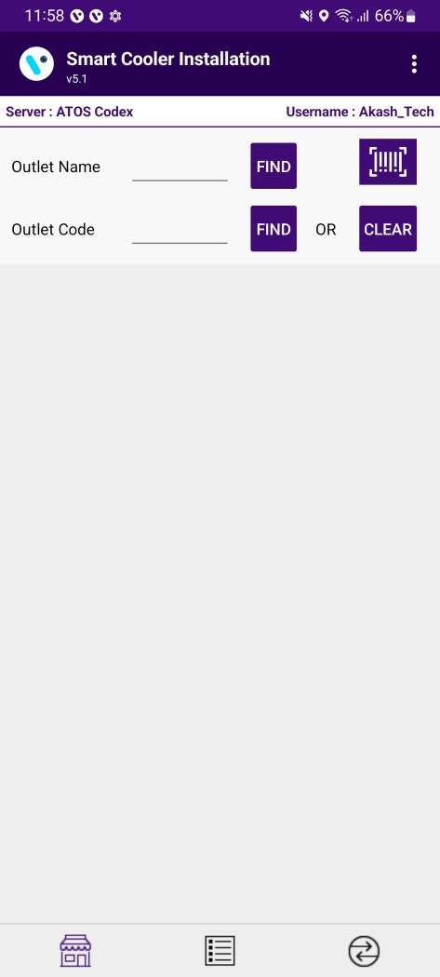
Application Functions
1. Association Screen
Use for Do the Association and Remove Association.
2. Configuration/Scanning Screen
Use for Check the Device Advertisement and Configuration check.
3. VH Screen
Use for the Data Download and Upload to the Server.
1
2
3

Slide 7
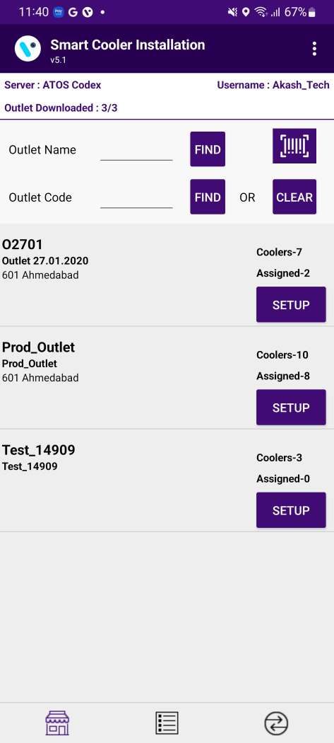
Association Screen
Click on Association Icon to move to Association Screen.

Slide 8
Total # of outlets in BD territory and how many have been loaded, outlets are loaded at startup.
Use this box to quickly search for the Asset Serial. If a cooler is found the association menu for this cooler will be shown.
Use this box to quickly search for the Outlet Code or Outlet Name. If an Outlet is found the result of the Outlet will be shown.
On successful login, a list of outlets will be shown.
Only Assigned User outlets will be shown, for each one the Outlet name, address & code will be displayed.
Coolers – 10
Shows the number of coolers in the outlet.
Associated – 8
Shows the number of coolers already associated/ provisioned.
Tap on Setup to enter the Outlet and view assigned and unassigned Coolers.

Slide 9
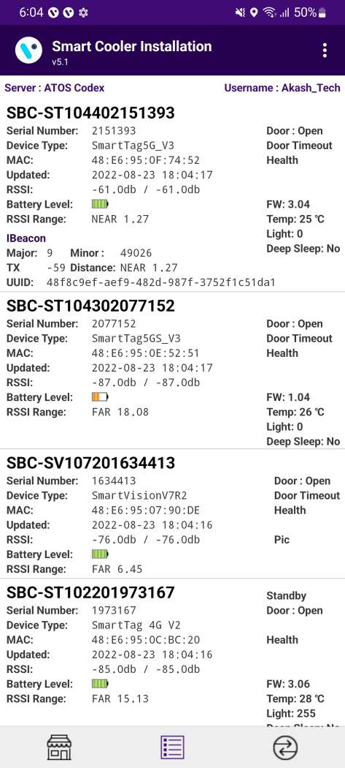
Configuration/Scanning Screen
Click on Configuration Icon to move to Configuration/Scanning Screen.
Smart Device # – Smart Device Serial Number
Smart Device Type – Name Type of Smart Device
MAC Address – Smart Device’s MAC Address
Updated – Last Update Time while Device found in Scan
RSSI – Range of Smart Devices in dB
Battery Level – Smart Device Battery Level(Green > Orange > Yellow > Red)
RSSI Range – Range of Smart Devices in meters
IBeacon Frame – Smart Devices iBeacon Advertisement Frame(Showing if Enable)
Major – Smart Device IBeacon Major value
Minor – Smart Device IBeacon Minor value
TX – Smart Device Transmit Power value
Distance – Range of Smart Devices in meters
UUID – Smart Devices iBeacon UUID Value
Standby – Flag Showing if Device in Standby Mode
Door – Flag of Door Status of Smart devices Open /Close
Health – Flag of Health if available for Smart devices
Pic – Flag of Image if available for Smart devices
FW – Firmware Version of Smart device
Temp – Current temperature Value of Cooler
Light – Light Status of Cooler
Deep Sleep – Flag Showing if Device in Standby Mode

Slide 10
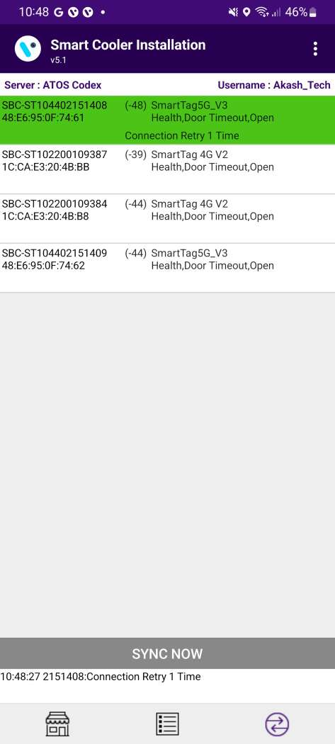
VH Screen
Click on VH Icon to move to VH Screen.
Showing Nearest Whitelisted Devices here for which Application Can download the Smart devices Data and Upload on the Server.
In each Smart Device Type, Sensor Data Flags, MAC Address, Smart Device Serial, etc. Information is showing.
The operation status of each Smart device perform by Application like Connection > Data Download > Data Upload Status showing.

Slide 11
Association Process
Selecting Outlet – Using Barcode Scanning:
Click on the Barcode icon, Barcode scanning window will open.
Scan the cooler barcode using the barcode scanner – Position the camera of the mobile device in such a way that the barcode of the Cooler (Technical ID) is in the box.
Outlet will automatically be selected, and a menu will be shown for choosing the device which will be installed.
B. Alternative – Selecting Outlet by entering Outlet Code or Name:
If Scanning of the Cooler serial is not possible enter either the Outlet Name or Outlet Code and Tap on “Find”.
C. Alternative – Selecting Outlet – Manual selection of cooler
If Scanning of the Cooler serial is not possible and the outlet code/name is not known, User can manually select the outlet.
A
B
C
Click on Association Icon to move to Association Screen.

Slide 12
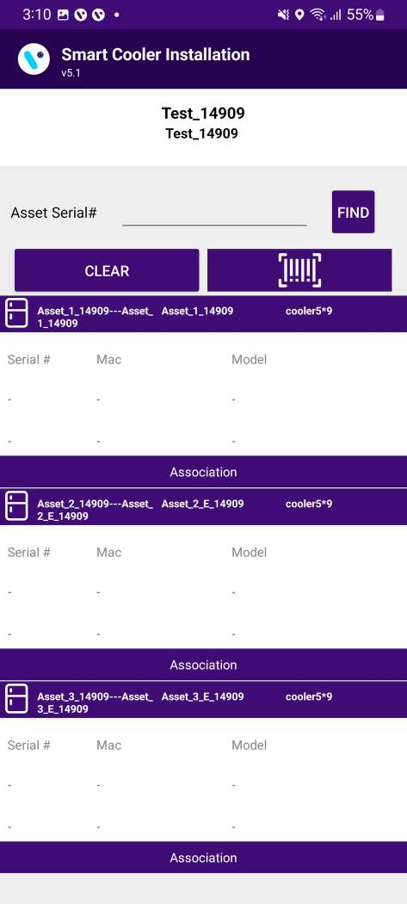
Association - SmartTags
Selecting Cooler:
A new window will open allowing User to manually select the cooler for the outlet selected.
Click on “Association” to select the Asset for installation.

Slide 13
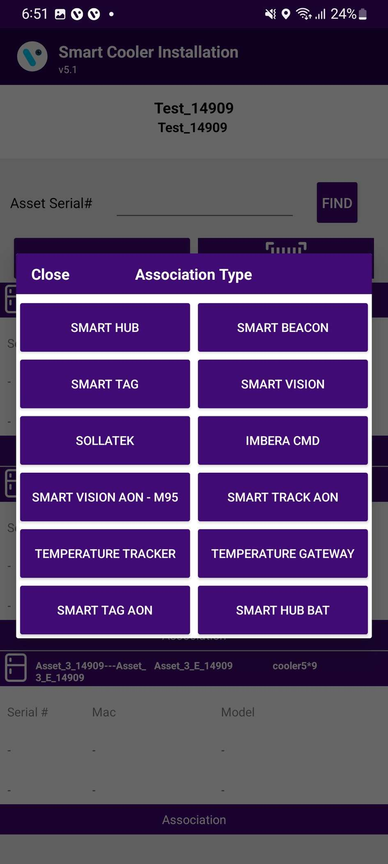
Selecting Smart Device type:
A new window will open to ask for the selection of device types to be associated with.
Click on “SMART TAG ” to Associate the SmartTag device.

Slide 14
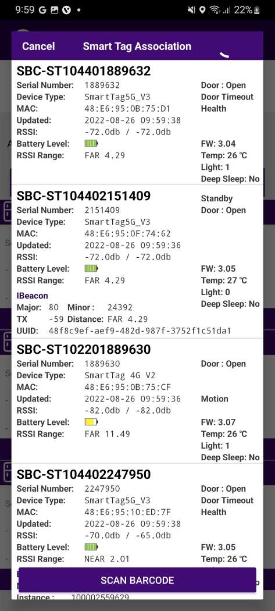
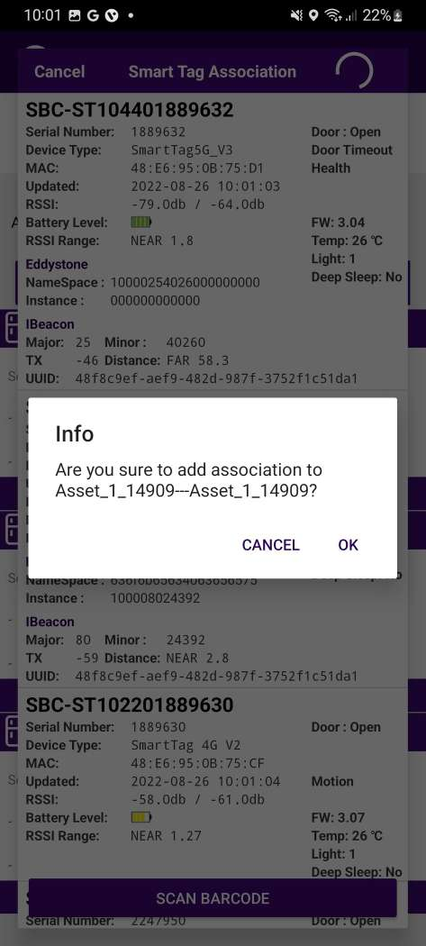
Selecting Device to do the association with:
User will see a list of unassociated devices; User can use the door status to identify the device being installed
After identifying the device, select the device to start Installation
App will give a popup to confirm the association, Click on Ok to confirm.
Note: Please note the device only wakes up when the cooler Door is Closed for 15sec.

Slide 15
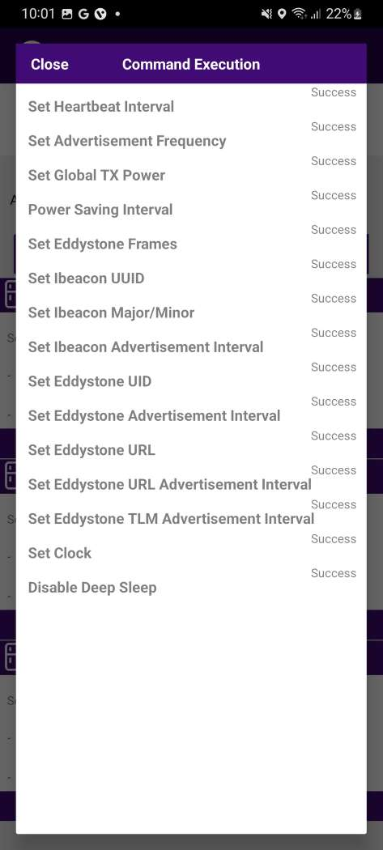
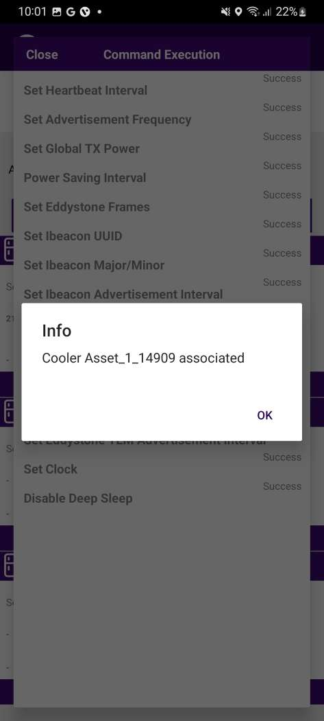
Smart Device Configuration Setting:
On selection of the device, the application will connect to the device, make all configuration changes and provide status.
A success message will appear after successful association, press OK to close the popup.
When this window appears the device is provisioned, and User can press close to return to the outlet screen.

Slide 16
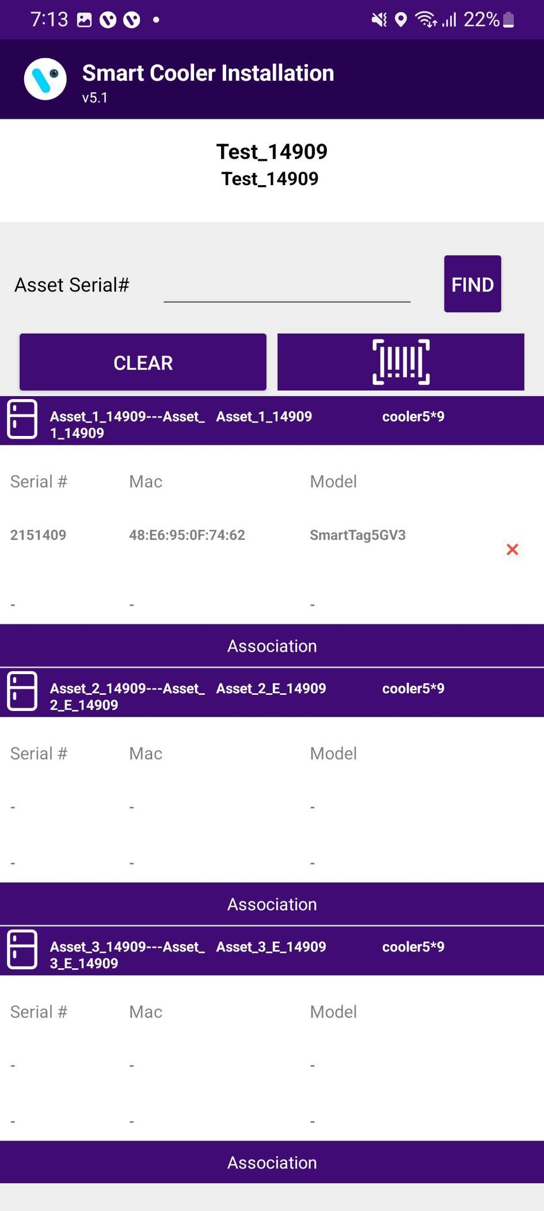
When the process is completed, User will be returned to the Outlet Screen, and now User see that the Proximity / Smart Tag is associated with the Cooler.

Slide 17
Association - SmartVisions
Selecting Cooler:
A new window will open allowing User to manually select the cooler for the outlet selected.
Click on “Association” to select the Asset for installation.

Slide 18
Selecting Smart Device type:
A new window will open to ask for the selection of device types to be associated with.
Click on “SMART VISION ” to Associate the PencilSmartVision device.

Slide 19
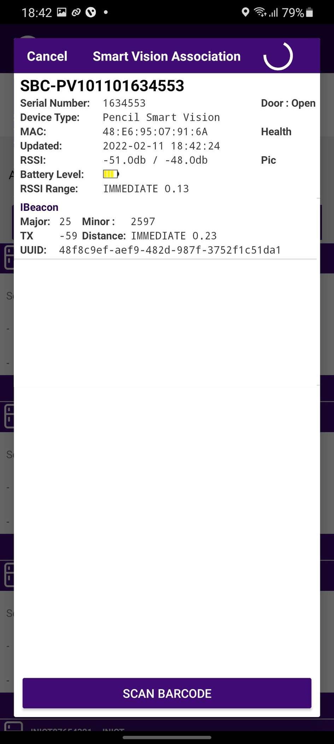
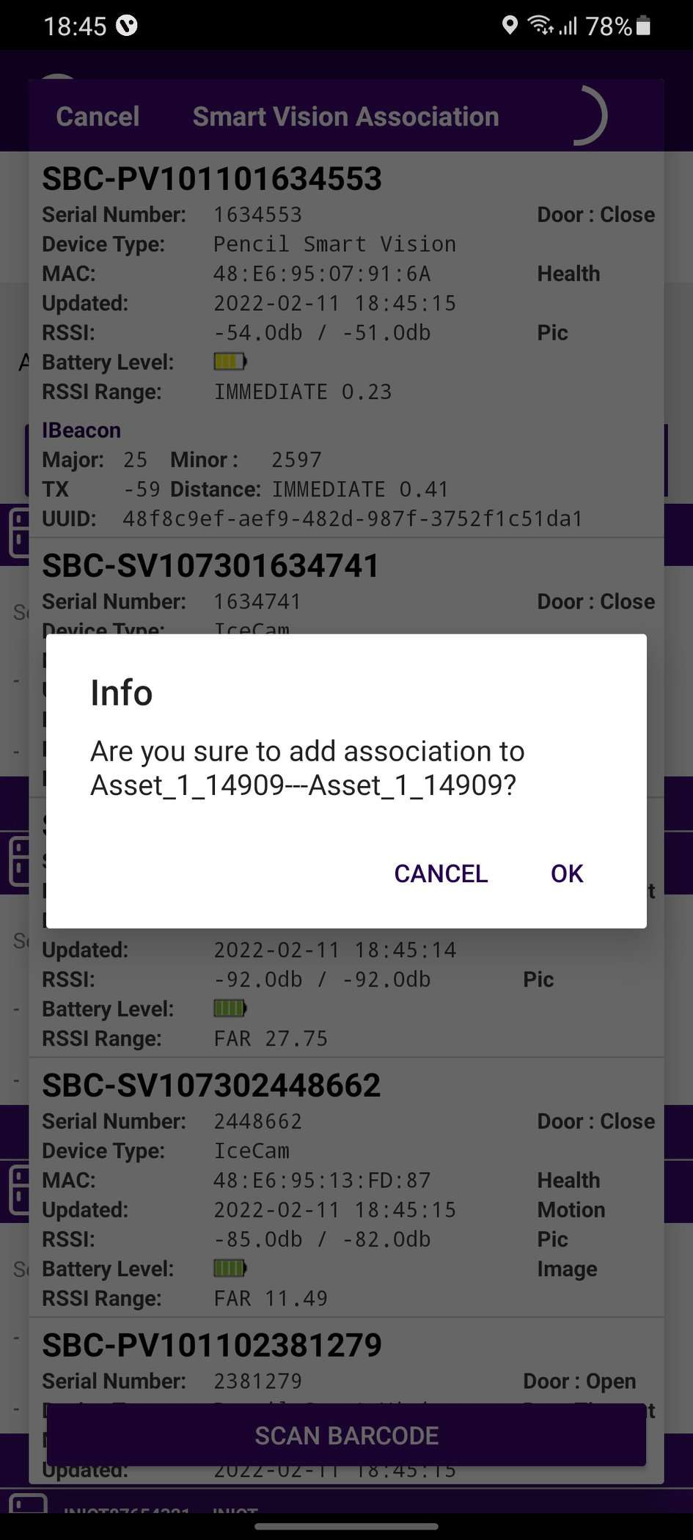
Users will see a list of unassociated devices. The user can use the door status to identify the device being installed.
After identifying the device, select the device to start Installation.
The application will give a popup to confirm the association, click on OK to confirm.
Note: Please note the Smart device only wakes up when the cooler Door is Closed for 15sec.

Slide 20
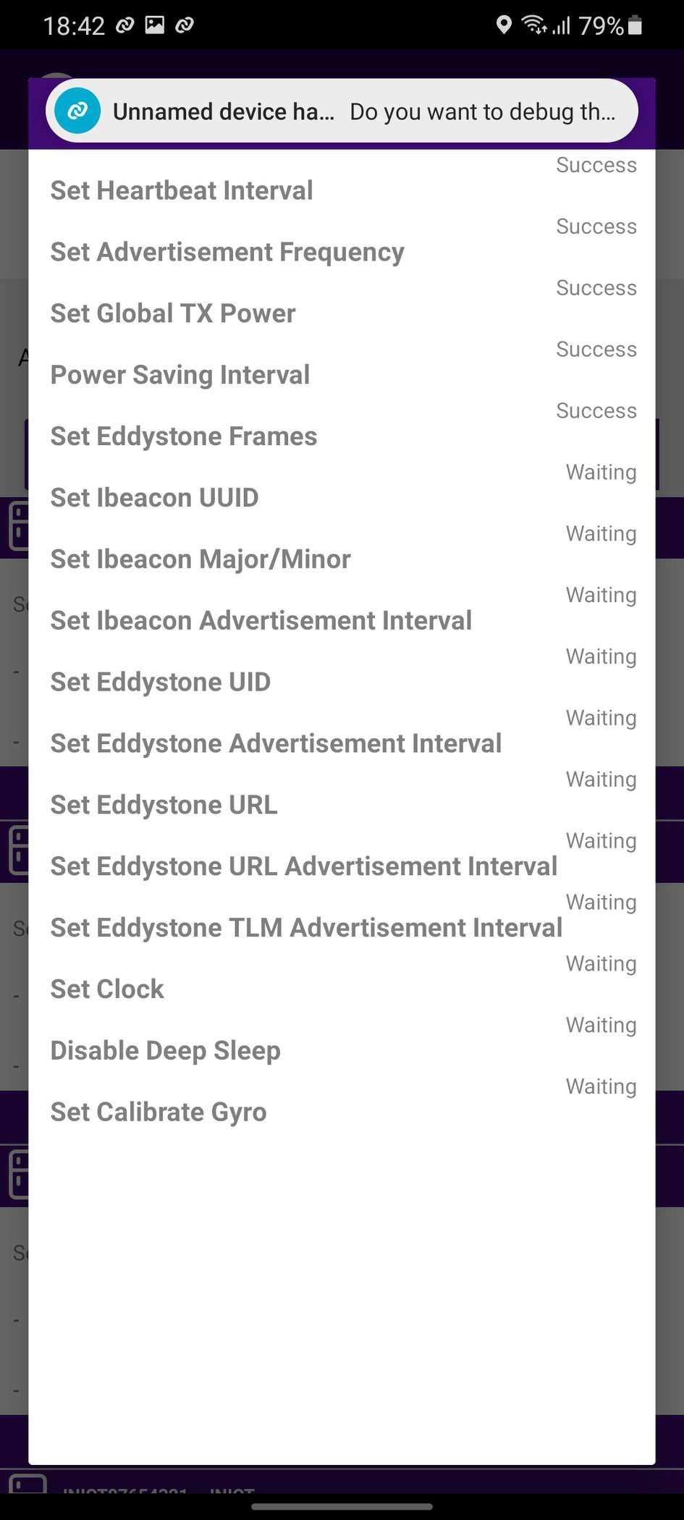
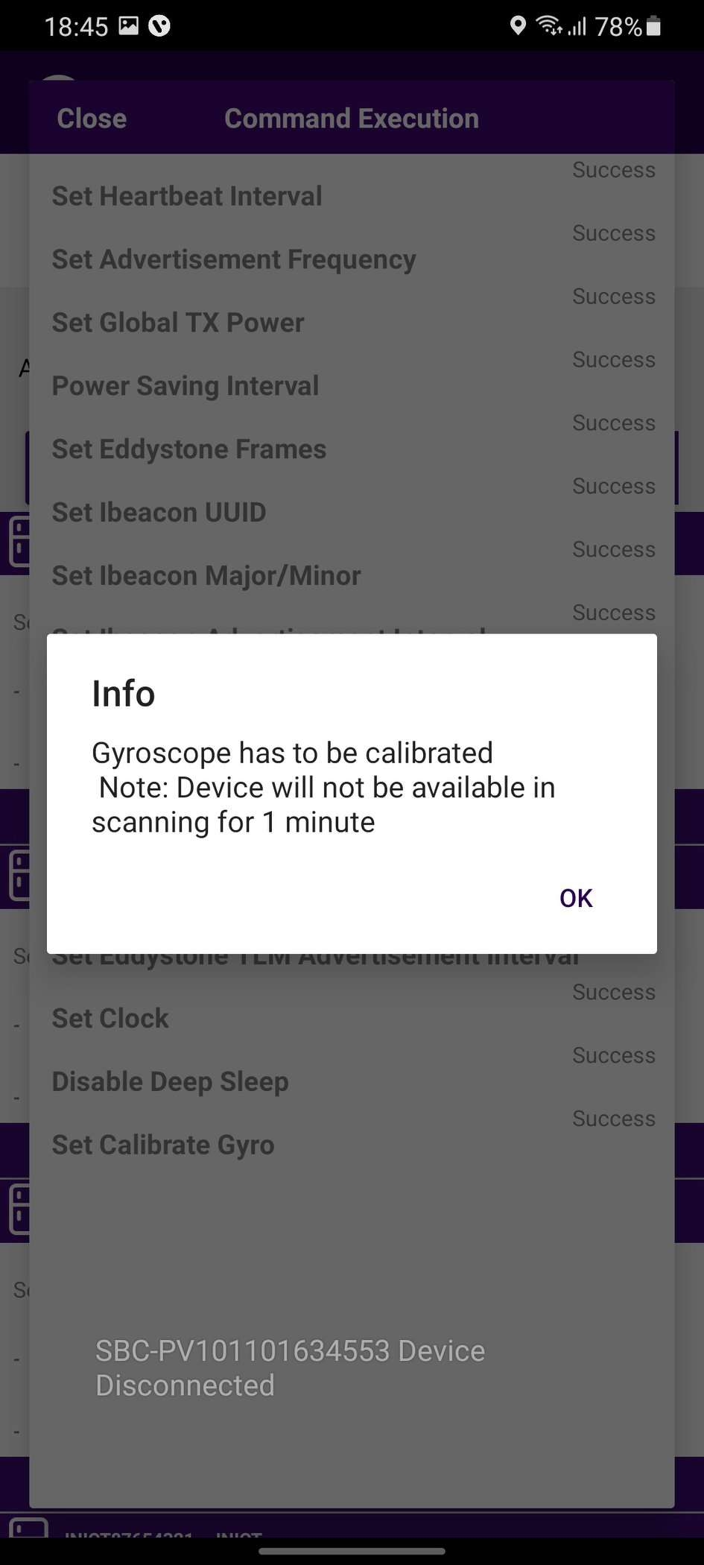
On selection of the device, the app will connect to the device and make all configuration changes and provide status.
Success Message will appear after successful association, press OK to close the popup.
When this window appears the device is provisioned, and the user can press close to return to the outlet screen.
When the door closes, a screen pop-up will show, click on OK.

Slide 21
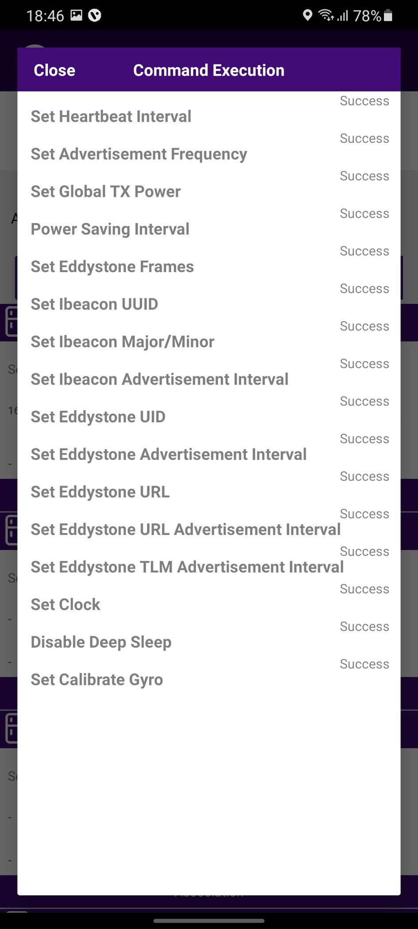
On selection of the device, the app will connect to the device and make all configuration changes and provide status.
Success Message will appear after successful association, press OK to close the popup.
When this window appears the device is provisioned, User can press close to return to the outlet screen.

Slide 22
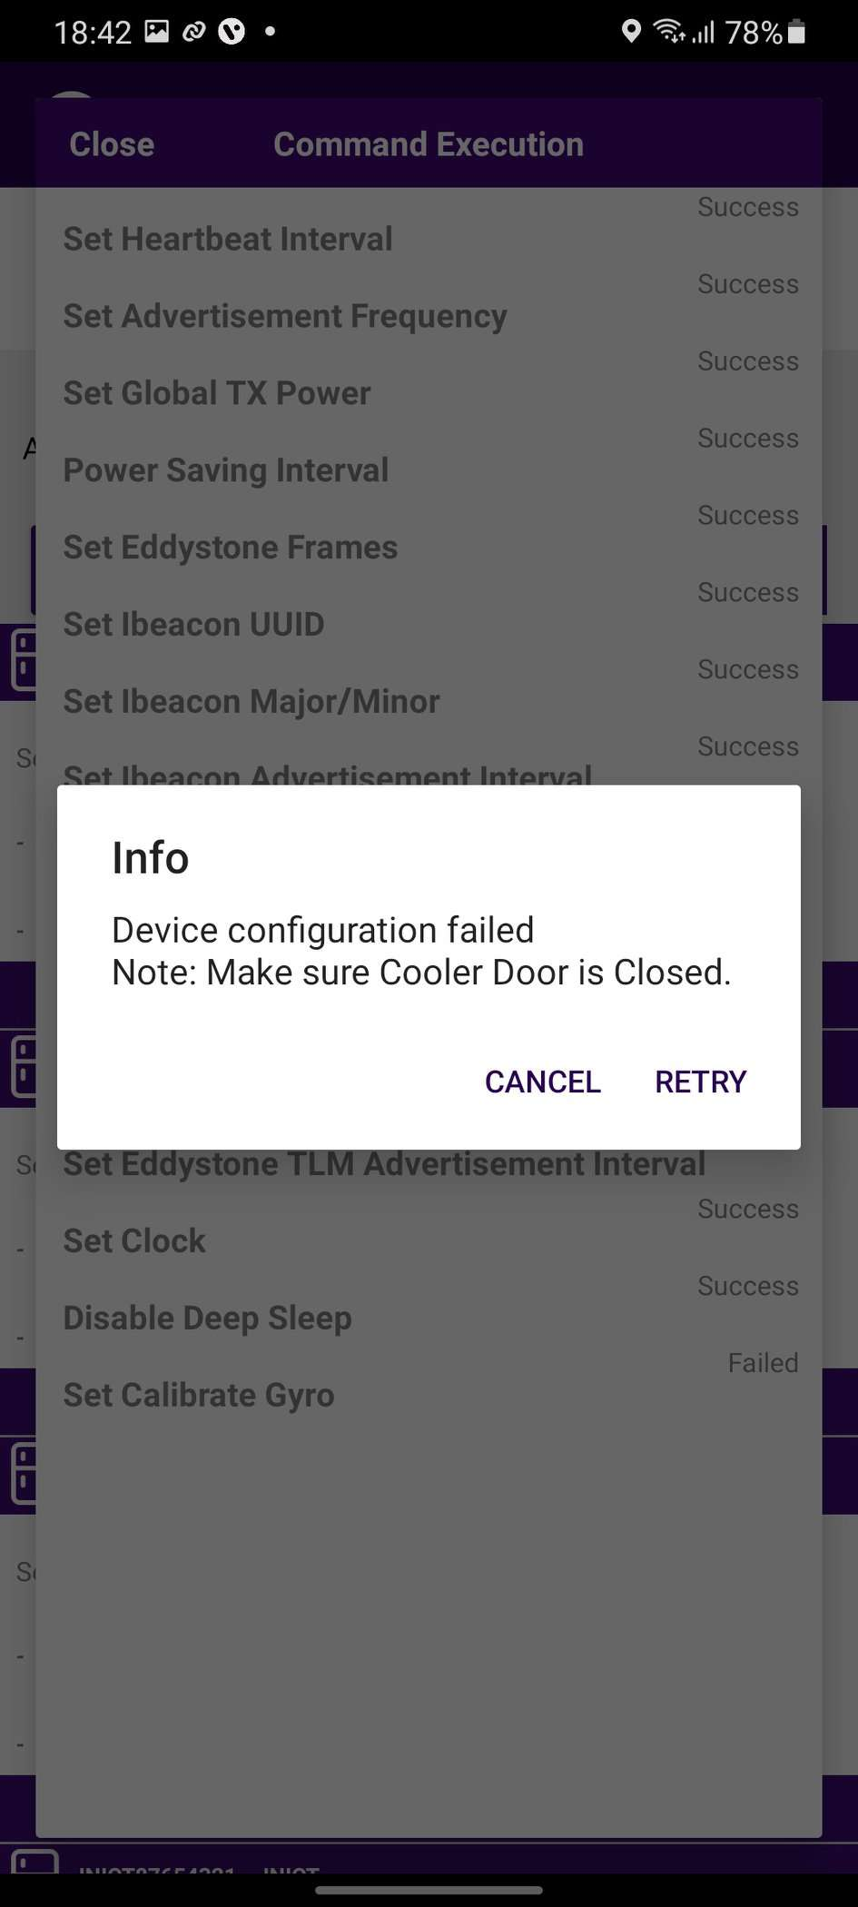
In case gyro command is not getting success response and it showing waiting or failed.
Waiting
Users can wait for 1 min and if the pop-up does not show then try again.
Failed
Check the door status if it’s “Open” then close the door and Tap on the “Retry”.

Slide 23

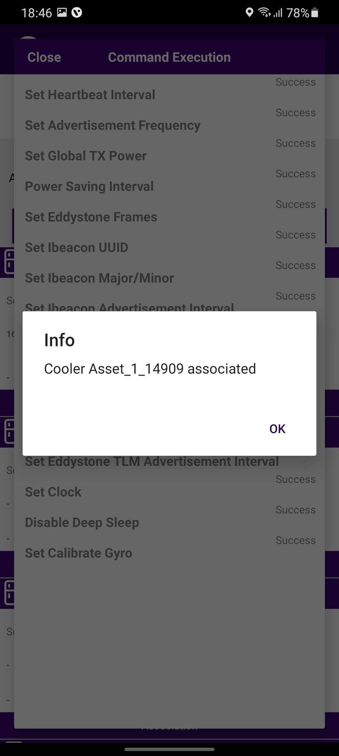
Verify Association :
When the process is completed, the User will be returned to the Outlet Screen and will see that the PencilSmartVision is associated with the Cooler.

Slide 24
Association - SmartHUBs
Selecting Cooler:
A new window will open allowing User to manually select the cooler for the outlet selected.
Click on “Association” to select the Asset for installation.

Slide 25
Selecting Gateway Device type:
A new window will open to ask for the selection of device types to be associated with.
Click on “SMART HUB ” to Associate the SmartHUB device.
Now Power on the Smart HUB device.

Slide 26
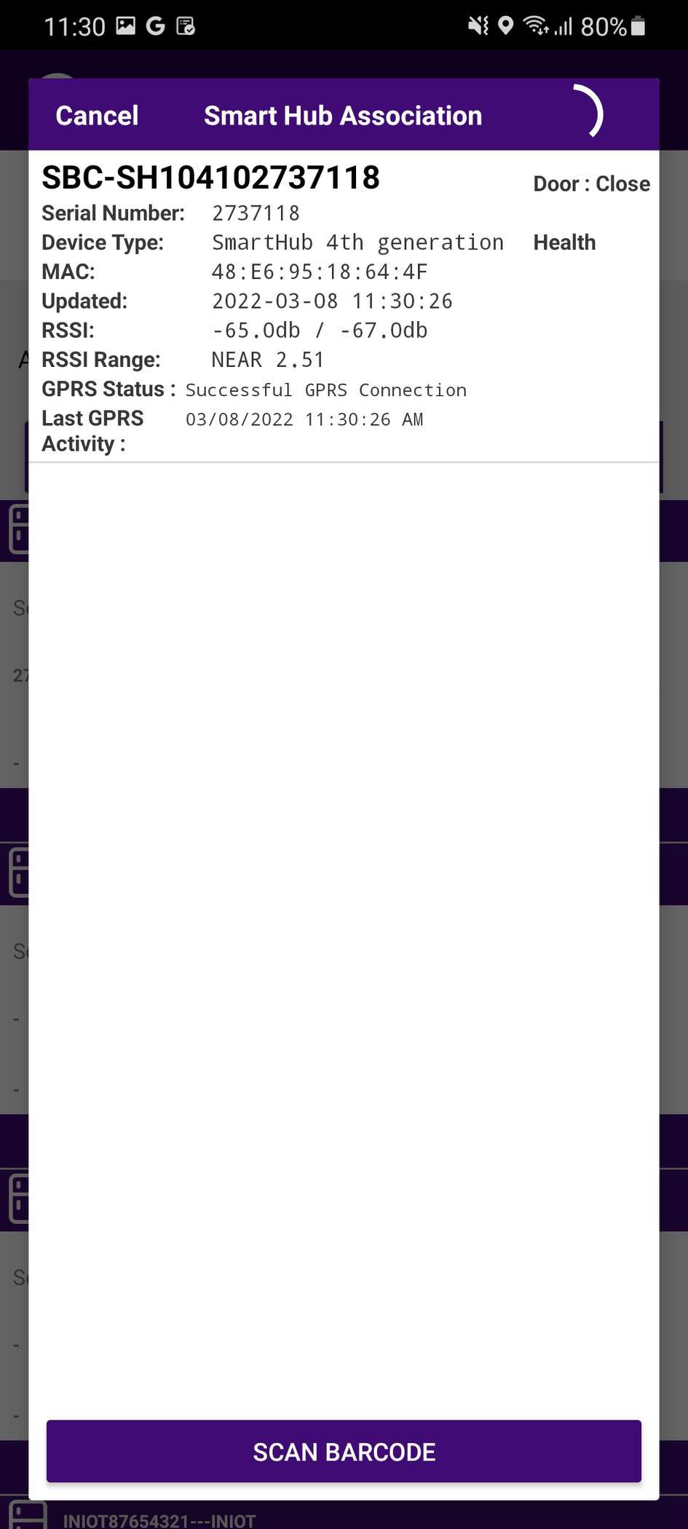
Selecting Gateway Device to do the association with:
User will see a list of unassociated devices; After identifying the device, select the device to start Installation
App will give a popup to confirm the association, Click on Ok to confirm.
Note: Please note the gateway device power on at association time.

Slide 27
Smart Device Configuration Setting:
On selection of the gateway device, the application will connect to the device, make all configuration changes and provide status.
A success message will appear after successful association, press OK to close the popup.
When the process is completed, the User will be returned to the Outlet Screen and will see that the Smart Hub is associated with the Cooler.

Slide 28
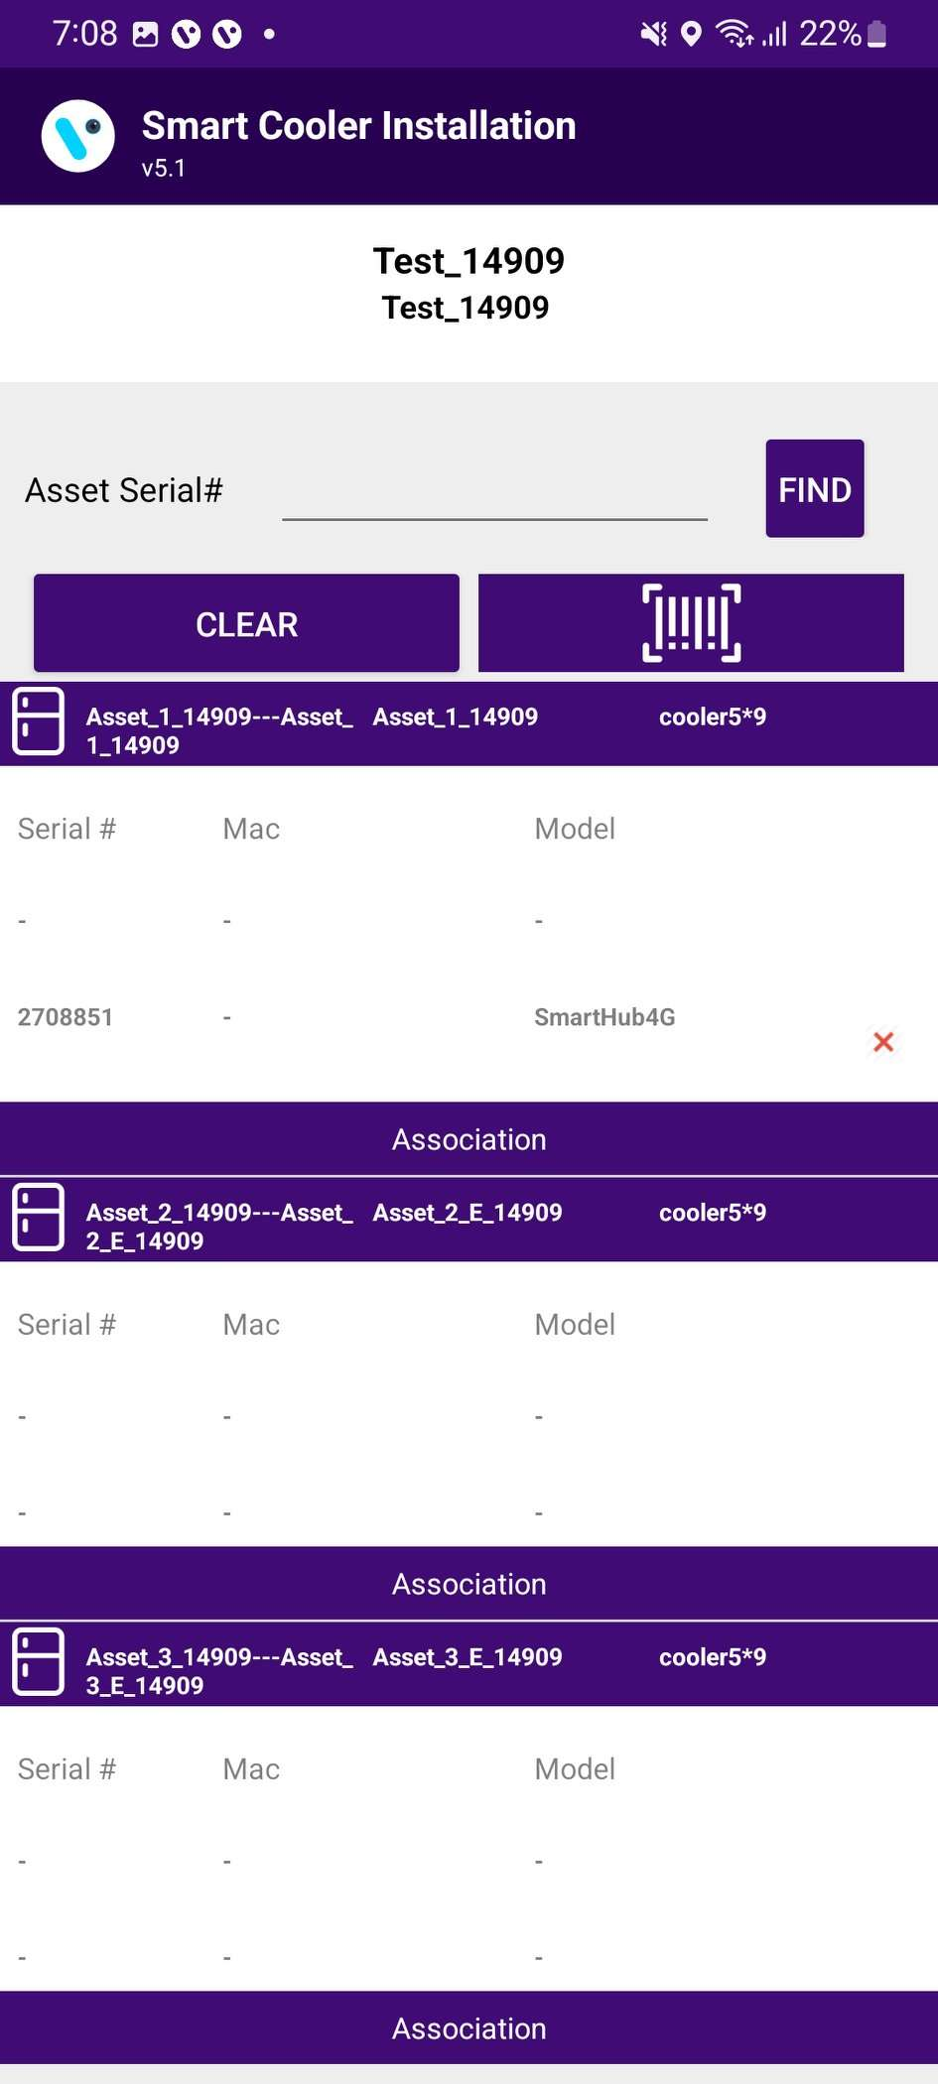
Verify Association:
Now Gateway devices are associated with the Single Cooler as shown in the right-side image.

Slide 29
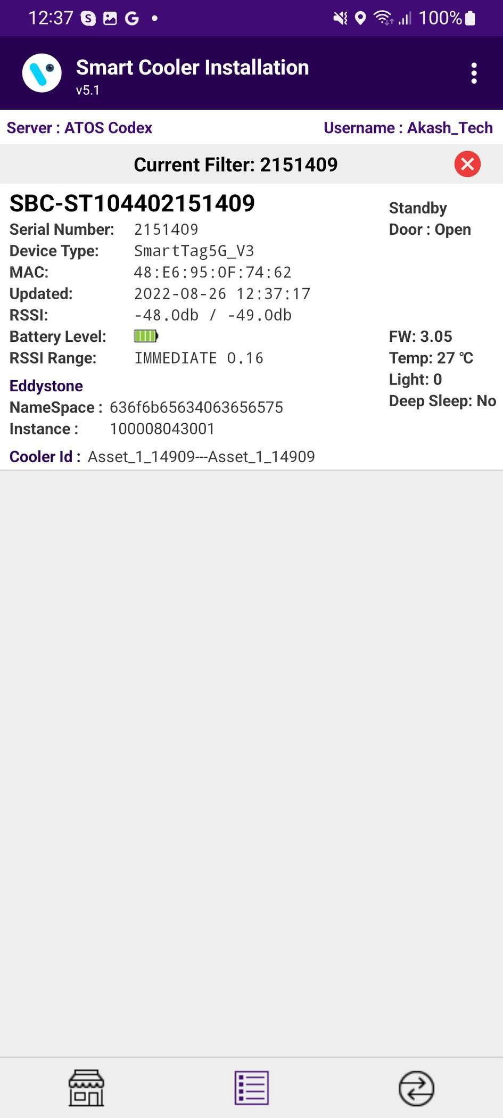
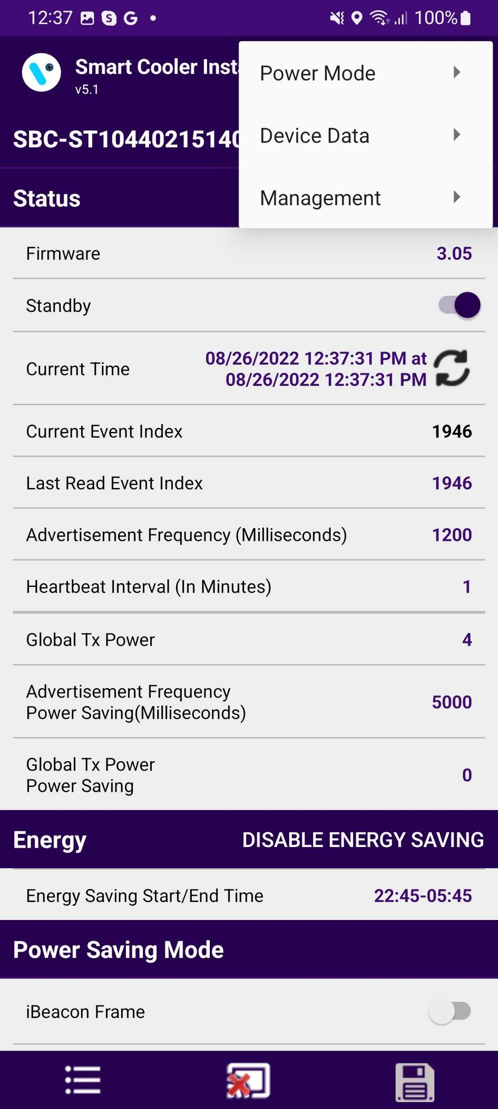
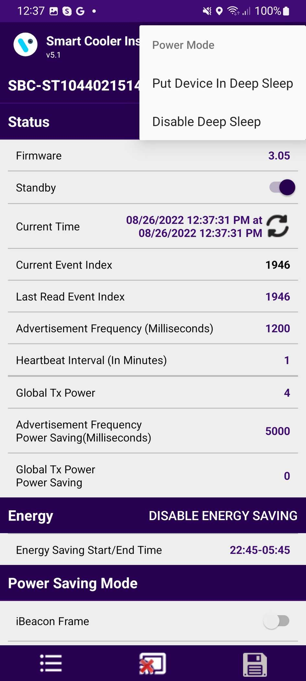

Configuration - Deep Sleep Mode
In Deep-sleep mode, the device neither advertises nor logs any event data. Deep sleep mode is by default enabled when installed in the field the first time.
A. To Disable Deep sleep
To disable deep sleep mode, the user must keep the door magnet close to the device then the device starts advertising for 30 seconds. user must connect within 30 seconds to a smart device, Tap on Smart Device and After the connection, go to Menu > “Power Mode” > “Disable Deep Sleep”.
After disabling deep sleep mode, the device will continuous advertisement forever and logs event data.
If the user doesn't disable deep sleep mode, then after 30 seconds of disconnection, the device will stop advertisement again and the user can’t see the device in scanning.
B. To Enable Deep sleep
After connection, go to Menu > “Power Mode” > “Put Device in Deep Sleep”.
After enabling deep sleep mode, the device will stop advertising and doesn’t log any event.
B
A

Slide 30
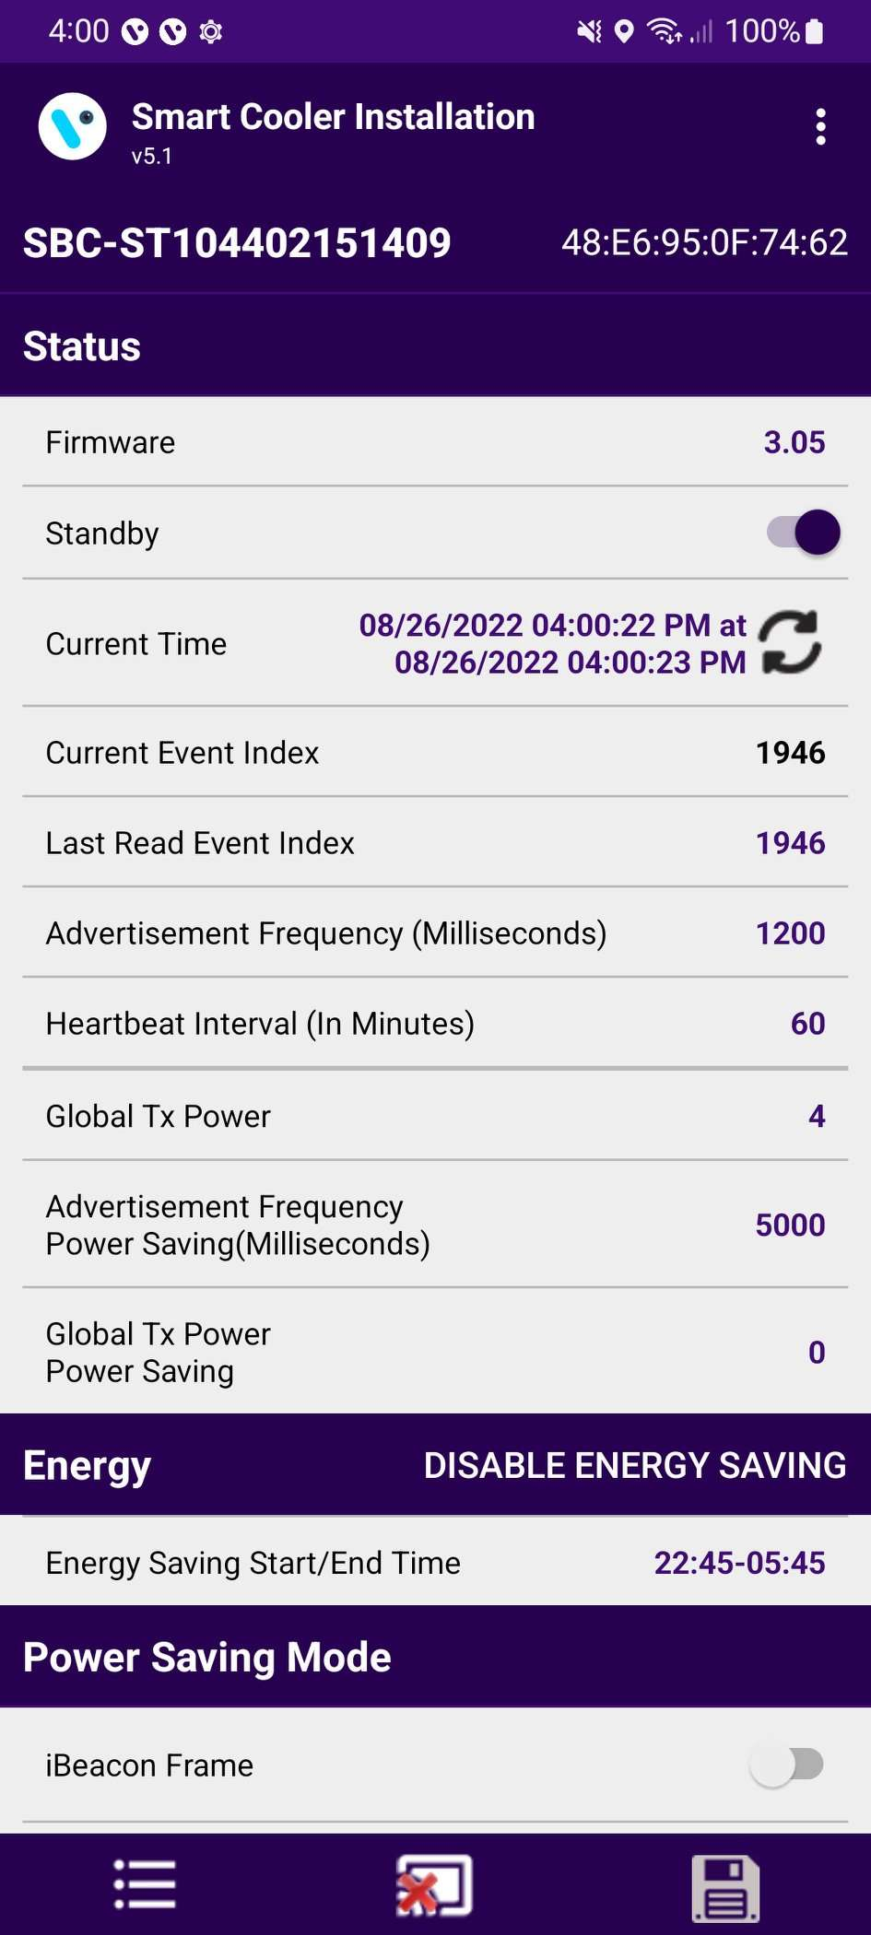
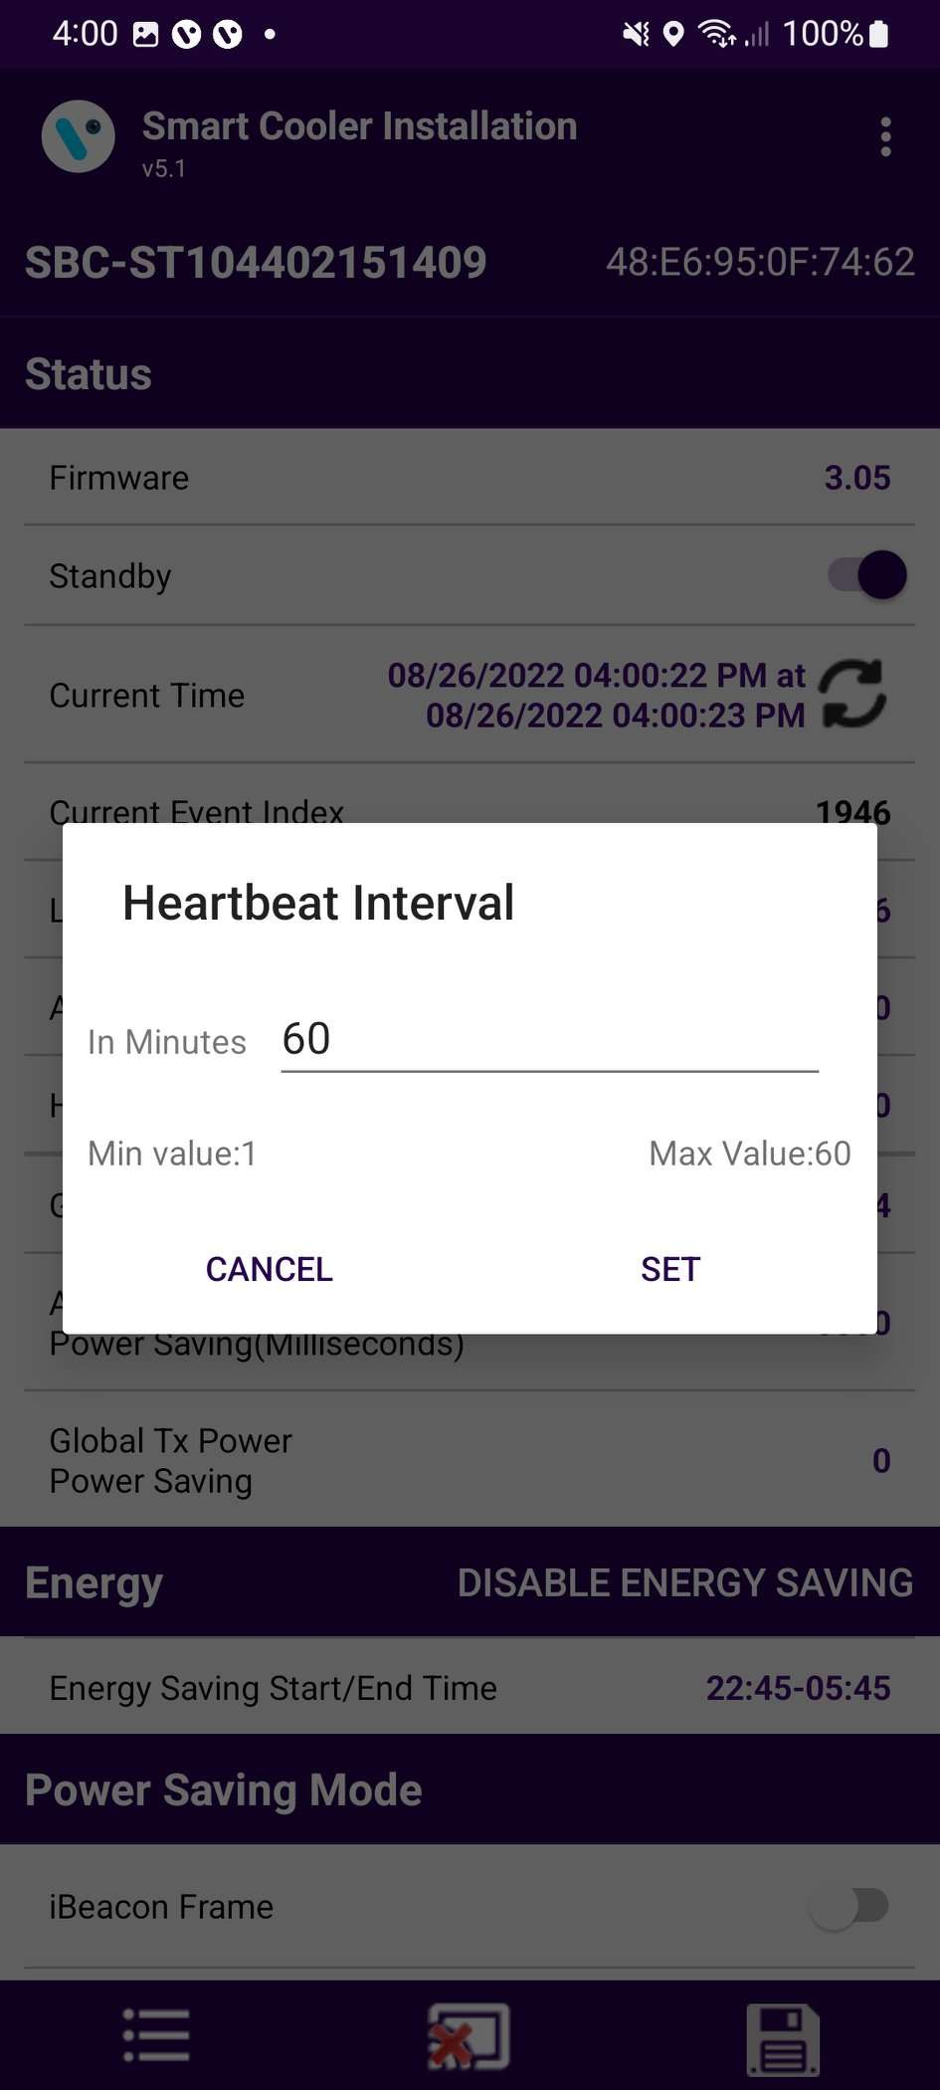
Configuration - Set Health Interval
After connecting with the device, the user can configure the following parameters.
In the STATUS Parameters, Tap on “Heartbeat Interval (In Minutes)”.
A. Enter the Interval Value and press the “Set” button.
B. After changing the values, press the SAVE button at the bottom to save it on the device.
A
B

Slide 31
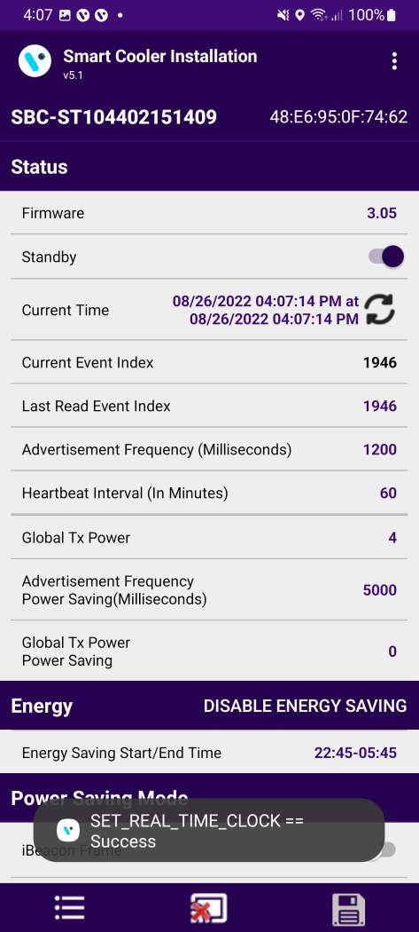
Configuration - Set Current Date Time
After connecting with smart devices, Tap on the Refresh button in STATUS > “Current Time” row to set the current time in the device.
After a Successful set, the clock time Popup message will show.

Slide 32
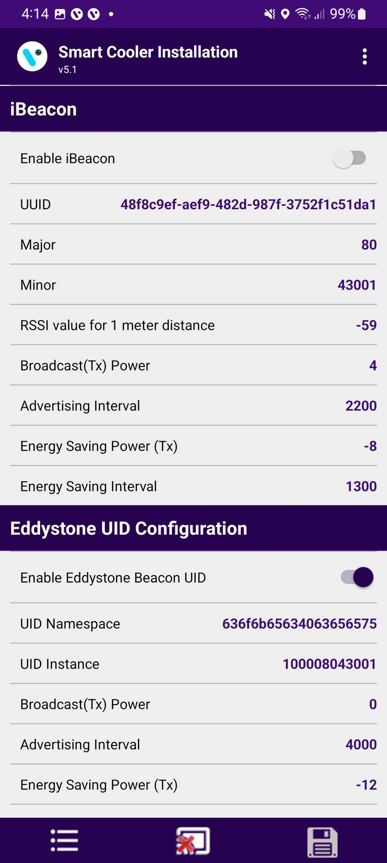
Configuration - Set IBeacon Parameters
Enable/Disable iBeacon Frame
Toggle button to Enable iBeacon row to enable or disable the iBeacon frame in the IBeacon Raw.
After changing the values, press the SAVE button at the bottom to save it on the device.

Slide 33
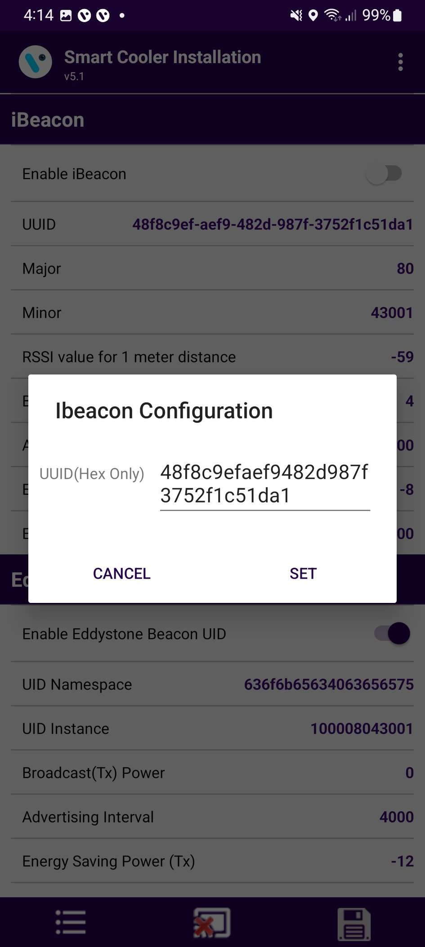
Set UUID
After connection, as shown in the figure, below the iBeacon bar touch on the UUID row.
Enter a 16-byte UUID and press “Set”.
After changing the values, press the SAVE button at the bottom to save it on the device.

Slide 34
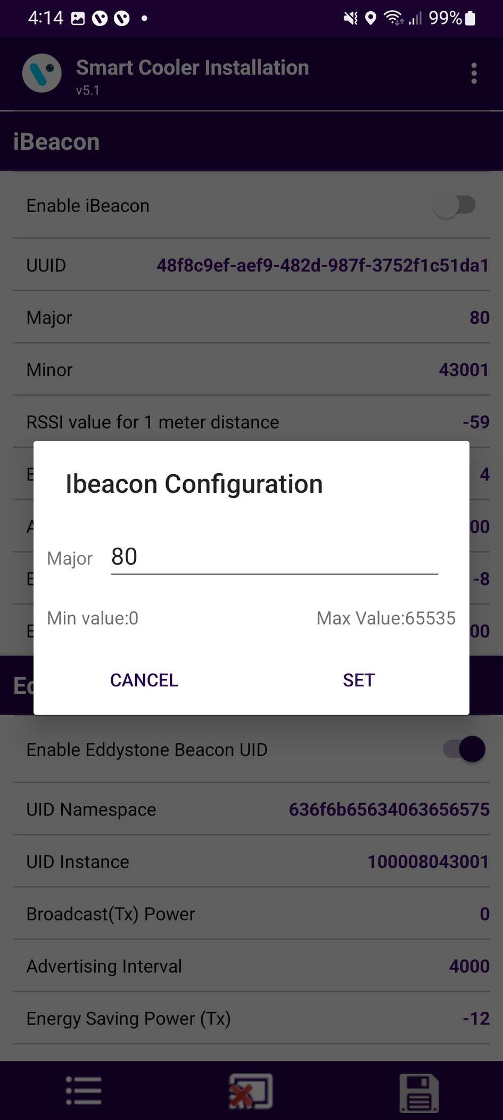
Set Major
After connection, as shown in the figure, below the iBeacon bar, there is a row for Major. Click on any row and write the value as shown below.
Enter the value and press “Set”.
After changing the values, press the SAVE button at the bottom to save it on the device.

Slide 35
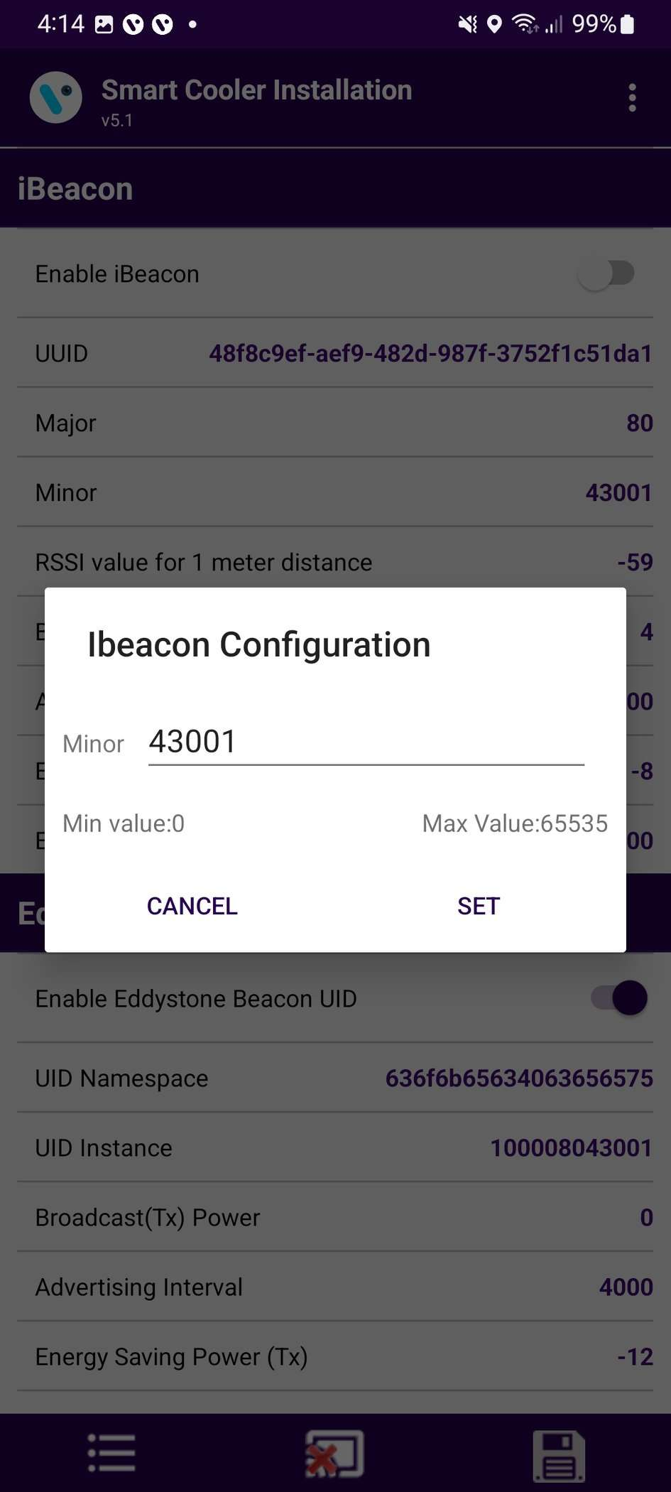
Set Minor
After connection, as shown in the figure, below the iBeacon bar, there is a row for Minor. Click on any row and write the value as shown below.
Enter the value and press “Set”.
After changing the values, press the SAVE button at the bottom to save it on the device.

Slide 36
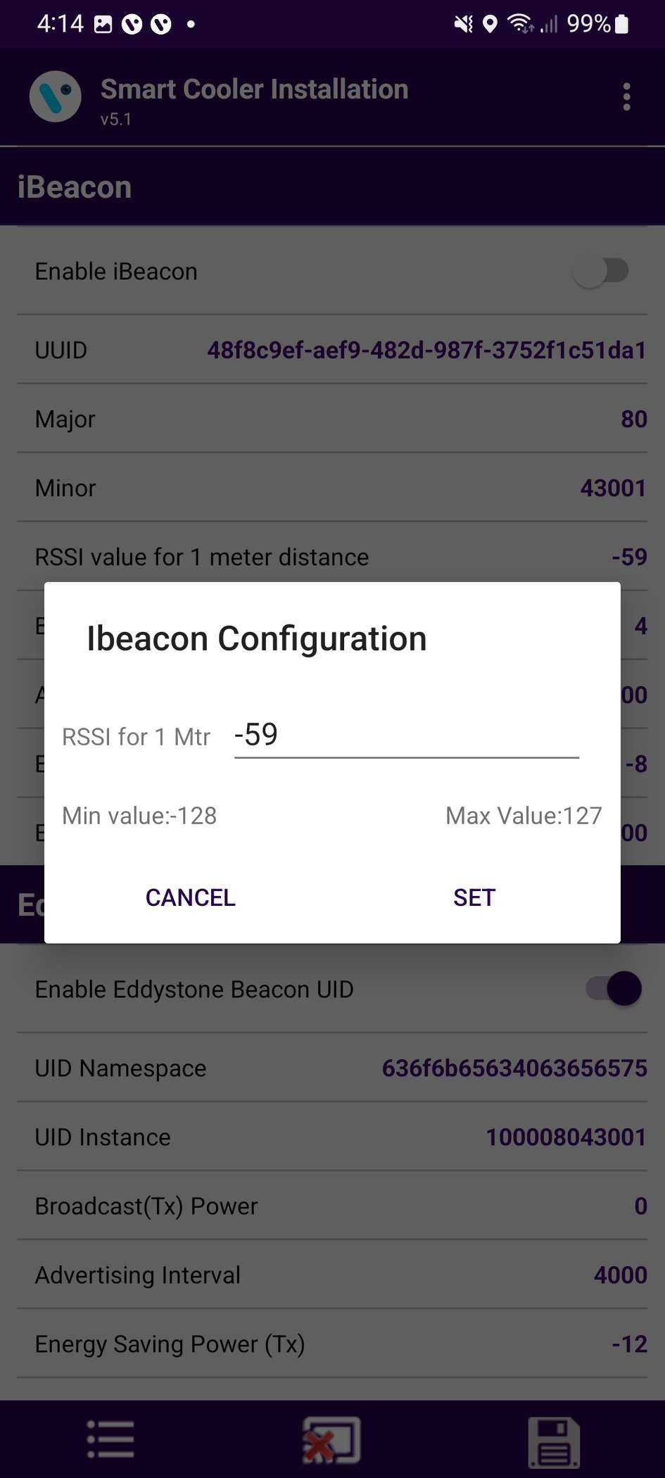
Set RSSI
After connection, as shown in the figure, below the iBeacon bar, there is a row for RSSI. Click on any row and write the value as shown below.
Enter the value and press “Set”.
After changing the values, press the SAVE button at the bottom to save it on the device.

Slide 37
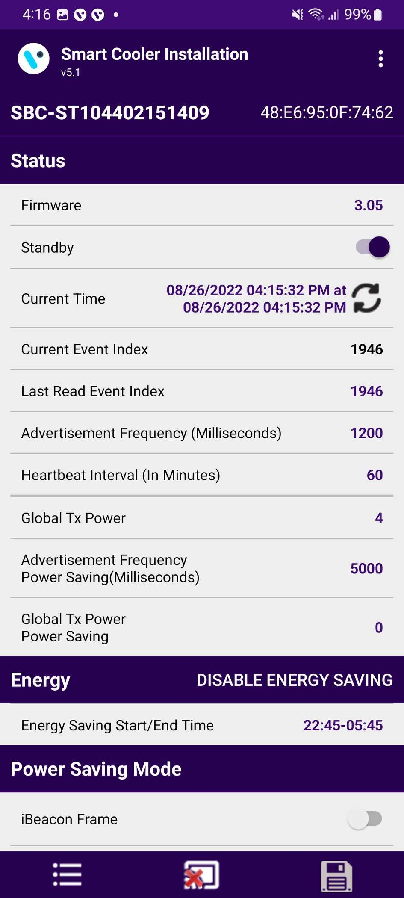
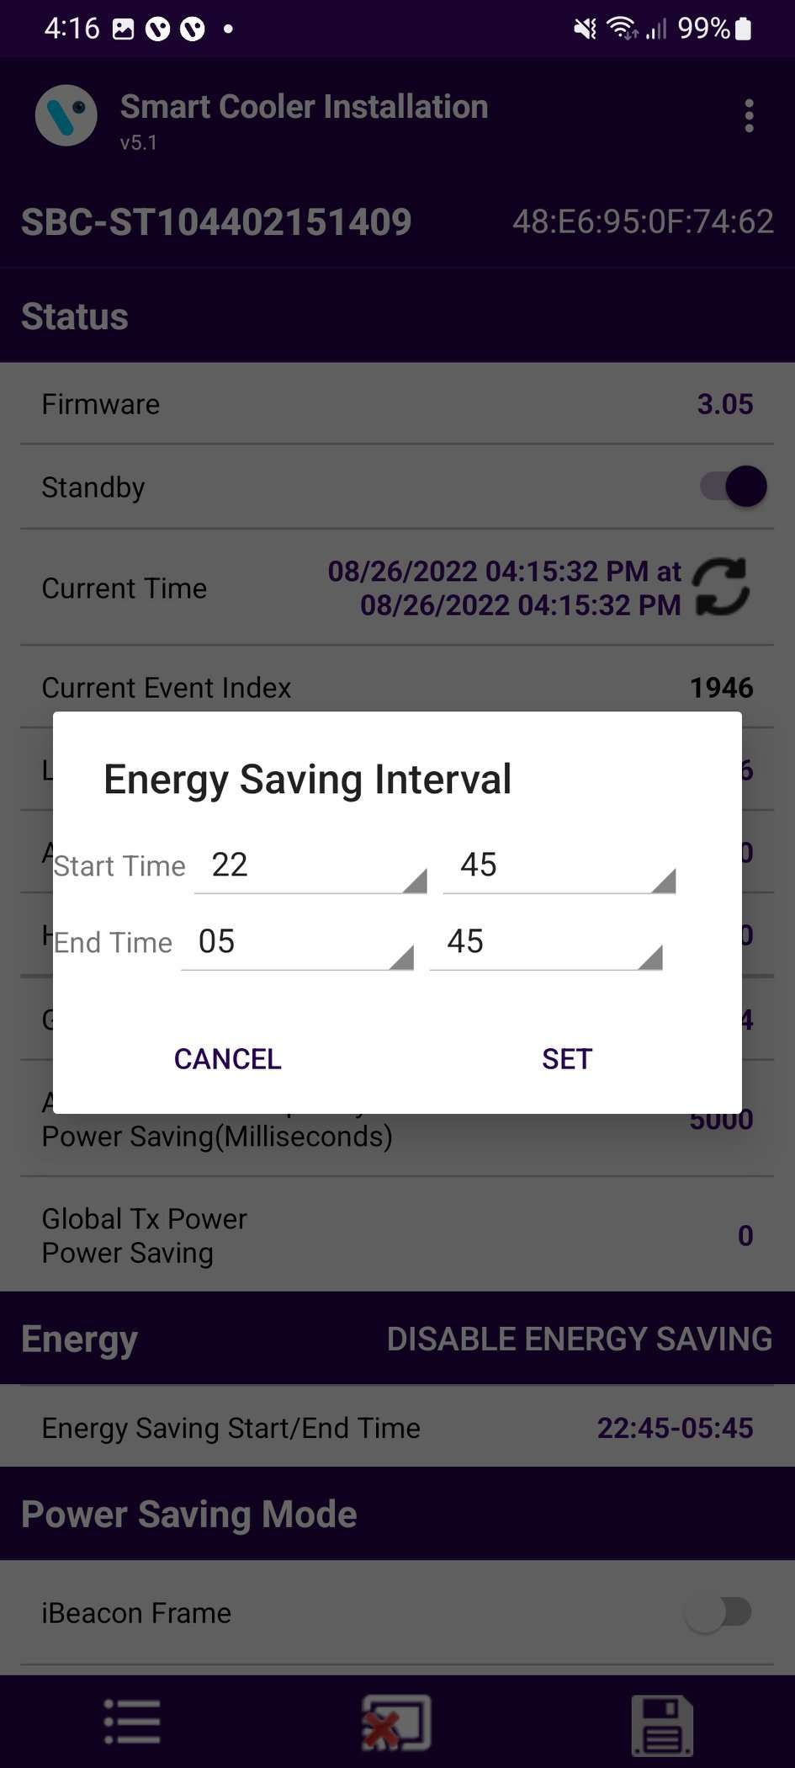
Configuration - Energy Saving Mode
Set Energy saving mode
Users can set the time duration for saving the power by changing the advertisement interval and it transmits power for that user need to touch on the row Energy Saving Start/End time.
After changing the values, press the SAVE button at the bottom to save it on the device.

Slide 38
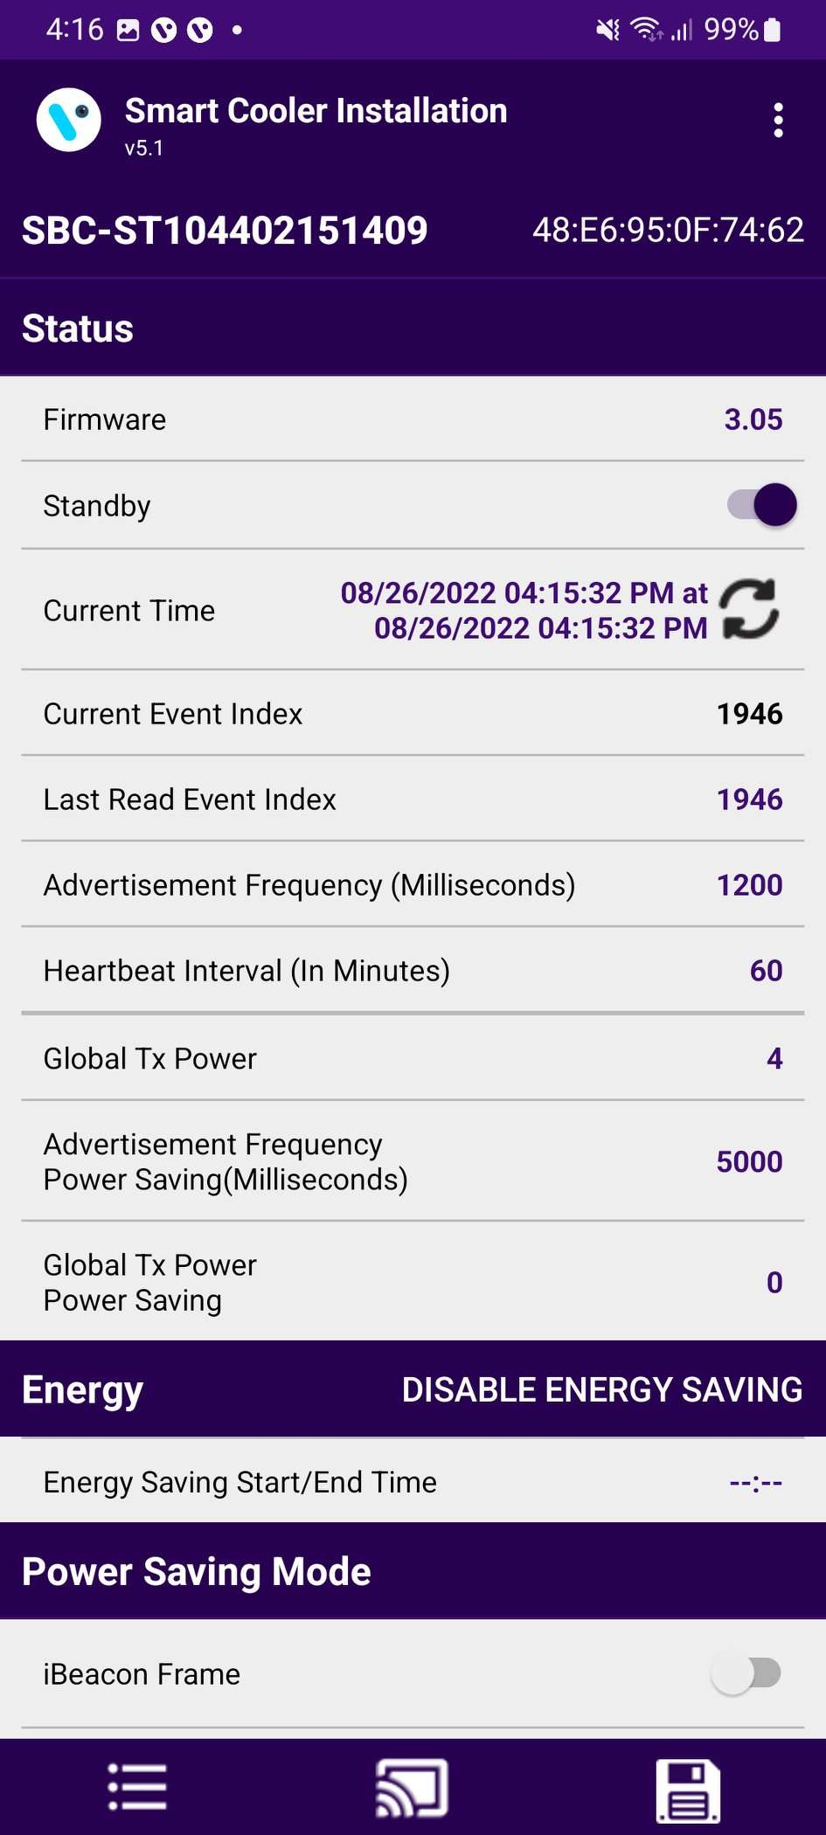
Disable Energy Saving Mode
Users can disable the energy-saving mode by tapping on the “Disable Energy Saving” as shown in the image.
After changing the values, press the SAVE button at the bottom to save it on the device.

Slide 39
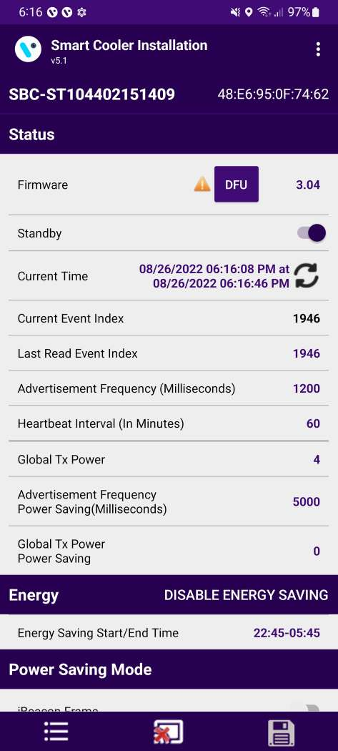
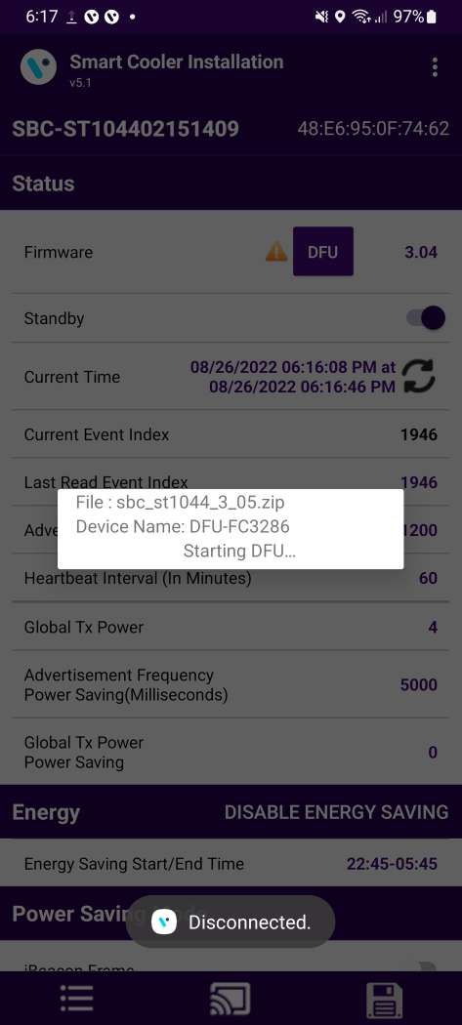
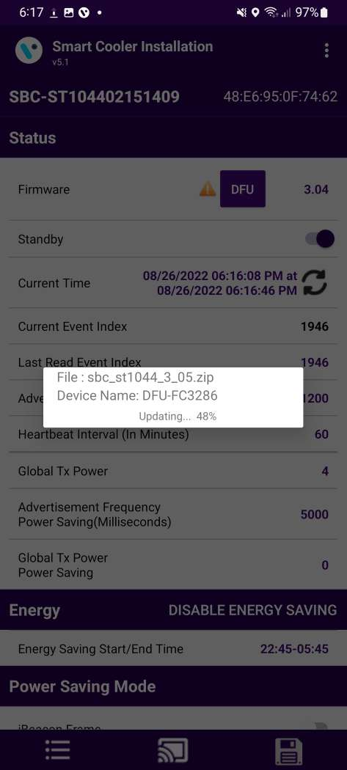

Configuration – DFU(Direct Firmware Update)
DFU - Direct Firmware Update
The DFU of the Smart device can perform by clicking on the Update DFU Button as shown in the image.
After performing the DFU update operation user can see the DFU Upgrade Process.

Slide 40
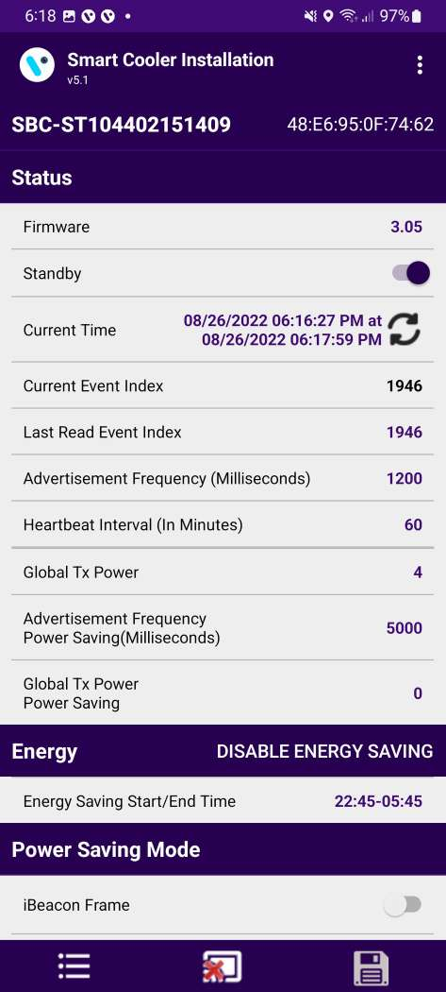
After the successful DFU process is completed, the user can see the Upgraded FW version of the smart device.

Slide 41
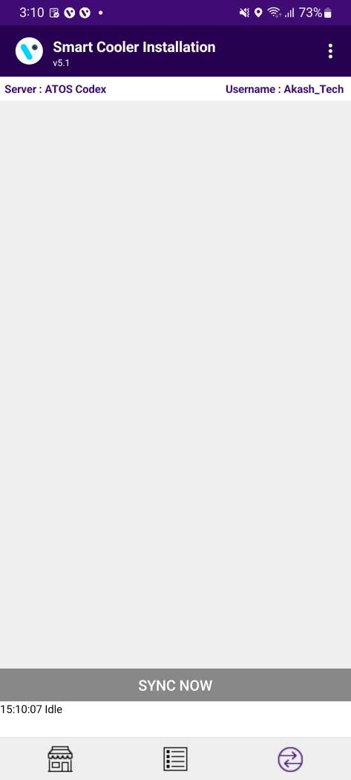
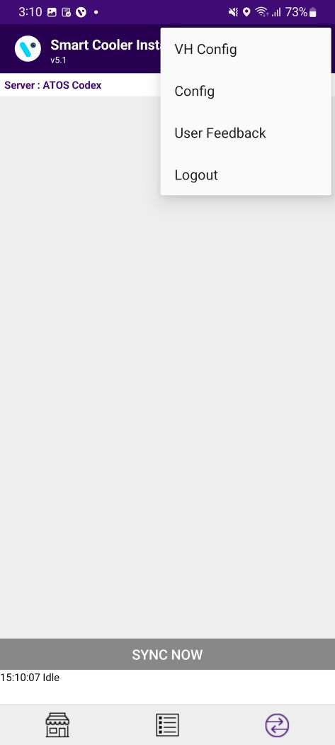
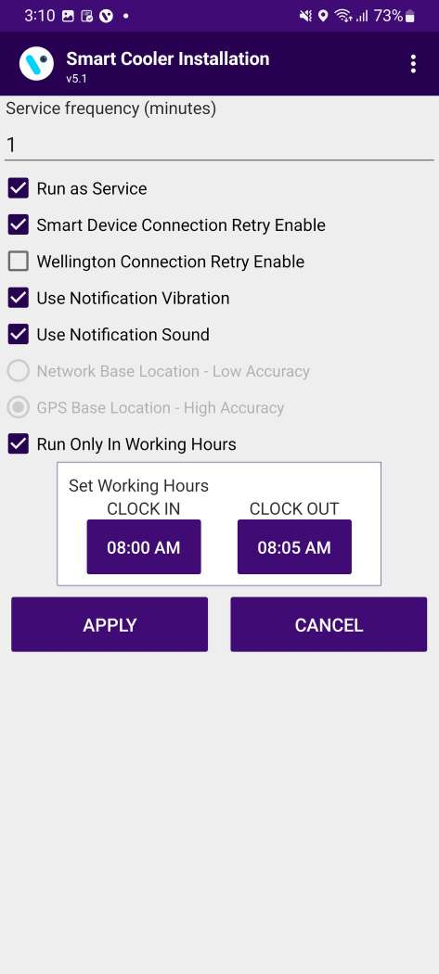
VH Process (Virtual Hub Screen Process)
Select the Hamburger Menu(3 Dots/Options Menu) and then Select VH to access the VH Settings.
Run as Service must be checked to activate the VH.
After Checking any one of the above, select “APPLY” to commit the settings.

Slide 42
Virtual Hub – Settings/Option for VH Services
1
2
Service Frequency: This is the delay between consecutive VH sessions.
Run as Service: Check this option if the VH must run.
Connection Retry Option: If Smart Device or Wellington does not connect in one try then it’s used.
Use GPS Service: Check this option if the GPS service must be used to capture the location of the user.
Working Hours: VH will work during define working hours.
3
4
5

Slide 43
Virtual Hub - Notification Settings
Enable Vibration – If this option is enabled the user gets notified by vibration once the data download is complete.
Enable Notification Sound– If this option is enabled the user gets notified by a sound once the data download is complete.
Notification enables the person collecting the data to identify the data download completion without checking the device manually.
1
2

Slide 44
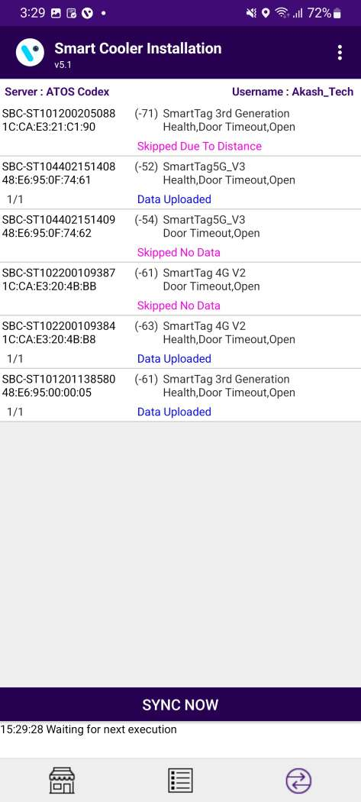
VH Screen – Data Download Access
Application data downloading from Smart Device’s and Upload.
Select here to access the virtual hub screen, all the VH activities can be monitored here on this screen.

Slide 45
VH Screen - Components
This screen displays the devices being connected and the VH data download and upload activities can be monitored here.
When the phone application read all the data from the device it will display as “Data Downloaded And Clock set”. After completing the read data from all the devices, the application will upload data to the cloud. After completion of data upload to the cloud application will give the status "Waiting for next execution".
Sync now can be selected to force a manual sync using the virtual hub

Slide 46
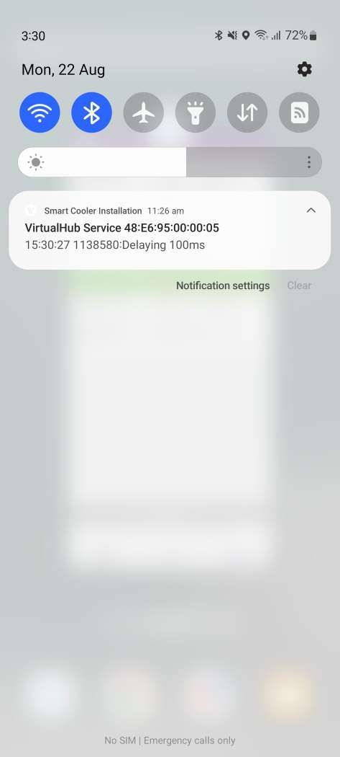
VH Screen - Notification
Pull down the notification to check the Virtual Hub service status when the application runs in the background.

Slide 47
