Slide 1
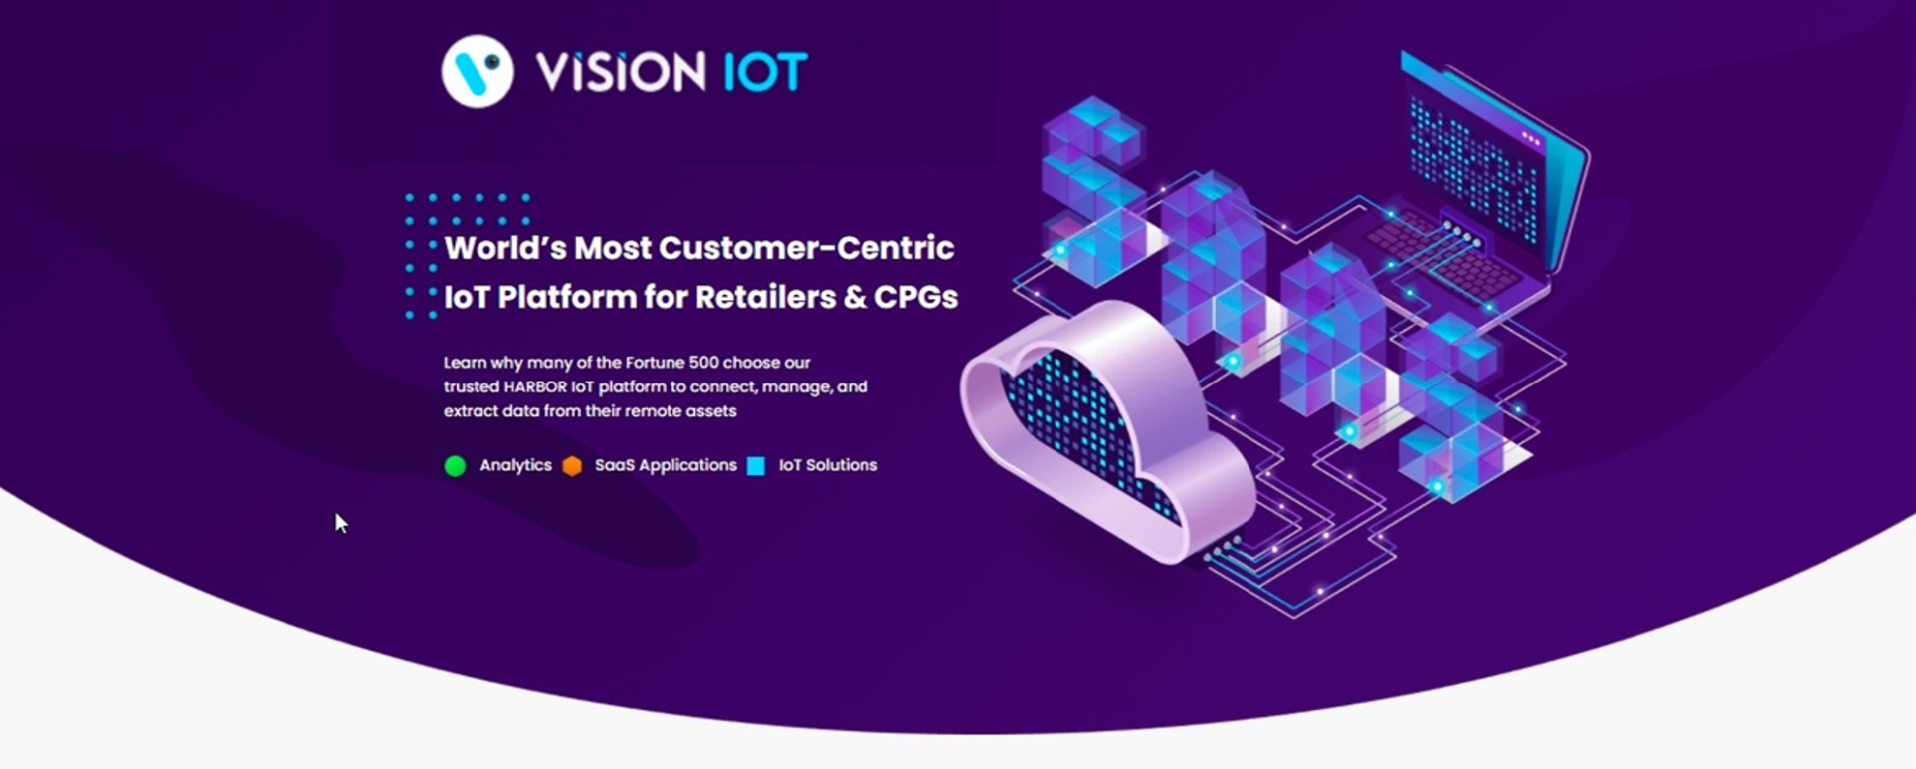
Field Technician
USER MANUAL
| March_2023

Slide 2

Application Features
Connect – Used for the already associated devices to connect.
Controller status – To check the Gateway device’s Last cellular status.
Error Messages – For controller error, msg easily diagnoses the fault and identifies a solution.
Change Controller Settings – For Checking Smart Device Last Communication Status.
Add/Replace Controller – For users to have a new add controller or replace controller for the available asset.
Remove Controller only – For users who have removed the controller.
Upgrade Firmware – This option is enabled if the device has the latest FW available.
Disconnect – When the user has connected to device, they have an option for disconnect device.

Slide 3
Minimum Requirements for the Android Phones
Component | Minimum Required
Bluetooth | BLE 4.2 and above
Camera | At least 5.0 MP with Autofocus and flashlight
Free Storage | 4 GB and more
Operating memory (RAM) | 4 GB and more
Operating system | Android 8.0 and above
Processor (CPU) | A quad-core processor or faster

Slide 4
Minimum Requirements for the iPhones
Component | Minimum Required
Bluetooth | BLE 4.2 and above
Camera | At least 5.0 MP with Autofocus and flashlight
Free Storage | 4 GB and more
Operating memory (RAM) | 4 GB and more
Operating system | iOS version 13 or above

Slide 5
Application Download
Download the below link to the phone application.
Android application link
https://apps.visioniot.net/downloads/Android/Field%20Technician/

Slide 6
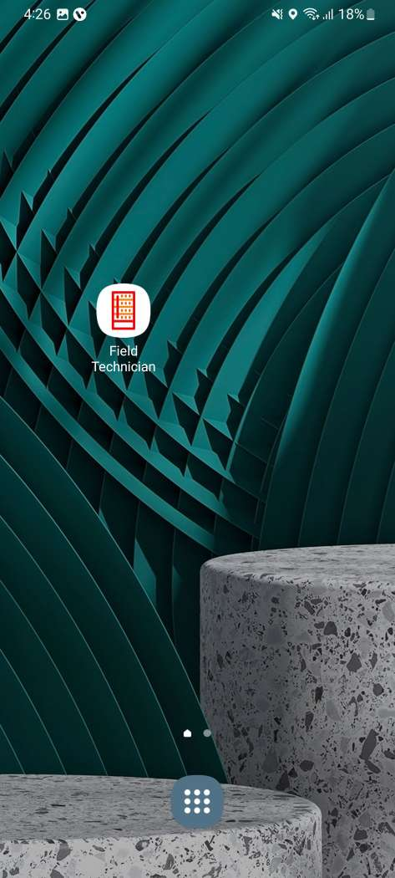
Application Installation
1.Open VISION IOT’s “Field Technician” Application.
2. Log in to the application using the credentials provided by your administrator – after successful login, the user will be directed to the selection screen.
Suggested Note
Before installation of every new version delete the previous one.
Note
Please ensure Bluetooth & Mobile Wi-Fi or Mobile Data must be ON the device.
The Android Field Technician application is compatible only with Smartphones having OS v8.0 and above.

Slide 7
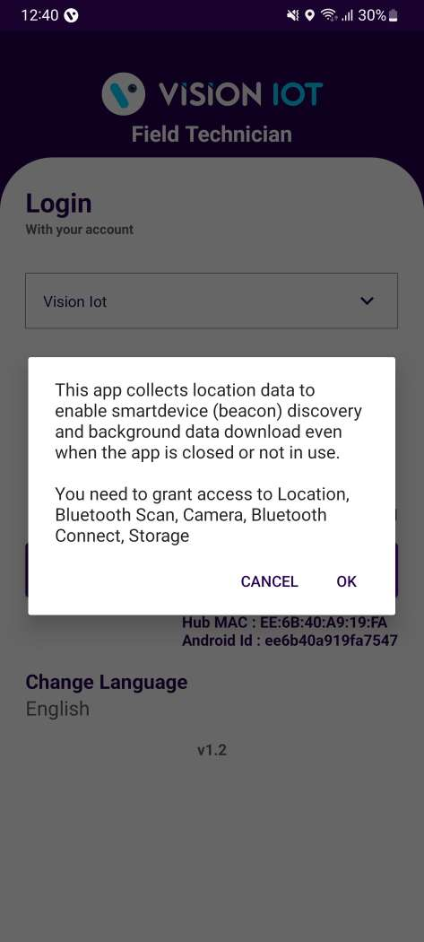
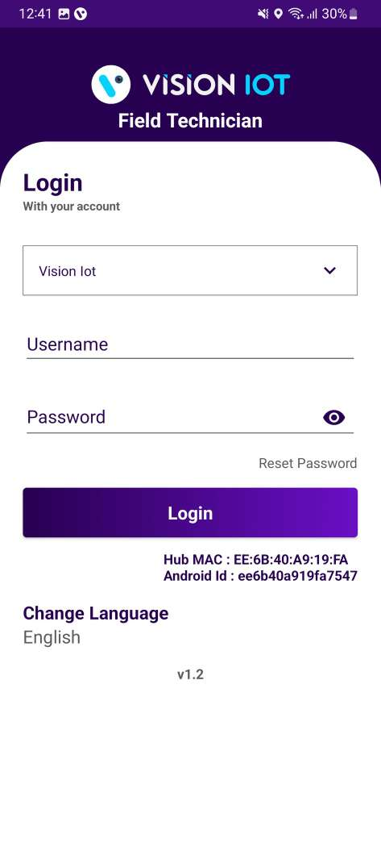
Application Permission
After Installation & launch, the Application will ask for permission to access.
Server: For TCCC client used only Visioniot server.
Camera Permission, File and Media Permission, Location Permission(always allow), Nearby Device Permission Need to Allow.
Image 1
Image 2

Slide 8
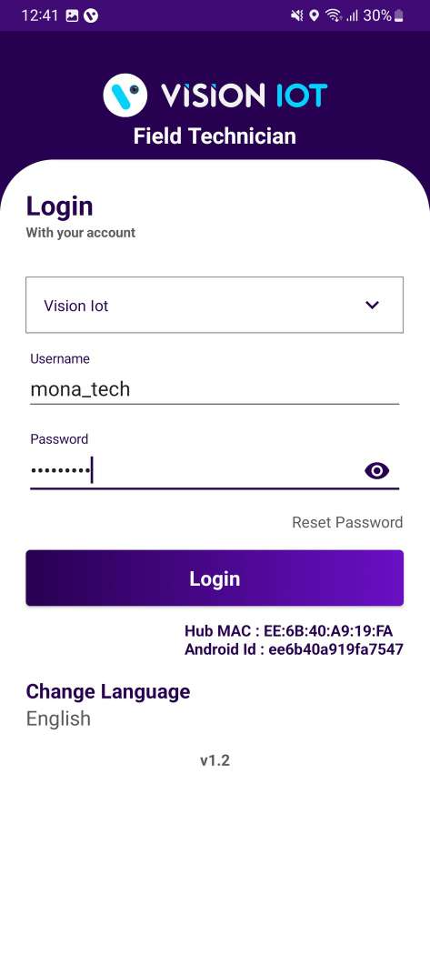
Login
After successfully installation the Field Technician Application, Open the Application and the application will redirect to Login Page. Select the server Visioniot and log in with valid Credentials.
Bluetooth and location services should be enabled.
The application requires an internet on.
Image 3

Slide 9

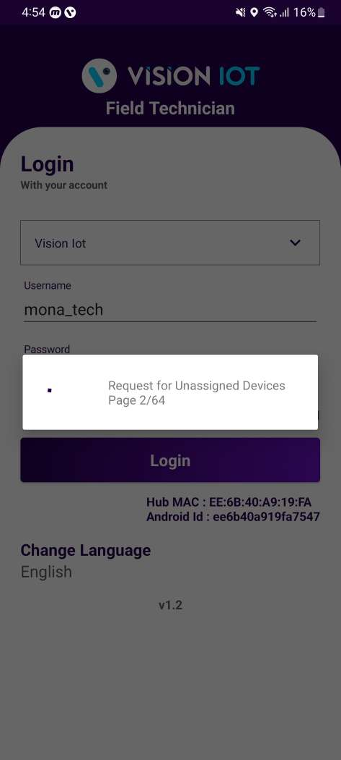
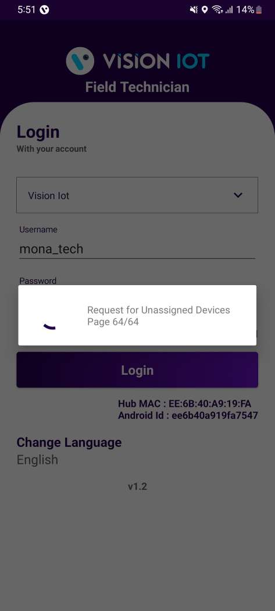
Enter valid credentials and tap on the Login button. The application will download necessary data from the cloud, once download the data, application will redirect in home page.
Image 4
Image 5
Image 6

Slide 10
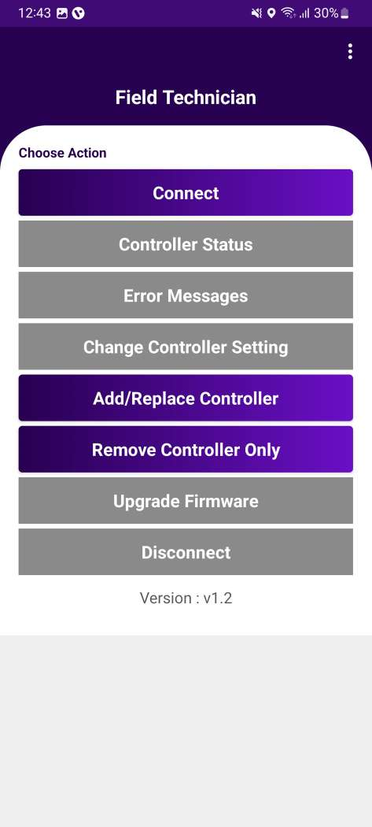
Field Technician – Choose Action
After successful login, the following screen will appear. Please choose an ACTION from the list as per the required operation.
Connect – Used for the already associated devices to connect.
Controller status – To check the Gateway device’s Last cellular status.
Error Messages – For controller error, msg easily diagnoses the fault and identifies a solution.
Change Controller Settings – For Checking Smart Device Last Communication Status.
Add/Replace Controller – For users to have a new add controller or replace controller for the available asset.
Remove Controller only – For users who have removed the controller.
Upgrade Firmware – This option is enabled if the device has the latest FW available.
Disconnect – When the user has connected to device, they have an option for disconnect device.
Image 7

Slide 11
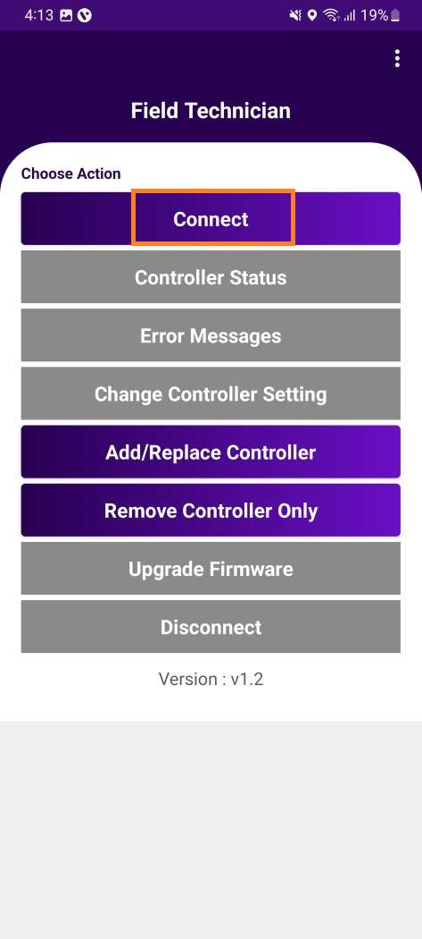
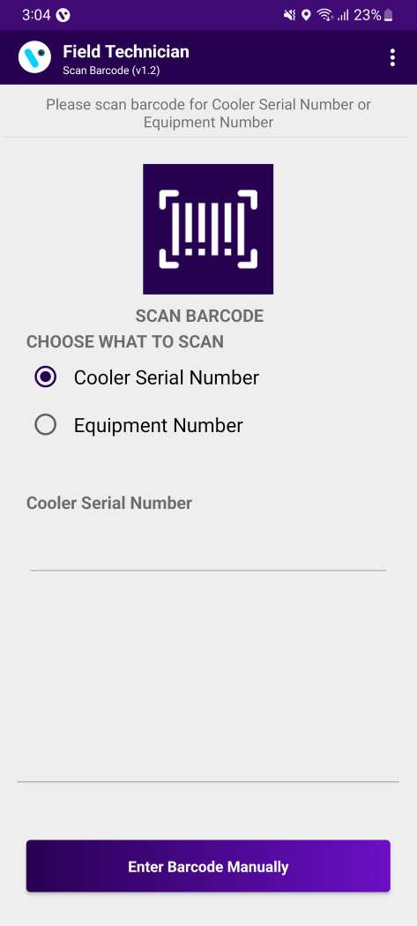
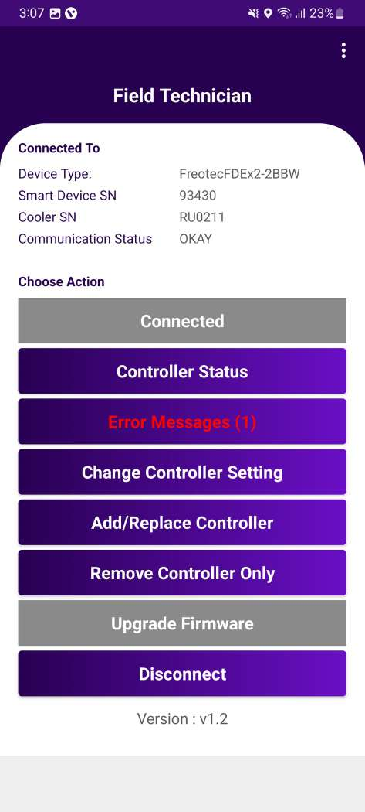
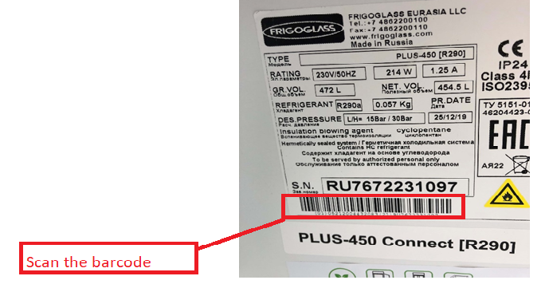
Connect- ASSOCIATE SMART DEVICE TRY TO CONNECT
Image 8
Image 9
Image 10
After successful login selects Connect to the Device is for as to initiate a connection with the controller.
Please enter manually or scan the barcode for the cooler serial number. (see the image 9).
After that device connected successfully. (see the image 10)
Note: This application supported only FDEX2.

Slide 12
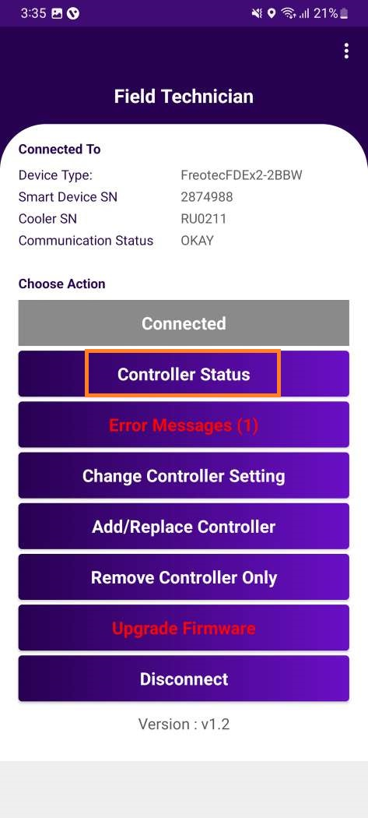
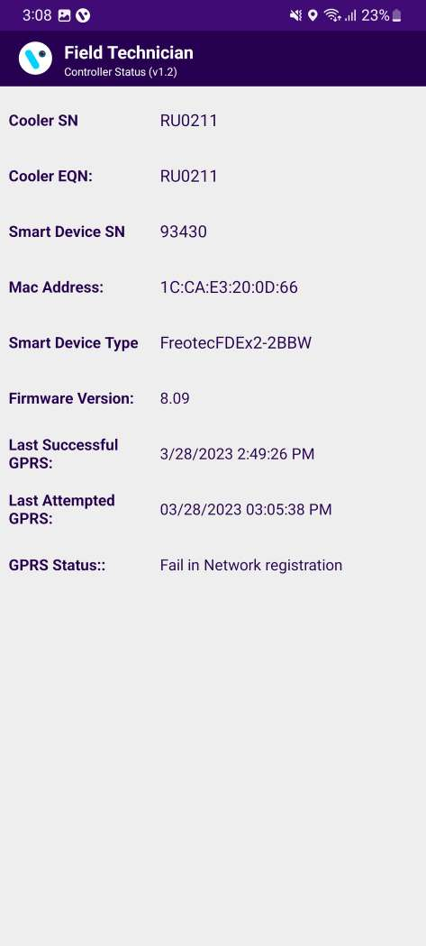
CONTROLLER STATUS
The date and time the controller last communicated with the portal should be displayed (It should be a ping data transaction to confirm the connection is successful with the portal).
Image 11
Image 12

Slide 13
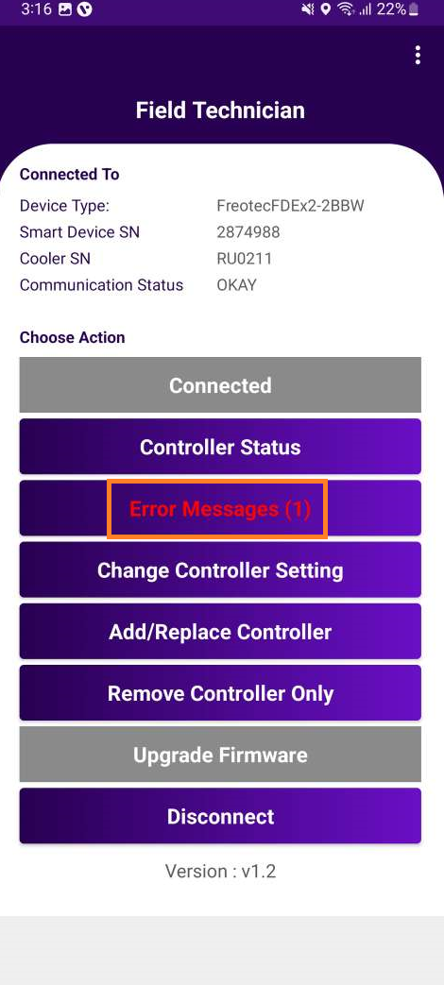
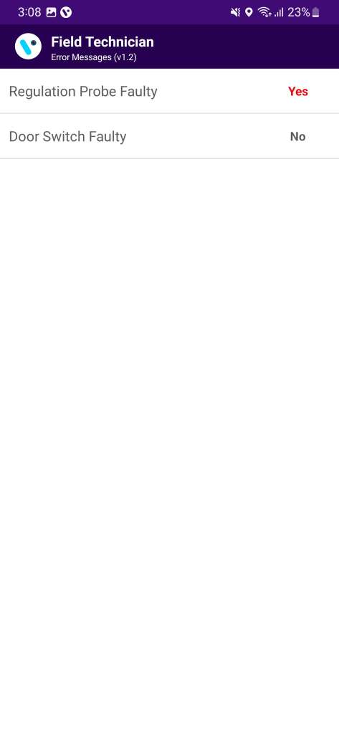
ERROR MESSAGE
Any error messages coming from the controller, user can easily diagnose the fault and identify a solution.
If any error is there in the controller then Application shows status as “Yes” else Application shows status as “No”.
Image 13
Image 14

Slide 14
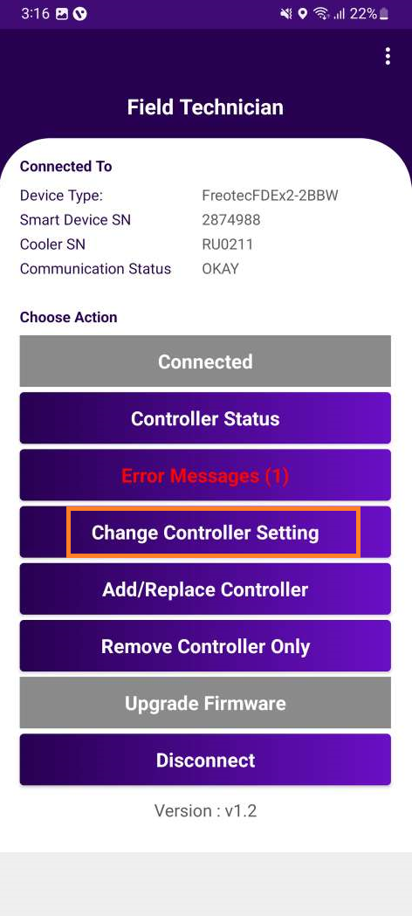
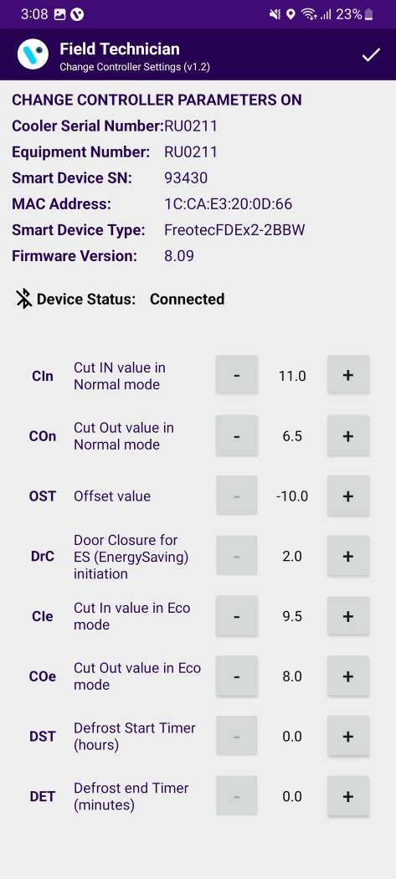
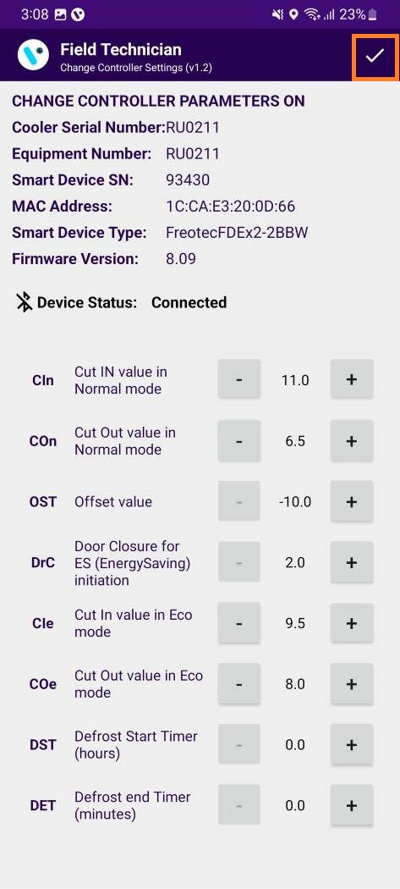
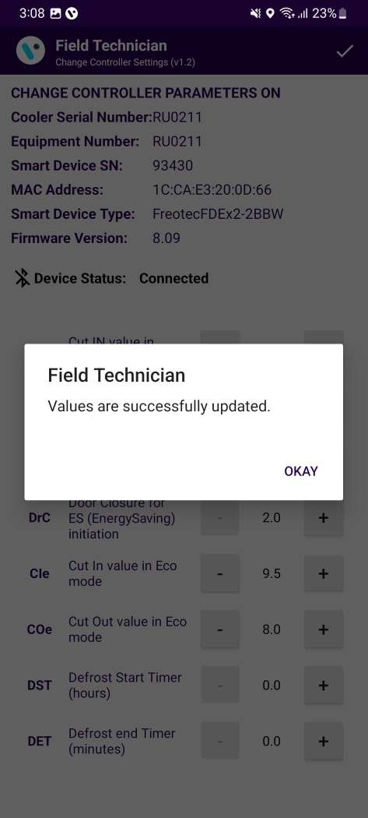
CHANGE CONTROLLER SETTING
User can change all available settings for FFA / FDE controllers according to requirement (Image 12) . After changing setting , user should click on “Right button” shows in (Image 17).
Image 15
Image 16
Image 17
Image 18

Slide 15
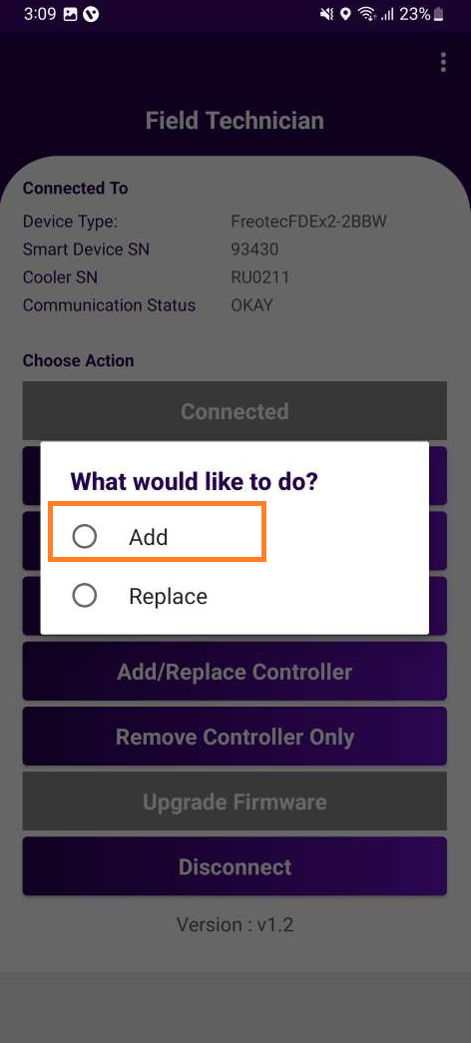
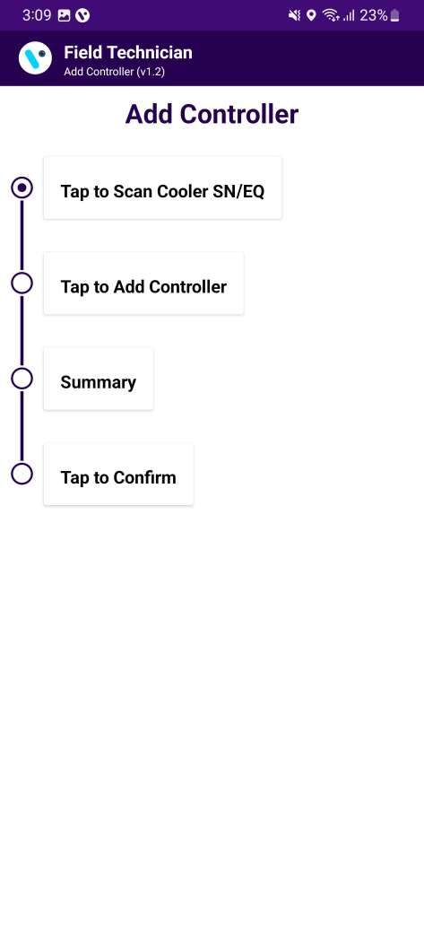
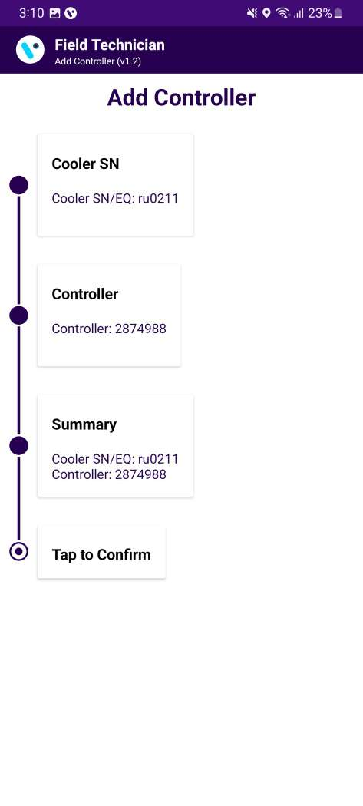
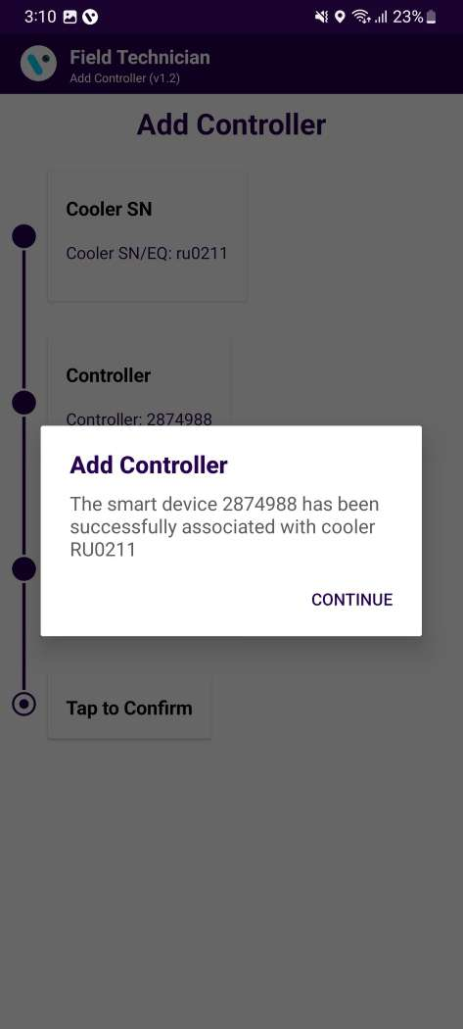
ADD CONTROLLER
Image 19
Image 20
Image 21
Image 22
User click on “Add/Replace Controller” next one pop-up shows “ Add or Replace” (image 23), After that When the user click on Add button. Click on “Tap to scan cooler” scan or entered manually. After that Tap on Add Controller – which will add Controller. Check all detail for add the controller seen as “Summary”. Last screen user has seen the pop-up message “controller added successfully” (seen image 22).

Slide 16
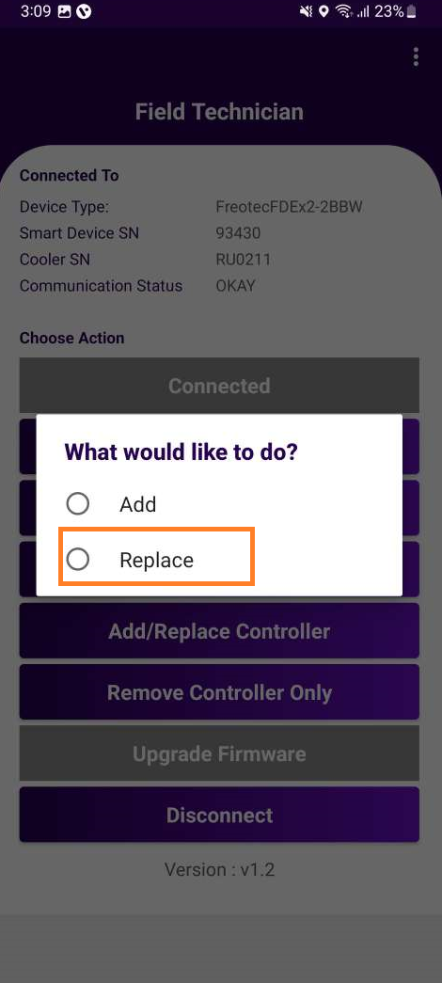
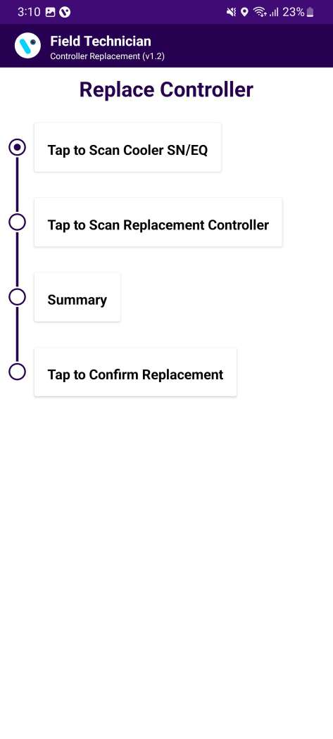
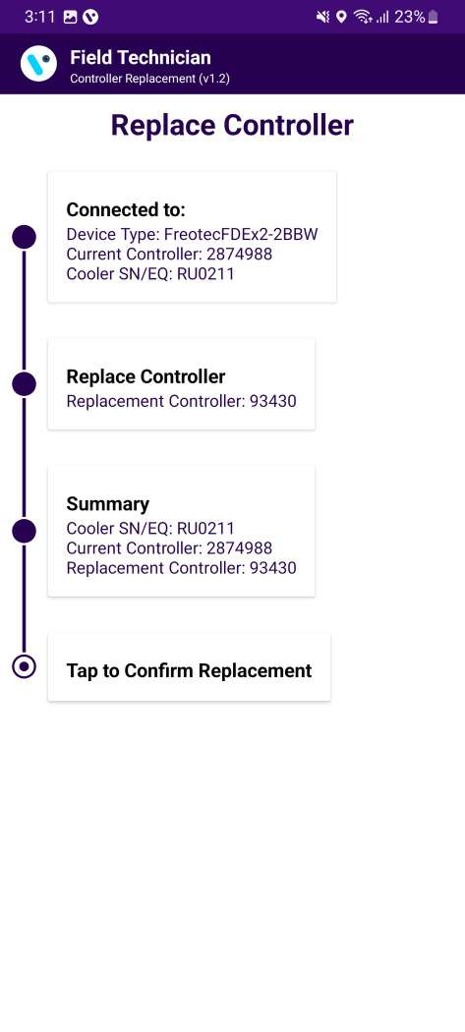
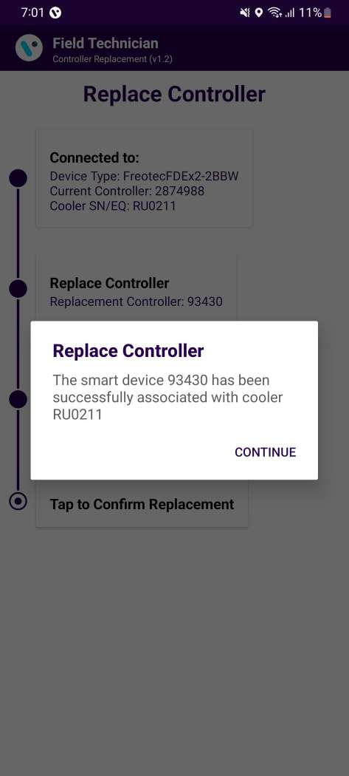
REPLACE CONTROLLER
Image 23
Image 24
Image 25
Image 26
User click on “Add/Replace Controller” next one pop-up shows “ Add or Replace” (image 27), After that When the user click on Replace button. Click on “Tap to scan cooler” scan or entered manually. After that Tap on Replace Controller – which will replace Controller. Check all detail for replace the controller seen as “Summary”. Last screen user has seen the pop-up message “controller replacement success” (seen image 26).

Slide 17
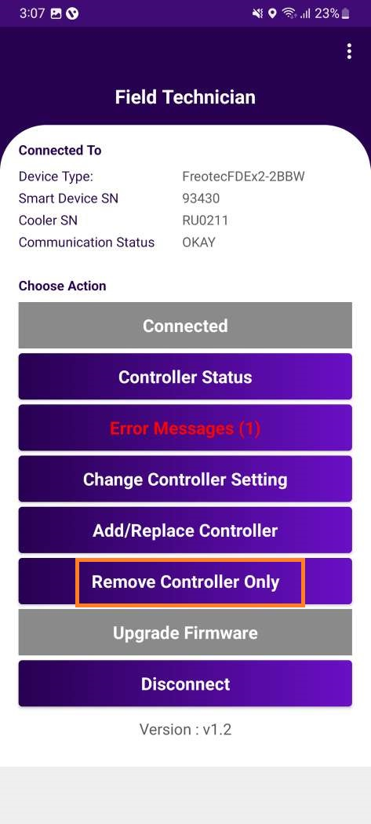

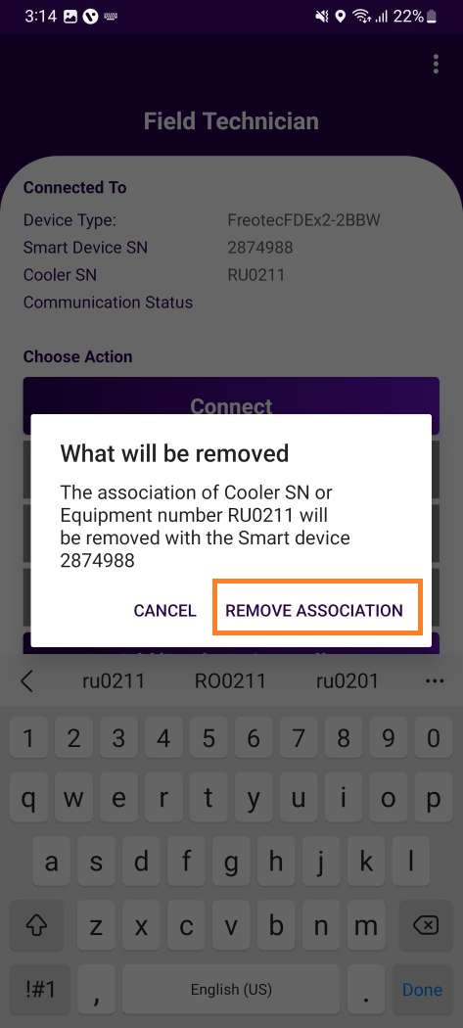
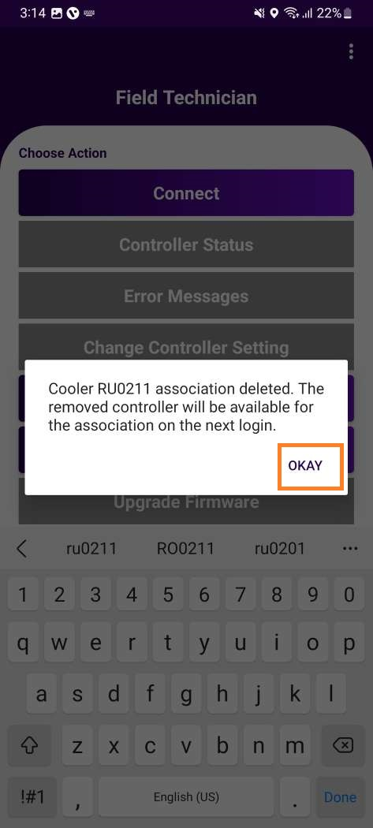
REMOVE CONTROLLER ONLY
Image 27
Image 28
Image 29
Image 30
After successfully connected the device, click on the “Remove controller only” button.
The first step should be to scan the cooler serial number or enter manually cooler serial number to establish the details of the current controller (looked up from the Vision IOT platform based on the cooler that is scanned).
Click on “Remove association” button.(seen image 29)
Association was removed, and confirmation Pop-up generated “cooler-association deleted”.(seen image 30)

Slide 18
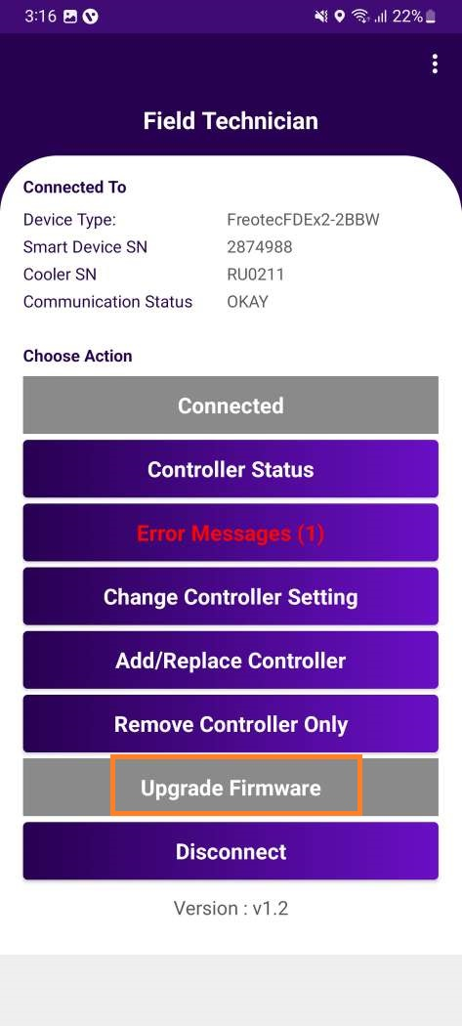
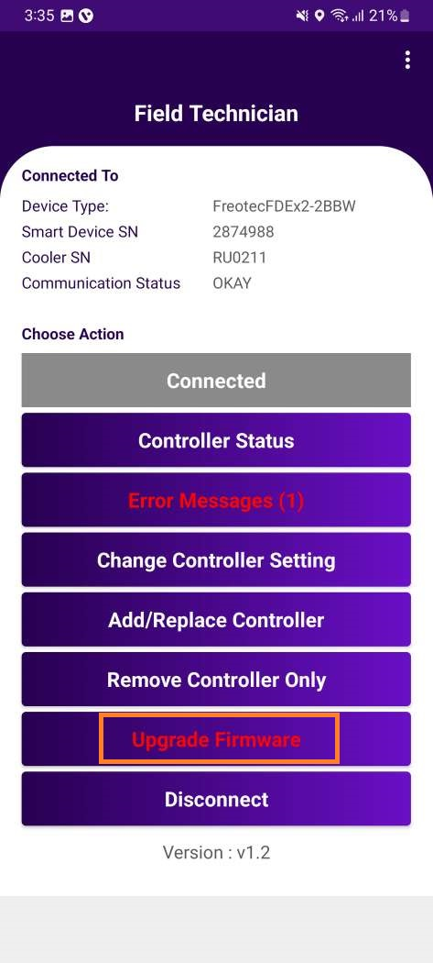
UPGRADE FIRMWARE
Image 31
Image 32
If the firmware is already up to date, the button is Disable, and click the button one pop-up generated is “The firmware is already up to date”.
If new firmware is available, the button should be highlighted in “red” and say “Upgrade Firmware”

Slide 19
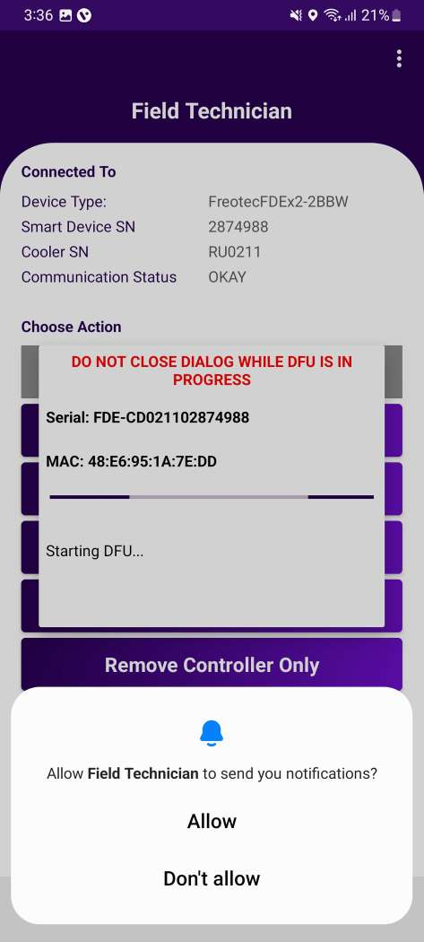
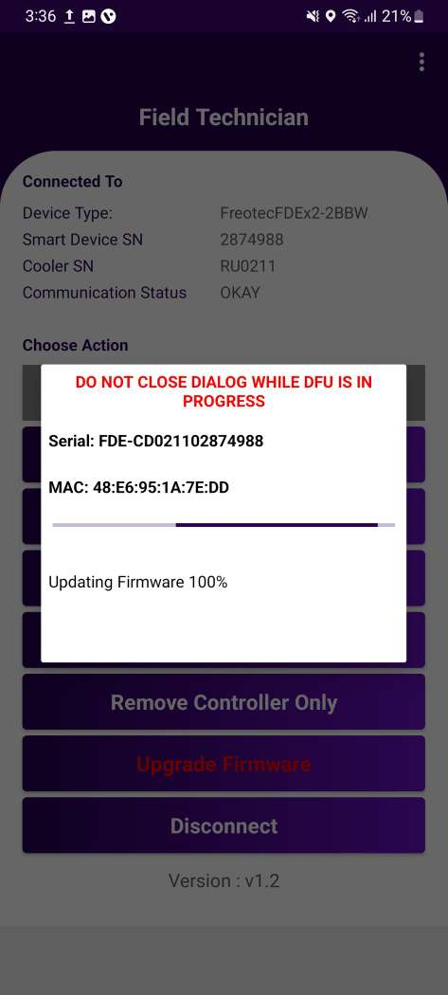
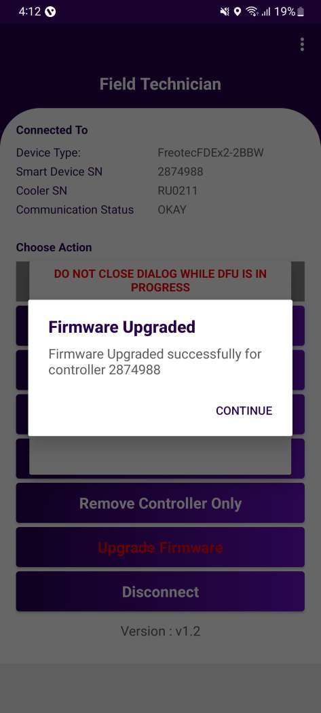
UPGRADE FIRMWARE
When user click on “upgrade firmware” button, the latest firmware from the eBest platform should be update to the cooler.
When FW upgrade in progress pop-generated “Updating Firmware”(image 34).
When the firmware upgrade completed successfully, the button of “Update Firmware” should be disable and says, “Firmware Up to Date”.
Image 33
Image 34
Image 35

Slide 20
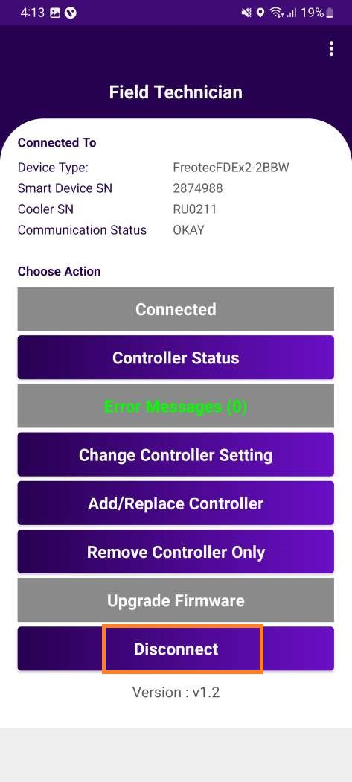
DISCONNECT
When user pressed the disconnect button, it should disconnect the controller/device from the application. (image 36)
Application returned to the home page with the default active buttons.(image 37)
Image 36
Image 37

Slide 21
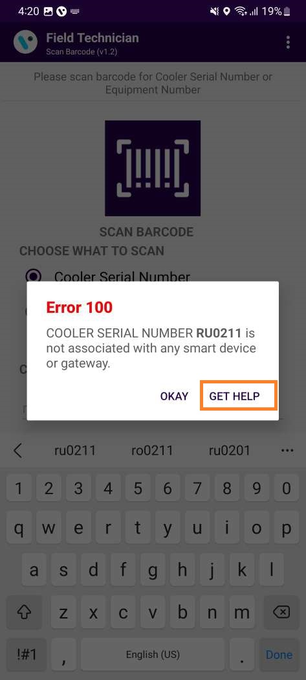
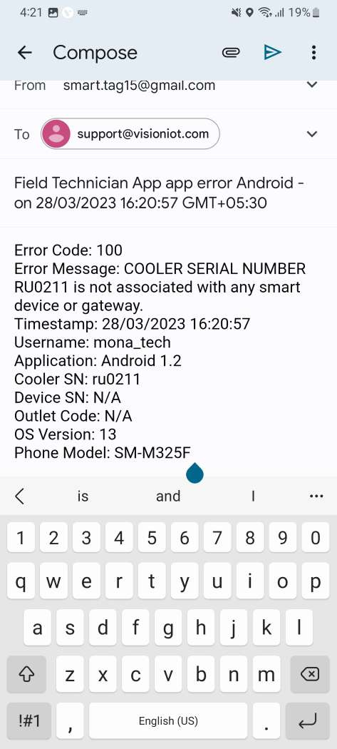
GET HELP FUNCTIONALITY
If user gets any error in the application, click on the “Get Help” button.
When user click on “Get help” in application, it will redirect the user to the default email application on the mobile device and generate one email.
If the mail application didn’t log in, then one pop-up generated is “No mail application is available”.
Image 38
Image 39

Slide 22
MESSAGES
Detailed Message | Short Message | User Story
Cooler SN or Equipment Number <Cooler SN> is associated with Gateway <GW SN> | Error 101 | If Cooler is available in the portal and not associated with any smart device but associated with any gateway.
Cooler SN or Equipment Number <Cooler SN> is associated with Smart Device <SD SN> | Error 102 | If Cooler is available in the portal and not associated with any gateway but associated with any smart device.
Cooler SN or Equipment Number <Cooler SN> is associated with Gateway <GW SN> and Smart Device <SD SN> | Error 103 | If Cooler is available in the portal but associated with Smart Device and the gateway.
Cooler SN or Equipment Number <Cooler SN> does not exist in portal | Error 104 | If the cooler does not available in the portal.
The smart device serial number and mac address not valid | Error 107 | If the user try to connect with the device but device serial number and mac address not available in the portal.
The cooler SN or Equipment Number already associated with different cooler | Error 108 | If the user try to connect with the device but device associated with different cooler SN.

Slide 23
Detailed Message | Short Message | User Story
Cooler SN or Equipment Number <Cooler SN> is not associated with any smart device or Gateway <GW SN> | Error 100 | If Cooler is available in the portal but not associated with any smart device or any gateway.
Duplicate Cooler SN on system, try with the equipment number or check with the Support Staff | Error 110 | Duplicate Cooler SN on a cloud, try with the Technical ID or check with the Support Staff.
Duplicate Equipment Number on system try with the Cooler SN or check with the Support Staff | Error 111 | If Duplicate Technical ID on system, try with the Cooler SN or check with the Support Staff.
Cooler SN or Equipment Number <Cooler SN> is on system but not assigned to user client | Error 112 | If the cooler is available in the portal but does not assign to user client.
Cooler SN or Equipment Number is already associated with different device | Error 109 | If the user try to associate the device but same cooler already associated with different device.

Slide 24
